Slide 1
Accreditation
Engaging in Continuous Improvement

Slide 2
What Is Accreditation?
Accreditation is a voluntary method of quality assurance developed more than 100 years ago by American schools and universities.
The goal of accreditation is to evaluate, verify and improve the institution’s quality.
Accreditation is the recognition that the institution meets high quality standards, engages in continuous improvement and produces quality results.

Slide 3
Accreditation…
Is an international protocol for institutions committed to systemic, systematic and sustainable continuous improvement
Builds the capacity of the institution to increase and sustain student learning
Stimulates and supports continuous improvement and effectiveness

Slide 4
Accreditation…
Ensures all people, processes, departments and operations of the institution work in concert
Strengthens efforts to meet accountability requirements
Encourages growth to achieve excellence, not compliance
Promotes continuous not episodic improvement

Slide 5
Continuous Improvement Process
Institutions must select and implement a process that:
comprehensively addresses continuous improvement
helps the institution meet AdvancED Standards
focuses on improvement of student learning and organizational effectiveness
satisfies local, state, federal improvement process requirements
is implemented in a systematic, systemic and sustainable manner
Notes:
5

Slide 6
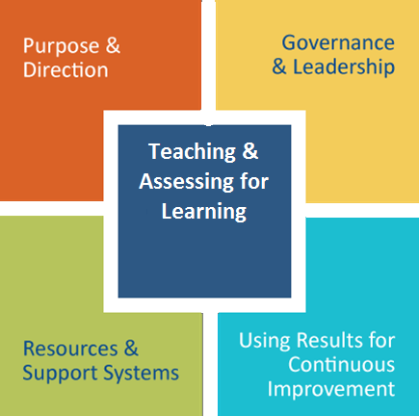
Standards for Quality Schools
Statements (5)
Indicators (33)
Focus of internal review
Rated individually
Contain multiple concepts
Quality Evidence
Multiple sources
Performance Rubrics
Four levels

Slide 7
AdvancED Standards
Are based on research
Are inter-related, interdependent and systemically connected
Focus on factors that contribute to student learning and organizational effectiveness
Address variables institutions can impact

Slide 8
Accreditation Process
Applicant
Candidate
Internal Review
External Review
Accredited
Continuous Improvement
Ongoing Internal Review
Notes:
8

Slide 9
Steps to Accreditation
Applicant
Submit application
Complete the Self-Assessment of Readiness
Host a Readiness Visit
Begin Internal Review processes

Slide 10
Steps to Accreditation
Candidate
Submit preferred dates for the External Review
Complete all components of the Internal Review
Complete the Accreditation Report
Host the External Review

Slide 11
Internal Review
The institution completes:
The Self Assessment of Standards
The Executive Summary
The Student Performance Diagnostic
The Stakeholder Feedback Diagnostic
The continuous improvement plan
Assurances

Slide 12
External Review Process
The institution submits the Accreditation Report six weeks prior to the External Review
Institution hosts an External Review
Plans for and hosts a two-day on-site review
External Review Team provides report that contains
Findings
Opportunities for Improvement
Powerful Practices
Improvement Priorities

Slide 13
External Review Team
The External Review Team collects information:
Conducts interviews
Reviews documents/artifacts provided by the institution
Makes professional observations
The External Review Team:
Engages in professional deliberations
Reaches consensus on Standards, Powerful Practices, Improvement Priorities and an accreditation recommendation
Creates and presents an oral exit report
Formulates and submits a written report

Slide 14
Steps to Accreditation
Accredited
Act on the findings from the External Review Report
Continue to implement the accreditation process
Adhere to AdvancED Quality Standards
Engage in continuous improvement
Monitor for quality assurance
Complete and submit the Accreditation Progress Report

Slide 15
Accreditation Progress Report
Within two years, complete the Accreditation Progress Report (APR)
Schools are required to act and report on all Improvement Priorities!
Engage in on-going Internal Review process

Slide 16
Essential To Success
Effective Leadership
Establishes institution-wide direction
Develops processes to monitor and maintain efforts
Provides support, guidance, assistance, resources
Ensures accountability
Systems Approach
A systemic and systematic process is implemented
All system elements are focused, connected, aligned
All system elements work together to benefit students

Slide 17
Essential To Success
Culture
Professional culture of learning, collaboration and reflective practice
Stakeholders demonstrate trust and respect
High expectations for staff and students
Effective Communication
Stakeholders are informed and meaningfully engaged
Systematic processes are developed and used systemically

Slide 18
Benefits of Accreditation
External Mark of Quality
High Standards
Proven Improvement Processes
Vehicle to Meet Governmental Requirements
Professional Services
Technical Assistance
Peer Review and Support
Research-Based Products and Services
Credit Reciprocity
Access to Scholarships and Higher Education Opportunities

Slide 19
Ray Poplus – rpoplus@advanc-ed.org Rae DeLaughter – rdelaughter@advanc-ed.org
www.advanc-ed.org
Notes:
Working together, we can advance excellence in education worldwide.
This closing slide represents every country we touch. You – all of you in this room – represent the practitioners and ultimately the students we touch.
We could not do what we do without your leadership and commitment. Thank you for all you do on behalf of our organization.

