Slide 1
eDIRECT: Managing Student Groups
Notes:
Welcome and introduce yourself

Slide 2
Today’s Goals
By the end of today’s session, you should be able to:
Create student groups
Upload multiple student groups
Copy student groups
Create a test session from a student group

Slide 3
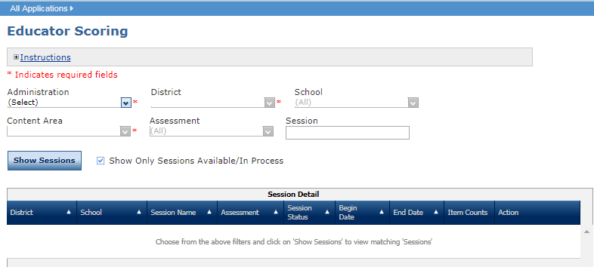
Student Groups Overview
Student groups are created to associate students and teachers within eDIRECT. Through this association, teachers can quickly access their students’ information, testing status, and Interactive reporting.
Student groups are required to give teachers who are not assigned as TAs to test sessions access to view student responses to items in Interactive Reporting.
Student groups can be used to quickly assign students to test sessions.
Detailed directions for Student Groups can be found in the eDIRECT User Guide posted in eDIRECT under General Information.

Slide 4
Managing Student Groups
Once logged into eDIRECT, choose All Applications → Student Group Management.

Slide 5
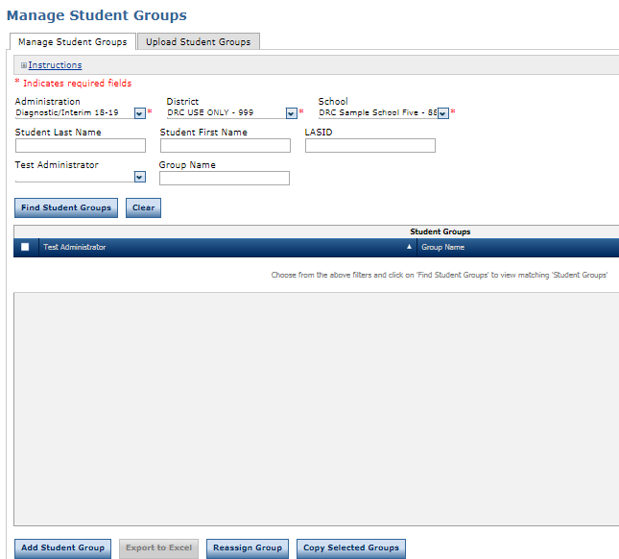
Creating Student Groups
To add an individual student group, under the Manage Student Groups tab:
Select an Administration, District, and School
Choose Add Student Group

Slide 6
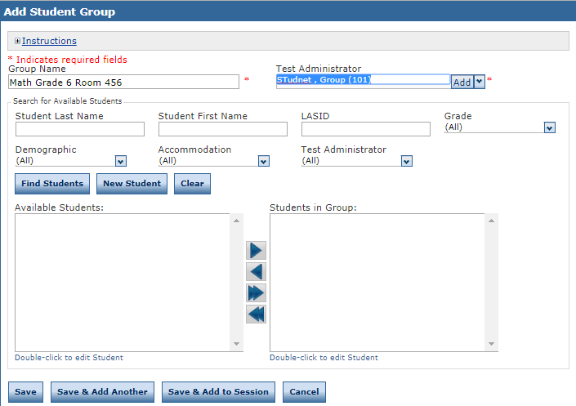
Creating Student Groups
The Add Student Group window will display:
Choose a Group Name*
Choose a Test Administrator
Choose Find Students for an available list of students in the school
*Student groups should be named such that other users of the system can clearly distinguish one student group from another.
Student Group Name Recommendation: Math Grade 6 Period 1 or Math Grade 6 Room 456

Slide 7
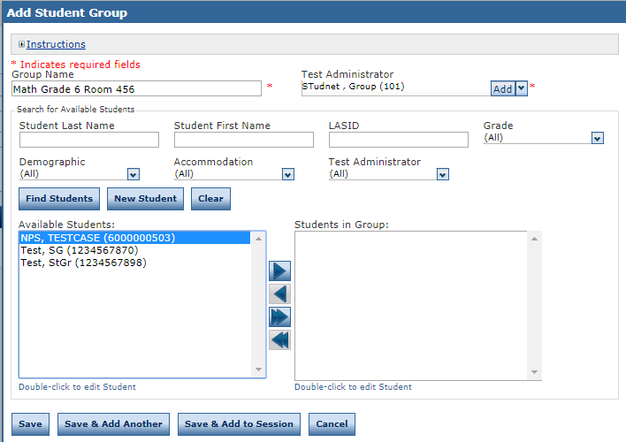
Creating Student Groups
Use the arrows to add or remove students from the Student Group
Click Save or Save & Add Another to continue adding Student Groups

Slide 8
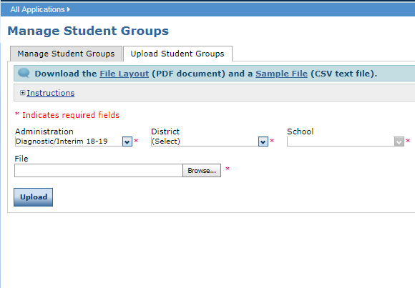
Adding Multiple Student Groups
To upload multiple Student Groups, select the Upload Student Groups tab.
Download the File Layout (.pdf document) and a Sample File (.csv text file)

Slide 9
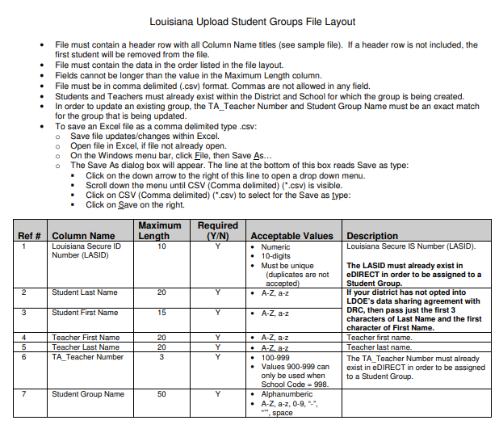
Adding Multiple Student Groups
Enter the student information into the .csv using the Student File Layout as a guide
The Student File Layout will indicate what fields are required for each administration
Save the .csv to your computer

Slide 10
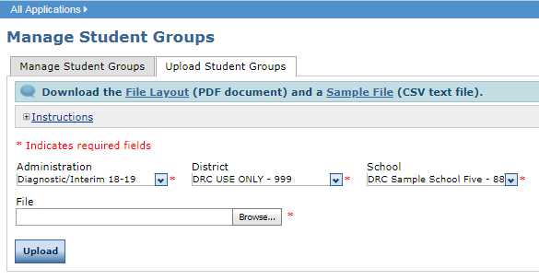
Adding Multiple Student Groups
Use Browse in eDIRECT to find your saved .csv
Click Upload. A message will display indicating the file is in process and is being checked for errors
After the file has been validated, you can review its status. If the file contains errors, you must correct them and repeat Steps 4 and 5

Slide 11
Reassigning or Copying Student Groups
From the Manage Student Groups page:
Selecting Reassign Group will allow the Test Administrator to be changed for a Student Group
Selecting Copying Selected Groups will allow the same student group to be assigned to another Test Administrator. Copied Student Groups will need new Group Names

Slide 12
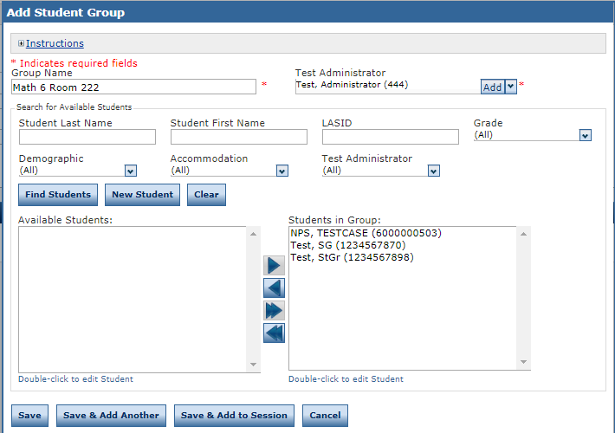
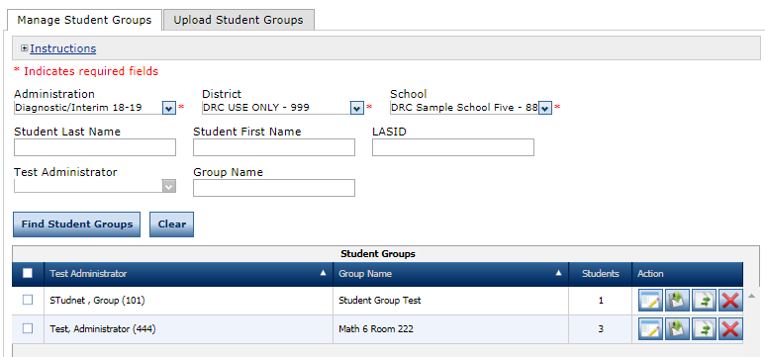
Assigning Student Groups to Test Sessions
A Student Group can be added to a test session by:
Selecting Save & Add to Session when creating the Student Group in the Add Student Group screen
Selecting the Add to Session icon for an existing Student Group on the Manage Student Groups tab

Slide 13
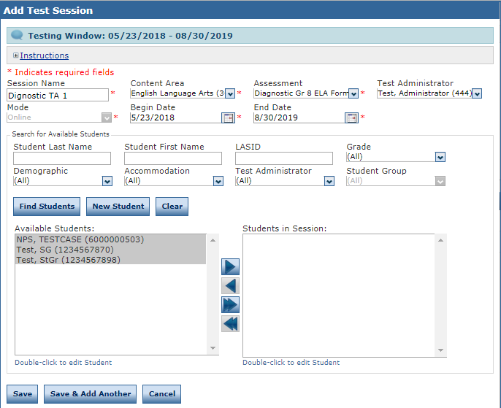
Assigning Student Groups to Test Sessions
The Add Session page displays.
Enter the required information:
Session Name
Content Area
Assessment
Test Administrator
Mode
Testing Window
Only students in the selected Student Group display in the Available Students column.

Slide 14
Assigning Student Groups to Test Sessions
Use the arrows to add or remove students from the students in session list
Click Save or Save & Add Another to continue adding test sessions

Slide 15
Support

Slide 16
User Guides
The following user guides are posted in eDIRECT under General Information:
eDIRECT User Guide
Technology User Guide
EAGLE 2.0 User Guide

Slide 17
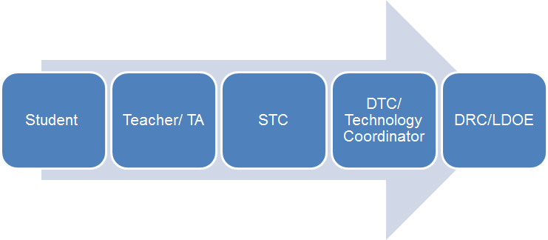
Technical Assistance Protocol
If technical problems occur, school and district staff should follow the protocol presented below.
DRC Louisiana Customer Service
1-888-718-4836 LAHelpDesk@datarecognitioncorp.com
LDOE
1-844-268-7320
assessment@la.gov

