Slide 1

Understanding PARCC
Evidence Statements for Mathematics Part I
Adapted from PARCC Materials

Slide 2
Agenda
Understand PARCC’s Evidence Centered Design
  Connections among Task Types, Sub-Claims, Scoring of Items, and PARCC’s Summative Assessments
Focus on Evidence Statements
  Definition and Purpose
  Connections to PARCC Summative Assessments
  Classroom Connections
  Types: How to Read and Interpret
Practice Time
2

Slide 3
Agenda
PARCC’s Evidence Centered Design
  Make connections among Task Types, Sub-Claims, Scoring of Items, and PARCC’s Summative Assessments
Focus on Evidence Statements
  Definition and Purpose
  Connections to PARCC Summative Assessments
  Classroom Connections
  Types: How to Read and Interpret
Practice Time
3

Slide 4
Evidence-Centered Design (ECD)
Claims (Model Content Frameworks)
Design begins with the inferences (claims) we want to make about students. These are identified in the MCFs.
Evidence
In order to support claims, we must gather evidence
Tasks
Tasks are designed to elicit specific evidence from students in support of claims
ECD is a deliberate and systematic approach to assessment development that will help to establish the validity of the assessments, increase the comparability of year-to year results, and increase efficiencies/reduce costs.
4

Slide 5
Claims Driving Design: Mathematics for the PARCC Summative Assessments
Master Claim: On-Track for college and career readiness. The degree to which a student is college and career ready (or “on-track” to being ready) in mathematics. The student solves grade-level /course-level problems in mathematics as set forth in the Standards for Mathematical Content with connections to the Standards for Mathematical Practice.
Total Exam Score Points:
82 (Grades 3-8), 97 or 107(HS)
Sub-Claim A: Major Content¹ with Connections to Practices
The student solves problems involving the Major Content¹ for her grade/course with connections to the Standards for Mathematical Practice.
Sub-Claim B: Additional & Supporting Content² with Connections to Practices
The student solves problems involving the Additional and Supporting Content² for her grade/course with connections to the Standards for Mathematical Practice.
Sub-Claim C: Highlighted Practices MP.3,6 with Connections to Content³ (expressing mathematical reasoning)
The student expresses grade/course-level appropriate mathematical reasoning by constructing viable arguments, critiquing the reasoning of others, and/or attending to precision when making mathematical statements.
~37 pts (3-8),
~42 pts (HS)
~14 pts (3-8),
~23 pts (HS)
Sub-Claim D: Highlighted Practice MP.4 with Connections to Content (modeling/application)
The student solves real-world problems with a degree of difficulty appropriate to the grade/course by applying knowledge and skills articulated in the standards for the current grade/course (or for more complex problems, knowledge and skills articulated in the standards for previous grades/courses), engaging particularly in the Modeling practice, and where helpful making sense of problems and persevering to solve them (MP. 1),reasoning abstractly and quantitatively (MP. 2), using appropriate tools strategically (MP.5), looking for and making use of structure (MP.7), and/or looking for and expressing regularity in repeated reasoning (MP.8).
14 pts (3-8),
14 pts (HS)
4 pts (Alg II/Math 3 CCR)
Sub-Claim E: Fluency in applicable grades (3-6)
The student demonstrates fluency as set forth in the Standards for Mathematical Content in her grade.
5-7 pts (3-6)
12 pts (3-8),
18 pts (HS)
6 pts (Alg II/Math 3 CCR)
¹ For the purposes of the PARCC Mathematics assessments, the Major Content in a grade/course is determined by that grade level’s Major Clusters as identified in the PARCC Model Content Frameworks v.3.0 for Mathematics. Note that tasks on PARCC assessments providing evidence for this claim will sometimes require the student to apply the knowledge, skills, and understandings from across several Major Clusters.
² The Additional and Supporting Content in a grade/course is determined by that grade level’s Additional and Supporting Clusters as identified in the PARCC Model Content Frameworks v.3.0 for Mathematics.
³ For 3 – 8, Sub-Claim C includes only Major Content. For High School, Sub-Claim C includes Major, Additional and Supporting Content.

Slide 6
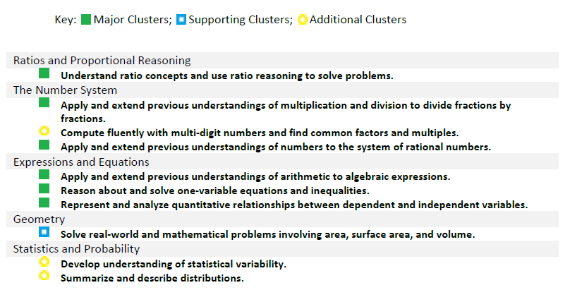
Model Content Frameworks
Grade 6 Content Emphases
Subclaim A
Subclaim B
6.NS.2 and 6.NS.3 – Subclaim E if timed; Subclaim B if untimed

Slide 7

Overview of PARCC Mathematics Task Types
Task Type | Description of Task Type
I. Tasks assessing concepts, skills and procedures | Balance of conceptual understanding, fluency, and application Can involve any or all mathematical practice standards Machine scorable including innovative, computer-based formats Will appear on the End of Year and Performance Based Assessment components Sub-claims A, B and E
II. Tasks assessing expressing mathematical reasoning | Each task calls for written arguments / justifications, critique of reasoning, or precision in mathematical statements (MP.3, 6). Can involve other mathematical practice standards May include a mix of machine scored and hand scored responses (requires rubric) Included on the Performance Based Assessment component Sub-claim C
III. Tasks assessing modeling / applications | Each task calls for modeling/application in a real-world context or scenario (MP.4) Can involve other mathematical practice standards May include a mix of machine scored and hand scored responses (requires rubric) Included on the Performance Based Assessment component Sub-claim D
For more information see PARCC Task Development ITN Appendix D.
7

Slide 8
Terminology Connections
Task Type | Sub-Claim(s) | Focus
Type I | A, B, E | Conceptual Understanding, Fluency, Application
Type II | C | Reasoning
Type III | D | Modeling
8

Slide 9
Three Types of Math Tasks
Concepts, skills and procedures | Mathematical reasoning | Model and apply what they know to solve problems
9

Slide 10
Three Types of Math Tasks
Concepts, skills and procedures | Mathematical reasoning | Model and apply what they know to solve problems
A painter is using a 30 foot extension ladder. He follows the safety regulations, making sure the base of the ladder is
1 foot from the wall for every 4 feet of ladder height. How high up the wall will the ladder reach? Use drawings, equations, and/or words to explain your solution.
?
What is the distance between A (3,6) and
B (15, 1)? Show your work and justify your answer.
5
12
10

Slide 11
Agenda
Understand PARCC’s Evidence Centered Design
  Make connections among Task Types, Sub-Claims, Scoring of Items, and PARCC’s Summative Assessments
Focus on Evidence Statements
  Definition and Purpose
  Connections to PARCC Summative Assessments
  Classroom Connections
  Types: How to Read and Interpret
Practice Time
11

Slide 12
What are Mathematics Evidence Statement Tables and Why are They Needed?
Describe what students might say or do to demonstrate mastery of the standards with connections to the mathematical practices.
Includes all the evidences to be measured on each of the PARCC Summative Assessments and include clarifications for item writing purposes.
Unpack the standards in a way that is meaningful to test developers and educators.
Are directly aligned to the claims presented by PARCC.
Indicate when the PARCC assessment will measure multiple standards and practices.
12

Slide 13
Agenda
Understand PARCC’s Evidence Centered Design
  Make connections among Task Types, Sub-Claims, Scoring of Items, and PARCC’s Summative Assessments
Focus on Evidence Statements
  Definition and Purpose
  Connections to PARCC Summative Assessments
  Classroom Connections
  Types: How to Read and Interpret
Practice Time
13

Slide 14
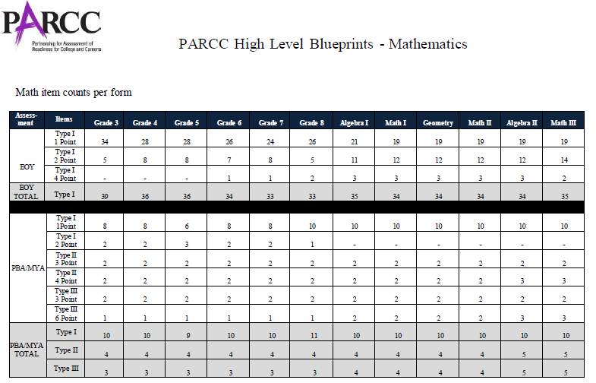
PARCC Blueprints
PBA Total: 17 items

Slide 15
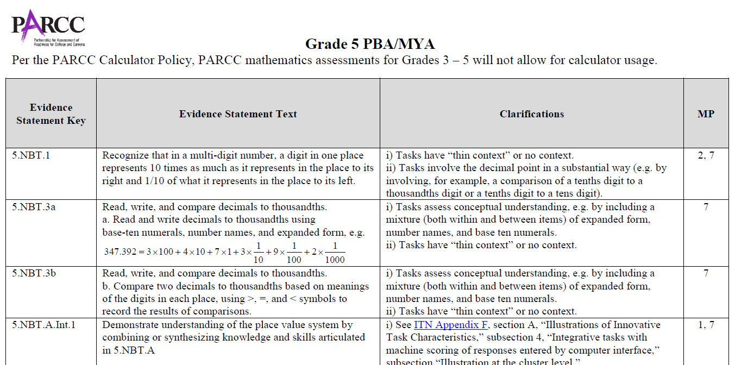
Evidence Table
15

Slide 16
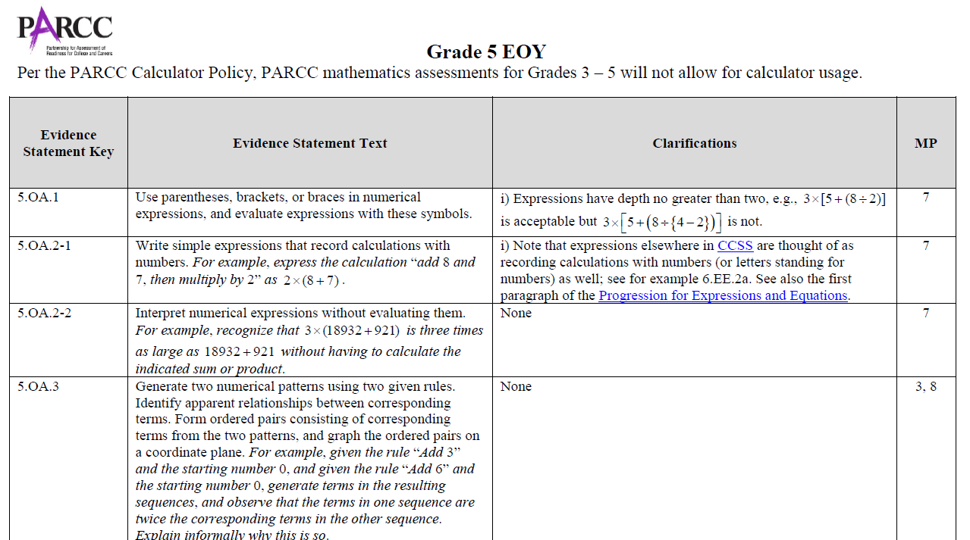
Evidence Table
16

Slide 17
Agenda
Understand PARCC’s Evidence Centered Design
  Make connections among Task Types, Sub-Claims, Scoring of Items, and PARCC’s Summative Assessments
Focus on Evidence Statements
  Definition and Purpose
  Connections to PARCC Summative Assessments
  Classroom Connections
  Types: How to Read and Interpret
Practice Time
17

Slide 18
Of What Benefit to Teachers Are Evidence Statements?
Determine how students will be assessed on PARCC Summative Assessments
Understand information found in
  PARCC Sample items and EOY Practice Tests
  LDOE PARCC Assessment Guide
For instructional use,
  evaluate pre-made tasks for alignment to PARCC assessments
  create PARCC-like tasks
18

Slide 19
Agenda
Understand PARCC’s Evidence Centered Design
  Make connections among Task Types, Sub-Claims, Scoring of Items, and PARCC’s Summative Assessments
Focus on Evidence Statements
  Definition and Purpose
  Connections to PARCC Summative Assessments
  Classroom Connections
  Types: How to Read and Interpret
Practice Time
19

Slide 20
Types of Evidence Statements
Several types of Evidence Statements are used to describe what a task should be assessing, including:
Those using exact standards language
Those transparently derived from exact standards language, e.g., by splitting a content standard
Integrative evidence statements indicate proficiencies that align to more than one standard and reinforce coherence reflected in the CCSS.*
Sub-claim C (reasoning) & D (modeling) evidence statements, which put MP.3, 4, 6 as primary with connections to content
* Wording modified by LDOE.
20

Slide 21
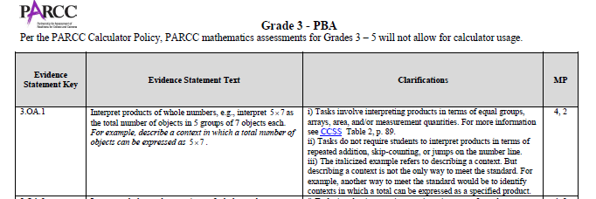
Evidence Statements using Exact Standards
1. Those using exact standards language
Grade 8 - PBA
Key | Evidence Statement Text | Clarifications | MP | Calculator
8.EE.1 | Know and apply the properties of integer exponents to generate equivalent numerical expressions. For example, 3² × 3⁻⁵ = 1/3³ = 1/27. | i) Tasks do not have a context. ii) Tasks center on the properties and equivalence, not on simplification. For example, a task might ask a student to classify expressions according to whether or not they are equivalent to a given expression. | 7 | No
21

Slide 22
Evidence Statements Derived from Exact Standards
2. Those transparently derived from exact standards language, e.g., by splitting a content standard. Here 8.F.5 is split into 8.F.5-1 and 8.F.5-2.
Key | Evidence Statement Text | Clarifications, limits, emphases, and other information intended to ensure appropriate variety in tasks | Relationship to MP
8.F.5-1 | Describe qualitatively the functional relationship between two quantities by analyzing a graph (e.g., where the function is increasing or decreasing, linear or nonlinear). | i) Pool should contain tasks with and without contexts. | 2, 5
8.F.5-2 | Sketch a graph that exhibits the qualitative features of a function that has been described verbally. | i) Pool should contain tasks with and without contexts. | 2, 5, 7
CCSS 8.F.5
Describe qualitatively the functional relationship between two quantities by analyzing a graph (e.g., where the function is increasing or decreasing, linear or nonlinear). Sketch a graph that exhibits the qualitative features of a function that has been described verbally.
22

Slide 23
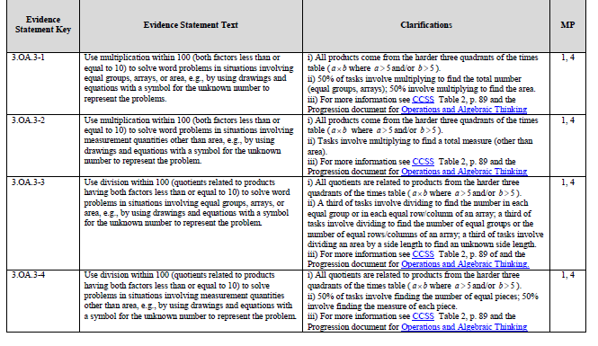
Evidence Statements Derived from Exact Standards
For the PBA, tasks will assess 3.OA.3. This CCSS has been split into 4 Evidence Statements 3.OA.3-1, 3.OA.3-2, 3.OA.3-3 and 3.OA.3-4. The full text of 3.OA.3 is listed in the CCSS.
“Clarifications” provide item developers and educators with guidance on the depth and breadth of the tasks.
“MP” - Mathematical Practices provide guidance on how content should be connected to practices.
Grade 3 PBA
For Type 1 tasks, “Evidence Statement Text” may represent all or part of CCSS.
23

Slide 24
A Closer Look at Evidence Statements and Clarifications
Key | Evidence Statement Text | Clarifications
3.OA.3-3 | Use division within 100 (quotients related to products having both factors less than or equal to 10) to solve word problems in situations involving equal groups, arrays, or area, e.g., by using drawings and equations with a symbol for the unknown number to represent the problem. | i) All quotients are related to products from the harder three quadrants of the times table (where a > 5 and/or b>5) ii) A third of tasks involve dividing to find the number in each equal group or in each equal row/column of an array; a third of tasks involve dividing to find the number of equal groups or the number of equal rows/columns of an array; a third of tasks involve dividing an area by a side length to find an unknown side length. iii) For more information see CCSS Table 2, p. 89 and the Progression document for Operations and Algebraic Thinking.
24

Slide 25
Integrative Evidence Statements
Integrative evidence statements indicate proficiencies that align to more than one standard and reinforce coherence reflected in the CCSS.*
Items written to Integrative Evidence Statements will appear only on the EOY assessment.
An Evidence Statement could be integrated across
Grade/Course –4.Int.2 (Integrated across Grade 4)
Domain –5.NBT.Int.1(Integrated across the NBT Domain)
Cluster – 8.EE.C. Int.1 (Integrated across Expressions and Equations, Cluster C)
The extension numbers “.1, .2, 3-3” on all “Int” Evidence Statements are used for numbering/ordering purposes for item developers.
*Wording modified by LDOE
25

Slide 26
Integrative Evidence Statements
Grade/Course – Ex. 4.Int.1 (Integrated across Grade 4)
Key | Evidence Statement Text | Clarifications, limits, emphases, and other information intended to ensure appropriate variety in tasks | Relationship to MP
4.Int.1 | Solve one-step word problems involving adding or subtracting two four-digit numbers. | The given numbers are such as to require an efficient/standard algorithm (e.g., 7263 + 4875, 7263 – 4875, 7406 – 4637). The given numbers do not suggest any obvious ad hoc or mental strategy (as would be present for example in a case such as16,999 + 3,501 or 7300 – 6301, for example). i) Grade 4 expectations in CCSSM are limited to whole numbers less than or equal to 1,000,000; for purposes of assessment, both of the given numbers should be limited to 4 digits. | MP.1
Draws on content from ALL of grade 4
26

Slide 27
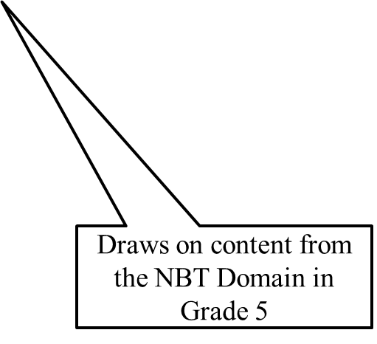
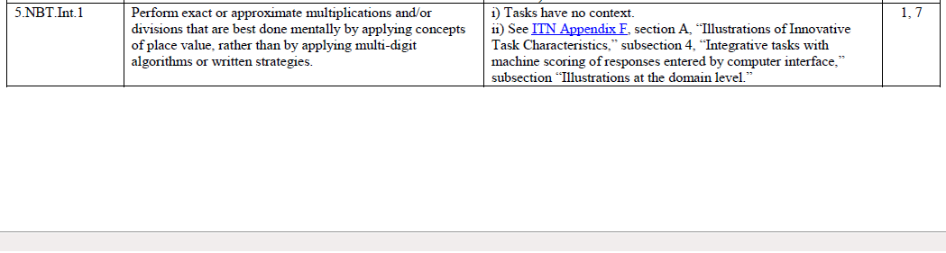
Integrative Evidence Statements
Cluster – 5.NBT.Int.1
(Integrated across NBT Domain in Grade 5)
27

Slide 28
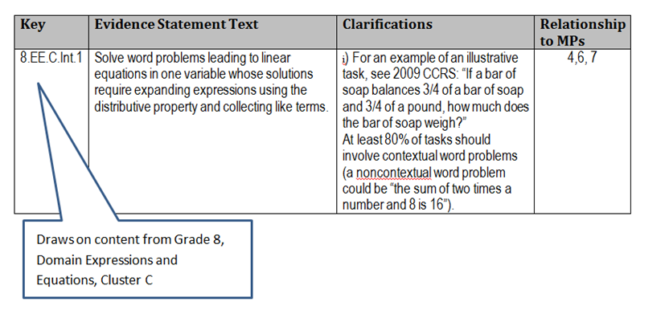
Integrative Evidence Statements
Cluster – 8.EE.C.Int.1
(Integrated across EE Domain, Cluster C)
28

Slide 29
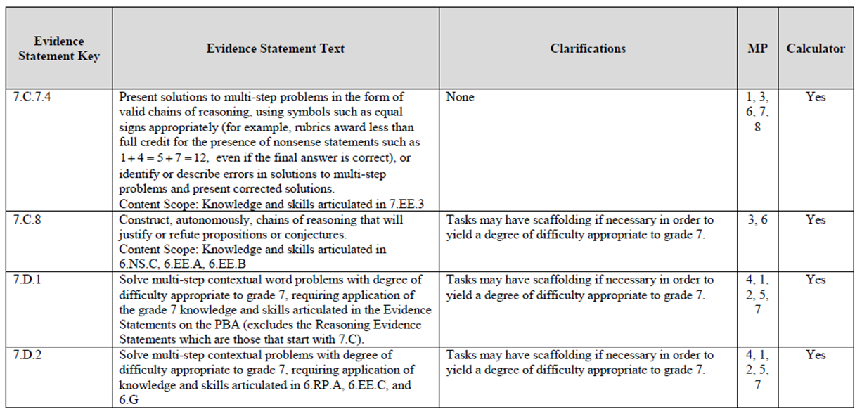
Sub-claim C Evidence Statements
4. Sub-claim C (reasoning) Evidence Statements, which put MP.3 and MP.6 as primary with connections to content
29

Slide 30
Sub-claim D Evidence Statements
4. Sub-claim D (modeling) Evidence Statements, which put MP. 4 as primary with connections to content
30

Slide 31
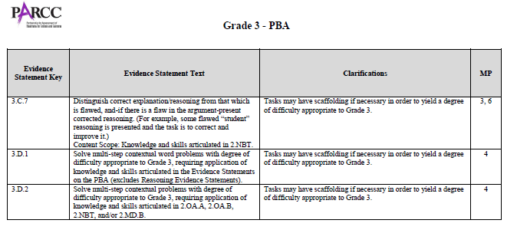
Sub-claims C and D Evidence Statements
31

Slide 32
Task Type | Description | Reporting Categories | Scoring Method | Mathematical Practice(s) | Summative Assessment
Type I | Conceptual understanding, fluency, and application | Sub-claim A: Solve problems involving the major content for the grade level Sub-claim B: Solve problems involving the additional and supporting content for the grade level Sub-claim E: Demonstrate fluency as indicated in the CCSS for grades 3-6 | Computer-scored only | Can involve any or all mathematical practice standards | EOY and PBA
Type II | written arguments/ justifications, critique of reasoning, or precision in mathematical statements | Sub-claim C: Express mathematical reasoning by constructing mathematical arguments and critiques | a mix of computer-scored and hand-scored tasks | Primarily MP.3 and MP.6, but may also involve any of the other practices | PBA only
Type III | modeling/application in a real-world context or scenario | Sub-claim D: solve real- world problems engaging particularly in the modeling practice | a mix of computer-scored and hand-scored tasks | Primarily MP.4, but may also involve any of the other practices | PBA only
32

Slide 33
Agenda
Understand PARCC’s Evidence Centered Design
  Make connections among Task Types, Sub-Claims, Scoring of Items, and PARCC’s Summative Assessments
Focus on Evidence Statements
  Definition and Purpose
  Connections to PARCC Summative Assessments
  Classroom Connections
  Types: How to Read and Interpret
Practice Time
33

Slide 34
Three Types of Math Tasks
Concepts, skills and procedures a²+b²=c² | Mathematical reasoning a²+b²=c² | Model and apply what they know to solve problems
A painter is using a 30 foot extension ladder. He follows the safety regulations, making sure the base of the ladder is
1 foot from the wall for every 4 feet of ladder height. How high up the wall will the ladder reach? Use drawings, equations, and/or words to explain your solution.
What is the distance between A (3,6) and
B (15, 1)? Show your work and justify your answer.
?
5
12
34

Slide 35
Pythagorean Theorem Task Analysis
Use the Grade 8 Evidence Statement Tables to complete this work.
Determine the Evidence Statement alignment and task type for each task shown.
Decide if each task meets the Evidence Statement and explain why?
Now that you better understand Evidence Statements, would you make adjustments to these tasks or to the ones you wrote earlier?
Be prepared to share your group’s thoughts in a whole group discussion.
35

Slide 36
A Closer Look at Evidence Statements for
Sub-claims C and D
Use the Grade 3 Math PBA Evidence Table to complete the following:
  How many Evidence Statements are there for Sub-Claim C?
  List the categories into which these Evidence Statement fall. How might teachers use this information to prepare students for the PARCC PBA?
  How many Evidence Statements are there for Sub-claim D? Compare and contrast these. Why is there a need for fewer modeling Evidence Statements than reasoning Evidence Statements?
36

Slide 37
Questions?

Slide 38
Learn More About PARCC
Partnership for Assessment of Readiness for College and Careers
www.parcconline.org
On Twitter:
@PARCCPlace
#askPARCC & #PARCCELC
38

