Slide 1
LDE Unit Plans: Integrating Social Studies Through Interactive Notebooks
“Lapin Plays Possum” &
“The Louisiana Purchase”

Slide 2
Instructional Vision
To meet these raised expectations, we must clarify our focus on what our students need. Specifically, we must ensure this year that our students…
English language arts
Comprehend (access) meaningful, on level texts
Speak and write in response to meaningful texts
Math students
Master math concepts of priority, on level content and practice standards (not just procedures)
Master targeted remedial content that allows practice faster focus of on level content

Slide 3
Teacher Leader Summit: Day 1 Ready!
This Summit will prepare teachers to make these shifts beginning the first day of the 14-15 school year. This will include focused training on:
Student Learning Targets
Assessment
Standards, curricula, and instructional strategies

Slide 4
What are Interactive Notebooks?
A note taking process that allows students to record information in a personal and meaningful way.
A way for students use teacher supplied notes to draw whatever illustration makes sense to them.
A way for students to personalize their work.
A way for students to organize and keep up with their learning.

Slide 5
Interactive vs. Regular Notebooks
Interactive
Creative, independent thinkers and learners
Students express their own ideas in addition to teacher instruction
Synthesis
Evaluation
Regular
Students record notes from a teacher
Worksheets
Knowledge
Comprehension

Slide 6
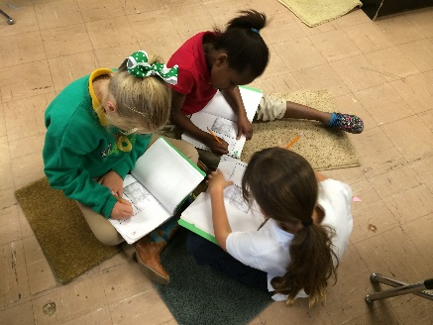
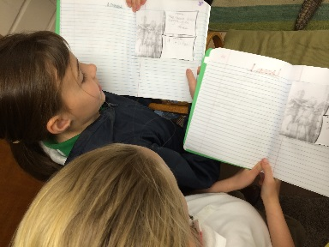
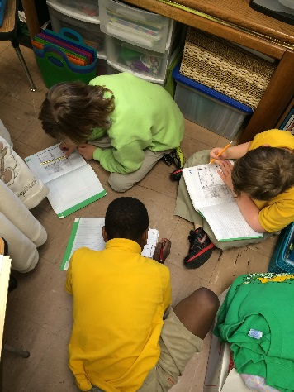
This Process…
Can be challenging
Takes a bit of patience and planning
Requires modeling, modeling, modeling
Must consistently be reinforced
Takes time to learn both for the teacher and for the students to develop their own style

Slide 7
The Payoff…
Is a way for students to organize their work
Uses reading strategies within a content area, such as science or social studies
Helps students keep up with useful information throughout a unit of study

Slide 8
…And Finally
Students make their own meaningful connections
It encourages pride in student work
It encourages cooperative learning
It appeals to multiple intelligences
The kids love it and learn so much!

Slide 9
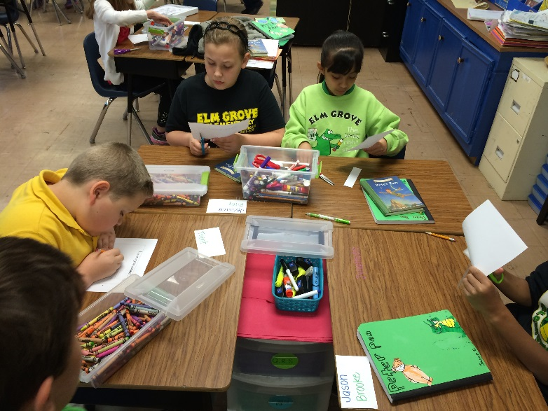
What Students Need…
The notebook-loose leaf paper in a three pronged folder, spiral notebook, or composition book
Pencils, regular and colored
Liquid glue or a glue stick
Scissors
Ruler
Teacher supplied notes
Grading expectations

Slide 10
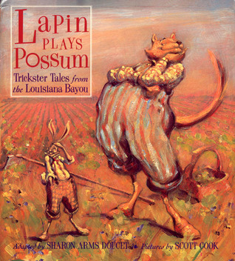
“Lapin Plays Possum”
Table of Contents
Cajun Expressions
“Tricky” Vocabulary
Lapin Literacy
My Thoughts
I Love Louisiana!

Slide 11
Table of Contents
This is the student’s organizing page.
Is an outline of their notebook and can be filled in as they go or completed at the end of the unit. It is easier to fill in as you go!
Make sure students leave enough room, especially for big units

Slide 12
Cajun Expressions
A list of memorable words from the text that have Cajun origins.
French or Cajun terms that will come up throughout the unit that impact the meaning of the text.
Record these terms using split-page note taking.
These words can be found in the introductions.

Slide 13
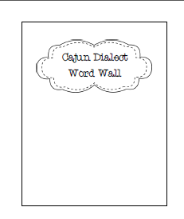
“Tricky” Vocabulary
Word Wall Pages
Cajun Dialect
Dialogue Tags
Walking Words
Landmark Vocabulary Pages
New vocabulary words in context

Slide 14
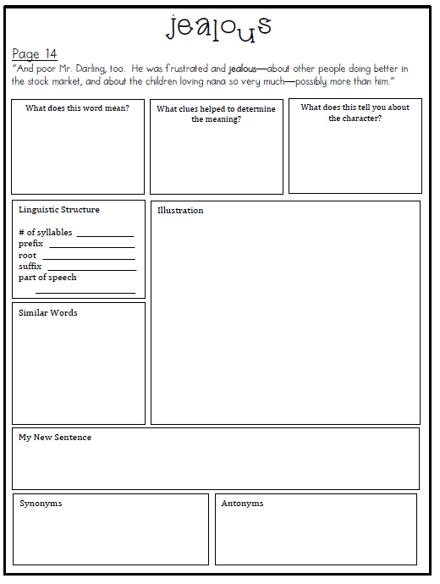
“Landmark” Vocabulary
new word
original sentence from text
working definition, context clues, and inferences
linguistic structure
student illustration to SHOW MEANING
words with similar word parts;
i.e. jealousy
student sentence to SHOW MEANING
synonyms
antonyms

Slide 15
Lapin Literacy
What is a Folktale/Trickster Tale ?
Graphic Organizers for literacy skills
Character Traits Word Walls
Character Motivation Chart
Figurative Language Tab-book

Slide 16
My Thoughts
Daily writing response to text
Short questions
Writing prompts
Mental Images

Slide 17
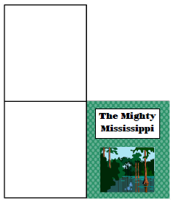
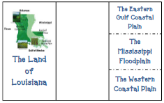
I Love Louisiana!
Louisiana Terms
Bayou / Swamp
Types of Resources
Natural Resources
Land of Louisiana
The Mighty Mississippi

Slide 18
What Social Studies Standards Can Be Addressed?
Describe and compare the physical characteristics of various regions of Louisiana (G-1B-E1)
Use maps, charts, and pictures to describe how places in Louisiana are different (e.g., land use, vegetation, architecture) (G-1B-E4)
Identify the relationship between geography and economic activities in Louisiana (G-1C-E5)
Identify natural resources in Louisiana and describe their uses and importance (G-1D-E4)
Identify the concepts of specialization (i.e., being an expert in one job) and interdependence (i.e., depending on others) in the production of goods and services (E-1A-E7)
Describe ways in which people are producers and consumers and why they depend on one another (E-1A-E5)
Identify examples of natural, human, and capital resources used to produce goods and services (E-1A-E6)
Describe the characteristics of various jobs and describe a job well performed. (E-1A-E6)
Identify goods that are produced within the local community and Louisiana and describe how they are shipped elsewhere for sale (E-1A-E9)
Identify cultural elements that have contributed to our state heritage (e.g., Mardi Gras, Cajun/Creole cooking) (H-1C-E4)

Slide 19
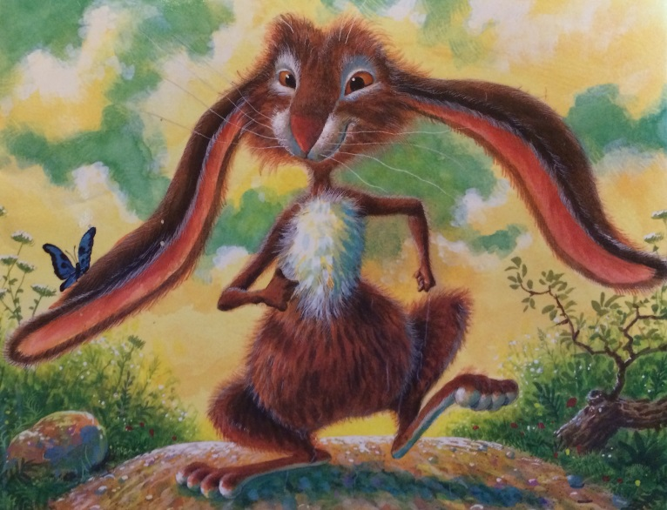
When Can I Address Each Standard?
Describe and compare the physical characteristics of various regions of Louisiana (G-1B-E1)
Use maps, charts, and pictures to describe how places in Louisiana are different (e.g., land use, vegetation, architecture) (G-1B-E4)
“Why Lapin’s Ears Are Long”

Slide 20
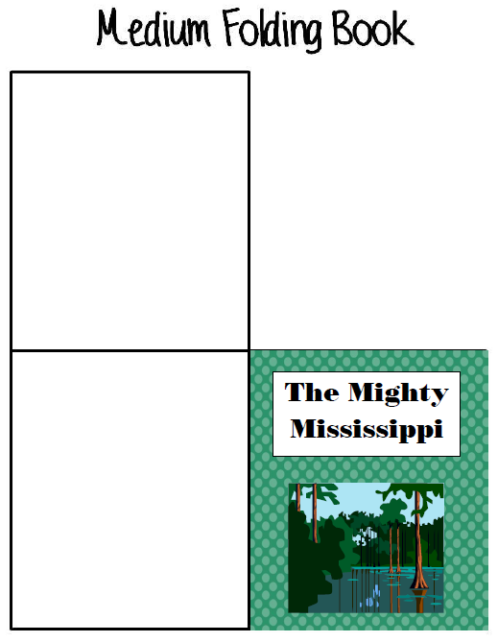
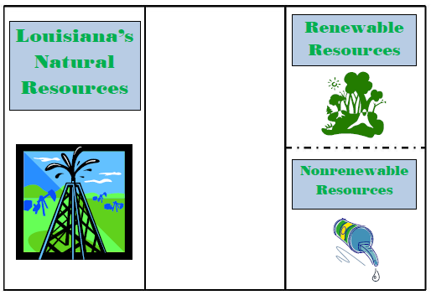
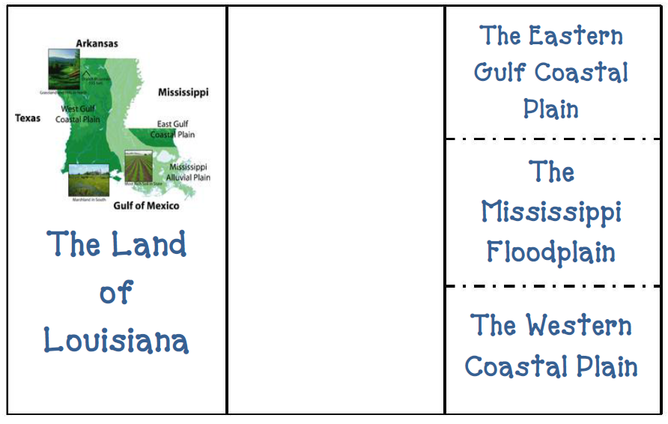

Slide 21
When Can I Address Each Standard?
“Why Lapin’s Tale is Short”
Identify natural resources in Louisiana and describe their uses and importance (G-1D-E4)

Slide 22
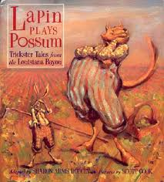
When Can I Address Each Standard?
Identify natural resources in Louisiana and describe their uses and importance (G-1D-E4)
Describe the characteristics of various jobs and describe a job well performed. (E-1A-E6)
Identify goods that are produced within the local community and Louisiana and describe how they are shipped elsewhere for sale (E-1A-E9)
Identify the concepts of specialization (i.e., being an expert in one job) and interdependence (i.e., depending on others) in the production of goods and services (E-1A-E7)
“Bouki Over A Barrel”

Slide 23
When Can I Address Each Standard?
Describe ways in which people are producers and consumers and why they depend on one another (E-1A-E5)
Identify examples of natural, human, and capital resources used to produce goods and services (E-1A-E6
Identify goods that are produced within the local community and Louisiana and describe how they are shipped elsewhere for sale (E-1A-E9)
Identify the relationship between geography and economic activities in Louisiana (G-1C-E5)
Identify natural resources in Louisiana and describe their uses and importance (G-1D-E4)
“ Lapin Plays Possum”

Slide 24
“The Louisiana Purchase”
Table of Contents
Vocabulary
Famous People
Literacy
My Thoughts

Slide 25
Vocabulary
Vocabulary from the anchor text.
Description:
a place where ships can load and unload their cargo.
Illustration:

Slide 26
Famous People
Character Traits
Evidence from Text
Sequence of events using temporal words
Thomas Jefferson

Slide 27
Louisiana Literacy
Main Idea / Details Organizers
Temporal Phrases Chart
Evidence Charts
Prediction 4-Square
Venn Diagrams

Slide 28
My Thoughts
Daily writing response to text
Short questions
Writing prompts
Mental Images

Slide 29
What Social Studies Standards Can Be Addressed?
Describe characteristics and uses of various maps (e.g., physical, political, topographical, population) (G-1A-E1)
Locate major geographic features of Louisiana on a map (G-1A-E2)
Complete a timeline based on given information (H-1A-E1)
Use information in a map, table, or graph to describe the past (H-1A-E3)
Describe changes in community life, comparing a given time in history to the present (H-1B-E2)
Describe family life at a given time in history and compare it with present-day family life (H-1B-E1)
Identify and describe early settlers in Louisiana (H-1C-E1)
Identify people and their influence in the early development of Louisiana (H-1C-E1)
Describe the importance of events and ideas significant to Louisiana’s development (H-1C-E1)

Slide 30
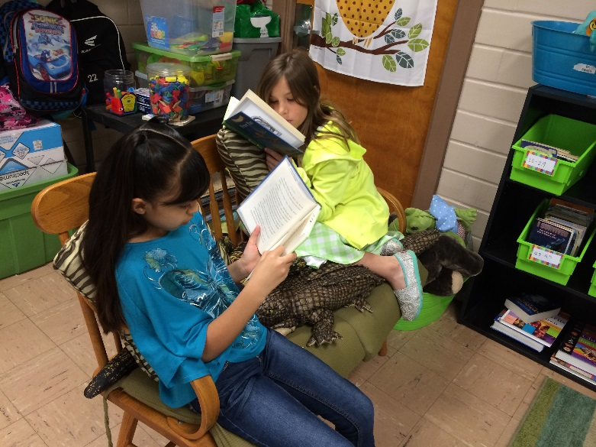
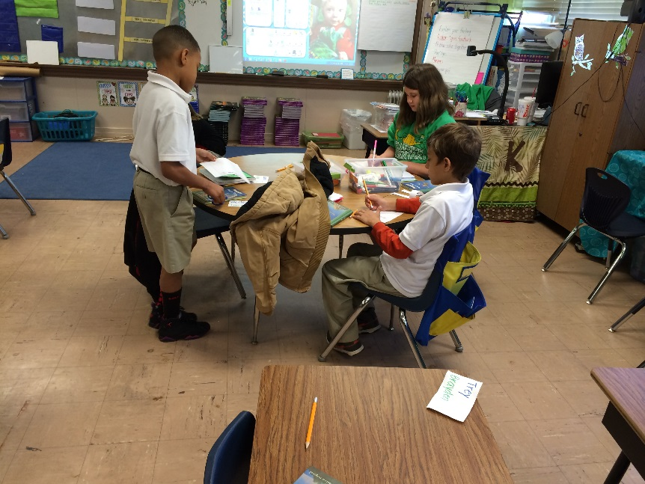
It’s that simple!!!
You can do it! We did and the kids loved it!

