Slide 1
Tape Diagrams Opening Exercise
H
If you have any tape diagramming experience, try to solve one of these problems using tape diagrams. If not, try to solve it algebraically.
Jess spent one-third of her money on a cell phone, and two-fifths of the remainder on accessories. When she got home her parents gave her $350. The ratio of money she had in the end to the money she had before was 4:3. How much money did she have at first?
94 children are in a reading club. One-third of the boys and three-sevenths of the girls prefer fiction. If 36 students prefer fiction, how many girls prefer fiction?
Notes:
Post the following slide and guide participants to do one or both of the problems. After allotting a few minutes time, inform the participants that we will revisit the problem at the end of this presentation.

Slide 2
A Story of Ratios
A Coherent Study of
The Major Work of the Grade Band
Grades 6-8
Notes:
NOTE THAT THIS SESSION IS DESIGNED TO BE 6 HOURS IN LENGTH
This full day session is intended to support a school-wide implementation of a story of units. This session highlights the progression of multiplication and division from third grade through fifth grade. Educators teaching and supporting these grade levels will understand how the concepts and skills taught at each grade level 3-5, fit together and ultimately play a key role in the profound understanding of multiplication and division.
Timing – 6 hours total
Opening – 16 minutes
Grade 3 – 110 minutes
Grade 4 – 108 minutes (Can cut it down once you all put in your numbers if needed.)
Grade 5 –
Closing – 2+ minutes
TIME ALLOTTED FOR THIS SLIDE:
1 minutes
MATERIALS NEEDED:
Session PowerPoint

Slide 3
This PowerPoint presentation is provided to individuals who participated in a live training by professional developers certified by, or affiliated with, the copyright holder, Common Core, Inc. It may be not be altered in any way. The presentation may be shared for non-commercial purposes only. However, Common Core makes no representations or warranties about the effectiveness of training provided by non-certified/non-affiliated presenters of the material. Any commercial use of this presentation is illegal and violates the copyrights of Common Core, Inc.

Slide 4
Session Objectives
Develop deep understanding of mathematics of the major work of Grades 6-8.
Study the cross-grade coherence of Grade 6-8 to increase our capacity to:
Bridge gaps in previous knowledge, and
Ensure coherence for development of the mathematics in future grades.
Notes:
Our objectives for this session are to:
Goal is to give teachers an idea of what happens across the band. I’ll be reaching back to grade 5 and looking ahead as well.
TIME ALLOTTED FOR THIS SLIDE:
2 minutes
MATERIALS NEEDED:
x

Slide 5
Key Areas of Focus in Mathematics
K–2 | Addition and subtraction - concepts, skills, and problem solving and place value
3–5 | Multiplication and division of whole numbers and fractions – concepts, skills, and problem solving
6 | Ratios and proportional reasoning; early expressions and equations
7 | Ratios and proportional reasoning; arithmetic of rational numbers
8 | Linear algebra and linear functions
Notes:
You probably recognize this chart put out by SAP on their Achieve the Core website. In Grades 3-5 students focused on multiplication and division, and in particular they began to make multiplicative comparisons such as Tom has 4 times as much as Erika. They also studied fractions including what it means for Erika to have 1 fourth as much as Tom. Those ideas are what prepare students for thinking about ratios and proportional reasoning – which, as we shall examine, takes on the form of a basic linear relationship whose graph goes through the origin.
Erika: I think including reference to division of fractions is a good idea here. We could speak to the connection from grade 5 – division of unit fractions, and then extend the progression to later grades where students fluently divide fractions when solving equations in grades 6, 7, and 8.

Slide 6
Cluster Designations – Grade 6
Notes:
We will only be looking at those clusters that were on the previous slide, though we will spend a fair amount of time on Geometry because of its implications for understanding linear equations and functions, and we will also spend time on division of fractions by fractions in support of students’ ability to solve equations.
TIME ALLOTTED FOR THIS SLIDE:
2 minutes
MATERIALS NEEDED:
x

Slide 7
Cluster Designations – Grade 7
Notes:
TIME ALLOTTED FOR THIS SLIDE:
2 minutes
MATERIALS NEEDED:
x

Slide 8
Cluster Designations – Grade 8
Notes:
TIME ALLOTTED FOR THIS SLIDE:
2 minutes
MATERIALS NEEDED:
x

Slide 9
Agenda
Ratios & Proportional Relationships
Geometry
The Number System
Expressions and Equations
Linear Equations and Functions
Notes:
Discuss how the material is coherently linked making a choice of sequencing difficult.
Ratios & Proportional Relationships (90 min)
The Number System – division of fractions, operations with negatives (45 min)
Expressions and Equations (90 min)
Geometry (90 min)
Linear Equations and Functions (45 min)
TIME ALLOTTED FOR THIS SLIDE:
2 minutes
MATERIALS NEEDED:
x

Slide 10
Tape Diagrams Using Tape Diagrams
Promote perseverance in reasoning through problems.
Develop students’ independence in asking themselves:
“Can I draw something?”
“What can I label?”
“What do I see?”
“What can I learn from my drawing?”
Notes:
Before we begin, consider that the use of tape diagrams goes hand in hand with word problems and that our delivery should promote perseverance in problem solving and develop independence in students’ ability to work through problems. We want the process and the questioning to be naturally internalized by students.

Slide 11
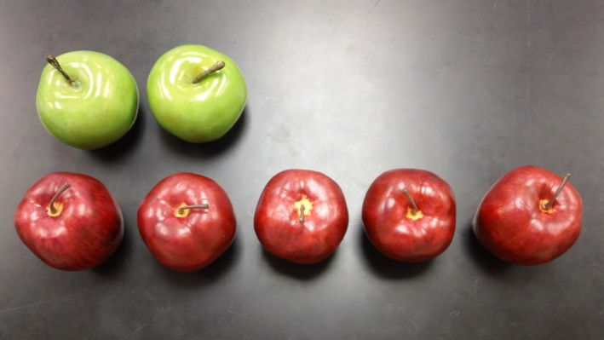
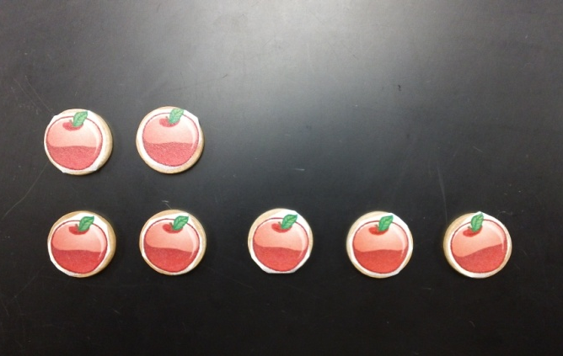
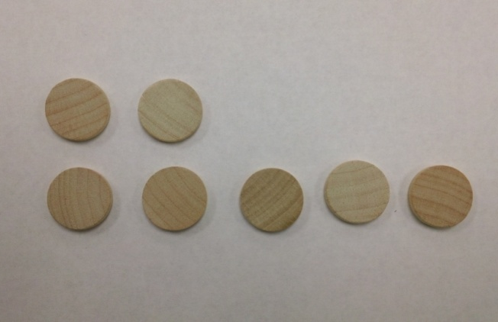
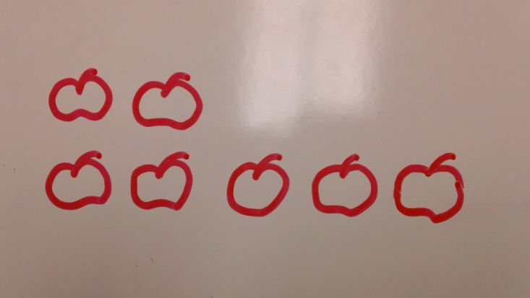
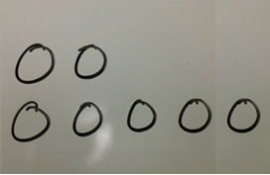
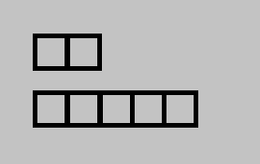
Tape Diagrams Foundations in PK–1
Sara has 2 apples. Jon has 5 apples. How many apples do they have altogether? How many more apples does Jon have than Sara?
Notes:
In the very early grades, we count out objects, and do comparisons of quantities (e.g., Who has more? Who has fewer? How many more? How many fewer?). It is important that students see groups of objects in many arrangements and learn to instantly recognize quantities up to 5 or 6. But it is equally important that we begin modeling for students the laying out of objects in an organized fashion that previews bar modeling, in both the end-to-end fashion and the comparison fashion. This is especially appropriate when working with word problems of addition and subtraction.
As the teacher, model a comparison of two quantities in the manor that makes the comparison easiest to see. It is not recommended to become overly structured in forcing students to model it a certain way every time. The suggestion, ”This time can you lay yours out like I have mine” will serve to build this habit of setting up items in rows to support counting, comparison, and the model of using rectangular bars.
A benefit of using rectangular bars without the markings of individual items is that students can now model non-discrete quantities – like measurements of distance or weight – as well as being able to represent unknown quantities.
In these examples, the number of items that each bar represents is known. As students begin using bars without the individual markings, they initially are restricted to using bars that represent known quantities. Then the next jump in complexity is in moving from a problem where both bar segments represent known quantities and the unknown is the total or the difference, to a problem where the total or difference is known and the bar is representing an unknown.

Slide 12
Tape Diagrams Forms of the Tape Diagram
8
5
?
5
8
?
Notes:
There are two basic forms of the bar diagram model. The first form is sometimes called the part-whole model; it uses bar segments placed end-to-end. The second form, sometimes called the comparison model, uses two or more bars stacked in rows that are left-justified; in this form the whole is depicted off to the side.
We will reflect on the nuances of the two forms when we have finished this section. For now, you can use whichever works best for you with any given problem.

Slide 13
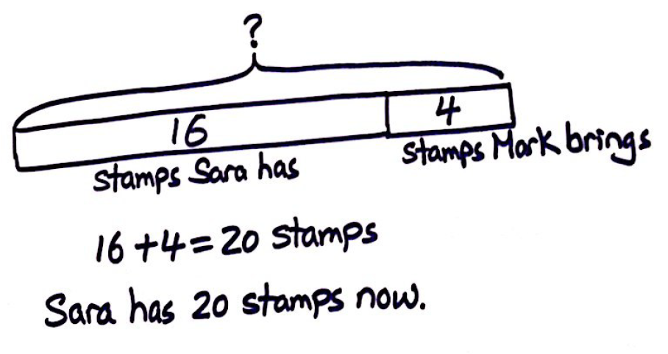
Tape Diagrams Early Examples
Example A: Sarah has 16 stamps. Mark brings her 4 more stamps. How many stamps does Sara have now?
Notes:
We start by asking a question about the whole, then students advance to finding the part.

Slide 14
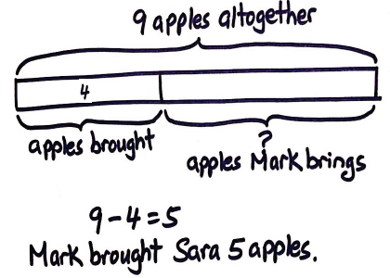
Tape Diagrams Early Examples
Example A: Sara brought 4 apples to school. After Mark brings her some more apples, she has 9 apples altogether. How many apples did Mark bring her?

Slide 15
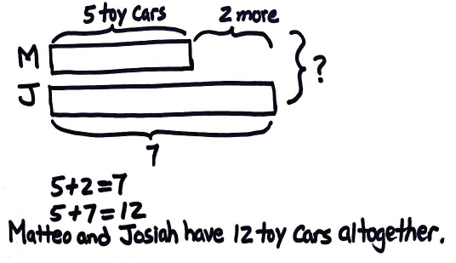
Tape Diagrams Early Examples
Example B: Matteo has 5 toy cars. Josiah has 2 more than Matteo. How many cars do Matteo and Josiah have altogether?
Notes:
***Beginning the tape diagram process can sometimes bring rise to student comments of, “But, I can solve this without a diagram.” In general you can convey to students that you are asking them to explain or prove that their thinking is correct, so they can share their thinking with their friends and justify their answers.

Slide 16
Tape Diagrams Early Examples
Example D: Jose has 4 paper clips. Harry has twice as many paper clips as Jose. How many paper clips does Harry have?
Notes:
Here is a multiplicative comparison.

Slide 17
Tape Diagrams
Example 1:
Sam has 7 more stamps than Joe. They have 45 stamps altogether. How many stamps does each boy have?
Notes:
Beginning the tape diagram process can sometimes bring rise to student comments of, “But, I can solve this without a diagram.” In general you can convey to students that you are asking them to explain or prove that their thinking is correct, so they can share their thinking with their friends and justify their answers.
As we work through the problems I will model the presentation of the problems as though I am the teacher and you are the students…
We have many of these problems to do, so while I will demonstrate quite a bit of delivery as I just did, I am not going to go through the entire delivery of every problem. And, in particular we will not be taking time to write out the answer in a complete sentence as shown here. Those steps can be very important with students, but to make most efficient use of our time, we will focus on the tape diagram leading to the answer and then move on to the next example.
(EXAMPLE 1) Let’s consider the first example.
Read the first sentence with me. Do I know how many stamps Sam has?
Do I know how many stamps Joe has?
What do we know?
Can we draw something to show this? Make your drawing look like mine today.
I’m going to draw a bar to represent the number of stamps Sam has first.
So who has more stamps, Sam or Joe?
So when I draw a bar to represent Joe’s stamps will it be longer or shorter?
OK, I’ll start drawing you tell me when to stop.
Can I label something? What else do you see?
Read the next sentence with me. “They have 45 stamps altogether.”
What can I draw or label to show this in the problem? What else do I see in my diagram? Is there anything else I can label?
Let’s go ahead and read the final sentence “How many stamps does each boy have?”
What are we being asked to find? Let’s label what we’re being asked with ? marks.
Is this piece (the part that is separated from the 7) of Jamal’s bar longer or shorter than Thomas’ bar? Or is it the same? Do we know how many stamps is represented by this piece of the bar? What do we know? Could it be a number as big as 100? Could it be as big as 20? This problem is introducing a fundamental concept to bar modeling… the use of equal sized bar segments to represent equal numbers.
Scaffold by setting up a problem with smaller numbers. Consider giving them starburst to use to model the situation. This is the beginning of algebraic thinking. You can’t add the numbers in the problem or multiply, divide, or subtract to get the answer. It’s worth taking the time to hone this skill before working with ratios and proportional relationships.

Slide 18
Tape Diagrams
Example 2:
Desmond has 5 times as many toy cars as Luke. They have 42 cars altogether. How many cars does each boy have.
Notes:
Do my last two questions seem inappropriate – why would I ask them when there is nothing else that I really need the students to label or notice yet? I don’t want the students developing a dependency on the teacher to suggest what to do next, instead I want them internalizing the habit of pausing after each reading or drawing to ask if there is anything more to see or note.
With multiplication and division problems, the use of a consistently sized bar to represent equal parts becomes even more obvious and central to solving. We refer to this quantity as a unit, and then reason through the problem with this language: 6 units is 42 toy cars. Reasoning with this relationship, 3 units would be 21 cars. 1 unit would be 7 toy cars, and 5 units would then be 35 toy cars.
Who has more cars? Whose bar should be longer? If this is how many cars Desmond has, tell me when to stop drawing the bar to represent Luke. It looks like I’ll need to add to the diagram for Desmond to show the equal parts.
Did anyone solve it differently? What matters is whether or not the model is useful.

Slide 19
Tape Diagrams
Example 3:
William’s weight is 40 kg. He is 4 times as heavy as his youngest brother Sean. What is Sean’s weight?
Notes:
(EXAMPLE 3) Read problem 3. Work the problem and share your tape diagram and answer with a partner.
(CLICK TO REVEAL SOLUTION.)
What mistake are students most likely to make when solving this problem? (Allow someone to share – we are looking for them to say that students might take the information ‘4 times as heavy’ and interpret that as Sean is 4 times as heavy as William, leading to an answer of 160 kg.)
This reason right here is a case in point of why teachers want students to internalize a specific habit from the RDW process. Whenever a second quantity is introduced in any of the comparison styles, ask the students, ‘who has more’ or, in this case, “Who weighs more, William or Sean?” That simple reflection should be a standard part of reading a word problem with a comparison.
Once internalized, students will be much less likely to make these mistakes of misrepresenting the relationship stated. They will instead have a habit of reflecting on who has more, and when asked directly they are much more likely to make a thoughtful reply, double checking the wording if they are unsure.

Slide 20
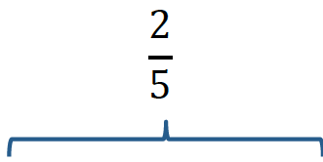
Tape Diagrams
H
Example 1:
David spent 2/5 of his money on a storybook. The storybook cost $20. How much did he have at first?
Notes:
(EXAMPLE 1) (Use judgment to either allow participants to try on their own, or follow the optional scaffold provided below.)
I think based on the previous work we’ve done from sessions 2 and 3 that you can try this first problem independently. (Allow participants 1-3 minutes to work the problem.)
Compare your model with a partner at your table. (Allow participants 1 minute to compare their work.)
Who has answer? (Allow for 1 or more people to answer.) Is he/she right? Did anyone get something different? (If there is any difference of opinion, allow 2 participants with different answers to draw their solutions on flip charts or on the document camera. Allow the two participants a chance to explain their reasoning.)
(CLICK TO REVEAL SOLUTION.)
Optional scaffold:
Let’s read the first sentence together, “David spent 2/5 of his money on a storybook.” Who is the story about? (David.) What do we know so far? (That he spent 2/5 of his money on a book.) Can we draw something?
What will our bar represent? (David’s money) (Draw one bar that is long enough to be partitioned into five equal parts.) What does two fifths of David’s money look like? Can you imagine it here? Go ahead and show me on the diagram. (Partition it into five equal parts.)
What can we label on our diagram?
Use’s whale’s tale’s to show 2/5 and label it book. Write David’s money to the left of the bar.
Is there anything else we can draw, or label? What do we see?
Let’s read the next sentence. “The storybook cost $20.” Can we revise or add a label to our diagram to include this new information?
What else do we see? (That each fifth represents $10.) Can we label something else?
What else does our diagram tell us? (That the whole is representing $50.) Where can we add that information?
Scaffold my removing 2/5 from the problem and just say that David spent a fraction of his money. Can you picture what that would be like? Then put in the fraction 2/5 and solve.

Slide 21
Tape Diagrams
H
Example 2:
Max spent 3/5 of his money in a shop and 1/4 of the remainder in another shop. What fraction of his money was left? If he had $90 left, how much did he have at first?
Notes:
(EXAMPLE 2) (Have participants try Example 2 on their own.)
What can we draw? Let’s draw a bar for Max’s money. Can you image what 3/5 looks like? Can you imagine what ¼ of the remainder looks like? Where’s the remainder in the diagram?
Some people think it’s easier to see when a new bar is drawn below the existing one to represent the ¼.
Where should I put the $90? Each of these parts would be ($30) because the remainder has three equal parts. Now we can label the rest of the diagram to find out how much money he had at first.

Slide 22
Tape Diagrams
Example 6:
Three-fifths of Jan’s money is twice as much as Lena’s money. What fraction of Jan’s money is Lena’s money?
Notes:
Example 6
Who do you think has more money? Yes, because Lena’s money is just a fraction of what Jan has.
Let’s draw Jan’s money. I’d like to be able to visualize 3/5 of it. That’s twice as much as Lena. Since Lena’s money is between two of Jan’s parts, let’s split each of the fifths of Jan’s money into 2 part. Now we see that the answer is 3/10.

Slide 23
Agenda
Ratios & Proportional Relationships
Geometry
The Number System
Expressions and Equations
Linear Equations and Linear Functions
Notes:
Discuss how the material is coherently linked making a choice of sequencing difficult.
Tape Diagrams (30 min)
Ratios & Proportional Relationships (70 min) BREAK
The Number System (40 min)
Expressions and Equations (90 min) LUNCH
Functions (20 min) BREAK
Geometry (90 min) Q&A
TIME ALLOTTED FOR THIS SLIDE:
2 minutes
MATERIALS NEEDED:
x

Slide 24
Ratios and Proportional Relationships
The transition into ratios and proportional relationships:
Why study ratios?
Make sense of proportional relationships
Definition and study of ratio, value of the ratio, equivalent ratios, unit rate of A:B, unit rate of B:A, constant of proportionality
Percent
Geometry
Scale Factor and Scale Drawings
Similarity
Properties of Similar Figures
Corresponding Side Lengths Equal in Ratio
Notes:
TIME ALLOTTED FOR THIS SLIDE:
2 minutes
MATERIALS NEEDED:
x

Slide 25
Ratios & Proportional Relationships When do we really use ratios? Jimmy’s allowance is twice as much as Johnny’s and Jeremy’s is 4/5 of Johnny’s. How much allowance does Jimmy get?
List as many real-world applications of ratios and proportional relationships as you can think of.
Choose one of them to make up your own ratio application problem that seems especially real- world.
Notes:
Jimmy’s allowance is twice as much as Johnny’s and Jeremy’s is 4/5 of Johnny’s. How much allowance does Jimmy get? The problems are so contrived…if you really want to know what Jimmy’s allowance is just go ask!
How do you write a real world ratio problem? How many different situations can you come up with? Allow time for participants to share their situations and time to reflect on the problems they have encountered previously when creating situations that are not contrived.
TIME ALLOTTED FOR THIS SLIDE:
2 minutes
MATERIALS NEEDED:
x

Slide 26
Ratios & Proportional Relationships Transitioning into ratio problems
H
Students have solved problems of multiplicative comparison.
There were 4 times as many boys as girls at the party. If there were 30 kids at the party, how many were boys?
What would motivate a student to want to use ratios to describe this type of situation?
Read through G6-M1, Lesson 1, Examples 1-2
Notes:
Students have solved problems of multiplicative comparisons since grade three. Take a look at this example. What seems problematic about this question? What would motivate a student to want to use ratios to describe this type of situation? Multiplicative comparisons motivate us to talk in terms of ratios. We need to remember that when we represent this, 4 units will represent the girls, and 1 unit will represent the boys, totaling 5 units. If 5 units represent 30 kids, then it is an easy determination that each unit represents six kids. The multiplicative comparison resides in understanding that if one unit represents six kids, then for the number of boys, which is represented by one unit, is six.
TIME ALLOTTED FOR THIS SLIDE:
2 minutes
MATERIALS NEEDED:
x

Slide 27
Ratios & Proportional Relationships Definitions and Descriptions
Ratio
A pair of non-negative numbers, A:B, which are not both zero. They are used to indicate that there is a relationship between two quantities such that when there are A units of one quantity, there are B units of the second quantity.
Value of a Ratio
For the ratio A:B, the value of the ratio is the quotient A/B as long as B is not zero. Likewise, for the ratio B:A, the value of the ratio is the quotient B/A as long as A is not zero.
Equivalent Ratios
Two ratios A:B and C:D are equivalent if there is a positive number, k, such that C=kA and D=kB. They are ratios that have the same value.
Notes:
Have participants try this as a self-quiz first and share their answers. Summarize their thoughts with the following definitions or descriptions.
TIME ALLOTTED FOR THIS SLIDE:
2 minutes
MATERIALS NEEDED:
x

Slide 28
Tape Diagrams
H
Example 3:
Ingrid is mixing yellow and green paint together for a large art project. She uses a ratio of 2 pints of yellow paint for every 3 pints of green paint.
Notes:
Example 3
Read the first two sentences of this problem with me. Can we draw something? (Show comparison model)
What kind of additional information and question could we provide from here? Allow audience members to make suggestions and then have the audience rank each suggestion in order of complexity or difficulty for students. Here are 3 examples provided in order of complexity.
If she uses 8 pints of yellow paint, how many pints of green paint does she need?
If she makes 25 pints altogether, how many pints of green paint did she use?
If she uses 6 more pints of green paint than yellow paint, how many pints of green paint did she use?
(Other examples that have come up are asking for a different unit, like if I used 2 gallons of yellow, how many gallons of paint would I have. Or having fractions like, if I want ½ a pint of paint, how much yellow and how much green.)
If you have 1 pint of yellow, how much green will you need?
These are the three main ways you can give more information – giving one either the number of green pints or the number of yellow pints, giving the total pints, or giving the difference in number of green pints and yellow pints. Then one can ask any one of the missing pieces of information – number of yellow pints, number of green pints, total number of pints, or difference between number of green pints and number of yellow pints.
Which of the above was the easiest question to answer? Which would be next?
We want to develop rigor. The three components are rigor are conceptual understanding, then fluency (being able to do something quickly and accurately), and application. This line of thinking is also setting students up for their work with associated ratios later in the module.

Slide 29
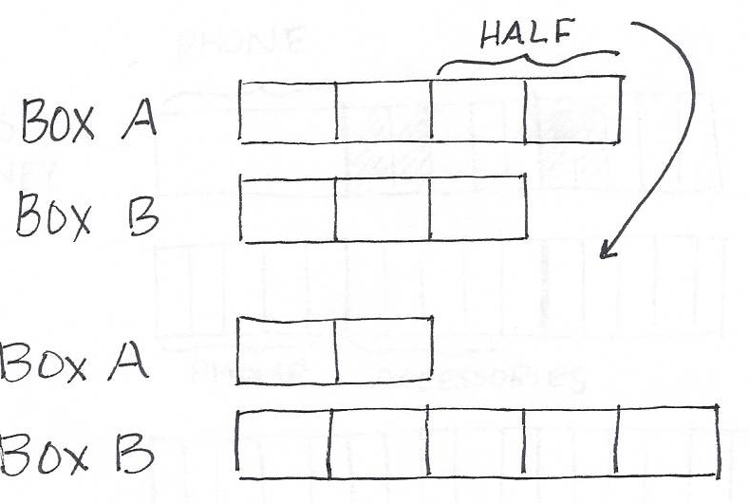
Tape Diagrams
H
Example 4:
Lena finds two boxes of printer paper in the teacher supply room. The ratio of the packs of paper in Box A to the packs of paper in Box B is 4:3. If half of the paper in Box A is moved to Box B, what is the new ratio of packs of paper in Box A to Box B?
Notes:
Example 4
(Allow participants to read and work the problem independently, then review the solution.)
Often times, when there is an event within the problem that changes the relationships between the quantities, it can be helpful to have a before diagram and an ‘after’ diagram.
Since Lena is taking half of what is in Box A, half of that diagram is 2 units. We move those two units to Box B that currently has 3 units. Since we took 2 away from the 4 units in A, there are 2 units left. When we moved those 2 units to Box B, there are now 5 units. The ratio of the number of packs of paper in Box A to the number of packs of paper in Box B is now 2:5.

Slide 30
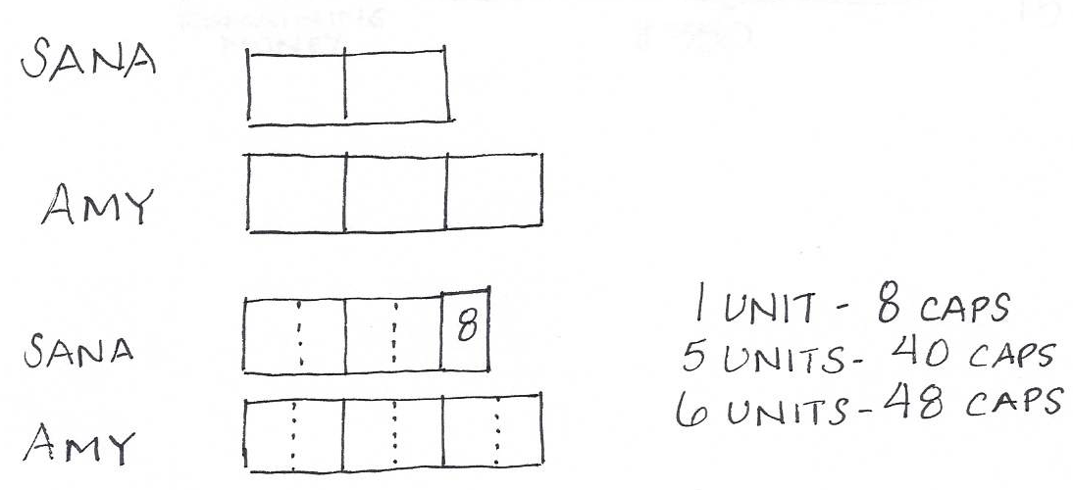
Tape Diagrams
H
Example 5:
Sana and Amy collect bottle caps. The ratio of the number of bottle caps Sana has to the number Amy has is 2 : 3. The ratio became 5 : 6 when Sana added 8 more bottle caps to her collection. How many bottle caps does Amy have?
Notes:
Example 5 – Changing Ratios Example
(Allow participants to read and work the problem independently, then review the solution.)
Draw the comparison model to represent 2:3. Then draw another model for 5:6. Should I draw the same sized boxes? If so, that would imply that Amy collected more bottle caps. So I can draw a bar of the same length, but divide each part into 2 equal pieces. Then it would illustrate the situation appropriately. Similarly, we would divide the existing two parts for Sana into 2 equal parts. Then the change in ratio has us add one more box to Sana, which represents the 8 bottle caps. Therefore Amy has 48 bottle caps.

Slide 31
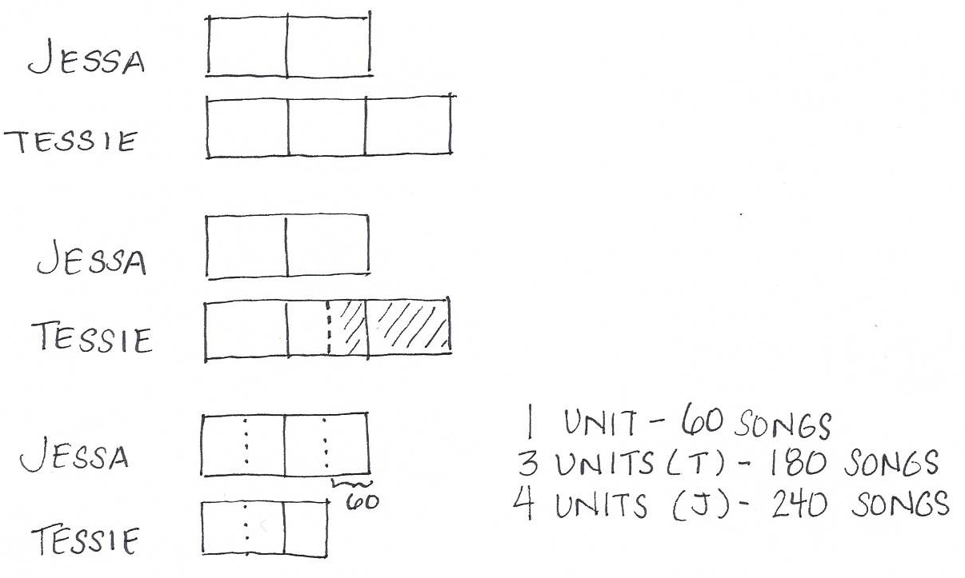
Tape Diagrams
H
Example 6:
The ratio of songs on Jessa’s phone to songs on Tessie’s phone is 2 to 3. Tessie deletes half of her songs and now has 60 fewer songs than Jessa. How many songs does Jessa have?
Notes:
Example 6
(Allow participants to read and work the problem independently, then review the solution.)
We begin with the ratio of the number of songs on Jessa’s phone to the number of songs on Tessie’s phone. That is 2:3. We represent the ratio with a tape diagram, 2 units for Jessa and 3 units for Tessie. If Tessie deletes half of her songs, we represent this on the diagram. Notice that we have to split one of the units in half. Once Tessie deletes half of her songs, she now has 60 songs fewer than Jessa. Notice how we recreated the tape diagram using those “halves.” We now see that there is a portion or one of the new units that is larger than Tessie’s. That unit represents 60 songs. If one unit represents 60 songs, 3 units (or Tessie’s songs) represents 180 songs because three times sixty is 180, and four units (or Jessa’s songs) represents 240 songs because each of those four units represents 60. Four times sixty is 240.

Slide 32
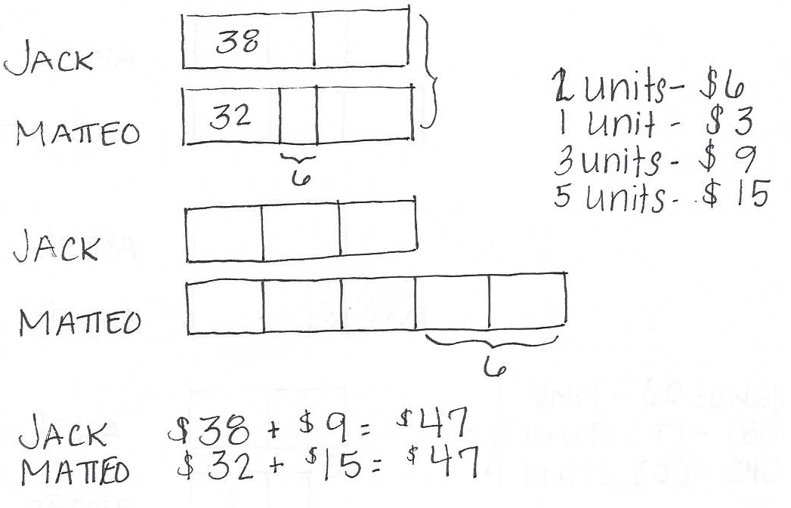
Tape Diagrams
H
Example 7:
Jack and Matteo had an equal amount of money each. After Jack spent $38 and Matteo spent $32, the ratio of Jack’s money to Matteo’s money was 3:5. How much did each boy have at first?
Notes:
Example 7
(Allow participants to read and work the problem independently, then review the solution.)
Note we start with the same amount for Jack and Matteo. Jack spent 38 dollars, which is represented in the diagram, and Matteo spent 32 dollars, represented, which is six dollars less than Jack, also represented. We now know that after they spent this money, the ratio of their money is 3:5. Since Matteo has six dollars more, since Jack spent six dollars more than him, we know the extra two units on Matteo’s diagram represents that six dollars. If two units represents six dollars, then one unit represents three dollars. Since each unit represents three dollars, then three units represents 9 dollars and five units represents 15, we can determine that Jack spent $47 because 38+9=47, and Matteo also spent $47 dollars because 32+15=47.

Slide 33
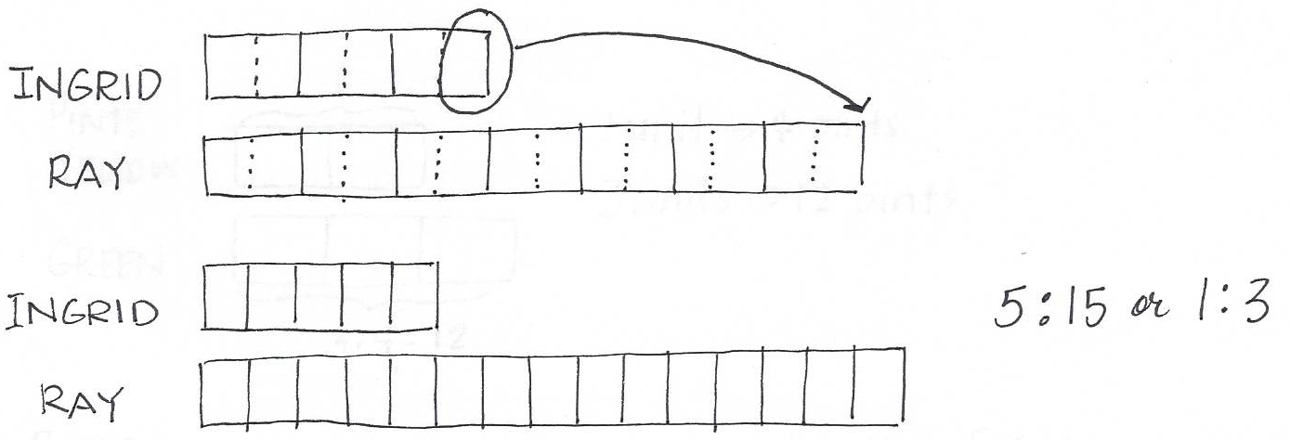
Tape Diagrams
H
Example 8:
The ratio of the number of Ingrid’s stamps to the number of Ray’s stamps is 3 : 7. If Ingrid gives one-sixth of her stamps to Ray, what will be the new ratio of the number of Ingrid’s stamps to the number of Ray’s stamps?
Notes:
Example 8
(Allow participants to read and work the problem independently, then review the solution.)
Notice that we begin the diagram with the number of stamps Ingrid has being represented by 3 units and the number of stamps Ray has being represented by 7 units. Ingrid gives one-sixth of her stamps to Ray. Since Ingrid’s stamps are being represented by three units, we can split each of the units in half to determine sixths. Now that we do that, we can give that sixth of Ingrid’s stamps to Ray. Since we split each of the units in half for Ingrid, we do the same for Ray. Before given the sixth from Ingrid, he had 14 sixths. With the additional sixth, he has 15. Now we can determine that the ratio representing the number of Ingrid’s stamps to the number of Ray’s stamps is now 5:15, or even 1:3.

Slide 34
Tape Diagrams
Example 8:
The ratio of the Gavin’s money to Manuel’s was 6 : 7. After Gavin spent two-thirds of his money and Manuel spent $39 Manuel had twice as much money as Gavin. How much money did Gavin have at first?
Notes:
Example 8
(Allow participants to read and work the problem independently, then review the solution.)

Slide 35
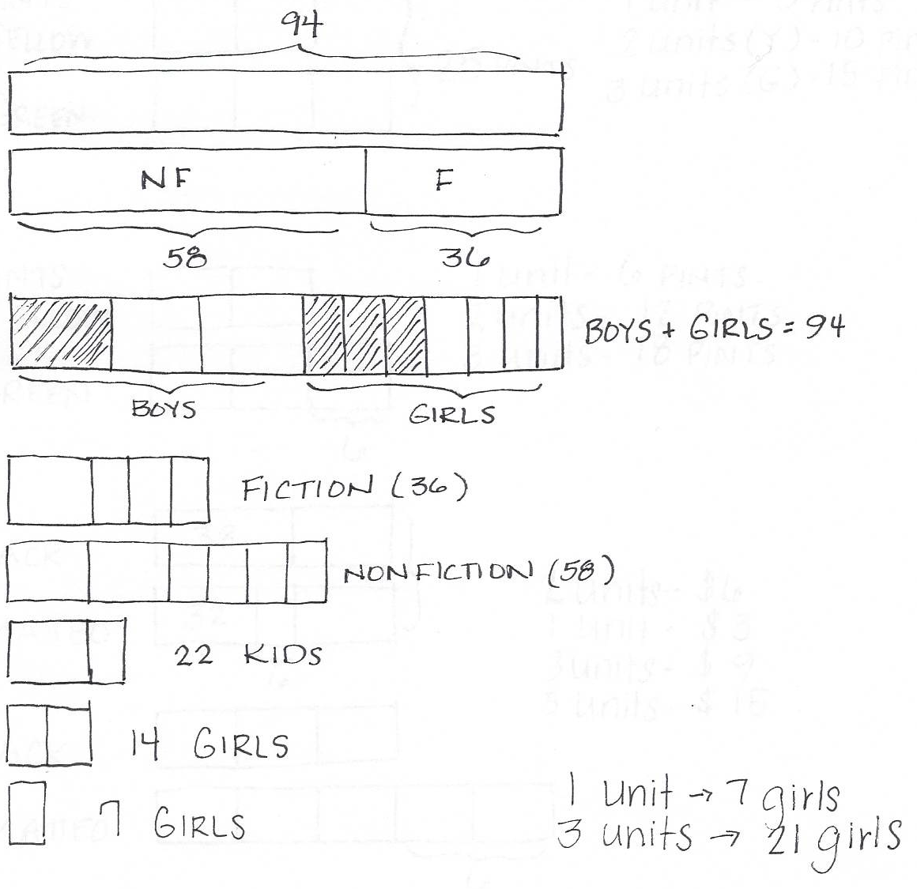
Tape Diagrams Revisiting the Opening Exercise
94 children are in a reading club. One-third of the boys and three-sevenths of the girls prefer fiction. If 36 students prefer fiction, how many girls prefer fiction?
Notes:
Give participants a few minutes to revisit the opening exercise and see if they can now complete the problems or would change their approaches in each. Reveal the answers.
Note how we begin with the total amount of books, which is 94. We show that 58 of those books are non-fiction and 36 of the books are fiction. We take that whole and split it up first into thirds, and then into sevenths. We show that one of the thirds represents the boys who prefer fiction and three of the sevenths represent the girls who prefer fiction. We see that the difference between nonfiction books and fiction books is 58-36, which provides us with 22 total students. We see the difference between 36 of the fiction and 22 of the students is 14. Fourteen represents two units, so one unit represents 7 girls. If one unit represents seven girls, then three units represents 21 girls because 3 times 7 is 21.

Slide 36
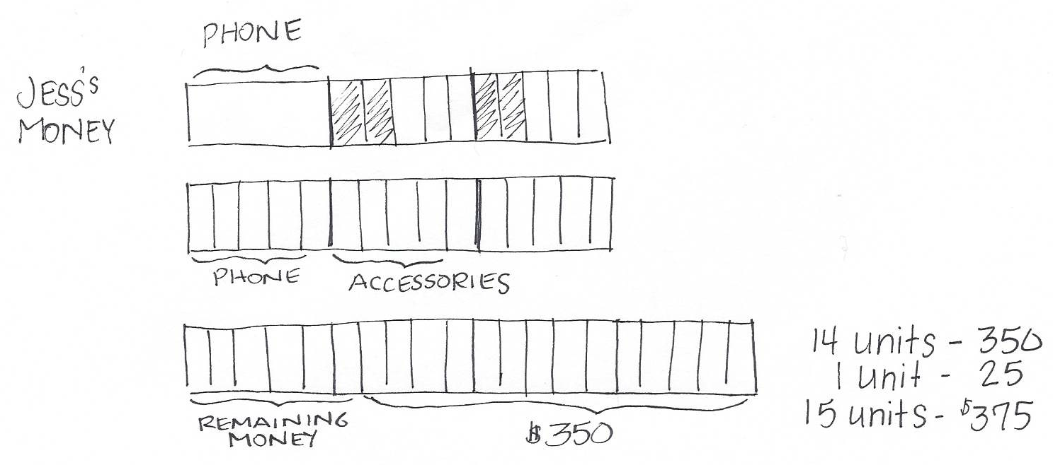
Tape Diagrams Revisiting the Opening Exercise
Jess spent one-third of her money on a cell phone, and two-fifths of the remainder on accessories. When she got home her parents gave her $350. The ratio of money she had in the end to the money she had before is 4:3. How much money did she have at first?
Notes:
Draw a bar to represent Jess’ money. Show 1/3 of it being spent on the phone. It’s not easy to show fifths with the thirds we have, so lets divide each of the thirds into fifths. Is the 2/5 just two of the bars? No, it’s four of them.
Now I need to show the ratio, (draw a bar with 4 parts where the original drawing was 3 parts). Divide the four parts into 5 equal parts each. Then the $350 that her parents gave her is represented by 14 out of the 20 parts, then 2 units is $50 and 1 unit is $25. What Jess had to begin with was 15 units so Jess had $375.

Slide 37
Double Number Line Diagrams
H
Example: Rate Problems
A photocopier can print 12 copies in 36 seconds. At this rate, how many copies can it print in 1 minute?
Notes:
Draw two number lines using the document camera. At 12 on the copy number line it is the same as 36 on the seconds number line. Break the lines down. If I can do 12 copies in 36 seconds, then I can do 6 in 18 seconds, 3 in 9 seconds and 1 in 3 seconds. I’m looking for the number of copies at 60 seconds, which is 20 copies. Why would we use this strategy instead of, say, a tape diagram?

Slide 38
Ratios & Proportional Relationships Representations of Equivalent Ratios
Notes:
It is our goal that students develop intuition about representation(s) that would be most helpful in answering questions. So far, they have seen tape diagrams and double number lines. These are the representations that are used in Grade 6 and Grade 7.
Further, in all grades 6 – 8 students use tables and graphs to represent equivalent ratios. Note the proportional relationship is represented in quadrant one. Is there a proportional relationship that you can think of that would go beyond quadrant 1? Most proportional relationships do not warrant the use of negative values.

Slide 39
Ratios & Proportional Relationships Equivalent Ratios – Tape Diagrams and Double Number Line Diagrams
H
Represent each situation using a tape diagram or double number line diagram.
Monique walks 3 miles in 25 minutes.
Sean spends 5 minutes watching television for every 2 minutes he spends on homework.
Notes:
(3 minutes) Use either a tape diagram or a double number line diagram to support your answer. Explain your reasoning for using the chosen visual.
Explain to participants that same units use tape diagram (#2- bottom) and different units use double number line diagrams. (#1- top).

Slide 40
Ratios & Proportional Relationships Rate and Unit Rate
Rate: If I traveled 180 miles in 3 hours; my average speed is 60 mph. The quantity, 60 mph, is an example of a rate.
Unit Rate: The numeric value of the rate, e.g. in the rate 60 mph, the unit rate is 60.
Rate’s Unit: The unit of measurement for the rate, e.g. mph.
Notes:
The ratio of miles to hours is 180 to 3. In this instance, the ratio x:y is represented with 180:3. We figure out the distance in 1 hour to determine the rate. The rate has a unit, that is mph, it’s the comparison of miles and hours.
The unit rate is the numerical portion of the rate, so just the number 60.
The rate’s unit is mph, it is the measure of the rate.

Slide 41
Ratios & Proportional Relationships Ratio & Proportions Exercise 1
H
In Jasmine’s favorite fruit salad, the ratio of the number of cups of grapes to number of cups of peaches is 5 to 2.
How many cups of peaches will be used if 25 cups of grapes are used?
Create both a ratio table and a graph of the proportional relationship to depict the relationship and find your answer.
What is the constant of proportionality?
Write the equation of the line depicted in the graph.
Notes:
Provide participants time to work through the Exercise.

Slide 42
Cups of Grapes | Cups of Peaches
5 | 2
10 | 4
15 | 6
20 | 8
25 | 10
Cups of Peaches
Cups of Grapes
Cups of Peaches | Cups of Grapes
2 | 5
4 | 10
6 | 15
8 | 20
10 | 25
Cups of Grapes
Cups of Peaches
Notes:
Students will begin organizing the information using a table. They determine that the ratio of cups of grapes to cups of peaches is 5:2. Because the unit rate represents the relationship of B:A and the constant of proportionality is determined by the equation y=kx, students understand they can determine the value of k (or the unit rate or the constant of proportionality) to be the quotient of y/x. So, in this example students will determine that the constant of proportionality is 2/5 and further determine that the equation that represents this relationship is y=2/5x.
Similarly in the next example, students notice the ratio relationship of cups of peaches to cups of grapes to be 2:5. Using their knowledge of constant of proportionality, they can determine that the y value is 5 in this example and the x value is 2, and discover that the constant of proportionality, or the unit rate is 5/2. Therefore, they can determine the equation that represents this relationship is y=5/2x.

Slide 43
Ratios & Proportional Relationships Ratio & Proportions Exercise 2
H
Jack is taking a hike through a forested park. He moves at a constant rate, covering 5 miles every 2 hours.
How much time will have passed when he has hiked 9 miles?
Create both a ratio table and a graph of the proportional relationship to depict the relationship and find your answer.
What is the constant of proportionality?
Write the equation of the line depicted in the graph.

Slide 44
Miles | Hours
5 | 2
6 | 2.4
7 | 2.8
8 | 3.2
9 | 3.6
Hours
Miles
Hours | Miles
2 | 5
2.4 | 6
2.8 | 7
3.2 | 8
3.6 | 9
Miles
Hours
Notes:
Students will begin organizing the information using a table. They determine that the ratio of number of miles to number of hours is 5:2. Because the unit rate represents the relationship of B:A and the constant of proportionality is determined by the equation y=kx, students understand they can determine the value of k (or the unit rate or the constant of proportionality) to be the quotient of y/x. So, in this example students will determine that the constant of proportionality is 2/5 and further determine that the equation that represents this relationship is y=2/5x.
Similarly in the next example, students notice the ratio relationship of the number of hours to the number of miles is 2:5. Using their knowledge of constant of proportionality, they can determine that the y value is 5 in this example and the x value is 2, and discover that the constant of proportionality, or the unit rate is 5/2. Therefore, they can determine the equation that represents this relationship is y=5/2x.

Slide 45
Ratios & Proportional Relationships Constant of Proportionality
H
Given a ratio A : B, and given that one places the quantity associated with A on the x-axis and the quantity associated with B on the y-axis, then:
The constant of proportionality for the ratio A : B is the unit rate of the ratio B : A (the value of the ratio B:A).
Notes:
See page 14 of the 6-7 Ratio and Proportional Relationships Progression document for a definition of constant of proportionality.

Slide 46
Ratios & Proportional Relationships Constant of Proportionality
And the equation of the line depicted will be:
If a proportional relationship is described by the set of ordered pairs that satisfies the equation y = kx, where k is a positive constant, then k is called the constant of proportionality.; e.g., If the ratio of x to y is 5 to 2, then the constant of proportionality represents the ratio of y to x and is 2/5, and y = (2/5) x.
Cups of Grapes | Cups of Peaches
5 | 2
10 | 4
15 | 6
20 | 8
25 | 10
Cups of Peaches
Cups of Grapes
Notes:
Note to the participants that students’ first encounter with slope is looking at the unit rate of a proportional relationship. In this example it is clear that the constant of proportionality is 2/5, which is also the unit rate of y to x, and is also the slope.

Slide 47
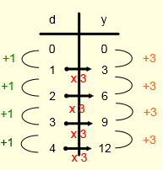
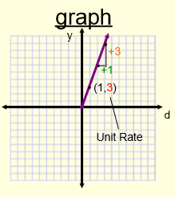
Ratios & Proportional Relationships Constant of Proportionality
H
Where and how is the constant of proportionality represented?
Song Downloads cost $3 each.
(unit rate of the ratio y:d)
Notes:
(5 minutes) Take a couple of moments now to review pages 8 and 9 looking for the visual representations used in Grade 7 to depict a proportional relationship. For each way, make note of how the constant of proportionality is represented. Make sure the following is noted:
In grade 7, students identify value of a ratio, or unit rate of y to x, as the constant of proportionality and focus on its representation in equations and graphs.
Students will write equations in the form y = cx, where c is the constant of proportionality, or unit rate. This unit rate can be seen on the graph as the amount of increase in y as x increases by 1, and also located at the point (1, r). For each increase of 1 on the x-axis, you increase by 3 on the y=axis.
When looking at the graph, the proportional relationship is indicated by a straight line going through the origin. This understanding forms the foundation for linear equations in grade 8.
In grade 8 students understand that the unit rate B:A of a proportional relationship is the same as the slope of the graph of the relationship. Because the unit rate is a number that does not include a label, this can be clarified by the labels on the x and y axes. We see that the unit rate of B:A, or the constant of proportionality, or the slope is 3. The rate unit is the amount of dollars per download.

Slide 48
Ratios & Proportional Relationships Average Rate vs. Constant Rate
H
AVERAGE RATE. Let a time interval of t hours be given. Suppose that an object travels a total distance of d miles during this time interval, t. The object’s average rate in the given time interval is d/t miles per hour.
CONSTANT RATE. For any positive real number v, an object travels at a constant rate of v mph over a given time interval, t, if the average rate is always equal to v mph for every fixed time interval.
Notes:
Read and interpret
Grade 8 M4 Lesson 10, let’s look at example 1 together. Challenge this. Now look at example 2 and read through the dialogue points
A constant rate occurs when a situation can be directly modeled by a proportional relationship—that is, when a motion or rate is directly modeled by an equation of the form .

Slide 49
Ratios & Proportional Relationships Testing for Proportional Relationships
H
G7-M1 Lesson 3 Exercises 1-3
Now create graphs of the data in each table. What do you notice?
Recall the lesson from G8-M4 Lesson 10:
Calculating an average rate does not dictate that there was a constant rate on that interval, nor does it guarantee that the rate will continue at that same average rate.
Notes:
Have participants work Exercises 1-3. Then talk through the bullets.
We are testing for proportional relationships in the three exercises from G7. From there, we are really looking at the average rate of each row of data. When each row of data yields the same average rate, then we know we are looking at a proportional relationship because each average rate is equal to the same constant. Further, if the data in each row does not yield the same constant, as in Exercise 1, then the relationship is not proportional, nor is it a constant rate.
TIME ALLOTTED FOR THIS SLIDE:
2 minutes
MATERIALS NEEDED:
x

Slide 50
Ratios & Proportional Relationships Scale Factor
H
G7-M1 End of Module Assessment, Item 2
Scale factor is a unit rate, and is therefore unit-less. To calculate the true scale factor, one must compare using the same unit of measure in each quantity.
Students work informally to know that the area of the scaled drawing is altered by a factor of (scale factor)²
Does creating a scale drawing ever effect the measure of the angles in the drawing?
Notes:
Creating a scale drawing never effects the measure of the angles in a drawing. They will remain the same size.
TIME ALLOTTED FOR THIS SLIDE:
2 minutes
MATERIALS NEEDED:
x

Slide 51
Ratios & Proportional Relationships Percent is a rate per 100
Suppose the ratio of girls to boys in a class is 1:4.
What are some associated ratios?
The ratio of boys to girls is 4:1,
The ratio of girls to total students in the class is 1:5
The ratio of boys to total students in the class is 4:5.
If the total number of students in the class were 50, how many girls are there?
Notes:
As you have noticed, we have been addressing associated ratios throughout our discussion of ratios and proportional relationships. We categorize associated ratios as A:B, B:A, A:A+B, B:B+A.
TIME ALLOTTED FOR THIS SLIDE:
2 minutes
MATERIALS NEEDED:
x

Slide 52
Ratios & Proportional Relationships Percent is a rate per 100
To give a percentage is to define a ratio relationship between two quantities by telling how many/much of A per 100 of B.
When I ask, “What is the percentage of girls in the class?” I am asking, “How many girls for every 100 students in the class?”
How can you answer that question?
The same way you answer any equivalent ratio problem.
Notes:
BEGIN EMPHASIZING IT’S ALL ABOUT IDENTIFYING THE WHOLE
The key stumbling block for students is in recognizing the hidden ratio problem within. The scaffold I am suggesting for addressing that stumbling block starts with this exact exercise.
TIME ALLOTTED FOR THIS SLIDE:
2 minutes
MATERIALS NEEDED:
x

Slide 53
Ratios & Proportional Relationships Percent is a rate per 100
Convert each example of a percent statement into a ratio statement.
The sale price of the computer is 80% of the original price.
The ratio of the sales price to the original price is 80:100.
35% of the kids at my school play an instrument.
The ratio of kids who play an instrument to the total number of kids is 35:100.
Notes:
So I recommend scaffolding with exercises such as these. Start by simply asking students to translate percent statements into ratio statements.
Students can do ratios but have difficulty with percent.
TIME ALLOTTED FOR THIS SLIDE:
2 minutes
MATERIALS NEEDED:
x

Slide 54
Ratios & Proportional Relationships Percent, Fraction, Decimal
Convert each statement into a ratio statement and a percent statement.
2/5 of the cars in the parking lot were white.
The ratio of cars that were white to cars in the parking lot was 2:5.
40% of the cars in the parking lot were white.
Six-tenths (0.6) of the boxes that arrived were damaged.
The ratio of boxes that arrived damaged to total boxes that arrived was 6:10.
60% of the boxes that arrived were damaged.
Notes:
Commentary. .6 is a number on the number line.
What is 60%? The standards call us to convey that 60% is a rate. The unit rate, for the rate 60% is the number .6. When we draw a number line or say that 60% = .6, we are saying that 60% of 1 is equal to .6 of 1.
I recommend developing fluency of these relationships in context, before doing so out of context. i.e., convert .35 to a percent. This is an abstraction.
Erika – There are sprints on this in grade 6 and 7.
TIME ALLOTTED FOR THIS SLIDE:
2 minutes
MATERIALS NEEDED:
x

Slide 55
Ratios & Proportional Relationships Percent of a Quantity
40% of my crayons are broken.
Rewrite this using ratio language.
If I have 150 crayons, how many are broken?
Is this problem asking the same thing as, “How many is 40% of the 150 crayons?”
Of the 25 girls on the soccer team, 40% also play on a travel team. How many of the 25 girls play on a travel team?
Notes:
The ratio of the number of broken crayons to the total number of crayons is 40 to 100. How many broken crayons are there if there are 150 crayons in all?
Write the first statement as a ratio statement. The ratio is part to whole: The ratio of girls that play on the travel team to the girls that play soccer as a whole. This sets us up for percent of increase/decrease.
100 boxes would be ridiculous to draw. I might do 4 to 10 or use a double number line.
Travel team: Mark 40.
Total girls on “school team”: Mark 100. Find 25 on the number line.
The number at 25 on the number line is associated with 10 on the travel team number line.
TIME ALLOTTED FOR THIS SLIDE:
2 minutes
MATERIALS NEEDED:
x

Slide 56
Ratios & Proportional Relationships Percent of a Quantity
What is 40% of 60?
Could this problem be viewed as a ratio problem?
If so, what information are we being given?
Create a context for the problem.
Work on fluency of these computations before moving on.
Notes:
Write this as a ratio statement. The ratio of part to whole is 40 to 100. The problem implies that 60 is the whole. I’m setting up an equivalent ratio problem.
We don’t always want students to go back to the tape diagrams or other models, but it allows them to understand the concept of percent being part of a whole. In G6 and G7, we move students to greater levels of abstraction. In G6 they write the equation but don’t solve it right away, then in G7 they write an equation and are expected to solve it and use it to answer problems. We have students represent situations in more than one way to unify the thinking about the problem.
Context: There were 60 problems on a test and I only got 40% of them right.
If I think of 40% as a rate, how can I put that on a number line? I can convert it to 0.4, what is the whole? It’s one. Abstraction begins by first understanding percent as a rate, then just the number.
TIME ALLOTTED FOR THIS SLIDE:
2 minutes
MATERIALS NEEDED:
x

Slide 57
Ratios & Proportional Relationships Solving Percent Problems
Jane paid $40 for an item after she received a 20% discount. Jane’s friend says this means that the original price of the item was $48.
How do you think Jane’s friend arrived at this amount?
Is her friend correct? Why or why not?
Notes:
What’s the ratio statement? What does 20 : 100 represent?
Show using a tape diagram and perhaps a double number line diagram.
TIME ALLOTTED FOR THIS SLIDE:
2 minutes
MATERIALS NEEDED:
x

Slide 58
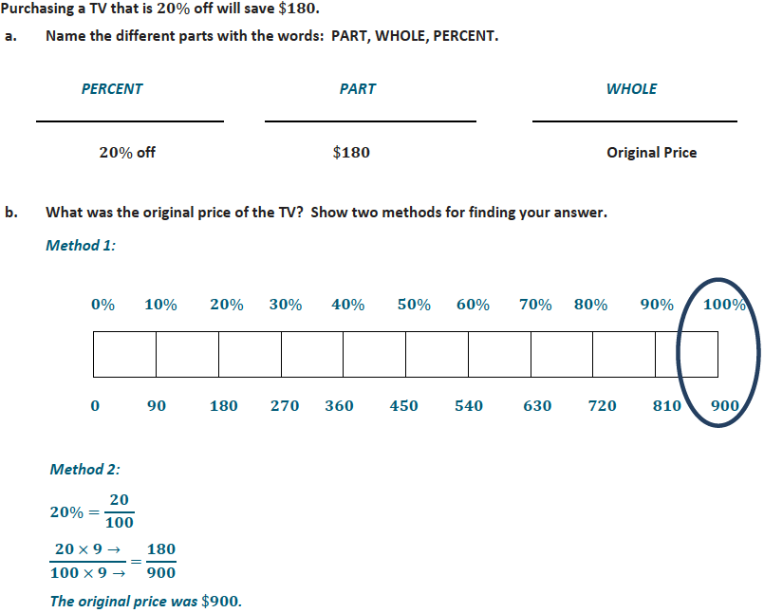
Notes:
Students begin differentiating between percent, part, and whole in Grade 6. Here you see that students are identifying these parts in order to determine the original price of a TV. They use visual representations and move to an algebraic form where they are representing mathematically what is depicted in the visual representation.

Slide 59
Notes:
From there, students in Grade 7 analyze scenarios to find whole units in each situation. (CLICK) Then, they investigate problems to determine the part, percent and whole in order to find the missing value. (CLICK) Students use visual representations to find the whole when given the part and the percent, and then through exploration, (CLICK) students formally use the equation Part=Percent x Whole to find missing values.

Slide 60
Ratios & Proportional Relationships Percent & Proportional Relationships
H
G7-M4 Lesson 3 Exit Ticket, Number 1
Notes:
Have participants solve the first problem in the exit ticket for G7M4, Lesson 3. If time permits, allow a participant model their work using the document camera. Elicit responses for each solution: algebraic, numeric, and the alternate numeric solution as depicted by the following:
12:90
X:100
90 is 100%
9 is 10%
3 is 10/3 %
12 is 40/3 %
TIME ALLOTTED FOR THIS SLIDE:
2 minutes
MATERIALS NEEDED:
x

Slide 61
Ratios & Proportional Relationships Fluency
H
Rapid white board exchanges
Sprints
Notes:
If timing is problematic, move this fluency discussion to G8 Expressions and Equations work.
Let’s say we wanted to work on a fluency for finding percents of a whole.
Explain how to do the white board exchange.
What is 10% of 500. “Yes, yes, yes, look again…”
What is 15% of 60.
I went from easy to difficult very quickly.
Becoming fluent (quick and accurate) requires adrenalin! Giving 100 problems to take home and practice is not going to make you fluent.
Point to sample of sprint in lesson excerpts and describe how to implement. Explain the first 11, second 11 and so on. After you acknowledge the top sprinters, then “cool down” by asking students to finish the problems on the sprint.
TIME ALLOTTED FOR THIS SLIDE:
2 minutes
MATERIALS NEEDED:
x

Slide 62
Ratios & Proportional Relationships Percent Increase and Decrease
H
G7-M4 Lesson 4 Opening Exercise
G7-M4 Lesson 4 Exit Ticket
Notes:
Have participants do them. Work the problems out using the document camera. For scaffolding, model with double number line diagrams and/or tape diagrams.
TIME ALLOTTED FOR THIS SLIDE:
2 minutes
MATERIALS NEEDED:
x

Slide 63
Agenda
Ratios & Proportional Relationships
Geometry
The Number System
Expressions and Equations
Linear Equations and Linear Functions
Notes:
Discuss how the material is coherently linked making a choice of sequencing difficult.
Ratios & Proportional Relationships (70 min) 9:50-11:00 BREAK
The Number System (40 min) 11:10-11:50
Expressions and Equations (90 min) 11:15-12 then LUNCH then 1-1:45
Functions (20 min) 1:45-2:05 then BREAK
Geometry (90 min) 2:15-3:45 then Q&A
TIME ALLOTTED FOR THIS SLIDE:
2 minutes
MATERIALS NEEDED:
x

Slide 64
Geometry
Congruence (G8-M2)
Similarity (G8-M3)
Notes:
TIME ALLOTTED FOR THIS SLIDE:
2 minutes
MATERIALS NEEDED:
x

Slide 65
Geometry Why move things around?
H
To avoid direct measurement…
… while answering questions, making conjectures.
Work through: G8-M2 Lesson 1 Exploratory Challenge
Students describe motions intuitively, working towards comfort with formal concepts and language.
Notes:
Provide a transparency sheet and fine white board marker
Slide the original figure to the image (1) until they coincide. Slide the original figure to (2), then flip it so they coincide. Slide the original figure to (3), then turn it until they coincide.
The descriptions are intuitive, a transparency should not yet be used.

Slide 66
Geometry Transformation of the Plane
Think of a plane as a sheet of overhead projector transparency, or a sheet of paper.
Consider an aerial photo of a portion of a city. Map each point on the street to a point on your paper (the map) in a way that intuitively “preserves the shape” (foreshadowing similarity).
Another way of mapping, we can project (using a light source) from one sheet to another.
A transformation of the plane, to be denoted by F, is a rule that associates (or assigns) to each point P of the plane to a unique point which will be denoted by F(P).
Notes:
All of the examples mentioned here show that without a doubt, a transformation is of the Plane. We are not just moving a few points or segments or figures. Everything in the plane is transformed just as everything on the transparency has moved, even the “white space”.
TIME ALLOTTED FOR THIS SLIDE:
2 minutes
MATERIALS NEEDED:
x

Slide 67
Geometry Three Rigid Transformations
A
Understand and perform:
Translation:
a transformation along a vector.
Reflection:
a transformation across a line.
Rotation:
a transformation about a point for a given angle measure
Notes:
Switch over to the document camera and model a translation, reflection and rotation.
In grade 8 geometry there is an emphasis on precision. When you translate along a vector you must name the vector. When you reflect across a line the line must be specified. When you rotate, you rotate around a point and a certain degree.
Have participants draw a line, a vector, a point, an angle, and a curved figure on a white piece of paper.
Have participants trace each onto a transparency, and show them that when we translate, this is what happens.
TIME ALLOTTED FOR THIS SLIDE:
2 minutes
MATERIALS NEEDED:
x

Slide 68
Geometry Three Rigid Transformations
H
Translations, reflections, and rotations have three basic properties:
Map lines to lines, rays to rays, segments to segments, and angles to angles.
Preserve the lengths of segments.
Preserve the measures of angles.
Students verify these properties informally.
Work through:
G8 M2 Lesson 2
G8 M2 Lesson 4
G8 M2 Lesson 5
Notes:
(1 min)
“In Lesson 2, students learn about the rigid motion, translation, and its properties.”
Jill – how do they know that this is true?
Students verify the properties experimentally. L2EX2
TIME ALLOTTED FOR THIS SLIDE:
2 minutes
MATERIALS NEEDED:
x

Slide 69
Geometry Congruence
H
Rigid transformations can be sequenced. Does order matter?
Can sequences of rigid transformations be reversed?
Work through:
G8 M2 L8
G8 M2 L9
Notes:
(1 min)
The work with rigid motions (translation, reflection, rotation) provides the foundation for understanding congruence. That is, two figures are congruent if a sequence of rigid motions can map one figure onto the other.
Participants sample problem showing an example of congruence and a non-example of congruence.
Emphasize the precision of naming the vector
TIME ALLOTTED FOR THIS SLIDE:
2 minutes
MATERIALS NEEDED:
x

Slide 70
Geometry Congruence
H
A congruence is a sequence of basic rigid motions (translations, reflections, or rotations) that maps one figure onto another.
Work through:
G8 M2 L10
A two-dimensional figure is congruent to another if the second can be obtained from the first by a sequence of rotations, reflections, and translations.
Work through:
G8 M2 L11
Notes:
(1 min)
The work with rigid motions (translation, reflection, rotation) provides the foundation for understanding congruence. That is, two figures are congruent if a sequence of rigid motions can map one figure onto the other.
Participants sample problem showing an example of congruence and a non-example of congruence.
Emphasize the precision of naming the vector
TIME ALLOTTED FOR THIS SLIDE:
2 minutes
MATERIALS NEEDED:
x

Slide 71
Geometry Congruence
Are these properties true for a congruence?
Map lines to lines, rays to rays, segments to segments, and angles to angles.
Preserve the lengths of segments.
Preserve the measures of angles.
A two-dimensional figure is congruent to another if the second can be obtained from the first by a sequence of rotations, reflections, and translations.
Notes:
(1 min)
Students know that the properties apply to individual transformations. Now they verify they apply to the sequence, i.e., the congruence.
TIME ALLOTTED FOR THIS SLIDE:
2 minutes
MATERIALS NEEDED:
x

Slide 72
Geometry What does “same shape” mean?
Similarity is often referred to as “same shape” (but not necessarily same size).
But what does “same shape” mean? Which if any of these properties would still apply to a ‘Similarity Transformation’?
Map lines to lines, rays to rays, segments to segments, and angles to angles.
Preserve the lengths of segments.
Preserve the measures of angles.
Notes:
(1 min)
A similarity implies a dilation from a center with a scale factor. When the scale factor ≠1, then lengths of segments are not preserved.
TIME ALLOTTED FOR THIS SLIDE:
2 minutes
MATERIALS NEEDED:
x

Slide 73
Geometry Dilations
A dilation is a transformation of the plane with center O and scale factor r, that assigns to each point P of the plane a point Dilation(P) so that:
Dilation(O) = O and
If P ≠ O, then Dilation(P), denoted as P’, is the point on the ray OP so that |OP’| = r |OP|.
When r = 1, then the figures are congruent.
When 0 < r < 1, then the dilated figure is smaller than the original.
When r > 1, then the dilated figure is larger than the original.
Notes:
(1 min)
If the scale factor is equal to 1, then what you have is a congruence. If the scale factor is 0<r<1 then the length of segments are shorter than their original. If the scale factor is r>1 then the length of segments are longer than their original.
TIME ALLOTTED FOR THIS SLIDE:
2 minutes
MATERIALS NEEDED:
x

Slide 74
Geometry Dilations
H
Do dilations:
Map lines to lines, rays to rays, segments to segments, and angles to angles?
Preserve the lengths of segments?
Preserve the measures of angles?
Notes:
(1 min)
“In Lesson 2, students learn about the properties of dilations.”
Students dilate a figure by a scale factor, then informally verify the properties of dilations.
Model the work in G8M3L2 Examples 1 and 2. Let participants do the related exercise.
TIME ALLOTTED FOR THIS SLIDE:
2 minutes
MATERIALS NEEDED:
x

Slide 75
Activity – Part 1
A
On a lined piece of paper:
Choose a point near the top of the page on a line to use as our center of dilation. Label the point O.
Draw a ray, from point O, through a whole number of lines, e.g., through 2 lines, or 5 lines, etc. Label this point P.
Draw another ray, from point O, through the same number of lines. Label this point Q.
Along ray (you may need to extend it), find another point, P’, a whole number of lines away from O.
Along ray (you may need to extend it), find another point, Q’, the same whole number of lines away from O.
Connect points P and Q. Connect points P’ and Q’.
Notes:
(5 min)
Read the instructions on the slide. If possible, use a document camera to model the steps as you talk through them.
TIME ALLOTTED FOR THIS SLIDE:
X minutes
MATERIALS NEEDED:
X

Slide 76
Activity – Part 2
A
What do you notice about lines PQ and P’Q’?
Lines PQ and P’Q’ are parallel, i.e., they never intersect.
Write the scale factor that represents the dilation from O to P and O to P’, e.g., if you went 2 lines for P and 5 lines for P’, then scale factor r = 5/2.
Notes:
(5 min)
Read the instructions on the slide. Model if necessary.
What do you notice about lines PQ and P’Q’?
Lines PQ and P’Q’ are parallel, i.e., they never intersect.
Write the scale factor that represents the dilation from O to P and O to P’, e.g., if you went 2 lines for P and 5 lines for P’, then scale factor r = 5/2.
Why does it make sense for the scale factor to be r = 5/2 and not r = 2/5?
If triangle OPQ was the original figure and it has been dilated to triangle OP’Q’ (where the lengths of the sides are longer than the original), that means that the triangle has been magnified, therefore the scale factor should be greater than 1.
Now if triangle OPQ was the original figure and it has been dilated to triangle OP’Q’ (where the lengths of the sides are shorter than the original), that means the triangle has been shrunk, therefore the scale factor should be less than one (but greater than zero).
TIME ALLOTTED FOR THIS SLIDE:
X minutes
MATERIALS NEEDED:
X

Slide 77
Activity – Part 3
A
Measure the distance from to , label your diagram. Measure and label and .
Compare the length of the dilated segment to the original: to , and to . (Use values rounded to nearest tenths place.) What do you notice?
That the length of the dilated segment OP’ divided by the original segment OP is equal to OQ’ divided by OQ.
Notes:
(5 min)
Read the instructions on the slide. Model if necessary.
TIME ALLOTTED FOR THIS SLIDE:
X minutes
MATERIALS NEEDED:
X

Slide 78
Activity – Part 4
A
Measure the lengths P’Q’ and PQ. Compare the lengths as before. What do you notice?
Now compare the ratio of the lengths to the scale factor. What do you notice?
Notes:
(5 min)
They should notice that all ratios are equal to the scale factor.
TIME ALLOTTED FOR THIS SLIDE:
X minutes
MATERIALS NEEDED:
X

Slide 79
Geometry Fundamental Theorem of Similarity
The activity leads to an understanding of FTS:
Theorem:
Given a dilation with center O and scale factor r, then for any two points P, Q in the plane (when points O, P, Q are not collinear), the lines PQ and P’Q’ are parallel, where P’ = Dilation(P) and Q’ = Dilation(Q), and furthermore, |P’Q’| = r |PQ|.
Notes:
(1 min)
The Fundamental Theorem of Similarity:
If D is a dilation with center O and scale factor r, then for any two points P, Q in the plane so that O, P, Q are not collinear, the lines PQ and P’Q’ are parallel, where P’ = D(P), and Q’ = D(Q), and furthermore, P’Q’=r(PQ).
Mathematically speaking; when two points are dilated, then the segment that connects the two points and the segment that connects the two dilated points is also dilated by the same scale factor. Also surprising is the fact that the lines containing these segments are parallel!
TIME ALLOTTED FOR THIS SLIDE:
2 minutes
MATERIALS NEEDED:
x

Slide 80
Geometry Dilations
Dilations:
DO map lines to lines, rays to rays, segments to segments, and angles to angles.
DO NOT preserve the lengths of segments.
DO preserve the measures of angles.
Notes:
(1 min)
TIME ALLOTTED FOR THIS SLIDE:
2 minutes
MATERIALS NEEDED:
x

Slide 81
Geometry Similarity
H
Two figures are said to be similar if you can map one onto another by a dilation followed by a congruence.
Show figures are similar by describing the sequence of the dilation and congruence.
Notes:
(1 min)
Lesson 8
Students practice describing the sequence that is required to show a similarity.
TIME ALLOTTED FOR THIS SLIDE:
2 minutes
MATERIALS NEEDED:
x

Slide 82
Geometry Similarity – The AA Criterion
H
G8-M3 Lesson 10
Two triangles are said to be similar if they have two pairs of corresponding angles that are equal.
G8-M3 Lesson 11
If two triangles have one pair of equal corresponding angles and the ratio of corresponding sides (along each side of the given angle) are equal, then the triangles are similar.
Notes:
(1 min)
Lesson 10 – 11
TIME ALLOTTED FOR THIS SLIDE:
2 minutes
MATERIALS NEEDED:
x

Slide 83
Agenda
Ratios & Proportional Relationships
Geometry
The Number System
Expressions and Equations
Linear Equations and Linear Functions
Notes:
Ratios & Proportional Relationships (70 min) 9:50-11:00 BREAK
The Number System (40 min) 11:10-11:50
Expressions and Equations (90 min) 11:15-12 then LUNCH then 1-1:45
Geometry (90 min) 2:15-3:45 then Q&A
Linear Equations and Functions (20 min) 1:45-2:05 then BREAK
TIME ALLOTTED FOR THIS SLIDE:
2 minutes
MATERIALS NEEDED:
x

Slide 84
The Number System
Dividing a fraction by a fraction (G6-M2)
Introducing negative numbers (G6-M3)
Operating with negative numbers: (G7-M2)
Why should a negative x a negative = a positive?

Slide 85
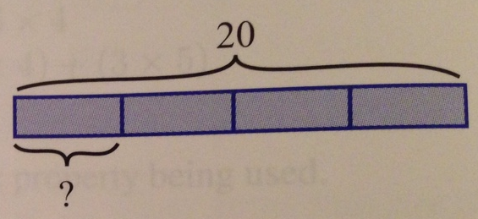
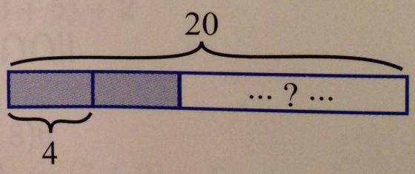
The Number System Fractions ÷ Fraction: Division Basics
There are two models of division:
Partitive:
20 is 4 groups of how many?
Measurement:
How many groups of 4 in 20?
Which model does this problem fit into:
12 is 2/3 of what number?
Notes:
Classic way of introducing division and the models of division begins with this assignment: Write me a word problem that uses the numbers 12 and 3 and requires one to compute 12/3 to get the answer.
Replace the number 3 with ½. Can you write a problem now?
For teachers only: Take the challenge! Write me a word problem where you have to compute 2/3 ÷1/6.
Do we need a common denominator to divide a fraction by a fraction?
Add in practice where for a given problem, participants write two different word problems and show the associated tape diagrams so that one is partitive and one is measurement. Repeat several times if needed by audience.

Slide 86
The Number System Fractions ÷ Fraction: G5-M4-L25
Whole number ÷ unit fraction
Notes:
Ask them which model? Measurement model
Are these right?
“I know how many groups I have and want to know how many are in each group” Partitive?
“I know how many I have in each group, and I want to know how many parts I have” Measurement?

Slide 87
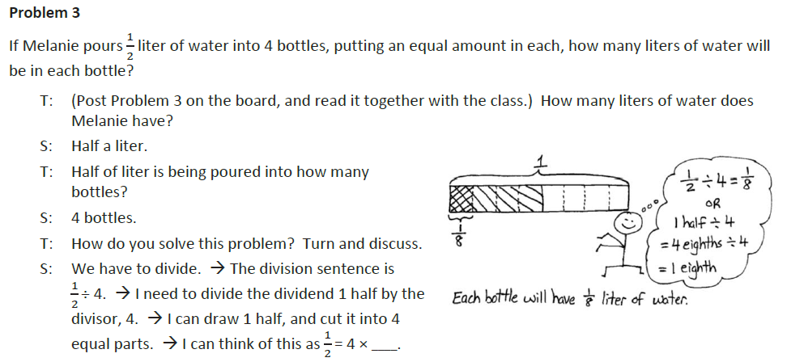
The Number System Fractions ÷ Fraction: G5-M4-L26
Unit fraction ÷ whole number
Notes:
Ask them which model
Partitive model

Slide 88
The Number System A Progression of the Measurement Model
A Progression for students: Use tape diagram to demonstrate the answer to the following:
How many ½’s are in 6?
How many 1/3’s are in 6?
How many 1/3’s are in 1?
How many 1/3’s are in 2/3?
How many 1/3’s are in ½?
How many 5/2’s are in 2/3?
Notes:
Do we need a common denominator to divide a fraction by a fraction?
In order to see how many thirds are in there, it’d be nice to have a common unit.
How many ¾’s are in 7/2?
We want to get to “invert and multiply” to divide fractions. Don’t put it out there first, students need time to develop the division conceptually.

Slide 89
The Number System Fractions ÷ Fraction
H
Grade 6 – Module 2: Lesson 1
Interpreting Division of a Fraction by a Whole Number—Visual Models (Partitive)
Notes:
They have this in the handout.

Slide 90
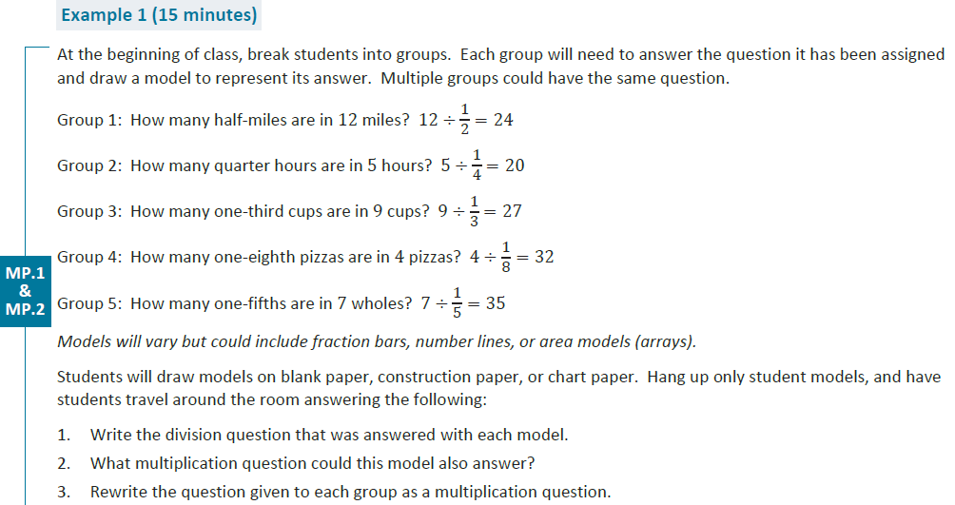
The Number System Fractions ÷ Fraction
H
Grade 6 – Module 2: Lesson 2
Interpreting Division of Whole Number by a Fraction—Visual Models (Measurement)
Notes:
They have this in the handout

Slide 91
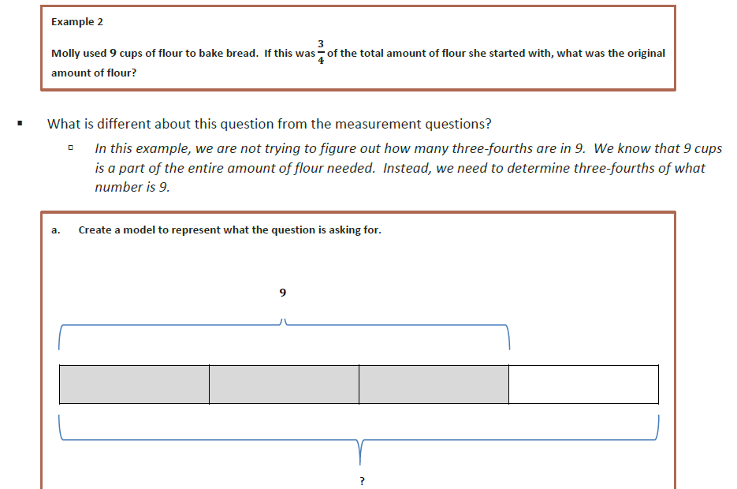
The Number System Fractions ÷ Fraction
Grade 6 – Module 2: Lesson 2
Interpreting Division of Whole Number by a Fraction—Visual Models (Partitive)
Notes:
They have this in the handout

Slide 92
The Number System Fractions ÷ Fraction
H
G6M2: Lesson 3 - Interpreting and Computing Division of a Fraction by a Fraction
Notes:
I think they have this one too…
Write a word problem to provide context for this problem.

Slide 93
The Number System Fractions ÷ Fraction
Notes:
What is this question asking me to find? 2/5 of what number is ¾?
How did we choose which fraction strip to use?
We are dividing by 2/5. There is a 5 in the denominator, which tells us what kind of fraction, so we chose fifths.
How did we know to shade in two sections?
There is a 2 in the numerator. That tells us how many of the fifths to shade.
How did we know to put the 3/4 in the brace that shows 2/5?
That is the part we know.
What about the bottom brace?
That is unknown right now and is ready to be calculated.
Think about this problem like this:
2 units = 3/4.
1 unit is half of 3/4=1/2·3/4=3/8.
5 units =3/8·5=15/8.
So 3/4÷2/5=15/8.
We have the answer to our initial question, but perhaps there is another way to solve the problem. Do you think it is possible to solve this problem without using division?
Extension: Allow time for students to inspect the problem and offer conjectures using the reciprocal of the divisor. Prompt them, if necessary, to consider another operation (multiplication). The following is a series of steps to explain how “invert and multiply” is justified. Switch to document camera and perhaps split screen so the visual can still be referenced:
Using the Any-Order Property, we can say the following:
1/2·3/4·5=3/4·(1/2·5)=3/4·5/2=15/8.
So 3/4÷2/5=15/8 and 3/4·5/2=15/8.
Therefore, 3/4÷2/5=3/4·5/2.
This method for dividing fractions by fractions is called “invert and multiply”. Dividing by a fraction is the same as multiplying by its inverse. It is important to invert the second fraction (the divisor) and not the first fraction (the dividend).

Slide 94
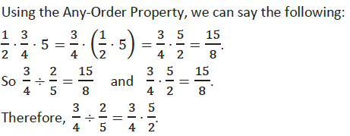
Fraction ÷ Fraction
Invert and Multiply

Slide 95
The Number System Introducing Negative Numbers
Have you ever heard of a negative number? Who can give an example of a when someone would use a negative number?
Example 1: Explain and show how to find the opposite of the number 5 on a number line.

Slide 96
The Number System Introducing Negative Numbers
Example 2:
Write an integer to represent each of the following situations:
A business loses $250,800 in 2012. __________
You receive $15 for babysitting. __________
A fish swims at 49 feet below sea level. __________
The temperature is 4 degrees below zero. __________
Mount McKinley is 20,320 feet in elevation. __________
Example 3:
Describe a situation that can be modeled by the integer -5. Explain what zero represents in the situation.

Slide 97
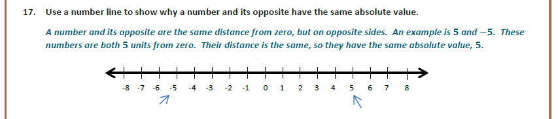
The Number System Magnitude and Absolute Value
G6-M3 Lesson 11
Notes:
A lot of discussion in this module about the use of language,
Lesson on magnitude, even before this slide here.
Stef: Magnitude is revisited in grade 8 with respect to integer powers of 10.

Slide 98
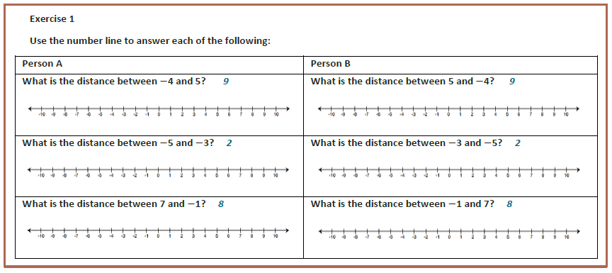
The Number System Distance Between Two Rational Numbers
G7-M2 Lesson 6
Notes:
A lot of discussion in this module about the use of language,
Lesson on magnitude, even before this slide here.

Slide 99
The Number System Adding Using the Number Line Model
Notes:
Beau: the big connection of 6th to 7th, is the number line model,
counting steps, with individual little hops, foreshadowing the idea of a vector without calling it a vector

Slide 100
The Number System Subtracting a Negative is Like Adding

Slide 101
The Number System Operations with Negatives
Why is (5)(-3) negative?
Why is (-5)(3) negative?
Why should a negative x a negative = a positive?
Using properties of operations
-5(0)=0
-5(3+(-3))=0
-5(3)+-5(-3)=0
-15 + ? = 0
-15 + 15 = 0, therefore -5(-3) must be 15.
Notes:
-5(0) = 0
-5(3 + -3) = 0 This still has to equal zero because 3 + -3 = 0
The distributive property tells me that -5(3) + -5(-3) has to equal zero.
-5(3) + -5(-3) =0
-15 + ? = 0 That unknown number must be positive fifteen in order to satisfy the equation.
Commutative property of multiplication, distributive, as well as any number times zero is zero.
Show area model problem. Caveat, area can’t be negative-it’s just a model.
[Beau]: Use the integer game to model this…Multiplying a positive number is repeat addition, and multiplying a negative number is repeat subtraction. Consider the following card hands:
Pick up (+) three card value Effect on the total of card values in your hand
3 x 5 Increase of 15 3 x 5 = 15
3 x (-5) Decrease of 15 3 x (-5) = -15
Lay Down (-) three card value
-3 x 5 Decrease of 15 (-3)x 5 = -15
-3 x (-5) Increase of 15 (-3)x(-5)=15

Slide 102
The Number System Operations with Negatives
Why is (5)(-3) negative?
Why is (-5)(3) negative?
Why should a negative x a negative = a positive?
Using properties of operations
Using extension of the area model
Using the context of the card game
Repeated (5 times) laying down (-) of card whose value is -3; what is the affect on your score?
Notes:
-5(0) = 0
-5(3 + -3) = 0 This still has to equal zero because 3 + -3 = 0
The distributive property tells me that -5(3) + -5(-3) has to equal zero.
-5(3) + -5(-3) =0
-15 + ? = 0 That unknown number must be positive fifteen in order to satisfy the equation.
Commutative property of multiplication, distributive, as well as any number times zero is zero.
Show area model problem. Caveat, area can’t be negative-it’s just a model.
[Beau]: Use the integer game to model this…Multiplying a positive number is repeat addition, and multiplying a negative number is repeat subtraction. Consider the following card hands:
Pick up (+) three card value Effect on the total of card values in your hand
3 x 5 Increase of 15 3 x 5 = 15
3 x (-5) Decrease of 15 3 x (-5) = -15
Lay Down (-) three card value
-3 x 5 Decrease of 15 (-3)x 5 = -15
-3 x (-5) Increase of 15 (-3)x(-5)=15

Slide 103
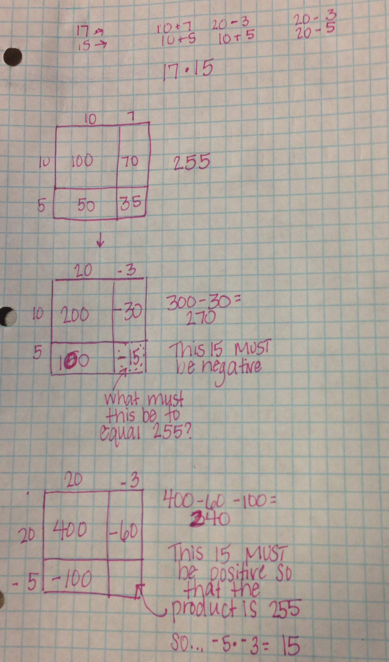
Notes:
Jill’s area model examples
[Beau]: We make a point in module 3 lesson 4 of not using rectangular arrays for negative numbers because it makes no sense mathematically…should consider this if we choose to use area models to show negative integer products.

Slide 104
Agenda
Ratios & Proportional Relationships
Geometry
The Number System
Expressions and Equations
Linear Equations and Linear Functions
Notes:
Ratios & Proportional Relationships (70 min) 9:50-11:00 BREAK
The Number System (40 min) 11:10-11:50
Expressions and Equations (90 min) 11:15-12 then LUNCH then 1-1:45
Geometry (90 min) 2:15-3:45 then Q&A
Linear Equations and Functions (20 min) 1:45-2:05 then BREAK
TIME ALLOTTED FOR THIS SLIDE:
2 minutes
MATERIALS NEEDED:
x

Slide 105
Expressions and Equations
The what, the why, and the how of it all
Categories of student capacities
A progression of each capacity

Slide 106
Expressions and Equations What is an expression?
An expression expresses something – using more concise and more powerful representations than words.
How can I express the total cost if I know that it costs a flat fee of $5 plus 4 cents for every page?
Numerical expressions have only numbers, no variables for which the value hasn’t been stated.
Algebraic expression suggests that there is at least one variable.
Notes:
TIME ALLOTTED FOR THIS SLIDE:
15 minutes(118)
MATERIALS NEEDED:

Slide 107
Expressions and Equations What is a variable?
How do we define / describe what a variable is?
A variable is a letter standing for a number (the EE progression)
A variable is a placeholder for a number (Eureka math curriculum)
When we describe what our variable represents
it must be a number of something or the amount of something or the unit rate in a rate.
Notes:
We do not say that a variable varies.
TIME ALLOTTED FOR THIS SLIDE:
15 minutes(118)
MATERIALS NEEDED:

Slide 108
Expressions and Equations Why use variables?
The same reason we humans have studied math for centuries…
… to make generalizations and answer questions and curiosities!
Notes:
Trigonometry (originally called circleometry) – curiosity about the positioning of the stars
TIME ALLOTTED FOR THIS SLIDE:
15 minutes(118)
MATERIALS NEEDED:

Slide 109
Expressions and Equations What we do with expressions
The big picture:
Create an algebraic expression, thereby decontextualizing it, and treating it as an object in its own right
Make full use of the properties of numbers, (that they’ve come to understand in K-5) to manipulate that expression in USEFUL ways
Re-contextualize it to answer the original questions or curiosities
Notes:
TIME ALLOTTED FOR THIS SLIDE:
15 minutes(118)
MATERIALS NEEDED:

Slide 110
Expressions and Equations From expressions to equations
Often, it is USEFUL to make a statement of equality about two expressions.
A number sentence is a statement of equality between two numerical expressions.
It is said to be true if both numerical expressions are equivalent (that is, both evaluate to the same number). It is said to be false otherwise.
Notes:
Students recall from early grades that, a number sentence is a statement of equality between two numerical expressions. One can say with certainty that a number sentence is either true or false.
TIME ALLOTTED FOR THIS SLIDE:
5 minutes(160)
MATERIALS NEEDED:
1 copy for facilitator of lesson 4 pp. xx to xx.

Slide 111
Expressions and Equations From expressions to equations
An algebraic equation is a statement of equality between two expressions.
Algebraic equations can be number sentences (when both expressions are numerical), but often they contain symbols whose values have not been named.
Notes:
It is grade 8 when students examine all the possible solutions to algebraic equations.
TIME ALLOTTED FOR THIS SLIDE:
5 minutes(160)
MATERIALS NEEDED:
1 copy for facilitator of lesson 4 pp. xx to xx.

Slide 112
Expressions and Equations Categories of Student Capacities
Replace numbers in numerical expressions and number sentences with variables to express generalizations.
Write algebraic expressions to represent a verbal expression,
appropriately describing the number that the variable(s) represents.
Notes:
Let’s remove these slides where we list out these capacities and go directly
Progression of properties of equality…
Students recall from early grades that, a number sentence is a statement of equality between two numerical expressions. One can say with certainty that a number sentence is either true or false.
(Click to advance animation.)
Find the handout at the end of your package of slides. Titled Lesson 10 Exercise 2 and complete as many as you can within the next 2-3 minutes. (Allow 2-3 minutes).
TIME ALLOTTED FOR THIS SLIDE:
5 minutes(160)
MATERIALS NEEDED:
1 copy for facilitator of lesson 4 pp. xx to xx.

Slide 113
Expressions and Equations Equivalent Expressions
How do we define / describe what it means for two algebraic expressions to be equivalent?
Grades 6 and 7:
Replacing the variable(s) with a number computes to the same number for both expressions no matter which number we choose.
Grade 8:
Using the commutative, associative, and distributive properties, one expression can be converted to the other expression.
Notes:
Take a minute now and answer the following for yourself:
What does it mean for two algebraic expressions to be algebraically equivalent?
Give your best effort at a textbook definition for algebraically equivalent expressions.
Revisiting the definition of algebraic equivalence:
Two algebraic expressions are equivalent if we can convert one expression into the other by repeatedly applying the Commutative, Associative, and Distributive properties and the properties of rational exponents to components of the first expression.
TIME ALLOTTED FOR THIS SLIDE:
15 minutes(118)
MATERIALS NEEDED:

Slide 114
Expressions and Equations An analogy to solving equations:
Julie is 300 feet away from her friend’s front porch and observes, “Someone is sitting on the porch.”
Given that she didn’t specify otherwise, we would assume that the ‘someone’ Julie thinks she sees is a human.
We can’t guarantee that Julie’s observatory statement is true. It could be that Julie’s friend has something on the porch that merely looks like a human from far away.
Julie assumes she is correct, and moves closer to see if she can figure out who it is. As she nears the porch she declares, “Ah, it is our friend, John Berry.”
Notes:
Continuing with our analogy between English sentences and equations. Let’s consider a scenario that mimics our use of equations.
Julie is 300 feet away from her friend’s front porch and observes, “Someone is sitting on the porch.”
What in this sentence is similar to a variable that we use in a mathematical equation? (Someone.)
(Click to advance animation.)
Given that she didn’t specify otherwise, we would assume that the ‘someone’ Julie thinks she sees is a human.
This assumption is very similar to our often unstated but important assumption that the variable in our equation is representing a real number.
(Click to advance animation.)
We can’t guarantee that Julie’s observatory statement is true. It could be that Julie’s friend has something on the porch that merely looks like a human from far away.
Recall the standard A-REI.1 that says, “starting with the assumption that the original equation has a solution.”
(Click to advance animation.)
Julie assumes she is correct, and moves closer to see if she can figure out who it is. As she nears the porch she declares, “Ah, it is our friend, John Berry.”
(Click to advance animation.)
What do we use equations for in the real world? We have some information that we suspect or know to be true about the relationship between quantities, and we are not sure what measure of a given quantity will make it true. We write out the equation, and then we “get closer” and closer until we can reveal the value or measure that makes the equation true, or find that our “someone” does not exist. Perhaps it was a halloween gag – a scarecrow of sorts, perhaps there is no value that can make it true.
TIME ALLOTTED FOR THIS SLIDE:
5 minutes(160)
MATERIALS NEEDED:
1 copy for facilitator of lesson 4 pp. xx to xx.

Slide 115
Equations and Expressions A Progression of Each Capacity
H
Read through the page in the handout to learn about the progression through grades 6-8 of equations and expressions.
Next, we will take a closer look at lessons in each grade.
Notes:
TIME ALLOTTED FOR THIS SLIDE:
5 minutes(160)
MATERIALS NEEDED:
1 copy for facilitator of lesson 4 pp. xx to xx.

Slide 116
Equations and Expressions A Progression of Each Capacity
H
In Grade 6, students work with concrete numbers and symbols to relate addition and subtraction.
Work through Grade 6, Module 4, Lesson 1
Work through Grade 6, Module 4, Lesson 9
In Grade 8, students are expected to know how to write equations using symbols. Note the increased rigor.
Work through Grade 8, Module 4, Lesson 1
Notes:
TIME ALLOTTED FOR THIS SLIDE:
5 minutes(160)
MATERIALS NEEDED:
1 copy for facilitator of lesson 4 pp. xx to xx.

Slide 117
Equations and Expressions A Progression of Each Capacity
H
In Grade 6, students continue work with writing expressions that contains numbers and variables.
Work through Grade 6, Module 4, Lesson 10
In Grades 6-7, students generate equivalent expressions and verify equivalence by evaluating expressions.
Work through Grade 6, Module 4, Lesson 20
Work through Grade 7, Module 3, Lesson 1
Notes:
TIME ALLOTTED FOR THIS SLIDE:
5 minutes(160)
MATERIALS NEEDED:
1 copy for facilitator of lesson 4 pp. xx to xx.

Slide 118
Equations and Expressions A Progression of Each Capacity
H
Replace numbers in numerical expressions and number sentences with variables to express generalizations.
G6-M4 Lessons 1-4, 8
Notes:
TIME ALLOTTED FOR THIS SLIDE:
5 minutes(160)
MATERIALS NEEDED:
1 copy for facilitator of lesson 4 pp. xx to xx.

Slide 119
Equations and Expressions A Progression of Each Capacity
H
Write algebraic expressions to represent a verbal expression (or statement of equality or inequality) (and vice versa),
appropriately describing the number that the variable(s) represents.
G6-M4 Lessons 9-10, 13-22, 34
G7-M2 Lessons 18 and19
G8-M4 Lesson 1
Notes:
Compare how expressions and equations begin in grade 6 and then continue with the work in grade 8.
TIME ALLOTTED FOR THIS SLIDE:
5 minutes(160)
MATERIALS NEEDED:
1 copy for facilitator of lesson 4 pp. xx to xx.

Slide 120
Equations and Expressions A Progression of Each Capacity
H
Manipulate expressions using the properties of numbers and properties of operations
Be certain about whether two expressions are algebraically equivalent
Develop an intuition about what manipulations might be useful in a given situation
G6-M4 Lessons 5-6, 9-12
G7-M3 Lessons 1-6
G8: we make use of equivalent expressions to explain how to use the substitution method for solving a linear system. When two expressions are equal to the same number, then the expressions are equal to one other.
Notes:
Work through the examples/exercises in the lesson excerpt.
In grade 8, we make use of equivalent expressions to explain how to use the substitution method for solving a linear system. When two expressions are equal to the same number, then the expressions are equal to one another. EX: If {6+8x=y and 3x-4=y then 6+8x=3x-4.
TIME ALLOTTED FOR THIS SLIDE:
5 minutes(160)
MATERIALS NEEDED:
1 copy for facilitator of lesson 4 pp. xx to xx.

Slide 121
Equations and Expressions A Progression of Each Capacity
Evaluate an expression by replacing the variable(s) with a single number.
G6-M4 Lessons 7, 18-22
G7-M3 Lessons 16-26
Notes:
TIME ALLOTTED FOR THIS SLIDE:
5 minutes(160)
MATERIALS NEEDED:
1 copy for facilitator of lesson 4 pp. xx to xx.

Slide 122
Equations and Expressions A Progression of Each Capacity
Solving equations (or inequalities), that is, finding the value(s) of a variable that creates a true number sentence, given a statement of equality between two expressions.
Using the properties of operations and numbers on either expression, and
Using the properties of equality
G6-M4 Lessons 23-34
G7-M3 Lessons 7-15, some of 16-26
G8-M4 Lessons 3-8, 10-14, 24-31
Notes:
Should most of what is written below be deleted?
Continuing with our analogy between English sentences and equations. Let’s consider a scenario that mimics our use of equations.
Julie is 300 feet away from her friend’s front porch and observes, “Someone is sitting on the porch.”
What in this sentence is similar to a variable that we use in a mathematical equation? (Someone.)
(Click to advance animation.)
Given that she didn’t specify otherwise, we would assume that the ‘someone’ Julie thinks she sees is a human.
This assumption is very similar to our often unstated but important assumption that the variable in our equation is representing a real number.
(Click to advance animation.)
We can’t guarantee that Julie’s observatory statement is true. It could be that Julie’s friend has something on the porch that merely looks like a human from far away.
Recall the standard A-REI.1 that says, “starting with the assumption that the original equation has a solution.”
(Click to advance animation.)
Julie assumes she is correct, and moves closer to see if she can figure out who it is. As she nears the porch she declares, “Ah, it is our friend, John Berry.”
(Click to advance animation.)
Do not delete this part.
What do we use equations for in the real world? We have some information that we suspect or know to be true about the relationship between quantities, and we are not sure what measure of a given quantity will make it true. We write out the equation, and then we “get closer” and closer until we can reveal the value or measure that makes the equation true, or find that our “someone” does not exist. Perhaps it was a Halloween gag – a scarecrow of sorts, perhaps there is no value that can make it true.
TIME ALLOTTED FOR THIS SLIDE:
5 minutes(160)
MATERIALS NEEDED:
1 copy for facilitator of lesson 4 pp. xx to xx.

Slide 123
Expressions and Equations A Progression of Each Capacity Solving Equations – Grade 6
H
Use tape diagrams paired with algebraic solutions that makes use of the properties developed in G6-M4 Topic A such as a + b – b = a.
Check it by substituting into both equations:
Work through:
G6-M4 Lesson 26 Exercise 1
G6-M4 Lesson 27 Exercise 3, 17-19
G6-M4 Lesson 30 Exercise 3-5
Notes:
TIME ALLOTTED FOR THIS SLIDE:
5 minutes(170)
MATERIALS NEEDED:
Module overview

Slide 124
Expressions and Equations A Progression of Each Capacity Solving Equations – Grade 7
H
Includes rational numbers
Includes using the commutative and associative and distributive properties; promotes efficiency in understanding that they lead to an ‘any order, any grouping’ consequence for addition and multiplication.
Introduces the properties of equality and inequality, and refers to them as ‘if-then’ moves. If then If then .
Read through:
G7-M3 Lesson 7 Example 1 and Exercise
G7-M3 Lesson 9 Example 1 and Problem Set 6
G7-M3 Lesson 10 Exercise 1, Example 2
Notes:
TIME ALLOTTED FOR THIS SLIDE:
5 minutes(170)
MATERIALS NEEDED:
Module overview

Slide 125
Expressions and Equations A Progression of Each Capacity Solving Equations – Grade 8
H
Includes using the distributive property to expand and to combine like terms.
Asks students to generalize when a linear equation in 1 variable will have one solution, infinite solutions or no solutions.
Emphasizes there are multiple ways to solve.
Emphasizes that answers aren’t always integers.
Work through:
G8-M4 Lesson 4 Exercises 1-5
G8-M4 Lesson 5 Examples 1-2
G8-M4 Lesson 28 Examples 1-2
Notes:
Stef: Show an example of how the distributive property is used to “combine like terms.” This is new to most teachers. EX: 4x+9x=(4+9)x=13x.
[Beau]: Agreed…EE Progressions says “Collecting like terms …should be seen as an application of the distributive law, not as a separate method.” pg 6 There is a nice progression of combining like terms in G7M3 Lesson 1.
Erika – As well as in grade 6. This is where I referred to in my email: making the progression of how students use the distributive property in all three grade levels. From tape diagrams to area model to GCF to…. 7th and 8th representations/methods. We also use the phrase “collect like terms”
TIME ALLOTTED FOR THIS SLIDE:
5 minutes(170)
MATERIALS NEEDED:
Module overview

Slide 126
Expressions and Equations Solving Equations
In Grades 6-8: Find which value makes the equation true, recognize that there are some equations that are always true: identities and equations in one variable that simplify down to the identity a = a.
In Grade 9:
The solution set is the set of all values that make the equation or inequality true.
Applying the properties of equality is guaranteed to preserve the solution set.
Applying the Distributive, Associative, and Commutative Properties or the properties of rational exponents to either side is guaranteed to preserve the solution set.
Notes:
So, in summary we have learned that applying the properties of Equality is guaranteed to preserve the solution set. And that applying the Distributive, Associative, and Commutative Properties or the properties of rational exponents to either side is also guaranteed to preserve the solution set.
Let’s take a look at what else we can do to equations.
Stef: In grade 8 students learn that a transformed equation of the form a = b has no solutions, a=a has infinitely many solutions and x=a has one solution.
Erika – Students in grade 6 also use solution sets to determine which values make equations and inequalities true.
TIME ALLOTTED FOR THIS SLIDE:
5 minutes(170)
MATERIALS NEEDED:
Module overview

Slide 127
Expressions and Equations An Example from Grade 9
Consider the equation x – 3 = 5.
Multiply both sides of the equation by a constant and show that the solution set did not change.
Now, multiply both sides by x.
x(x – 3) = 5x
Show that x = 8 is still a solution to the new equation.
Show that x = 0 is also a solution to the new equation.
Why did my solution set get altered? What did I do?
Notes:
(Walk participants through the exercise, click once to advance the first animation and continue through the exercise, then click again to advance the last animation and ask.) Why did my solution set get altered? Did I do something that wasn’t guaranteed to preserve my solution set?
(When multiplying through by x, we don’t know that x is not zero.)
TIME ALLOTTED FOR THIS SLIDE:
5 minutes(170)
MATERIALS NEEDED:
Module overview

Slide 128
Expressions and Equations The Graph of an Equation in 2 Variables
Grade 6-7:
Plot points of proportional relationships.
The graph itself is only a ray (or a line) if the context of the situation suggests that all the points along the ray (or line) are possible.
Grade 8:
All the possible solutions to the equation.
Notes:
Erika – Just a reminder that we very informally speak to discrete data and continuous data in grade 6 which will explain why most graphing opportunities do not call for the use of a ray to connect the points.

Slide 129
Expressions and Equations The Graph of an Equation in 2 Variables
Grade 6:
Students associate ratios with ordered pairs and plot the collected data as points on the coordinate plane.
Students represent discrete data as points on a graph (not a line or ray).
Students represent continuous data as points on a graph that can be connected by a line or ray.
Students are not expected to know the terms collected data, discrete or continuous.
Notes:
Erika – Just a reminder that we very informally speak to discrete data and continuous data in grade 6 which will explain why most graphing opportunities do not call for the use of a ray to connect the points.

Slide 130
Expressions and Equations The Graph of an Equation in 2 Variables
H
Grade 8:
Students graph equations in two variables with and without context.
The context, when given, dictates whether to connect the points or not.
Students are expected to know the terms discrete rate and continuous rate.
Allusions are made to domain and range, but students are not expected to know these terms.
Read: G8 M5 L2 Excerpt
Notes:
Erika – Just a reminder that we very informally speak to discrete data and continuous data in grade 6 which will explain why most graphing opportunities do not call for the use of a ray to connect the points.

Slide 131
Agenda
Ratios & Proportional Relationships
Geometry
The Number System
Expressions and Equations
Linear Equations and Functions
Notes:
Discuss how the material is coherently linked making a choice of sequencing difficult.
Ratios & Proportional Relationships (70 min) 9:50-11:00 BREAK
The Number System (40 min) 11:10-11:50
Expressions and Equations (90 min) 11:15-12 then LUNCH then 1-1:45
Functions (20 min) 1:45-2:05 then BREAK
Geometry (90 min) 2:15-3:45 then Q&A
TIME ALLOTTED FOR THIS SLIDE:
2 minutes
MATERIALS NEEDED:
x

Slide 132
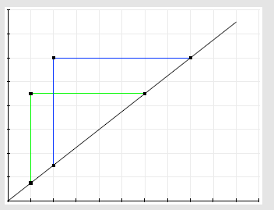
Linear Equations and Functions Slope of a Line
Choose any 2 pairs of points on the line. Use the points to create right triangles.
The AA criterion say these triangles are similar.
Thus, the proportion of the vertical leg to the horizontal leg is the same for each triangle.
Thus for any two points on a non-vertical line the ratio the vertical distance: horizontal distance between the two points is equal.

Slide 133
Linear Equations and Functions
Deriving the equation of a line
The ‘why’ and ‘what’ of functions?
Linear functions and rate of change
Solving systems of linear equations
Notes:
TIME ALLOTTED FOR THIS SLIDE:
2 minutes
MATERIALS NEEDED:
x

Slide 134
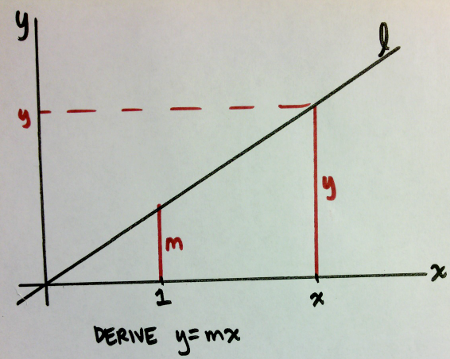
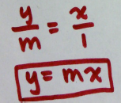
Linear Equations and Functions Deriving the Equation for a Line
For a line going through the origin:
Notes:
Deriving the equation is based on students understanding that slope, m, is equal to the unit rate of a proportional relationship and their knowledge of similar figures having corresponding side lengths that are equal in ratio.

Slide 135
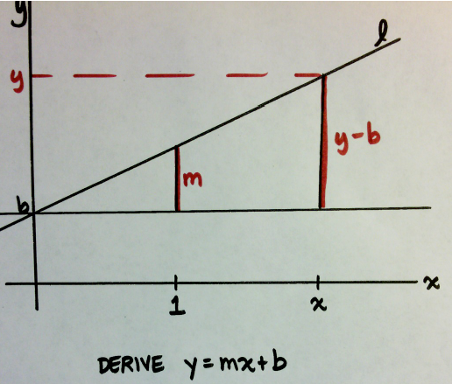
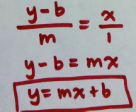
Linear Equations and Functions Deriving the Equation for a Line
For a line passing through point b on the y-axis:
Notes:
The only difference between this equation and the last one is that the line has been translated b units along the y-axis. Therefore the derivation of the equation y = mx+b, is just like y=mx except that we have to account for the corresponding side lengths being translated b units as well.

Slide 136
Linear Equations and Functions Why study functions?
H
Functions allow us to
make predictions,
classify the data in our environment.
G8-M5 Lesson 1 Examples 1 & 2
Notes:
Participants read through examples. Elicit their ideas on what the main points of the examples are, ultimately discerning that not everything in the world is linear, therefore we need to create functions to make predictions about the world around us.
TIME ALLOTTED FOR THIS SLIDE:
2 minutes
MATERIALS NEEDED:
x

Slide 137
Linear Equations and Functions What is a function?
H
Grade 8: A function is a rule that assigns to each input exactly one output.
Grade 9: A function is a correspondence between two sets, X and Y, in which each element of X is matched to one and only one element of Y. The set X is called the domain; the set Y is called the range.
The graph of a function is the set of ordered pairs consisting of an input and the corresponding output.
Notes:
Note that transformations of the plane were functions with planes as inputs and planes as outputs.
TIME ALLOTTED FOR THIS SLIDE:
2 minutes
MATERIALS NEEDED:
x

Slide 138
Linear Equations and Functions Building on Concepts from EE
H
An expression in 1 variable defines a general calculation in which the variable can represent / can be replaced with a single number (chosen from a set of acceptable inputs).
It’s useful to relate a function to an input-output machine with a variable representing the input, and an expression representing the output.
Review G8 M5 L2 Problem Set

Slide 139
Linear Equations and Functions Building on Concepts from EE
H
If we then choose a different variable to represent the output, we have an equation in two variables.
Plotting points gives a visual representation of the relationship between the two variables.
Work through:
G8 M5 L5 Exercise 4

Slide 140
Linear Equations and Functions Linear functions and rate of change
H
Grade 8 Module 4 defines slope as a number that describes “steepness” or “slant” of a line. It is the constant rate of change.
Review G8 M5 Lesson 7 Exercise 4
Notes:
In the handout there is an example from Lesson 7, Module 5, Exercise 4 where the students are given a graph and an input/output table, and they have to compare the function that are represented in these two ways. They are comparing the features of the representations which is very similar to a lesson in Grade 6. The main difference between the two is in grade 8, students are focusing on the y-intercept and rate of change.
TIME ALLOTTED FOR THIS SLIDE:
2 minutes
MATERIALS NEEDED:
x

Slide 141
Linear Equations and Functions Linear functions and rate of change
H
G8-M7 Lesson 22 introduces the concept of average rate of change.
Grade 9 Module 3 defines average rate of change:
Given a function whose domain includes the interval and whose range is real numbers, the average rate of change on the interval is
Notes:
The definition in grade 9 for average rate is just like average rate in grade 8: distance traveled over a specific time interval divided by the time interval.
TIME ALLOTTED FOR THIS SLIDE:
2 minutes
MATERIALS NEEDED:
x

Slide 142
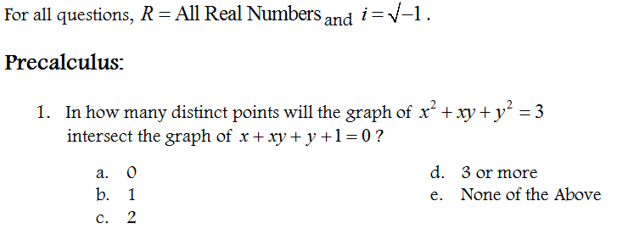
Linear Equations and Functions – Systems of Equations Solving Systems of Equations
Consider the following question:
Notes:
Start by doing a simple example! Lesson EXCERT here

Slide 143
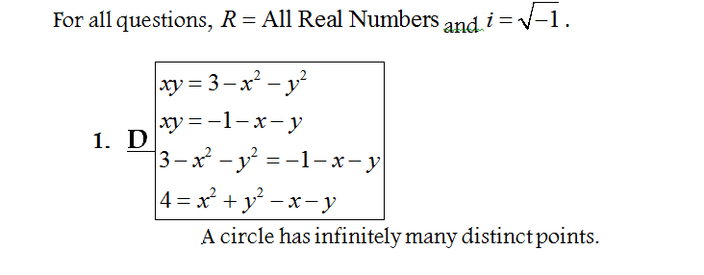
Linear Equations and Functions – Systems of Equations Solving Systems of Equations
Here is the solution according to the answer key for the test:

Slide 144
Linear Equations and Functions – Systems of Equations Solving Systems of Equations
A-REI.5
Prove that, given a system of two equations in two variables, replacing one equation by the sum of that equation and a multiple of the other produces a system with the same solutions.

Slide 145
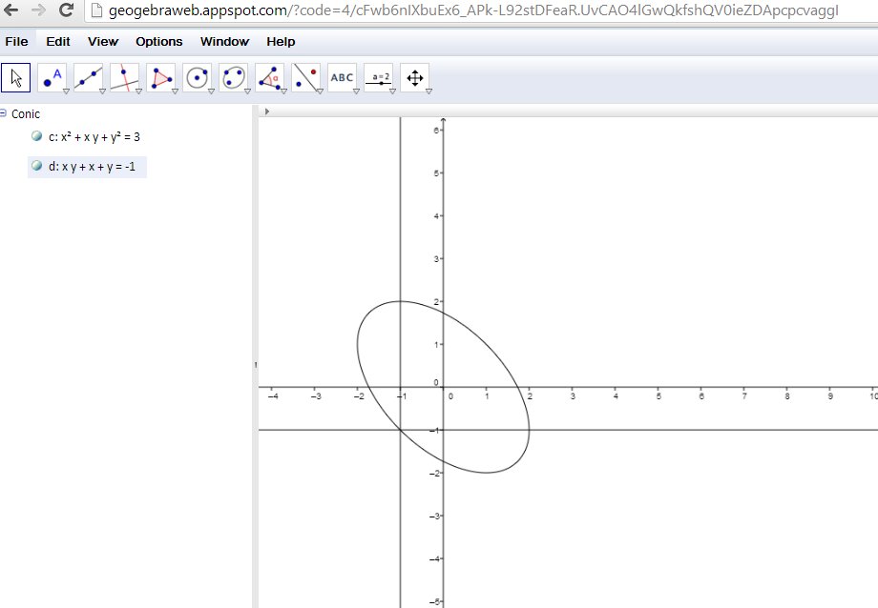
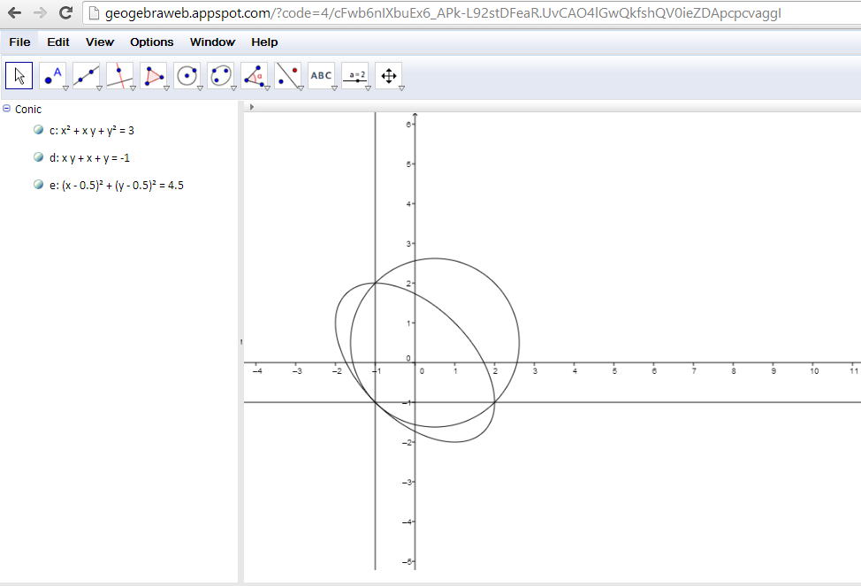
Linear Equations and Functions – Systems of Equations Solving Systems of Equations
Here is a graph of the two equations:

Slide 146
Linear Equations and Functions – Systems of Equations Correcting the Misconception
Sketch the graph of each equation in the following system:
$$\left\{\begin{aligned}3x −y=−6 \\ x+2y=5\end{aligned}\right.$$
Replace one equation with the sum of the first equation and the second equation and the sketch a graph the two equations.

Slide 147
Linear Equations and Functions – Systems of Equations Correcting the Misconception
Addressed in G8-M4 re: 8.EE.8
“The graph of the new equation will also pass through (or contain) the intersection point (the solution point).
Suppose the new equation is $x = 3$. The graph of that equation passes through the solution point, therefore the solution point must have an $x$-coordinate of $3$.”

Slide 148
Key Points
The progression of ratios from Grades 6 – 8: ratio relationship, ratio, value of a ratio, unit rate of A:B, unit rate of B:A (associated ratios), constant of proportionality, scale factor, similarity, and slope.
The progression of the number system from Grades 6 – 8: division of fractions, long division including division of decimals, integers, operations with integers, irrational numbers.
The progression of expressions and equations from Grades 6 – 8: the concrete representation in the form of diagrams and graphs to the abstract with variables using properties of operations and properties of equality.

