Slide 1
A Story of Units
  Fluency
  Kindergarten to Grade 5
Notes:
TIME ALLOTTED FOR THIS SLIDE: 5 minutes
MATERIALS NEEDED:
Session PowerPoint
This full-day session is intended to support a school-wide implementation of a systematic fluency program. This session highlights the progression and coherence of the key types of fluency activities that you’ll find woven across A Story of Units.
Welcome participants and introduce presentation team.
Fist to Five:
- How familiar are you with A Story of Units?
Poll the participants:
Are you using the lessons on a daily basis? Or to supplement your instruction?
Are you a Kindergarten classroom teacher? 1st grade? 2nd? 3rd? 4th? 5th? Beyond 5th grade?
Are you a math coach? Coordinator? Resource teacher?
Are you a school-level administrator? District-level administrator?

Slide 2
A Story of Units
  Fluency
  Kindergarten to Grade 5
Notes:
Video list for session: These videos are inserted through the presentation. Depending on the amount of time you do or don’t have, use them for analysis of teaching practice, both strengths and weaknesses.
To watch the video, click on the video symbol on the slide, which is a URL hot button.
Scott Baldridge, PhD: Sprints - Fluency in Action
http://www.engageny.org/resource/nti-november-2012-rigor-breakdown-sprints-fluency-in-action
Kindergarten: Finger Counting http://www.engageny.org/resource/nti-november-2012-rigor-breakdown-counting-exercises-for-k-1
2nd Grade: Counting with Bundles http://www.engageny.org/resource/nti-november-2012-rigor-breakdown-counting-with-bundles
2nd Grade: Happy Counting by 2’s
http://commoncore.org/maps/math/video-gallery/happy-counting
2nd Grade: 10-Frame Flash http://www.engageny.org/resource/nti-november-2012-rigor-breakdown-ten-rame-flash
3rd Grade: Counting Sixes
https://www.youtube.com/watch?v=wSVlWDK8dVE&feature=youtu.be
5th Grade: Addition Fractions to make 1 Whole (part 1); Happy Counting by Fractions (part 2)
http://www.engageny.org/resource/common-core-video-series-fraction-fluency-in-grade-5
5th Grade: Skip Counting by Fractions
http://www.engageny.org/resource/nti-november-2012-rigor-breakdown-skip-counting-by-fractions

Slide 3
Focus on Fluency
Session Objectives:
Study, analyze, and practice Sprints, counting exercises, and other specific fluency activities.
Analyze fluency sequences and practice adjusting them to meet varied students’ needs.
Recognize and appreciate the coherence of K-5 fluency.
Understand fluency as a component of rigor, as defined by the Instructional Shifts.
Notes:
2 Minutes
Introduce the objectives quickly so as to move right into taking the Sprint.
TIME ALLOTTED FOR THIS SLIDE: 2 minutes

Slide 4
Sprint: Take the Challenge!!
Grade 5 Sprint
Write the Missing Factor
You try!
Notes:
The total time on Sprints is about 1 hour 30 minutes.
(If doing a full day session, you might include the writing of a Sprint towards the end of the session AFTER lunch.)
10 minutes
Delivery of a Sprint on Finding the Missing Factor from Grade 5, Module 3, Lesson 1.
Take Sprint A.
Correct Sprint A.
Recognize most correct answers.
Allow 60 seconds for participants to do more problems on Sprint A.
Repeat answers for Sprint A.
Fast counting activity (e.g. jumping jacks while skip counting twos).
Slow counting activity (e.g. arm circles while skip counting sixes).
Take Sprint B.
Correct Sprint B.
Recognize most correct answers.
Recognize most improved.
TIME ALLOTTED FOR THIS SLIDE: 10 minutes
MATERIALS NEEDED:
Grade 5, Module 3, Lesson 1 Sprint A and Sprint B

Slide 5
Sprint Directions
Read the Directions for Administration of Sprints
Located in the overview of first module of every grade,1st through 5th
Notes:
10 minutes
Participants read through the Directions for Administration of Sprints and discuss the details with a partner.
Questions inevitably ensue. Take time for the Q and A.
TIME ALLOTTED FOR THIS SLIDE: 10 minutes
MATERIALS NEEDED:
Sprint administration directions

Slide 6
What is the architecture of a Grade 2 through Grade 5 Sprint?
4 quadrants:
1st: Very easy 1-11 (every student
feels successful)
2nd: Easy 12-22
3rd: Moderate 23-33
4th: Challenge 34-44 (strongest student
couldn’t finish)
Notes:
27 minutes (6 minute video included of Scott’s session)
5 Minutes: Quadrant Analysis.
Have participants draw a vertical and horizontal line to show the 4 quadrants and analyze how the complexity increases from quadrant to quadrant
16 minutes: Have participants
3 minutes: Analyze the Sprint: circle where there is a new complexity being introduced between each problem.
5 minutes: Share their analysis: share their analysis within a triad.
5 minutes: Plan collaboratively the addition of at least 2 replacement problems, one which would make the sequence easier, and one which would make the sequence more challenging.
3 minutes: Whole group share out of observations and sequences.
6 minutes
Scott Baldridge, PhD: Sprints - Fluency in Action
http://www.engageny.org/resource/nti-november-2012-rigor-breakdown-sprints-fluency-in-action
TIME ALLOTTED FOR THIS SLIDE: 27 minutes
MATERIALS NEEDED:
G5 Missing Factor Sprint

Slide 7
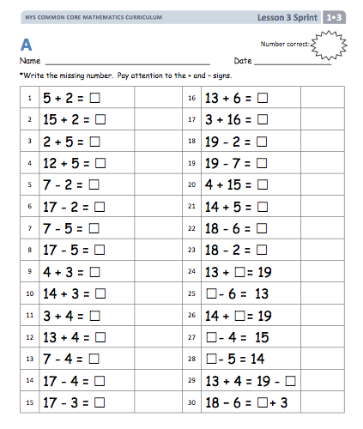
Analyze the sequence of this
Grade 1 Sprint.
Notes:
10 Minutes
Have participants locate the G1 Sprint in their handout.
3 minutes: Analyze the sprint. Circle where there is a new complexity being introduced between each problem.
4 minutes: Share their analysis. Share their analysis within a triad.
3 minutes: Whole group share out of observations and sequences.
Presenter Notes:
Scaffolding of “10+ facts” for many problems (5+2 and 15+2).
“10+ Facts” scaffolding ends at Problem 16 where the order is reversed.
Complexity increases at Problem 24 with addend unknown.
Problem 29 and 30 use “true number sentences” – 2 expressions with an equal sign.
TIME ALLOTTED FOR THIS SLIDE: 10 minutes
MATERIALS NEEDED:
G1 Sprint Handout

Slide 8
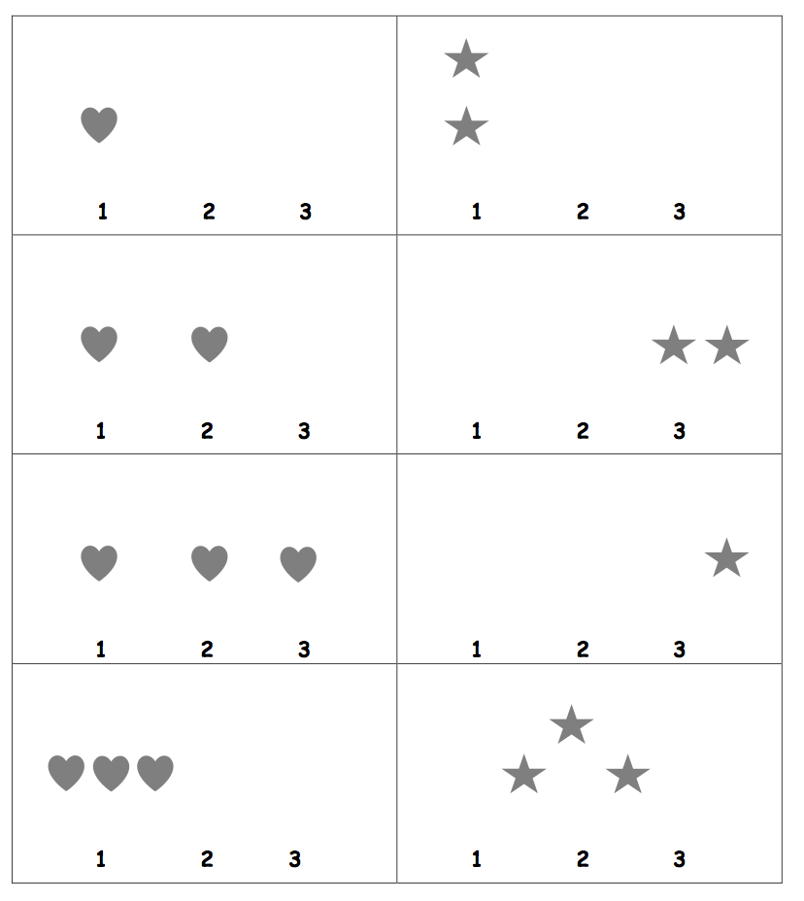
Analyze the sequence of this Kindergarten Sprint.
Notes:
3 minutes
(Note: This Sprint is not included within participant’s handouts.)
Have participants:
Analyze the sprint’s sequence and notice new complexities.
Have the participants discuss them and then share out whole group.
Presenter notes:
Kindergarten students count the number of shapes and circle the number.
Correspondence of shape to number in the first 3 problems.
Problem 4 increases difficultly without the 1-to-1 correspondence.
Different configurations (linear-vertical and horizontal, scattered, no number correspondence) increases challenge in the right column.
TIME ALLOTTED FOR THIS SLIDE: 3 minutes

Slide 9
What is the teaching sequence of the Sprint routine in Kindergarten?
Kindergarten Module 3
Lesson 16: Starting and stopping at a signal, while writing numbers 1-10.
Lesson 19: Starting and stopping at a signal, 10-1.
Lesson 20: Watching their teacher take a Sprint. Students talk about their observations.
Lesson 21: Take the first half of a Sprint
Lesson 25: Repeat the first half of the Sprint twice.
Lessons 28 and 31: Do a complete Sprint!
Notes:
5 minutes
Sprints are used throughout A Story of Units K-5 and beyond. They are first introduced in Kindergarten Module 3 Lesson 16.
Hearts and stars to show the students to do the columns first, do all the hearts first then the stars.
In Lesson 16, students practice starting and stopping at the signal, while writing numbers quickly.
In Lesson 19, a slight layer of complexity is added. Students repeat the same activity, but now, counting down, challenging them to remain alert to their teacher’s signal while concentrating more heavily on an academic task.
In Lesson 20 not only do they observe the teacher, or other students taking a Sprint, but more importantly they engage, reflect, and have a dialogue about the process before they do it themselves.
In Lesson 21, students take only one Sprint, the same Sprint they observed just the day before. The focus is on the successful completion of a very complicated procedure, and putting forth a strong effort. Note that 2 different shapes are used in each column, as a scaffold that assists students in working down, instead of across, the 2 columns.
In Lesson 25, the concept of “beating your score” is introduced. Continue to emphasize improvement over completion, by reminding students that they are racing against themselves.
In Lessons 28 and 31, new Sprints are delivered. The content is still very familiar, although slightly more difficult than before. Scaffolds remain in place in Lesson 28 to ensure that students complete problems in the intended sequence, down the columns, rather than across, but are then removed by Lesson 31. As always, problems move from simple to complex, and the pattern drives students closer to the finish line.
With the right classroom culture, and careful attention to social and emotional needs Kindergarten students will grow to love Sprints and look forward to seeing themselves making progress.
Presenter Notes:
Use a similar structure for introducing Sprints to other grade level students who need additional scaffolding before being introduced to Sprints.
TIME ALLOTTED FOR THIS SLIDE: 5 minutes

Slide 10
Troubleshooting in Kindergarten
If motor skills haven’t caught up to cognitive ability…
    Have the student use a highlighter to swipe the answer
If the student is working across the columns, instead of down…
    Try covering one column at a time
If a student is slow to get started…
    Check pencil position.
    Pencils ready before beginning!
Notes:
3 minutes
If motor skills haven’t caught up to cognitive ability…
try having the student use a highlighter to “swipe” the correct answer, rather than write it.
If the student is still working across the columns, instead of down…
try making a green stripe along the left side, and a red stripe down the right to lead the eye down the columns.
If a student is slow to get started…
check to see that they are holding the pencil “ready to write”, that is, in the writing grip position, not by the eraser, or in the middle.
Fumbling to orient the pencil when the signal is given leads to valuable seconds lost!
Presenter Notes:
Similar ideas may be adapted to.
TIME ALLOTTED FOR THIS SLIDE: 3 minutes

Slide 11
All Grades: Differentiation Techniques
Provide students with the Sprint the night before
Use Sprints as morning work, classwork, or homework
Create differentiated Sprints
Create Sprints to address student needs
Notes:
6 minutes
Provide students with the Sprint the night before
For lower-performing students, casually hand students the Sprint without any stipulation. They don’t have to complete it, hand it in, nor will it be graded. It is just if the student wants to review it. Chances are a student may be encouraged to practice the counting skill on their own, prior to class, to feel more successful during the Fluency activity.
Use Sprints as morning work, classwork, or homework
Sprints should be administered directly before a Concept Development to keep the brain focused on math.
But Sprints can be handed out casually as extra facts practice, not using the administration directions.
But Sprints should never be used as a grade, no matter in which they are delivered.
Create differentiated Sprints
Use a selected Sprint (e.g. multiplying by tens) and create another Sprint with the same answers but with a different skill (e.g. 10+ facts). So if Problem 4 is 2x10, the differentiated Sprint could be 10+10.
Create Sprints to address student needs
If a Sprint addressing a specific skill can’t be located in Eureka Math, create your own using the blank Sprint handout provided.
Allow for more Q and A
TIME ALLOTTED FOR THIS SLIDE: 6 minutes

Slide 12
What are Sprint essentials?
  Intelligent design of the sequence
  A fast pace within a consistent routine
    An adrenaline rich experience, like that of sports.
    Students’ motivation to do personal best
  Recognition of improvement, success
  Varied topics previously taught
Notes:
5 minutes
Dr. Yorham Sagher, inventor of the Sprints, designed Sprints to promote automaticity by engaging students in practice that gets their adrenaline flowing. Adrenaline produces long term memory (research sited above. Suggest participants to Google the research). Automaticity is critical so that students avoid using up too many of their attention resources with lower-level skills when they are addressing higher-level problems. The automaticity prepares students with the computational foundation to enable deep understanding in flexible ways.
Now let’s review the basics of Sprint design. Sprints have two parts. The problems on Sprint A should be almost identical to the problems on Sprint B without actually being identical. Sprint B should be neither harder nor easier than Sprint A.
Students are given 60 seconds for each Sprint: 60 seconds for Sprint A and 60 seconds for Sprint B. Your goal in writing the Sprint is that every student should get at least 25% correct, and ideally, no student will finish within the 60 seconds. A typical 4th or 5th grade Sprint has about 44 problems. Younger students need fewer problems.
You don’t want students skipping around while working a Sprint in hopes of finding the easiest problems to work – that only slows them down and takes their concentration off doing the problems and on finding easy ones. Therefore, problems on the Sprint should start easy and get progressively more complex, perhaps in quadrants. For example, the first 11 should be the simplest form, a complexity is added to the next 11, then an additional complexity is added to the next 11, and finally the last 11 problems are the most complex.
Problems should be designed with a pattern or rhythm in mind that encourages students to “Look for and express regularity in repeated reasoning.” This is MP.8.
The following links provide further information on Adrenaline and Memory Research:
http://www.meetingsupport.org/node/715
http://en.wikipedia.org/wiki/Memory_improvement#Rehabilitation_research_findings
TIME ALLOTTED FOR THIS SLIDE: 5 minutes

Slide 13
A Story of Units: Happy Counting!
SOU is unified by the big idea of the unit. In fluency activities, we count different units and by different units. For example: frogs, bananas, ones, tens, centimeters, meters, kilograms, grams, fourths, eighths, hundredths… and mixed units of tens and ones, meters and centimeters, hours and minutes, ones and thirds.
We rename or compose units as we count up, and rename or decompose units as we count down.
Notes:
Read the slide and discuss the importance of the unit. Remind participants to analyze the use of the unit during these counting activities.
Demonstrate Happy Counting with a K-5 sequence:
Establish your Happy Counting signals with participants before continuing (up, down, stop, think).
Kindergarten: By ones (e.g. 1, 2, 3, 2, 3, 2, 3, 4, 5, 4, 5, 6, 5, 4, 5, 6, 7, 8, 9, 10)
Grade 1: By tens (e.g. 0, 10, 20, 10, 20, 30, 40, 50, 40, 30, 40, 50, 40, 30, 20, 10, 0)
Video: 2nd Grade: Happy Counting by 2’s (1 min 21 sec)http://commoncore.org/maps/math/video-gallery/happy-counting
Grade 3: Group Counting by 3s (See example sequence below for scaffolding up to Happy Counting.)
Count by 1s: slapping legs/clapping hands (1-slap, 2-slap, 3-clap, 4-slap, 5-slap, 6-clap, etc.)
Whisper count by 1s, slapping legs and whispering on 1s and 2s and clapping hands speaking on threes (1-slap/whisper, 2-slap/whisper, 3-clap/speak, 4-slap/whisper, 5-slap/whisper, 6-clap/speak, etc.)
Think count by 1s. Repeat as above but only speak on the threes. Keep slapping legs and clapping hands.
Happy Count by 3s.
Grade 4: Unit Counting (See an example sequence below.)
50cm, 100cm, 150 cm, 200cm, 250cm, 300m, 250cm, 200cm, 150cm, 100cm, 50cm.
50 cm, 1 m, 150 cm, 2 m, 250 cm, 3 m, 250 cm, 2 m, 150 cm, 1 m, 50 cm.
50 cm, 1 m, 1 m 50 cm, 2 m, 2 m 50 cm, 3 m, 2 m 50 cm, 2 m, 1 m 50 cm, 1 m, 50 cm.
Grade 5: Count by Fractions (See an example sequence below.)
1 half, 2 halves, 3 halves, 4 halves, 5 halves, 6 halves, 5 halves, 4 halves, 3 halves, 2 halves, 1 half
1 half, 1, 3 halves, 2, 5 halves, 3, 5 halves, 2, 3 halves, 1, 1 half
1 half, 1, 1 and 1 half, 2, 2½ , 3, 2½ , 2, 1½ , 1, ½
Finish by having participants practice and role play Happy Counting by twos. It is very important to decide how to signal counting up and counting down.
Circulate and check their methods.
Have 1-2 participants demonstrate for the group.
TIME ALLOTTED FOR ALL COUNTING: 1 Hour 45 minutes (slides 13-22)
TIME ALLOTTED FOR THIS SLIDE:
15 Minutes
MATERIALS NEEDED:
Video of Bill Happy Counting in Grade 2 (See link below)

Slide 14
Kindergarten Counting Exercises
Rekenrek Roller Coaster
Finger Counting
Rekenrek Say Ten Counting
Pop Up
Green Light, Red Light*
Notes:
Students need to be fluent and automatic with counting strategies to be able to contend with higher level addition and subtraction problem types.
Select from the activities below that will highlight some of the major counting activities included in Kindergarten for the 10 minute segment.
Rekenrek Roller Coaster (1 min)
Materials: (T) 20 Rekenrek
Direct the students to gradually raise their hands as the numbers increase, and lower their hands as the numbers decrease, mimicking the motion of a wave. Refer to the Rekenrek fluency activity in Lesson 4 for a recommended sequence.
AND/OR Watch from 4 min 53 sec to 6 min 15 seconds of 7 min videohttp://www.engageny.org/resource/nti-november-2012-rigor-breakdown-counting-exercises-for-k-1
Finger Counting the Math Way (5 min)
Engage participants in stating the number of fingers shown, using fingers the Math way, counting up and down to 10. Use gloves if desired. Mention article on “Chinese Perspective on Addition and Subtraction.”
AND/OR Watch from 0 min to 1 min 25 seconds of 7 min videohttp://www.engageny.org/resource/nti-november-2012-rigor-breakdown-counting-exercises-for-k-1
Rekenrek Say Ten Counting
Materials: (T) Rekenrek
T: (Slide over all the beads in the top row.) How many do you see?
S: 10.
T: (Slide 1 bead from the second row.) That’s what ten 1 looks like on the Rekenrek. How many do you see?
S: Ten 1.
T: (Slide another bead from the second row.) How many do you see?
S: Ten 2.
Continue with the following suggested sequence: ten 1, ten 2, ten 1, ten 2, ten 3, ten 2, ten 3, ten 4, etc.
Pop Up Number (2 min)
T: Come sit in a circle on the rug. We’re going to play Pop Up Number! The Pop Up Number is 3. What number?
S: 3.
T: We’ll count around the circle to 5. If you say the Pop Up Number, you have to….
S: Pop up (Stand up.)!
T: Let’s begin. 1.
S: 2. → 3. (Stands up.) → 4. → 5.
The next student begins again at 1. Continue until some or all students are standing. For a variation, try counting down from 5.
Green Light, Red Light (*Sequence on Handout) (2 min)
Draw a green dot with a 1 underneath and a red dot with a 3 underneath on the board. Explain to students that they will start counting and stop counting on the number as indicated by the color code.
T: Look at your numbers (pointing to the number 1 written below the green dot, and 3 below the red dot), think, ready… green light!
S: 1, 2, 3.
T: Very good! (Erase numbers 1 and 3, and write the new numbers.) New numbers (green is 1, red is 5). Look, think, ready… green light!
S: 1, 2, 3, 4, 5.
A recommended sequence to follow these problems: (2, 3); (2, 3, 4); (3, 4); (3, 4, 5); (3, 2, 1); (5, 4, 3, 2, 1); (5, 4); (5, 4, 3); (4, 3); (4, 3, 2). LOOK AT HANDOUT FOR SEQUENCE
TIME ALLOTTED FOR THIS SLIDE: 10 minutes
MATERIALS NEEDED:
Rekenrek
Green Light, Red Light prepared sequence for document camera
Video of Melanie counting (see links below)

Slide 15
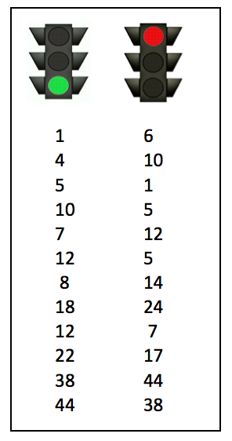
Grade 1 Counting Exercises
Green Light, Red Light*
Say Ten Push Ups
Coin Drop
Beep Counting*
Notes:
Select from the activities below that will highlight some of the major counting activities included in Grade 1 for the 12 minute segment. Include Red Light, Green Light and Beep Counting.
*Sequence Analysis of Red Light/Green Light: Counting by Ones (4 minutes)
Sequence Analysis Directions: Use the sequence on the “Counting Exercises with Sequence Analysis” handout. Have participants analyze both GK and G1 sequences and have them create a sequence for G2,3,4, or 5 as indicated on the handout.
Say Ten Push-Ups
T: We are going to do Say Ten Push-Ups. First, let’s get ready to push up by counting to 10 the Math Way.
S: 1, 2, 3, 4, 5, 6, 7, 8, 9, 10. (Students should start counting with 1 on the left pinky and continue to 10 on the right pinky.)
T: Great! Now that we have 10, we can continue counting with ten (push out both hands as if doing a push-up exercise in the air, then pause with closed fists close to body), 1 (push out the left hand, pinky finger). Repeat please.
S: Ten (push out both hands as if doing a push-up exercise in the air, then pause with closed fists close to body), 1 (push out the left hand, pinky finger).
T: Keep going with me. Ten (repeating push-up), 2 (push out the left hand pinky and ring finger).
Continue to 20 (2 ten or 10 and 10).
AND/OR Watch from 1 min 25 sec to 2 min 15 sec of 7 min video
http://www.engageny.org/resource/nti-november-2012-rigor-breakdown-counting-exercises-for-k-1
Coin Drop
Materials: (T) 4 dimes, 10 pennies
T: (Hold up a penny.) Name my coin.
S: A penny.
T: How much is it worth?
S: 1 cent.
T: Listen carefully as I drop coins in my can. Count along in your minds.
Drop in some pennies and ask how much money is in the can. Take out some pennies and show them. Ask how much money is still in the can. Continue adding and subtracting pennies for a minute or so. Then repeat the activity with dimes.
Beep Counting (*Sequence on Handout)
Note: This activity reviews counting and reading numbers to 120.
Write number sequences on the board with missing numbers. Students read the sequence aloud, saying “beep” for the missing number. Then, students say the missing number on your signal. Sequence on handout.
TIME ALLOTTED FOR THIS SLIDE:
12 minutes
MATERIALS NEEDED:
Coins and can (provided by presenter)
Sequence Analysis Set A: Green Light, Red Light handout
Sequence Analysis Set B: Beep Counting handout
Say Ten Push-Ups Video (see link below)

Slide 16
Grade 2 Counting Exercises
Beep counting*
Say Ten to the Next Ten
Skip-Count by Tens Up and Down Crossing 100
Counting with Bundles: 1s, 10s, 100s
Counting on a clock*
Notes:
Select from the activities below that will highlight some of the major counting activities included in Grade 2 for the 12 minute segment. Include Beep Counting and Minute Counting.
Sequence Analysis of Beep Counting*
Sequence Analysis Directions: Use the sequence on the “Counting Exercises with Sequence Analysis” handout. Then have participants analyze both G1 and G2 sequences and have them create a sequence for G2,3,4, or 5 as indicated on the handout. NOTE: This Fluency activity is not part of the G2 curriculum.
Say Ten to the Next Ten
(Optional: Use Rekenrek to model.)
T: I say 7 and you say 3. I say 16 and you say 4.
T: 8.
S: 2
T: 2 tens 8.
S: 2.
T: Tell me the addition sentence.
S: Two tens 8 + 2 = 3 tens.
T: 3 tens 2
S: 8.
T: Tell me the addition sentence.
S: 3 tens 2 + 8 = 4 tens.
Continue with examples through 100, sequencing to larger numbers of tens.
Skip-Count by Tens Up and Down Crossing 100 (2 minutes)
T: Let’s count by tens, starting at 60. Ready? (Teacher rhythmically points up until a change is desired. Show a closed hand then point down. Continue, mixing it up.)
S: 60, 70, 80, 90, 100, 110, 120, 130, 140 (switch). 130, 120, 110, 100, 90 (switch). 100, 110, 120, 130, 140, 150, 160, 170, 180, 190, 200, 210, 220 (switch). 210, 200, 190, 180, (switch), etc.
Counting with Bundles: 1s, 10s, 100s (4 minutes)
Materials: (T) Bundle of one hundred, 1 ten, and a single straw from Lesson 1
T: Let’s play a game using what we know about counting by ones, tens, and hundreds. I’ll hold bundles to show you what to count by. A bundle of 100 means count by hundreds, a bundle of 10 means count by tens, and a single straw means count by ones. (Create visual support by writing the numbers on the board as students count.)
T: Let’s start at 0. Ready? (Hold up a bundle of 10 until students count to 130.)
S: 10, 20, 30, 40, 50, 60, 70, 80, 90, 100, 110, 120, 130.
T: (Hold up a bundle of 100 until students count to 630.)
S: 230, 330, 430, 530, 630.
T: (Hold up a bundle of 10 until students count to 690.)
S: 640, 650, 660, 670, 680, 690.
T: (Hold up a single one until students count to 702.)
S: 691, 692, 693, 694, 695, 696, 697, 698, 699, 700, 701, 702.
T: (Isolate the numbers 698–702 by drawing a box around them.) Partner A, count these numbers up and down as fast as you can to Partner B. Then switch. If you both finish before one minute is up, try it again and see if you get faster!
AND/OR Watch from 5 min 15 sec Video
http://www.engageny.org/resource/nti-november-2012-rigor-breakdown-counting-with-bundles
Minute Counting* (This activity is analyzed with Grade 3’s clock counting activity.)
T: There are 60 minutes in 1 hour. Count by 5 minutes to 1 hour.
S: 5 minutes, 10 minutes, 15 minutes, 20 minutes, 25 minutes, 30 minutes, 35 minutes, 40 minutes, 45 minutes, 50 minutes, 55 minutes, 60 minutes. (Underneath 60 minutes, write 1 hour.)
T: How many minutes are in a half-hour?
S: 30 minutes.
T: Count by 5 minutes to 1 hour. This time, say half-hour when you get to 30 minutes.
Repeat the process using the following suggested sequences:
Count by 10 minutes to 1 hour.
TIME ALLOTTED FOR THIS SLIDE:
12 minutes
MATERIALS NEEDED:
Sequence Analysis Set B: Beep Counting handout
(Optional: Rekenrek)
Bundles of straws or craft sticks (1, 10 and 100)
Optional: Video of Lisa Counting With Bundles (see link below)
Clock

Slide 17
Grade 3 Counting Exercises
Skip Counting by Halves and Fourths on the Clock*
Group Counting/ Skip Counting
Gram Counting
Counting by Unit Fractions*
Notes:
Select from the activities below that will highlight some of the major counting activities included in Grade 3 for the 10 minute segment. Include Clock Counting and Counting by Unit Fractions.
Sequence Analysis: Clock Counting (1 min)
Rather than having a sequence to analyze, participants realize clock counting is sequenced by the standards that can be addressed using the clock.
Grade 2:
Counting by 5 minutes and by fives.
Grade 3:
Unwrap the circumference of the clock to make a number line on which we count by fives.
Counting in unit form leading to multiplication: 1 five, 2 fives, leads to 1 x 5, 2 x 5 etc.
Counting in fractional units: quarters, halves, and units of 1 hour.
Lead the participants in the fraction activities on the clock as indicated below:
Skip-Count by Halves on the Clock* (2 min)
T: (Hold or project a clock.) Let’s skip-count by halves on the clock starting with 1.
S: 1 o’clock, half past 1, 2, half past 2, 3, half past 3, 4, (Switch direction.) half past 3, 3, half past 2, 2, half past 1, 1.
Continue counting up and down.
Skip-Counting by Fourths on the Clock* (2 min)
T: (Hold or project a clock.) Let’s skip-count by fourths on the clock starting with 1.
S: 1, 1:15, 1:30, 1:45, 2, 2:15, 2:30, 2:45, 3.
Continue with possible sequences:
1, 1:15, half past 1, 1:45, 2, 2:15, half past 2, 2:45, 3.
1, quarter past 1, half past 1, quarter ‘til 2, 2, quarter past 2, half past 2, quarter ‘til 3, 3.
Video: Group Counting/Skip Counting https://www.youtube.com/watch?v=wSVlWDK8dVE&feature=youtu.be (2 min)
This is done in almost EVERY lesson in Modules 1,2, and 3. Students count up and down in order by 2-10 to the factor’s multiple of 10. They begin the year with 2s, 3s, etc. in order and graduate to the higher 7,8, and 9 counts. This leads and bridges to fluency with addition as they cross the ten and with multiplication facts. The teacher might change the pace to be faster, too.
Gram Counting (1 min)
T: There are 1,000 grams in 1 kilogram. Count by 100 grams to 1 kilogram.
S: 100 grams, 200 grams, 300 grams, 400 grams, 500 grams, 600 grams, 700 grams, 800 grams, 900 grams, 1 kilogram.
Counting by Unit Fractions* (2 min)
T: (Project a number line.) Count by halves from 1 half to 6 halves and back to 0.
S: 1/2, 2/2, 3/2, 4/2, 5/2, 6/2, 5/2, 4/2, 3/2, 2/2, 1/2, 0.
Continue with possible sequence for: thirds, fifths, and fourths.
TIME ALLOTTED FOR THIS SLIDE:
10 minutes
MATERIALS NEEDED:
Clock
Prepared Number line for Counting by Unit Fractions

Slide 18
Grade 4 Counting Exercises
Unit Skip Counting
Fraction Multiplication
Counting and Renaming Centimeters
Counting and Renaming Measurement Units (grams, liters, meters, minutes, etc.)
Count by Equivalent Fractions*
Notes:
Select from the activities below that will highlight some of the major counting activities included in Grade 4 for the 10 minute segment. Include Count by Equivalent Fractions.
Unit Skip-Counting (2 min)
T: Count by twos.
S: 2, 4, 6, 8, 10, 12, 14, 16, 18, 20.
T: Now count by 2 tens. Stop counting and raise your hand when you see me raise my hand.
S: 2 tens, 4 tens, 6 tens. (Raise hand.)
T: Say the number in standard form.
S: 60.
Continue stopping the students at 12 tens, 16 tens, and 20 tens.
Repeat the process for threes and three ten thousands.
Fraction Multiplication (3 min)
(Draw a tape diagram with 5 units. Give each unit a value of 4 by writing the value inside the tape.)
T: What is the value of the whole tape?
S: Twenty!
T: Let’s count the fours in unit form.
S: (Write each below the units as the students count.) 1 four, 2 fours, 3 fours, 4 fours, 5 fours.
T: Let’s restate our count in unit form as multiplication sentences starting with the number of fours.
S: (Write the number sentences below each unit as they 1 x 4 = 4, 2 x 4 = 8 etc.
(Draw a tape diagram exactly the same as the first one with 5 units to the right of the one labeled with the fours. Give each unit a value of 1 fifth by writing the value inside the tape.)
T: What is the value of the whole tape?
S: One!
T: Let’s count the fifths in unit form.
S: (Write each below the units as the students count.) 1 fifth, 2 fifths, 3 fifths, etc.
T: Let’s restate our count in unit form as multiplication sentences starting with the number of fifths.
S: (Write the number sentences below as the students 1 x 1/5 = 1/5, 2 x 1/5 = 2/5 etc).
Continue by drawing another tape diagram with or have students analyze the correlation of the fours and the fifths.
Counting and Renaming Centimeters (2 min)
Note: This fluency was demonstrated during the K-5 counting sequence on Slide 13.
Direct students to count by 50 cm in the following sequence, letting them know with gestures when to change direction in counting:
50 cm, 100 cm, 150 cm, 200 cm, 250 cm, 300 cm, 250 cm, 200 cm, 150 cm, 100 cm, 50 cm.
50 cm, 1 m, 150 cm, 2 m, 250 cm, 3 m, 250 cm, 2 m, 150 cm, 1 m, 50 cm.
50 cm, 1 m, 1 m 50 cm, 2 m, 2 m 50 cm, 3 m, 2 m 50 cm, 2 m, 1 m 50 cm, 1 m, 50 cm.
TIME ALLOTTED FOR THIS SLIDE: 10 minutes
MATERIALS
Prepared Tape diagram for Fraction Multiplication
Personal White Board (presenter only)

Slide 19
Grade 4 Counting Exercises
Notes:
Measurement Unit Counting (3 min)
Note: This fluency will deepen student understanding of the composition and decomposition of units, laying a foundation for adding and subtracting grams and kilograms. Numbers are bolded to show change in direction of counting.
Direct students to count by grams in the following sequence:
Count by 500 grams:
500 g, 1,000 g, 1,500 g, 2,000 g, 2,500 g, 3,000 g, 2,500 g, 2,000 g, 1,500 g, 1,000 g, 500 g
500 g, 1 kg, 1,500 g, 2 kg, 2,500 g, 3 kg, 2,500 g, 2 kg, 1,500 g, 1 kg, 500 g
500 g, 1 kg, 1 kg 500 g, 2 kg, 2 kg 500 g, 3 kg, 2 kg 500 g, 2 kg, 1 kg 500 g, 1 kg, 500 g
Count by 600 grams:
600 g, 1,200 g, 1,800 g, 2,400 g, 3 kg, 2,400 g, 1,800 g, 1,200 g, 600 g.
600 g, 1 kg 200 g, 1 kg 800 g, 2 kg 400 g, 3 kg, 2 kg 400 g, 1 kg 800 g, 1 kg 200 g, 600 g.
Count by Equivalent Fractions (2 min)
Materials: (T) Personal white board
T: Count by ones to 6.
S: 1, 2, 3, 4, 5, 6.
T: Count by sixths to 6 sixths. Start at 0 sixths. (Write as students count.)
S: 0/6 1/6 2/6 3/6 4/6 5/6 6/6.
T: 6 sixths is the same as one of what unit?
S: 1 one.
T: (Beneath 6/6 , write 1.) Count by sixths again. This time, say “1” when you arrive at 6 sixths. Start at zero.
S: 1/6, 2/6, 3/6, 4/6, 5/6, 1.
T: Let’s count by thirds to 6 thirds. Start at 0 thirds. (Write as students count.)
S: 0/3, 1/3, 2/3, 3/3, 4/3, 5/3, 6/3.
T: How many thirds are in 1?
S: 3 thirds.
T: (Beneath 3/3 , write 1.) How many thirds are in 2?
S: 6 thirds.
T: (Beneath 6/3, write 2.) Let’s count by thirds again. This time, when you arrive at 3 thirds and 6 thirds, say the whole number. Start at zero.
S: 0/3, 1/3, 2/3, 1, 4/3, 5/3, 2.
Repeat the process, counting by halves to 6 halves.
HIDDEN SLIDE

Slide 20
Grade 5 Counting Exercises
Measurement Unit Counting in Decimal Form
Decimal Counting
Skip count by 12’s, 12 tens
Happy Counting with Mixed Numbers
Notes:
Select activities below that highlight some of the major counting activities included in Grade 5 for the 10 minute segment. Include Happy Counting w/ Mixed Numbers.
Measurement Unit Counting in Decimal Form
Materials: (S) Personal white board
T: What fraction of a kilogram is 1 gram?
S: 1 thousandth.
T: Express 1 thousandth as a fraction of a kilogram in decimal form on your personal boards.
S: (Show 0.001 kg)
T: What fraction of a kilogram is 500 grams. Express your answer in thousandths.
S: 500 thousandths.
T: Express 500 grams as a fraction of a kilogram in decimal form on your personal boards.
S: (Show 0.500 kg or 0.5 kg)
T: On your board, count by 0.5 kilograms as high as you can in 30 seconds. Remember to notate the unit.
S: (Write 0.500 kg, 1 kg, 1.500 kg, 2 kg, 2.500 kg, 3 kg, 3.500 kg,4 kg, 4.500 kg, 5 kg etc.. Students may certainly express 500 thousandths as 5 tenths.)
Repeat the process counting by 200 grams, 400 grams, etc.
Repeat the process with milliliters and liters, meters and kilometers.
Count by Decimals
Materials: (S) Personal white board
Note: This fluency activity prepares students for G5–M6–Lesson 6.
T: Count by twos to twenty, starting at zero.
S: 0, 2, 4, 6, 8, 10, 12, 14, 16, 18, 20.
T: Count by 2 tenths to 20 tenths, starting at zero.
S: 0 tenths, 2 tenths, 4 tenths, 6 tenths, 8 tenths, 10 tenths, 12 tenths, 14 tenths, 16 tenths, 18 tenths, 20 tenths.
T: (Write 10 tenths = 1 __.) Write the number sentence.
S: (Write 10 tenths = 1 one.)
T: (Write 20 tenths = __ ones.)
S: (Write 20 tenths = 2 ones.)
T: Starting at zero, count by 2 tenths again. This time, when you come to a whole number, say the whole number.
S: 0 tenths, 2 tenths, 4 tenths, 6 tenths, 8 tenths, 1, 12 tenths, 14 tenths, 16 tenths, 18 tenths, 2.
T: (Write 0.2 = _/_)
S: (Write 0.2 = 2/10)
T: Count from zero tenths to 2 again. When I raise my hand, stop.
S: 0 tenths, 2 tenths, 4 tenths, 6 tenths.
T: (Raise hand.) Write 6 tenths as a decimal.
S: (Write 0.6.)
T: Continue.
S: 8 tenths, 1, 12 tenths, 14 tenths, 16 tenths.
Continue up to and down from 2 ones, stopping to have students write various numbers in decimal form.
OR VIDEO 5th Grade: Addition Fractions to make 1 Whole (part 1); Happy Counting by Fractions (part 2) (Show 2 min 40 sec to 4 min)
http://www.engageny.org/resource/common-core-video-series-fraction-fluency-in-grade-5
Skip Count by 12’s
Step 1: Distributive property. Partition the room into halves. Half the student add 10, half add 2. Have all students clap on the multiples of 12 (e.g. 10, 12, 22, 24, 34, 36, 46, 48 etc.) Try it with other numbers.
Step 2: Skip count by 12s (emphasize 60, 108, 132 and 144… they’re always the hardest)
Step 3: Skip count by 12 tens or 12 hundreds (stop periodically to have participants say the number in standard form)
5th Grade: Skip Counting by Fractions (3 min 15 sec)
http://www.engageny.org/resource/nti-november-2012-rigor-breakdown-skip-counting-by-fractions
Happy Counting with Mixed Numbers
T: Let’s count by 1/2 with mixed numbers. Ready? (Teacher rhythmically points up until a change is desired. Show a closed hand, then point down. Continue, mixing it up).
S: 1/2, 1, 1 1/2, 2 (stop), 1 1/2, 1, 1/2, 0 (stop), 1/2, 1, 1 1/2, 2, 2 1/2, 3, 3 1/2, 4 (stop), 3 1/2, 3, 2 1/2, 2, 1 1/2, 1 (stop), 1 1/2, 2, 2 1/2, 3, 3 1/2, 4, 4 1/2, 5.
T: Excellent. Try it for 30 seconds with your partner. Partner A, you are the teacher today.
Count by Fractions*
Follow the sequence on the “Counting Exercises with Sequence Analysis” sheet.
TIME ALLOTTED FOR THIS SLIDE: 10 minutes
Materials:
Personal white boards
Set C: Equivalent Counting Grade 5: Count by Fractions (for Happy Counting with Mixed Numbers)

Slide 21
Sequence Analysis of Equivalent Counting
Grade 3: Equivalent with Units of Four
Grade 4: Count by Equivalent Fractions
Grade 5: Count by Fractions
Notes:
7 minutes: Participant analysis
5 minutes: Debrief questions with participants
Sequence Analysis of Equivalent Counting
Sequence Analysis Directions: Use the sequences on the “Counting Exercises with Sequence Analysis” handout. Have participants analyze the G3, G4 and G5 sequences and create a sequence using measurement units or base ten units on the following page in the handout.
Debrief:
What is happening to the units as we count up?
What is the benefit of sequencing these from unit form to numerical form?
What is the benefit of moving back and forth between forms in a single count?
What is the benefit of the coherence of the equivalent counting in G3 – G5?
TIME ALLOTTED FOR THIS SLIDE: 12 minutes
MATERIALS
Sequence Analysis Set C: Equivalent Counting handout

Slide 22
Let’s Practice!
Confirm signals.
Study counting exercises in grades K-5. Look for coherence and study the sequences.
Role play with a partner when the sequence must be adjusted because:
  a) The student makes an error.
  b) The sequence needs more challenge.
You try!
Notes:
15 minutes
Take time at each of these. Call time when to move forward.
1 minutes: Collaboratively confirm signals. Check their signal and correct “sleepy signals” on the spot. Call attention to how hard it is for students to follow a signal that is not crisp and rhythmic.
5 minutes: Read through the counting exercises. Have participants use a highlighter or star to signal each time a unit is being renamed, either decomposed or composed. Have them study for coherence.
9 minutes: Role play with a partner where the student makes an error so that the sequence must be adjusted.
TIME ALLOTTED FOR THIS SLIDE: 15 minutes
MATERIALS NEEDED:
K-5 Counting Handout

Slide 23
Categories of Fluency
    Maintenance: Staying sharp on previously learned skills
    Preparation: Targeted practice for the current lesson
    Anticipation: Building skills to prepare students for the in-depth work of future lessons
In fluency work, all students are actively engaged with familiar content. This provides a daily opportunity for continuous improvement and individual success.
Notes:
4 minutes
Fluency activities serve a variety of purposes. In general, there are three main categories of fluency work:
Maintenance: Staying sharp on previously learned skills
Preparation: Targeted practice for the current lesson
Anticipation: Building foundational skills to prepare students for the in-depth work of future lessons
It is important to recognize that fluency work is always an extension of familiar content. It provides a daily opportunity for continuous improvement and individual success toward acquiring speed and accuracy.
Never new material, always something previously taught.
Fluencies are a bank of activities, change as needed for your class
Purposeful selection, not random
Careful planning to prepare students for what they will see in future lessons.
In our earlier fluencies, we were counting units. In each of these exercises, consider what the units are and what is happening to them.
TIME ALLOTTED FOR THIS SLIDE: 4 minutes
MATERIALS NEEDED:

Slide 24
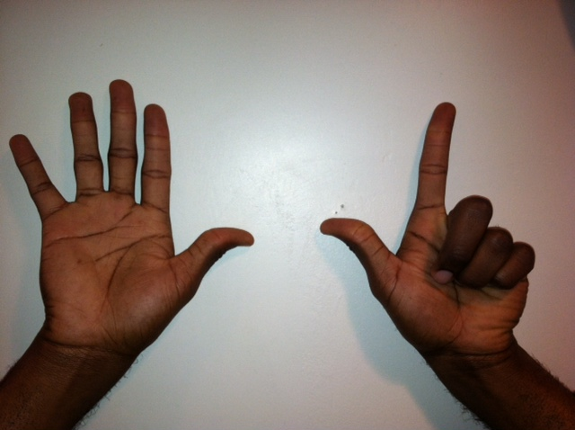
K-2: Three Essential Skills
Sums and Differences within Ten
Target Practice
Take out 1s, 2s, etc.
Ten Plus Facts
Say Ten counting
Partners to Ten
Ten and Tuck
Math Fingers Flash
Ten Frame Flash
Notes:
Sums and Differences within Ten
Target Practice: 8 and 9 (8 minutes)
Materials: (S) 9 counters and a die
Note: This activity addresses the core fluency objective for Grade 1.
Break students into partners. Give each set of partners 8 counters. Instruct them to take turns as the Roller and the Target Finder. The Roller rolls the dice. The Target Finder determines the partner to 8. Students may use counters as needed. First, play with 8 as the target number and then distribute another counter to each set of partners, and practice finding numerical partners to 9.
Take Out Ones, Twos, etc (5 minutes)
Materials: (S) Personal whiteboards
Note: Taking out some ones from a two-digit number strengthens students ability to apply the make ten strategy when adding two, two-digit numbers. Give students a sequence of three related numbers at a time and have them write number bonds on their personal whiteboards. Challenge early finishers to think of additional related number bonds for each sequence. Suggested sequence:
Take out 1: 8, 18, 28; 6, 56, 86;
Take out 2: 5, 15, 25; 7, 37, 97;
Take out 3: 6, 36, 76; 9, 69, 99, 109
Take out 4: 8, 48, 88, 108; 7, 77, 107, 117
Partners to Ten
Ten and Tuck (5 minutes)
Note: This activity addresses the core fluency objective for Grade 1.
Tell students to show 10 fingers. Instruct them to tuck 3 (students put down the pinky, ring finger and middle finger on their right hands). Ask them how many fingers are up (7) and how many are tucked (3). Then ask them to say the number sentence aloud, beginning with the larger part (7 + 3 = 10), beginning with the smaller part (3 + 7 = 10) and beginning with the whole (10 = 3 + 7 or 10 = 7 + 3).
Math Fingers Flash (3 minutes)
Note: Visually recognizing (perceptually subitizing) sets of objects, particularly fingers, allows students to move toward seeing two sets of objects together (conceptually subitizing), thus preparing them for the fluency objective of Grade 1.
Teacher flashes fingers the Math Way for numbers 0–10 (teacher’s raised fingers should begin with the right pinky and end with the left pinky so students see fingers from left to right).
T: I’m going to hold up some fingers the Math Way and then hide them. Look carefully and say the number you saw when I snap.
T: (Flash 3 fingers for 2–3 seconds and then hides them). Ready, (snap).
S: 3!
Repeat process for numbers within 5.
T: (Flash 7 fingers). Ready, (snap).
Ten Frame Flash (2 min 10 sec)
http://www.engageny.org/resource/nti-november-2012-rigor-breakdown-ten-rame-flash
Ten Plus Facts
State a number 1-10 and have students add it to ten or have students
Say Ten Counting, Hide Zero Cards, etc.
TIME ALLOTTED FOR THIS SLIDE: 5 minutes
MATERIALS NEEDED:
Dice
Hide Zero Cards

Slide 25
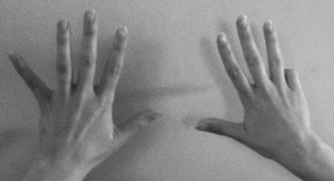
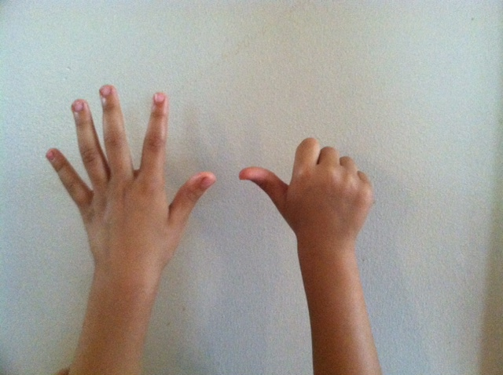
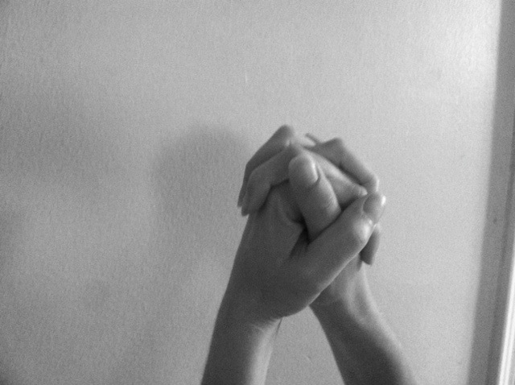
K-2: Use Ten(s) to Add and Subtract
Make Ten Addition with Partners
Take From Ten Subtraction with Partners
9 + 6
15 – 9
Notes:
3 minutes
Show the “hands” way of subtracting from ten or adding to make ten is a concrete model. Have participants analyze what students need to know in order to see the relationship of 9 and 6 to 10 and 5.
Participants Try:
Addition Subtraction
9 + 5 13 – 9
8 + 5 13 – 8
If time:
Relate to fraction/decimal work by changing the ones into tenths – each finger now has a value of 1 tenth.
Model
9/10 + 6/10 (0.9 + 0.6)
1 5/10 – 9/10 (1.5 – 0.9)
Participants Try:
Addition Subtraction
9/10 + 5/10 (0.9 + 0.5) 1 3/10 – 9/10 (1.3 – 0.9)
8/10 + 5/10 (0.8 + 0.5) 1 3/10 – 8/10 (1.3 – 0.8)
TIME ALLOTTED FOR THIS SLIDE: 3 minutes
MATERIALS NEEDED:
Participants’ hands and a partner

Slide 26
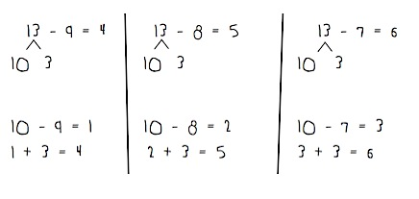
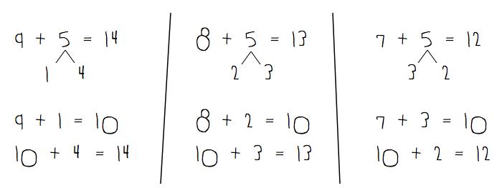
Develop skill with sums and differences within 20
Make Ten Addition
Take From Ten Subtraction
Notes:
4 minutes
This is one way Grade 1 students are preparing to meet the Grade 2 Fluency Standard of sums and differences within 20 by memory.
This is the abstract version of the prior slide.
(Optional: Use the Rekenrek to show a different concrete/pictorial version.)
Remind participants how to subtract and add with teen numbers from the magic counting fingers activity on the previous slide.
Have participants follow along with both fluencies on their white boards.
Make Ten Addition with Partners (6 minutes)
Materials: (S) Personal white boards
▪ Assign partners of equal ability.
▪ Partners choose an addend from 1 to 10 for each other.
▪ On their personal boards, students add their number to 9, 8, and 7.
Partners then exchange boards and check each other’s work.
Take from Ten Subtraction with Partners (5 minutes)
Materials: (S) Personal white boards
▪ Partners choose a number to from which to subtract between 10 and 15
▪ On their personal boards, students subtract 9, 8, and 7 from their number. Remind students to write the two number sentences, (e.g., to solve 13 – 8 they write 10 – 8 = 2, 2 + 3 = 5).
Partners then exchange boards and check each other’s work.
Relate to written fraction work, as fraction addition and subtraction is notated horizontal. For addition, students use number bonds to make 10 tenths as a strategy. Students can subtract by using a number bond to pull out 10 tenths from the whole.
TIME ALLOTTED FOR THIS SLIDE: 4 minutes
MATERIALS NEEDED:
(Optional) Rekenrek

Slide 27
Kindergarten
Choral & White Board Exercises
Number Bonds
Making 3 with Triangles
Left Hand Counting
Dot Cards
Number Pairs
5 Groups Hands
1 More/Less
What is happening to the units in each fluency?
Notes:
Number Bonds
Materials: Number Bond Template
Give the students a target number to be the total. Have them use materials to decompose the total into 2 parts and fill in their bond to show the decomposition. (Bond can be shown numerically, with materials. Important that the students have the same amount of materials in the total as reflected in the parts.) As the year progresses, have them find as many as they can in a given amount of time and start to learn them, notice patterns.
Making 3 with Triangles
Materials: (S) 3 beans, paper or foam triangle
T: Touch and count the corners of the triangle.
S: 1, 2, 3.
T: Touch and count your beans.
S: 1, 2, 3.
T: Our job is to make 3. Put your 2 beans on the corners of your triangle. Keep the other one in your hand. How many beans on your triangle?
S: 2.
T: How many beans in your hand?
S: 1.
T: We can tell how to make 3 like this: 2 and 1 makes 3. Echo me, please.
S: 2 and 1 makes 3.
T: Show me 1 bean on your triangle. Keep the rest in your hand. How many beans on your triangle?
S: 1.
T: How many beans in your hand?
S: 2.
T: Raise your hand when you can say the sentence, start with 1. (Wait until all hands are raised and then give the signal.)
S: 1 and 2 makes 3.
Left Hand Counting
Materials: (S) Left hand mat, bag of beans (painted red on one side)
Note: This fluency was selected in anticipation of future lessons. Although students will not be working with numbers in this lesson, they will need to develop fluency for upcoming lessons in which students will work with numbers in depth.
T: Take 1 bean out of your bag and put it on your mat. Count how many beans are on your mat.
S: 1.
T: Take another bean out of your bag and put it on your mat. Count how many beans are on your mat now.
S: 1, 2.
T: Yes. Take another bean out of your bag and put it on your mat. Count how many beans are on your mat now.
S: 1, 2, 3.
T: yes. Let’s touch and count them one at a time like this, 1, 2, 3.
S: 1, 2, 3 (as they touch each bean).
T: Move 1 bean to the pinky fingernail. How many fingers have a bean?
S: 1.
T: How many fingernails are under the bean?
S: 1.
T: Is that exactly the same number?
S: Yes!
Continue to 3 in this manner. Give time for students to touch and count, but take notice of which students must recount each time.
TIME ALLOTTED FOR THIS SLIDE: 12 minutes
MATERIALS NEEDED:
3 beans
Triangle Mat or drawing
Left Hand Mat
Dot Cards of 6 (presenter only)
5 Group Cards (presenter only)

Slide 28
Kindergarten
Choral & White Board Exercises
Invisible Page
Notes:
GRADE K CONTINUED
Dot Cards
Materials: (T/S) Varied dot cards of 6 (card template from GK–M3–Lesson 13)
Note: This activity deepens students’ knowledge of embedded numbers and develops part–whole thinking.
T: (Show card.) How many do you see?
S: 6.
T: How did you see them in two parts?
S: (Possible answers.) 5 on this side and 1 on that side. → 2 down and 4 up. → 3 up and 3 down.
Continue with other cards, especially focusing on numbers 6 – 10.
Number Pairs of Six
Materials: (T) dot cards (S) Personal white board
Show the dot cards with 5 and 1 indicated as parts.
T: Say the biggest part. (Give students time to count.)
S: 5.
T: Say the smallest part.
S: 1.
T: What is the total number of dots? (Give them time to re-count.)
S: 6.
T: Show the number bond on your personal white board.
Continue with 4 and 2, 3 and 3, and 6 and 0.
5-Group Hands
Materials: (T) Large 5-group cards (5–7)
T: (Show the 6 dot card.) Raise your hand when you know how many dots are on top. (Wait until all hands are raised, then signal.) Ready?
S: 5.
T: Bottom?
S: 1.
T: We can show this 5-group on our hands. 5 on top, 1 on the bottom, like this. (Demonstrate on hands, one above the other.)
S: (Show 5 and 1 on hands, one above the other.)
T: Push your hands out as you count on from 5, like this. 5 (extend the top hand forward), 6 (extend the bottom hand forward). Try it with me.
S: 5 (extend the top hand forward), 6 (extend the bottom hand forward).
Continue with 5, 6, 7, steadily decreasing guidance from the teacher, until students can show the 5-groups on their hands with ease.
1 More/Less
Show a ten frame card and ask students on the signal to say what is one more or one less (This can be done with personal boards, too.)

Slide 29
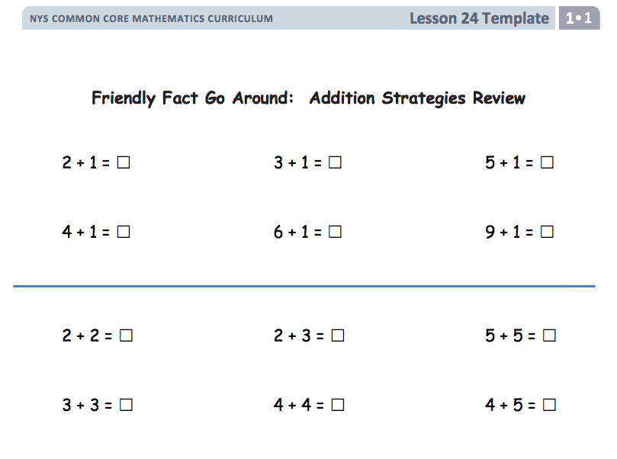
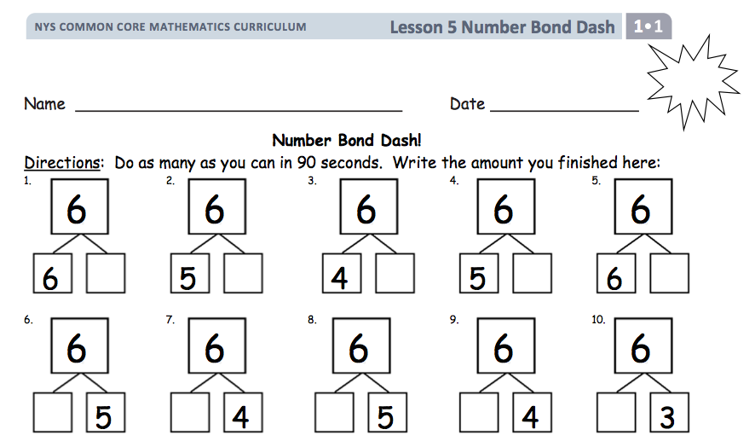
Grade 1
Choral & White Board Exercises
Count On Cheers
Number Bond Dash
Friendly Fact Go Around
Tens and Ones
1 More/Less,
10 More/Less
What is happening to the units in each fluency?
Notes:
Count On Cheers
Note: This activity supports the connection of counting on by 2 and adding 2.
Teacher says the number aloud. Students repeat the number, touching their heads and counting on as they put their fists in the air, one at a time. Alternately, students can count on with boxing punches.
Number Bond Dash
Many participants will have seen this in the Major Work of the Grade, therefore simply refer to the image and review the details, mentioning that the template can be put in the students’ personal boards and re-used.
Friendly Fact Go Around
Materials: (T) Friendly Fact Go Around: Addition Strategies Review or Addition Chart (Click again)
Note: This activity addresses the core fluency objective for Grade 1 of adding and subtracting within 10. Project the Friendly Fact Go Around: Addition Strategies Review sheet (or make a poster). Point to a problem
and call on a student to answer (e.g., 8 + 0 = ). The student answers (8), then the class says the sentence aloud, completed with the answer (8 + 0 = 8). If the student gives an incorrect answer, he or she then repeats the correct equation that the class gave. The teacher can adapt the problem to individual students, pointing to easier problems for students who are less fluent.
TIME ALLOTTED FOR THIS SLIDE: 12 minutes
MATERIALS NEEDED:
Rekenrek
Bundles of Ten sticks
Ten Frames
Tens and Ones
Materials: (T) 100-bead Rekenrek
Note: This activity addresses the grade level standard requiring students to understand that two-digit numbers represent amounts of tens and ones.
Practice decomposing numbers into tens and ones using the Rekenrek.
(Show 16 on the Rekenrek). How many tens do you see?
S: 1.
T: How many ones?
S: 6.
T: Say the number the Say Ten way.
S: Ten 6.
T: 1 ten plus 6 ones is?
S: 16.
T: (Slide over 10 from the next row.) How many tens to you see?
S: 2.
T: How many ones?
S: 6.
T: Say the number the Say Ten way.
S: 2 tens 6.
T: 2 tens plus 6 ones is?
S: 26.
Slide over the next row and repeat. Continue with the following suggested sequence within 40: 15, 25, 35; 17, 27, 37; 19, 29, 39.

Slide 30
Grade 1
Choral & White Board Exercises
Notes:
GRADE 1 CONTINUED
1 More/ 1 Less 10 More/10 Less
Materials: (T) ten sticks, dimes, bundles of ten sticks, ten frames (S) Personal white board
Show students 2 ten sticks.
Ask them to write the number sentence to find 1 more, then to find 1 less, to find 10 more, to find 10 less.
Vary the activity by using different ways to show the units and by using different start amounts.

Slide 31
Grade 2
Choral & White Board Exercises
Make Ten to Add
Take from Ten
Rename the Units
Take From Tens or Ones
Compensation
Place Value Practice
Zap to Zero with Hide Zero Cards
What is happening to the units in each fluency?
Notes:
TIME ALLOTTED FOR THIS SLIDE: 12 minutes
MATERIALS NEEDED:
Hide Zero Cards
Make 10 to Add
(Note: This was previously demonstrated concretely on slide 25 and pictorially on slide 26. This is the abstract version.)
T: Let’s make 10 to add. If I say 9 + 2, you say 9 + 2 = 10 + 1. Ready? 9 + 3.
S: 9 + 3 = 10 + 2.
T: Answer?
S: 12.
T: 9 + 5.
S: 9 + 5 = 10 + 4.
T: Answer?
S: 14.
Continue with possible sequence: 9 + 7, 9 + 6, 9 + 8, 8 + 3, 8 + 5, 7 + 4, and 7 + 6.
Take From 10
Note: Draw a number bond for the first example to model student thinking to solve.
T: For every number sentence I say, you will give a subtraction number sentence that takes from the ten first. When I say 12 - 3, you say 12 – 2 – 1. Ready?
T: 12 – 3.
S: 12 – 2 – 1.
T: Answer.
S: 9.
Continue with the possible sequences: 12 – 4, 12 – 5, 14 – 5, 14 – 6, 14 – 7, 15 – 7, 15 – 8, 15 – 9, 16 – 9, and 16 – 8.
Rename the Units:
T: (Write 10 ones = ____ ten.) Say the number sentence.
S: 10 ones = 1 ten.
T: (Write 20 ones = 1 ten ____ ones.) Say the number sentence.
S: 20 ones = 1 ten 10 ones.
T: (Write 24 ones = 1 ten ____ ones.) Say the number sentence.
S: 24 ones = 1 ten 14 ones.
T: (30 ones = 2 tens ____ ones.) Say the number sentence.
S: 30 ones = 2 tens 10 ones.
Repeat the process for 30, 32, 38, 40, 41, 46, 50, 63, 88.
Take from the Tens or Ones
Note: This fluency helps students to know when to unbundle a ten to subtract and when not to.
T: For every number sentence I say you tell me if I take from the tens or the ones. When I say 46 – 5, you say take from the ones, but If I say 46 – 7, you say take from the tens. Ready?
T: 46 – 6.
S: Take from the ones.
T: 46 – 9.
S: Take from the tens.
Continue with the following possible sequence: 52 – 1, 52 – 4, 63 – 6, 64 – 5, 65 – 4, 68 – 8, 70 – 3.

Slide 32
Grade 2
Choral & White Board Exercises
Notes:
GRADE 2 CONTINUED
Compensation (5 minutes)
Note: This fluency drill reviews the mental math strategy taught in Lesson 4, using compensation to add the same amount to each addend. By making a multiple of 10, students solve a much simpler addition problem.
T: (Write 42 + 19 = _____.) Let’s use a mental math strategy to add. How much more does 19 need to make the next ten?
S: 1 more.
T: Where can 19 get 1 more from?
S: From the 42!
T: Take 1 from 42 and give it to 19. Say the new number sentence, with the answer.
S: 41+20=61.
T: 37+19.
S: 36+20=56.
Continue with the following possible sequence: 29 + 23, 38 + 19, 32 + 19, 24 + 17, 34 + 19.
Place Value Practice (3 minutes)
Note: This fluency reviews place value concepts from Module 3 to prepare students for the lesson’s content.
T: (Write 352 on the board.) Say the number in standard form.
S: 352.
T: Say the number in expanded form.
S: 300+50+2.
T: Say the number in expanded form, reversing the order and complete the number sentence.
S: 2 + 50 + 300 = 352
T: What is 20 more than 352?
S: 372.
Continue with the following possible sequence: 20 less? 100 more? 100 less? 102 less? 220 less? 510 more?
Zap to Zero (3 minutes)
Materials: Hide Zero Cards, Personal Boards
Note: Practicing using place value concepts to mentally subtract will help lay a foundation for this lesson’s content.
T: (Write 184.) If I say zap the digit 8 to zero, you say subtract 80. Ready?
T: Zap the digit 8 to zero.
S: Subtract 80.
T: What is the number sentence?
S: 184–80=104.
(Show 184 with Hide Zero Cards and pull out the 80 card dramatically)
T: Start again with 184. Zap the digit 1 to zero.
(Demonstrate on Hide Zero Cards)
S: Subtract 100.
T: What is the number sentence?
S: 184–100=84
(Demonstrate on Hide Zero Cards)
Repeat using the following possible sequence: 173, 256.

Slide 33
Grade 3
Choral & White Board Exercises
Decomposition Tree
Add to Multiply
Rekenrek Division
Distributive Property and Multiplication
Commutative Multiplying
Find the Area
Find the Whole
Divide and Label the Meaning of the Factors
What is happening to the units in each fluency?
Notes:
Decomposition Tree:
Place template inside personal white board. Use the following to decompose into 2 smaller parts. Do as many as you can in 30 seconds. Then share with a partner. Then list as many more as you can in 30 additional seconds.
Decompose 12 fives (relate to the clock/distributive property)
Example: 50 and 10, 10 fives and 2 fives.
Decompose 1 dollar
Decompose ___
Add to Multiply (1 minutes)
Materials: (S) Personal white boards
T: (Project a picture array with 3 groups of 5 circled.) How many groups are circled?
S: 3.
T: How many are in each group?
S: 5.
T: Write it as an addition sentence.
S: (Write 5 + 5 + 5 = 15.)
T: Write a multiplication sentence representing 3 fives equals 15.
S: 3 × 5 = 15.
Continue with possible sequence: 3 groups of 10, 3 groups of 4, and 7 groups of 2.
Rekenrek Division: Number of Groups Unknown. (2 min)
T: (Show 3 rows of 4 on the Rekenrek) How many fours do you see? Say the answer in unit form.
S: 3 fours
T: How many ones do you see?
S:12 ones.
T: How many fours are in 12?
S: 3 fours.
T: Count by four up to 12. Track your counts on your fingers.
S: 4, 8, 12.
T: How many counts did you make?
S: Three.
T: What is 12 divided by 4?
Repeat the sequence with 3 fives, 6 threes, 4 sixes, etc.
Multiply Using the Distributive Property (4 minutes)
Materials: (S) Personal white boards
T: (Project a 5 × 6 array, covering a sixth row of 6.) How many groups of 6 are there?
S: 5.
T: Let’s find how many are in the array counting by fives. (Point as students count.)
S: 5, 10, 15, 20, 25, 30.
T: Let’s find how many are in the array counting by sixes. (Point as students count.)
S: 6, 12, 18, 24, 30.
T: Write two multiplication sentences for this array.
S: (Write 6 × 5 = 30 and 5 × 6 = 30.)
T: (Reveal the sixth row of 6.) How many groups of 6 are there now?
S: 6.
T: Add 1 more group of 6 to 30. (Write 30 + 6 = .) On your white boards, write the addition sentence.
S: (Write 30 + 6 = 36.)
T: On your white boards, write a multiplication sentence for this array.
S: (Write 6 × 6 = 36.)
Continue with the following suggested sequence: 5 × 8 → 6 × 8, 5 × 7 → 6 × 7, and 5 × 9 → 6 × 9.
TIME ALLOTTED FOR THIS SLIDE: 12 minutes
MATERIALS NEEDED:
Decomposition Tree handout
Rekenrek
Prepared templates for Distributive Property, Add to Multiply, and Find the Area activities

Slide 34
Grade 3
Choral & White Board Exercises
Notes:
GRADE 3 CONTINUED
Commutative Multiplying (3 minutes)
Optional: Use Rekenrek to model.
T: (Write 3 x 2 = ___.) Say the multiplication sentence.
S: 3 x 2 = 6.
T: Flip it.
S: 2 x 3 = 6.
Repeat process for 5 x 2, 5 x 3, 3 x 4, 2 x 8, and 3 x 7.
Find the Area (4 minutes)
T: (Project a rectangular array with 2 rows of 4 units. Write 1 tile = 1 square meter.) What does 1 tile equal?
S: 1 square meter.
T: (Point to the side length of 4 units.) This is the length of the rectangle. What is its value?
S: 4 meters.
T: (Point to the side length of 2 units.) This is the width of the rectangle. What is its value?
S: 2 meters.
T: Write a multiplication sentence to represent the area of the rectangle.
S: (Write2m×4m=8sqmor4m×2m=8sqm.)
Continue with the following possible sequence: 3 rows of 5 units, 3 rows of 7 units, 4 rows of 6 units, 4 rows of 9 units, and 6 rows of 8 units.
Find the Whole (2 minutes)
Materials: (T) Blank number bond
Note: Use as an active activity. Make the parts with your feet and hop together to make the whole.
T: (Project number bond with parts and .) Say the biggest part.
S: 3 fifths.
T: Say the smallest part.
S: 2 fifths.
T: How many fifths are in the whole?
S: 5 fifths.
T: (Write in the whole space.) Say the number sentence.
S: 3 fifths and 2 fifths equals 5 fifths.
Repeat with parts: Replace 8 eighths with one whole.
Divide and Label the Meaning of the Factors (4 minutes)
Materials: (S) Personal white boards.
T: Share 6 cookies fairly with 2 people. How many cookies will each get?
S: 3
T: Write the division sentence on your personal board.
S: 6 ÷ 2 = 3
T: In your division sentence, circle the number that tells the size of the group. Label it below with “SG”
S; (students circle the 3 and label it with ‘SG’.
T: Circle the number that tells the number of equal groups. Label it EG.
S: (students circle the 2 and label it EG.
Continue with other examples. 8 pens shared with 2 people. 8 pens shared with 4 people. 12 oranges in 2 bowls. 12 oranges in 3 bowls.

Slide 35
Grade 4
Choral & White Board Exercises
Rename the Place Value Units
Convert Units
Multiply or Divide Units
Divide with Remainders
Algorithms! Add, Subtract, Multiply or Divide
Add and Multiply Fractions
What is happening to the units in each fluency?
Notes:
Rename the Place Value Units (5 minutes)
Materials: (S) Personal white boards
T: (Write 54,783.) Say the number.
S: 54,783.
T: How many thousands are in 54,783?
S: 54 thousands.
T: (Write 54,783 = _____ thousands ____ ones.) On your boards, fill-in the number sentence.
Students write 54,783 = 54 thousands 783 ones.
T: How many ten thousands are in 54,783?
S: 5 ten thousands.
T: (Write 54,783 = _____ ten thousands ____ hundreds ____ ones.) On your white boards, fill-in the number sentence.
Students write 54,783 = 5 ten thousands 47 hundreds 83 ones. Follow the same process and sequence for 234,673.
Place Value (2 minutes)
Note: Reviewing and practicing place value skills in isolation will prepare students for success in comparing numbers during the lesson.
Materials: (T) Place value cards
T: (Write 3,487.) Say the number.
S: 3,487.
T: What digit is in the tens place?
S: 8.
T: (Underline 8.) What’s the value of the 8?
S: 80.
T: State the value of the 3.
S: 3,000.
T: 4?
S: 400.
Repeat for the following possible sequence: 59,607; 287,493; and 7,142,952.
Convert Units (5 minutes)
Note: Reviewing these unit conversions that were learned in third grade will help prepare the students to solve problems with kilometers and meters in Topic A of Module 2.
T: (Write 1 km = ___ m.) How many meters are in a kilometer?
S: 1km=1,000m.
Repeat process for 2 km, 3 km, 8 km, 8 km 500 m, 7 km 500 m, and 4 km 250 m.
T: (Write 1 kilogram= ___ m.) How many grams are in a kilogram?
S: 1 kg=1,000g.
Repeat process for 2 kg 500 g, 3 kg, 8 g, 8 kg 30 g
T: (Write 1 foot= ___ in) How many inches are in a foot?
S: 1 foot = 12 inches
Repeat process for 2 ft, 3 ft, 2 ft 11 in, 3 ft 1 in, etc.
TIME ALLOTTED FOR THIS SLIDE: 12 minutes
MATERIALS NEEDED:
Place value cards (aka Hide Zero Cards)

Slide 36
Grade 4
Choral & White Board Exercises
Notes:
GRADE 4 CONTINUED
Multiply or Divide Units (4 minutes)
Materials: (S) Personal white boards
T: (Write 3 × 2 = .) Say the multiplication sentence in unit form.
S: 3 ones × 2 = 6 ones.
T: Write the answer in standard form.
S: (Write 6.)
T: (Write 30 × 2 = __.) Say the multiplication sentence in unit form.
S: 3 tens × 2=6 tens.
T: Write the answer in standard form.
S: (Write 60.)
Repeat the process and sequence for 3 hundreds × 2, 3 thousands × 2, 5 ones × 3, 5 tens × 3, 5 thousands × 3, 5 thousands × 4, 5 tens × 4, 5 ones × 8, 5 hundreds × 8, and 9 tens × 7.
Repeat with division.
Divide with Remainders (4 minutes)
T: How many groups of 2 are in 10?
S: 5.
T: Let’s prove it by counting by twos. Use your fingers as you count.
S: (Showing one finger for each multiple.) 2, 4, 6, 8, 10.
T: Show and say how many groups of 2 are in 10.
S: (Showing 5 fingers.) 5.
T: (Write 11 ÷ 2.) Let’s find out how many groups of 2 are in 11. Count with me.
S: (Showing one finger for each multiple.) 2, 4, 6, 8, 10.
T: How many groups?
S: 5.
T: How many left?
S: 1.
Continue with the following possible sequence: 8÷4 and 9÷4,12÷3 and 13÷3,15÷5 and 17÷5, 20÷4 and 23 ÷ 4, 50 ÷ 10 and 55 ÷ 10.
Algorithms
Student practice addition and subtraction using the algorithm with a given problem. They practice multiplication and division using a place value disk model next to the algorithm with a given problem.
Adding Fractions to Make One Whole (4 minutes)
T: I say 1 third, you say 2 thirds. Say your answer at the signal.
T: 1 fourth? (Signal)
S: 3 fourths.
T: Write the addition sentence starting with 1 fourth.
T: 1 fifth? (Signal)
S: 4 fifths.
T” Write the addition sentence starting with 1 fifth.
Continue with possible sequence: 2/10, 1/3, 3/5, 1/2, 5/10, 6/7, 3/8.
OR VIDEO 5th Grade: Addition Fractions to make 1 Whole (part 1); Happy Counting by Fractions (part 2) (Show 0 min to 1 min 20 sec) *Practicing a G4 standard
http://www.engageny.org/resource/common-core-video-series-fraction-fluency-in-grade-5
Multiplying Fractions(4 minutes)
Start with a tape diagram. Generate the repeated addition sentence of unit fractions and have students rewrite as a multiplication of a unit fraction by a whole number.

Slide 37
Grade 5
Choral & White Board Exercises
Rename Units on the Place Value Chart
Rename the Decimal as a Mixed Number
Multiply and Divide by 10, 100, and 1,000
Multiply Metric Units
Decimal Parts to Make a Whole
Write in Exponential Form
All Operations with Whole Numbers and Fractions
What is happening to the units in each fluency?
Notes:
Rename Units on the Place Value Chart
T: (Write 10 hundreds = 1 ____.) Say the sentence, filling in the blank.
S: 10 hundreds = 1 thousand.
Repeat the process for 10 tens = 1 ____, 10 ones = 1 ____, 10 tenths = 1 ____, 10 thousandths = 1 ____, and 10 hundredths = 1 ____.
Repeat by unbundling.
Optional: Use place value chart to show multiplying and dividing by 10 to compose or decompose larger or smaller units.
Rename the Decimal as a Mixed Number (2 minutes)
Materials: (S) Personal white board
T: (Write 3.1.) Write the decimal as a mixed number.
Continue this process for the following possible suggestions: 9.8, 10.4, and 64.3.
Write the Unit as a Decimal
Materials: (S) Personal white boards
Note: Reviewing these skills will help students work towards mastery of decimal place value, which will in turn help them apply their place value skills to more difficult concepts.
T: 9 tenths.
S: 0.9
T: 10 tenths.
S: 1.0
Repeat the process for 20 tenths, 30 tenths, 70 tenths, 9 hundredths, 10 hundredths, 11 hundredths, 17 hundredths, 57 hundredths, 42 hundredths, 9 thousandths, 10 thousandths, 20 thousandths, 60 thousandths, 64 thousandths, and 83 thousandths.
OR Video showing Choral response for this activity
5th Grade: Addition Fractions to make 1 Whole (part 1); Happy Counting by Fractions (part 2) (Show 1 min 20 sec to 2 min 40 sec)
http://www.engageny.org/resource/common-core-video-series-fraction-fluency-in-grade-5
TIME ALLOTTED FOR THIS SLIDE: 12 minutes
MATERIALS NEEDED:
Place Value Chart (million)
Personal white boards

Slide 38
Grade 5
Choral & White Board Exercises
Notes:
GRADE 5 CONTINUED
Multiply and Divide Varied Units by 10 (5 minutes)
Materials: (S) Personal white boards, millions place value chart
T: (Project place value chart from millions to thousandths.) Write three ones disks and the number below it.
S: (Write 3 ones disks in the ones column. Below it, write 3.)
T: Multiply by 10. Cross out each disk and the number 3 to show that you’re changing its value.
S: (Students cross out each ones disk and the 3. They draw arrows to the tens column and write 3 tens disks. Below it, they write 3 in the tens column and 0 in the ones column.)
Repeat the process for 2 hundredths, 3 tenths 2 hundredths, 3 tenths 2 hundredths 4 thousandths, 2 tenths 4 hundredths 5 thousandths, and 1 tenth 3 thousandths. Repeat the process for dividing by 10 for this possible sequence: 2 ones, 3 tenths, 2 ones 3 tenths, 2 ones 3 tenths 5 hundredths, 5 tenths 2 hundredths, and 1 ten 5 thousandths.
Let’s take a look at how some choral response activities might be used in G5 to prepare students to multiply multi-digit numbers fluently.
Multiply and Divide Varied Units by 10, 100, & 1,000 (M2-L1)
3 x 10 “Say the product”→30… Repeat with 3 x 100; 3 x 1000; 5 x 100; 5 x 1000; 14 x 100; 14 x 1000; 20 x 100; 200 x 10; 20 x 1000; 370 x 10; 100 x 370; 1000 x 370
30 ÷ 10. Say the complete number sentence. 300 ÷ 10, etc.
Multiplying Metric Units (2 minutes)
Materials: (S) Personal white boards
Note: This fluency will help students work towards mastery on the concept that was introduced in Lesson 4.
T: (Write 3 m = ___ cm.) Show 3 in your place value chart.
S: (Students write 3 in the ones column.)
T: How many centimeters are in 1 meter?
S: 100 centimeters.
T: Show how many centimeters are in 3 meters on your place value chart.
S: (Students cross out the 3 and shift it 2 place values to the left to show 300.)
T: How many centimeters are in 3 meters?
S: 300 centimeters.
Repeat the process and procedure for 7 kg = ____ g, 7000 ml = ____ l, 7500 m = ____ km ____ m, and 8350 g = ____ kg ____ g.
Decimal Parts to make a whole:
T: Give the missing part to make 1 whole: 3 tenths,
T: Give the number sentence. 3 tenths + 7 tenths = 1
Write in Exponential Form (3 minutes)
Materials: (S) Personal white boards
Note: Reviewing this skill in isolation will lay a foundation for students to apply the skill in multiplication during the lesson.
T: (Write 100 = 10?.) Write 100 in exponential form.
S: (Students write 100 = 10².)
Repeat the process for 1000, 10,000, and 1,000,000.

Slide 39
Let’s Practice!
Develop protocol for using the personal white board.
Study fluency exercises (choral and white board activities) in Grades K-5. Look for coherence and study the sequences.
Role play with a partner where the sequence must be adjusted.
  a) The student makes an error.
  b) The sequence needs challenge.
You try!
Notes:
15 minutes
Take time at each of these. Call time when to move forward.
1 minutes: Collaboratively create protocol for using a personal white board. Check their signal and correct “sleepy signals” on the spot. Call attention to how hard it is for students to follow a signal that is not crisp and rhythmic. Consider types of activities that might require different uses of the personal board. Also confirm hand signals again.
5 minutes: Read through the counting exercises. Have participants use a highlighter or star to signal each time a unit is being renamed, either decomposed or composed. Have them study for coherence.
9 minutes: Role play with a partner where the student makes an error so that the sequence must be adjusted.
Considerations:
When is it wise to use a white board exchange?
What templates are good to have on hand?
TIME ALLOTTED FOR THIS SLIDE: 15 minutes
MATERIALS NEEDED:
K-5 Choral Response Exercises Handout

Slide 40
Implementation Considerations
Establish signals for student responses.
Use “I say, you say” to establish the fluency’s objective.
Sequence to meet the needs of your students! Adjust in the moment as necessary.
Keep the pace up and end with success.
Notes:
Establish signal for student response
“Raise your hand when you know…”
Allows wait time
Formative assessment for teacher to know who needs wait time and who is ready.
Use “I say, you say”
Don’t explain the activity to students.
Get the students right into the math.
Sequence to meet the needs of your students
Break it down! Used in Teach Like a Champion by Doug Lemov
Scaffold your questions
Use review material only
Keep the pace up and end with success
Keep exercises short and fast paced-after asking a question, wait a few seconds to signal for choral response. If you wait too long students will forget the initial question as well as their answer.
TIME ALLOTTED FOR THIS SLIDE: 2 minutes

Slide 41
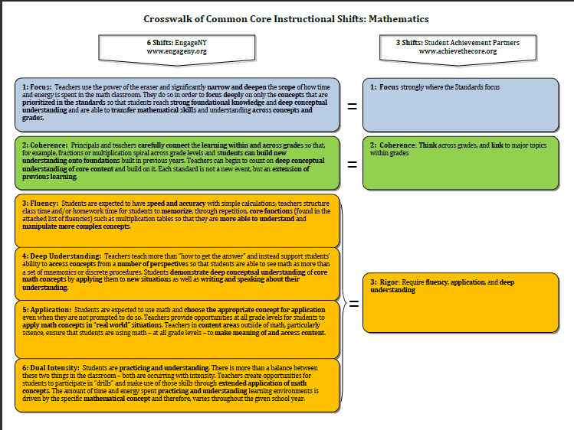
Fluency as Defined by the
Instructional Shifts
“Students are expected to have speed and accuracy with simple calculations; teachers structure class time and/or homework time for students to memorize through repetition, core functions.”
Notes:
2 minutes
Discuss the slide and clarify that Fluency within Eureka Math:
promotes speed and accuracy for simple calculations.
devotes class time in each lesson for this skill.
develops automaticity for students to devote cognitive power to solving more challenging problems.
TIME ALLOTTED FOR THIS SLIDE: 2 minutes

Slide 42
Required Fluencies
K | K.OA.5 | Add/Subtract within 5
1 | 1.OA.6 | Add/Subtract within 10
2 | 2.OA.2 2.NBT.5 | Add/Subtract within 20 (know single-digit sums from memory Add/Subtract within 100
3 | 3.OA.7 3.NBT.2 | Multiply/Divide within 100 Add/Subtract within 1000
4 | 4.NBT.4 | Add/Subtract within 1,000,000
5 | 5.NBT.5 | Multi-digit multiplication
Notes:
1 minute
Review Fluency standards for each grade, as defined by the CCSS.
These fluency goals are to be met at the end of the year.
TIME ALLOTTED FOR THIS SLIDE: 1 minutes

Slide 43
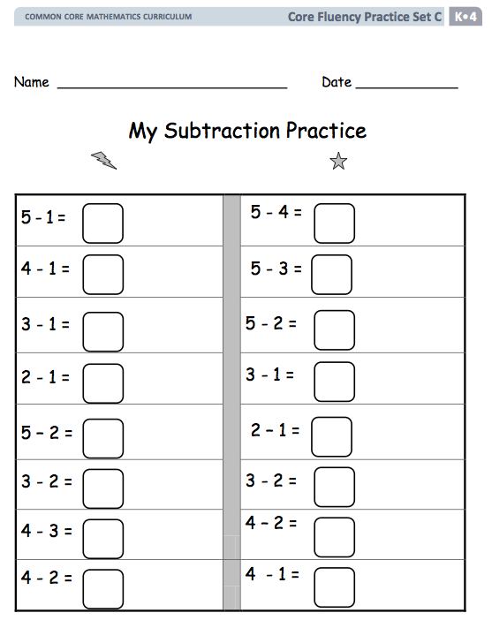
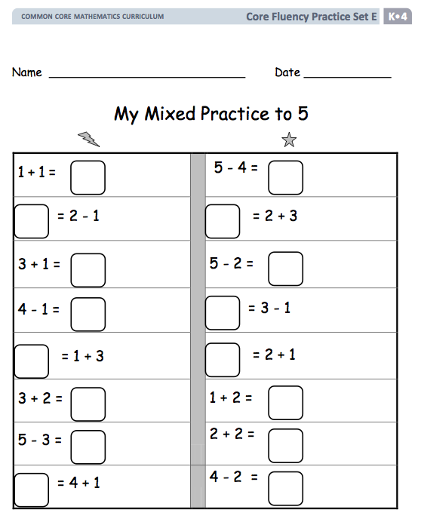
Kindergarten Core Fluency Materials
Core Fluency Differentiated Practice Sets
(Module 4, Lesson 29)
  Set A: My Addition Practice
  Set B: My Decomposition Practice
  Set C: My Subtraction Practice
  Set D: My Subtraction Practice
  Set E: My Mixed Practice
Notes:
2 minutes
Review the materials at GK – G3 in particular that target the specific fluencies.
TIME ALLOTTED FOR THIS SLIDE: 2 minutes

Slide 44
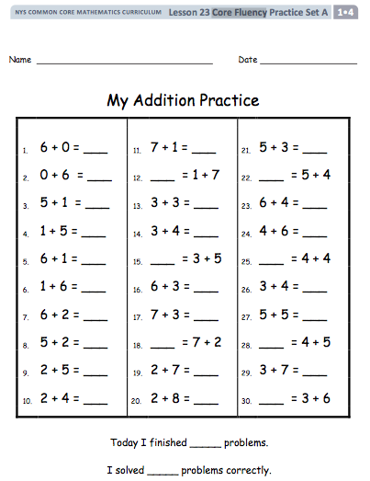
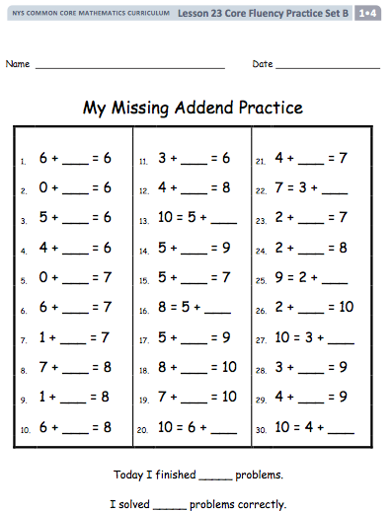
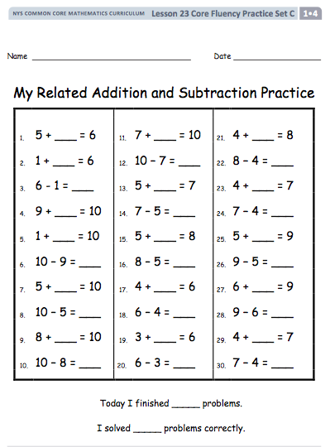
1st Grade Core Fluency Materials
Core Fluency Practice Sets
(Module 4, Lesson 23)
  Set A: My Addition Practice
  Set B: My Missing Addend Practice
  Set C: My Related Addition and Subtraction Practice
  Set D: My Subtraction Practice
  Set E: My Mixed Practice
Core Fluency Sprints
(Module 5, Lesson 1)
Notes:
2 minutes
Let the participants know that there are also core fluency sprints which begin in Lesson 23 of Module 4.
TIME ALLOTTED FOR THIS SLIDE: 2 minutes

Slide 45
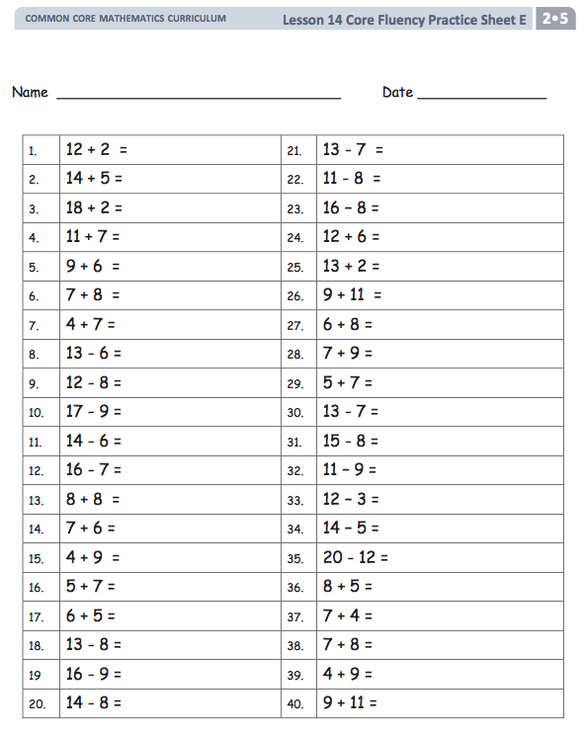
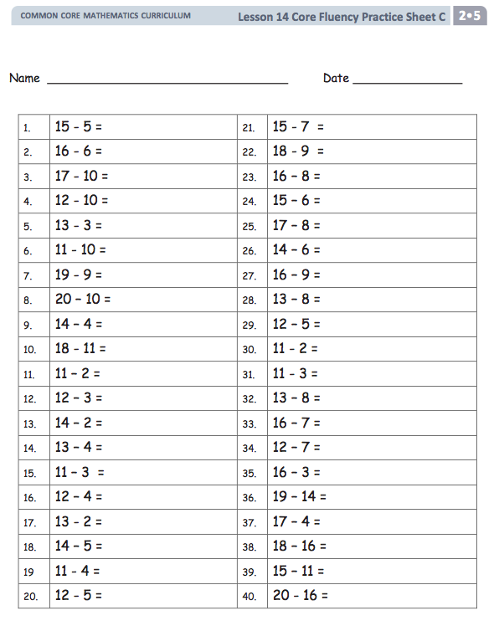
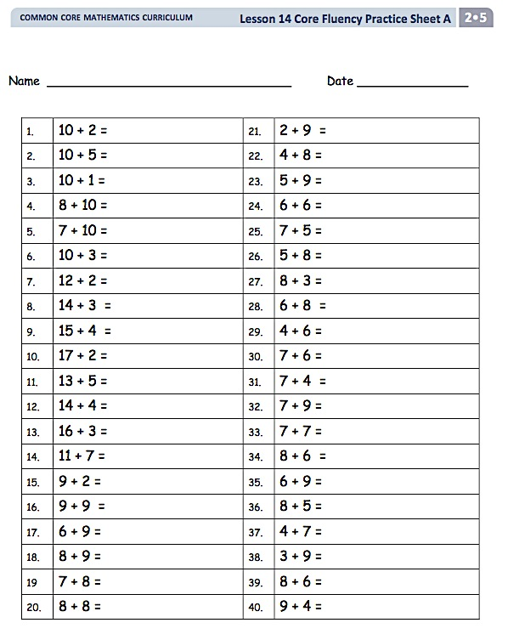
2nd Grade Core Fluency Materials
Core Fluency Practice Sets
(Module 4, Lesson 14)
  Set A: Addition
  Set B: My Missing Addend
  Set C: Subtraction
  Set D: More Subtraction
  Set E: Mixed Practice
Notes:
2 minutes
Let the participants know that there are core fluency practice sets beginning in Lesson 14 of Module 4.
TIME ALLOTTED FOR THIS SLIDE: 2 minutes

Slide 46
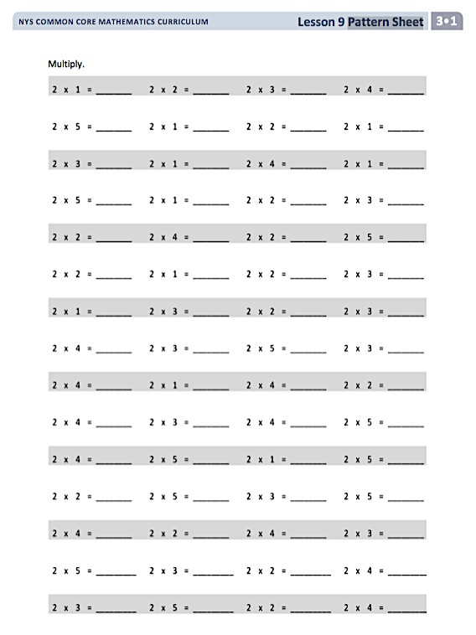
3rd Grade Core Fluency Materials
Pattern Sheets (Begin in Module 1)
Notes:
2 minutes
Pattern Sheets are used throughout the year and included with each assessment. The assessment Pattern Sheets are created especially for the assessments and but are analogous to the lessons.
TIME ALLOTTED FOR THIS SLIDE: 2 minutes

Slide 47
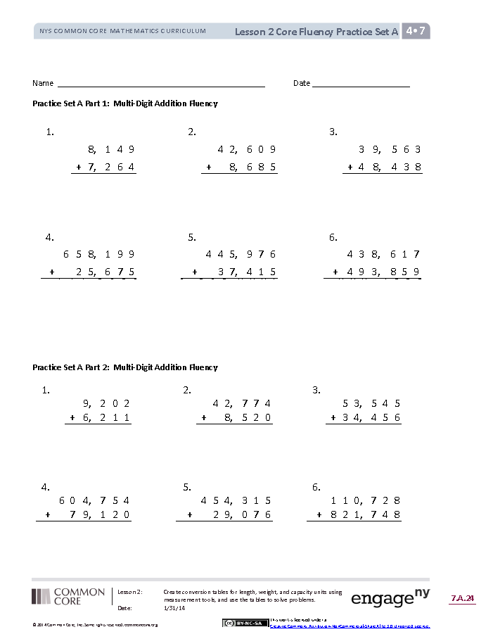
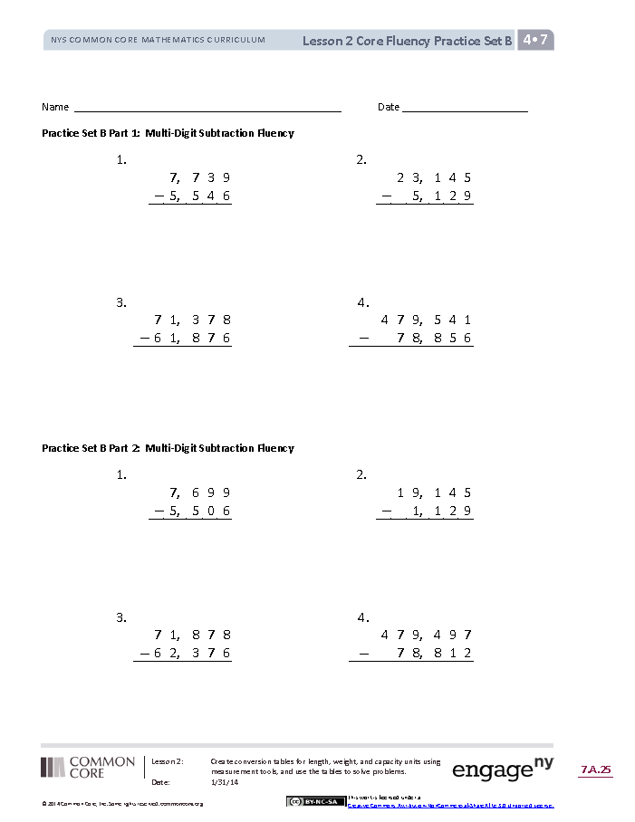
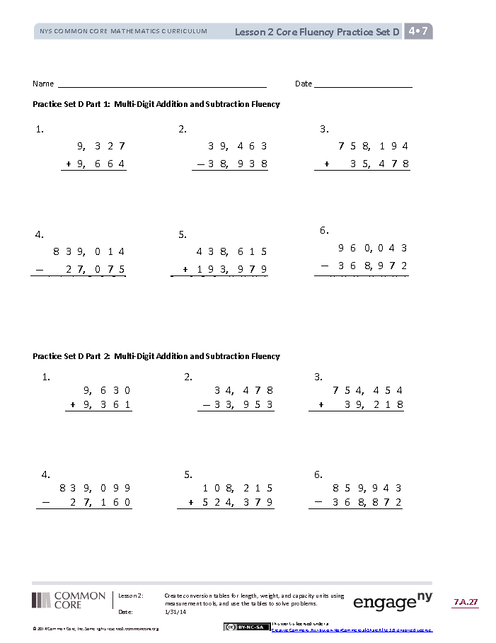
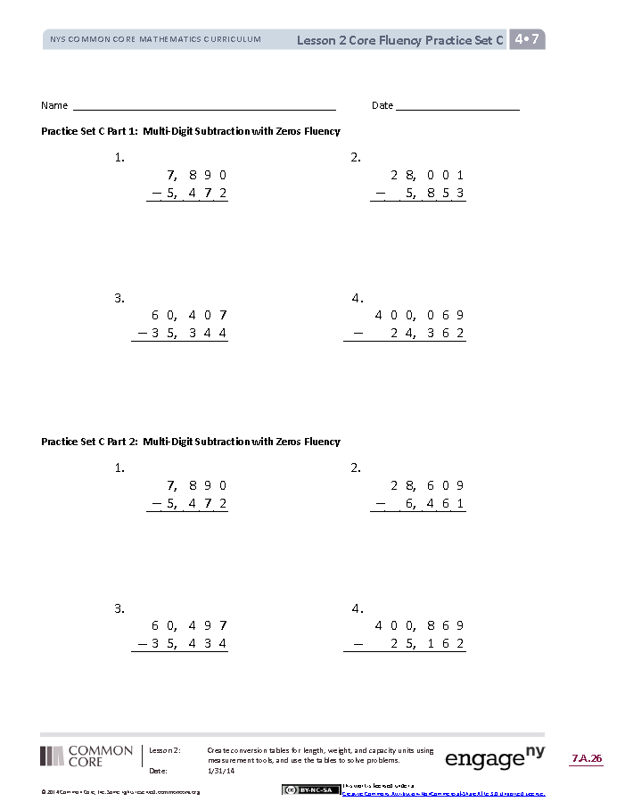
Grade 4 Core Fluency Materials
Core Fluency Differentiated Practice Sets
(Module 7, Lesson 2)
  Set A: Multi-Digit Addition
  Set B: Multi-Digit Subtraction
  Set C: Multi-Digit Subtraction with Zeros in the Minuend
  Set D: Multi-Digit Addition and Subtraction
Notes:
2 minutes
(CLICK to advance through the 4 images.)
All sets have a Part 1 and a Part 2.
Note that Part 2 has fewer regroupings and many be used for students working below grade level.
The answers to both Practice Sets are the same for ease in correction.
Reoccur as part of Fluency across nearly every lesson of Module 7.
Complete each set in 120 seconds.
100% accuracy on a set may move on to the next set.
Others repeat until mastery.
TIME ALLOTTED FOR THIS SLIDE: 2 minutes

Slide 48
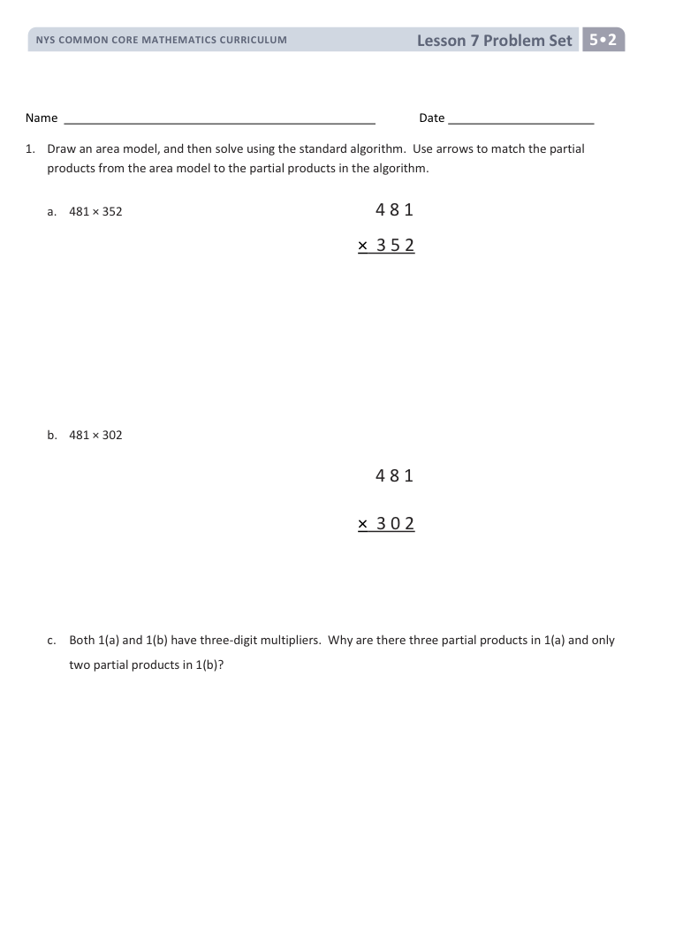
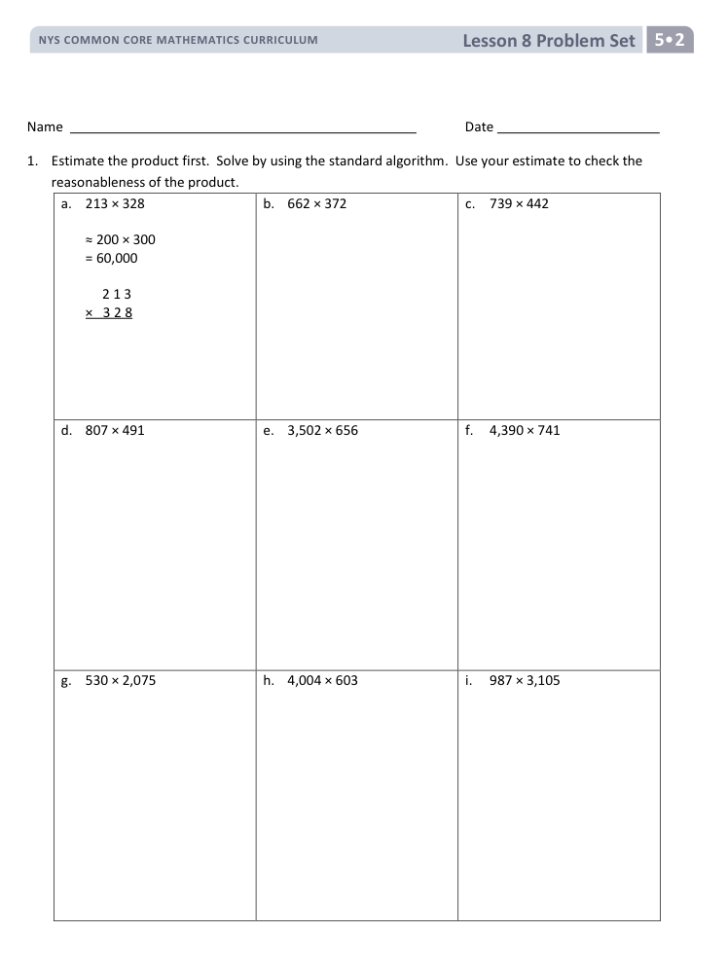
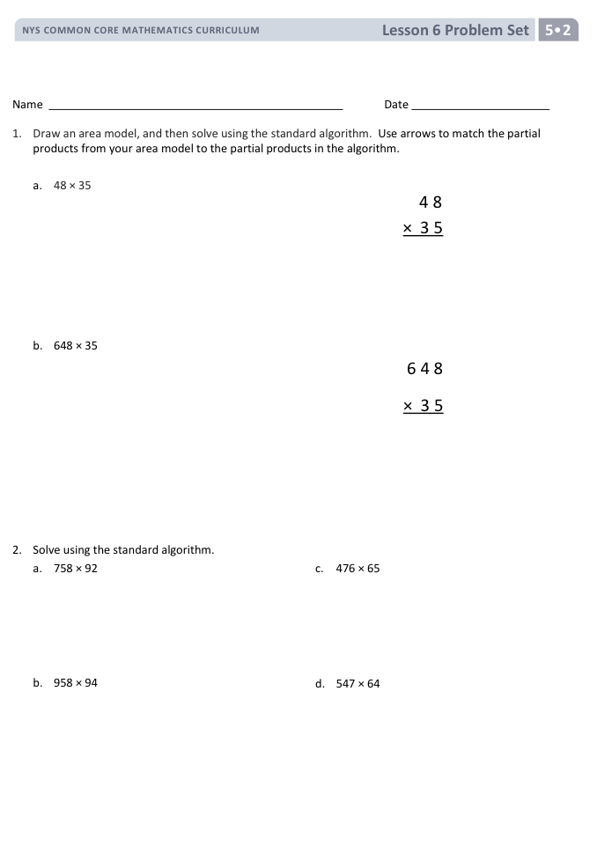
Grade 5 Differentiated Practice with Multi Digit Whole Number Multiplication
G5 Module 2 Topic B
Problem and Homework Sets
Lesson 5: Two Double-Digit Factors Without Renaming
Lesson 6: One Double, One Triple-Digit Factor with Renaming.
Lesson 7: Two Triple-Digit Factors with Renaming
Lesson 8: Two to Four-Digit Factors with Estimation and Renaming
Notes:
1 minute: (CLICK to advance through the 3 images.)
Starting in M4 or at the teacher’s discretion, teachers might revisit these Problem Sets to used as differentiated practice sets, monitoring when students have mastered each level, when necessary supplementing with additional analogous problems before moving students on. Remind teachers that the algorithm is begun in Grade 4 Module 3 at the pictorial level with the area model should they need to break it down further.
2 minutes: Have participants discuss the ways to track improvement at their grade level with core fluency.
TIME ALLOTTED FOR THIS SLIDE: 3 minutes

Slide 49
Next Steps
How does analyzing a fluency script improve your understanding of sequencing questions?
What units did we use in the fluencies? What happened to the units?
What are your next steps for planning, practicing, and implementing fluency in your classroom?
How can you monitor the improvement and effectiveness of your own and your colleagues fluency component?
Notes:
14 minutes
4 minutes: Private write
5 minutes: Share out in small groups
5 minutes: Whole group share out.
How does analyzing a fluency script improve your understanding of sequencing questions?
What are your next steps for planning, practicing, and implementing fluency in your classroom?
What resources do you need for your fluency component to be effective?
How can you monitor the improvement of your own and your colleagues fluency component?
TIME ALLOTTED FOR THIS SLIDE: 14 minutes

