Slide 1
Assessment and Accountability Monthly Call
February 2018

Slide 2
Agenda
Month-by-Month Checklist
Accountability
Assessment Administration
Support and Communication

Slide 3
2017-2018 Month-by-Month Checklist
The 2017–2018 Assessment and Accountability Month-by-Month Checklist
identifies key dates and deadlines for statewide assessment programs and accountability processes for next school year;
provides action steps to ensure readiness for administering statewide assessments; and
recommends resources for district and school staff.
The checklist includes information on the following areas:
Communication and Support
Accessibility and Accommodations
Assessment Preparation and Administration
Accountability
Reports
The 2017-2018 Assessment Month-by-Month Checklist is located in the Assessment Library.

Slide 4
February Assessment and Accountability Checklist
Communication and Support
Feb 1, 7, and 8: Winter Collaborations
Feb 1: Data Coordinator Monthly Webinar 1pm
Feb 2: Accountability Commission 1pm, Thomas Jefferson, Claiborne Bldg.
Feb 7: School System Monthly Planning Call
Feb 15: Data Coordinator Office Hours 1pm
Feb 20: Monthly Assessment and Accountability Call
Accountability and Assessment Preparation
Feb: Support continuous evaluation of accessibility/ accommodations effectiveness; revise
IEP, IAP, LEP, and PNP documents as needed
Feb: Utilize SER accommodation reports to plan for spring test administrations
Feb: Verify testing enrollment and order WorkKeys Accommodated materials online
Feb 5-March 14: Order additional WorkKeys accommodations materials

Slide 5
February Assessment and Accountability Checklist
Accountability and Assessment Preparation
Nov–Feb : Submit ACT approved accommodations in the TAA System
Feb: STCs ensure that TAs, proctors, and monitors are appropriately assigned to testing
groups for ELPT and LEAP Connect testing
Feb: Verify testing enrollment and order WorkKeys Accommodated materials online
Feb: Deadline for submitting to College Board complete disability documentation for
students with disabilities who will take a 2018 AP exam
Feb: LASID Audit #4 - Data coordinators will review retirement/split IDs and make updates in
applicable systems
Feb: Audit of spring high school LEAP 2025 testers (TSDL)
Feb: Deadline to submit class schedule corrections for high school LEAP 2025 testers
Late Feb: Download ACT Match-No Match lists second release from FTP for distribution to
STCs to ensure testing of all grade 12 students with no ACT score on record

Slide 6
February Assessment and Accountability Checklist
Feb 5-March 16: Submit Late Consideration Form for ACT-approved accommodations on
the ACT for eligible examinees through TAA
Feb 5-March 16: All LEAP Connect and ELPT voids should be emailed to assessment@la.gov
at the end of the week.
Feb 9-March 14: Add students and update student information in PearsonAccess^{next} and
place additional orders for initial ACT test materials
Feb 16: Request reconsideration of ACT-approved accommodations on the ACT in TAA
Feb 19-Feb 23: Receive ACT and WorkKeys test materials for initial testing (if this shipping
week was chosen)
Feb 20: Attend Q&A session about test administration for ACT and WorkKeys
Feb 26-March 2: Receive ACT and WorkKeys test materials for initial testing (if this
shipping week was chosen)
Feb 27: ACT delivers standard time and accommodation(s) materials to LEAs/districts on
holiday break in March

Slide 7
February Assessment Checklist
Assessment Administration and Reporting
Feb 5–March 16: ELPT Testing Window
Feb 5–March 16: LEAP Connect/LAA1 Testing Window
Oct 3-April 13: WorkKeys online test administration window

Slide 8
March Assessment and Accountability Checklist
Communication and Support
Mar: Assessment and Accountability Office Hours—Tuesdays at 1:00 p.m.
Mar 1: Data Coordinator Monthly Webinar at 1:00 pm
Mar 11: School System Monthly Planning Call
Mar 13: DTC Monthly Call
Accountability and Assessment Preparation
Mar: Finalize Graduation cohort data certification and exit code review for final calculation of
graduation rates and SPS graduation indices
Mar: Support STCs with delivery of test security, preparation, and administration training for spring
testing to TAs and other school personnel for applicable assessments
Mar: Support STCs to ensure that TAs, proctors, and monitors are appropriately assigned to testing
groups for spring testing
Mar: STCs deliver test security, preparation, administration training to TAs/school personnel for
spring assessments

Slide 9
March Assessment and Accountability Checklist
Accountability and Assessment Preparation
Early–Mid Mar: Access Test Administrator Upload System in eDIRECT for spring testing
Mar: Complete advanced search in Test Accessibility and Accommodations System (TAA) for
students with accommodations
Mar: DTCs receive final ACT Match/No Match Rosters
Mar: Configure INSIGHT on testing devices for LEAP 2025
Mar: Manage users in eDIRECT for Spring LEAP 2025 for high school
Mar: Orders placed for AP exam pre-administration materials
Mar: Utilize scheduling guidance to determine final LEAP 2025 test schedules prior to setting
up test sessions in eDIRECT
Mar: Create test sessions within eDIRECT in preparation LEAP 2025 and print student test
tickets
Mar: Train all staff members involved in testing in test security and administration

Slide 10
March Assessment and Accountability Checklist
Accountability and Assessment Preparation
Late Mar: Download third year cohort file/roster available on data management FTP sites
and distribute to STCs to ensure testing or accountability coding of students who
must participate in Algebra I and/or English II
Mar 3: Finalize IEP, IAP, and LEP accommodations for the ELA, math, SS, and science
Mar 13: Validate configuration and lock down devices (ACT online only)
Feb 5th-Mar 16th: All LEAP Connect and ELPT voids should be emailed to assessment@la.gov
at the end of the week
Once materials arrive-Mar 19: Conduct sessions for examinees to complete non-test
information on the answer documents for paper ACT
Mar 20-April 18: Order ACT accommodations materials for makeup testing by calling ACT
Accommodations
March 20-April 6: Order ACT standard time materials for makeup testing

Slide 11
March Assessment and Accountability Checklist
Accountability and Assessment Preparation
Mar 21-April 24: Add students and update student information in PearsonAccess^{next} for Act
makeup testing
Mar 23: Contact courier agency. Scheduled pickup of ACT secure materials from LEA office
Mar 24: Finalize IEP, IAP, and LEP accommodations for the Spring 2016 LEAP 2025 high
school test administration window
Mar 24: Priority Deadline for AP exam ordering
Late Mar–Mid Apr: Order additional test materials in eDIRECT for spring testing

Slide 12
March Assessment and Accountability Checklist
Assessment Administration and Reporting
Mar 20: ACT Initial Paper Testing
Mar 20-29 (Tuesdays-Thursdays only): ACT Online Testing Window
Mar 21-Apr 4:WorkKeys Accommodated Spring Testing Window
Mar 20–April 3: Administer ACT accommodations test (for ACT- approved and non-college
reportable)
Feb 5–Mar 16: ELPT and LEAP Connect test administration
Jan 29–Mar 9: NAEP testing in selected schools
Oct. 3-Apr 13: WorkKeys Online Testing Window

Slide 13
Accountability

Slide 14
Points Awarded to SPS for Students
Participating in the Alternate Assessment
Test | Grades/ Subjects | Points Awarded Toward SPS for Each Student and Subject
 |  | 150 | 100 | 80 | 0
LAA 1 | 3-8 Science High School Grades | Exceeds Standard | Meets Standard | N/A | Working Toward Standard
LEAP Connect | 3-8 ELA and Math | Level 4 | Level 3 | Level 2 | Level 1

Slide 15
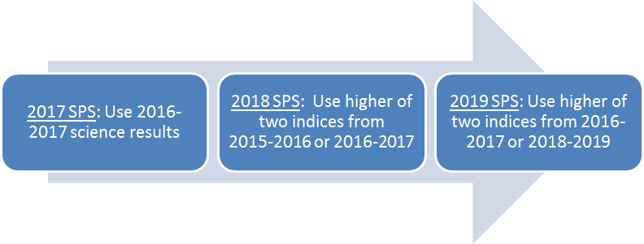
Science Assessment Index for 2018 SPS
BESE approved a policy for the 2018-2019 SPS to include the higher of the science assessment indices from 2016-2017 or 2018-2019.
NOTE: In 2019, the actual index points earned for 2016-2017 will be used if they were greater than points earned in 2018-2019. 2015-2016 index points will not be used in 2019.

Slide 16
2015-2016 and 2016-2017
Science Assessment Adjustment
The 2018 School Performance Score will include an adjusted science index from 2015-2016 or 2016-2017. The data for all students will be recalculated using the new achievement level point award for the 2018 SPS. The higher of the adjusted science indices will be used.
Students who earned 125 points for Mastery in the 2015-2016 or 2016-2017 science index will earn 100 points in the adjusted index.
Students who earned 100 points for Basic in the 2015-2016 or 2106-2017 science index will earn 80 points in the adjusted index.
The LDOE will release the indices to school systems later in the year.

Slide 17
Cohort Graduation Data Certification
In a few weeks, the LDOE will notify all accountability contacts and backup accountability contacts by email when the LA Data Review System opens for review of the 2016-2017 cohort graduation data that will be used in the 2018 SPS.
It is extremely important that the contact information provided to the LDOE is up to date.
Transcripts for students who are the the 2016-2017 cohort must include a graduation date in order to be credited as a graduate.
JumpStart credentials should be recorded in the Student Transcript System (STS).
TOPS-aligned dual enrollment courses must be evident on student transcripts.
The LDOE will conduct the annual review for students exited as out-of-state transfers, transferred to approved non-public school or BESE-approved home study. The students are identified on the roster and will become non-graduates if appropriate documentation is not provided to the LDOE by the close of cohort graduation data certification.

Slide 18
2017-2018 Assessment Administration

Slide 19
Technology Readiness

Slide 20
Technology Preparation
There are a number of actions that must occur
to prepare devices in schools prior to the
testing administration including setting up the
Testing Site Manager (TSM) and installing INSIGHT
on testing devices.
The following steps can be used to ensure that the
TSM and devices are connected and are working
properly.
Launch the Insight application.
Click on Test Sign In underneath End-of-Course.
Use the generic log in from one of the text-to-speech OTTs to log in. If the TSM is set up correctly then the text-to-speech will launch successfully.
Staff should check at least 1 device per TSM and Org Unit to ensure each the devices within each device organizational unit is set up correctly.

Slide 21
System Readiness Check
Before testing begins each day, students should run the system readiness check by following the steps below:
Open DRC INSIGHT.
Select the purple check mark in the bottom left corner.
Type 7745.
If the screen does not show all green check marks, alert your STC or technology coordinator.

Slide 22
Technical Assistance
If technical problems occur during testing, school and district staff should follow the ELPT or LEAP 2025 and LEAP Connect reporting protocol presented below. Technical problems include, but are not limited to, problems connecting INSIGHT, the inability to load test items, or missing buttons.
DRC Louisiana Customer Service AIR Louisiana Customer Service LDOE
1-888-718-4836 1-866-758-0231 1-844-268-7320 LAHelpdesk@datarecognitioncorp.com laelpthelpdesk@air.org assessment@la.gov
Student
Teacher/TA
STC
DTC/Technology Coordinator
DRC/AIR/LDOE

Slide 23
Online Scheduling Guidance
The Online Scheduling Guidance in available in the Assessment Library. The guidance allows schools and districts to view best practices for reducing testing time. Districts can decide how long they want their computer-based testing window to be based on the following:
Number of devices
Internet speeds
Number of sessions given in a day
The following guidelines for online administration still apply:
No more than 3 sessions in a day
Extended response sessions should not be given on the same day
Sessions within a content area must be given in order

Slide 24
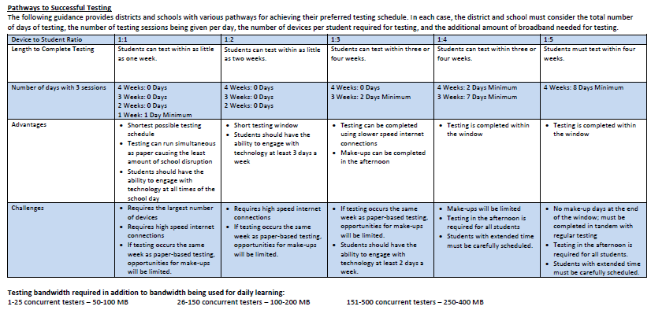
Online Scheduling Guidance

Slide 25
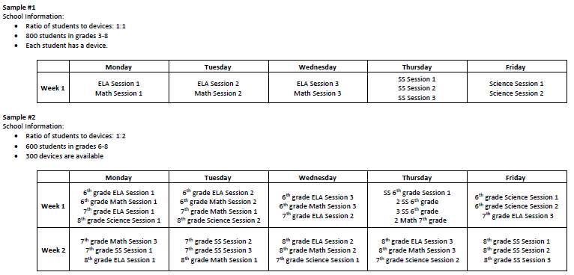
Online Scheduling Guidance

Slide 26
Scheduling Example
Below is an example of a school that tested one subject a week.
Week | Monday | Tuesday | Wednesday | Thursday | Friday
Week 1 | ELA Session 1 | ELA Session 2 | ELA Session 3 | Makeup | Makeup
Week 2 | Math Session 1 | Math Session 2 | Math Session 3 | Makeup | Makeup
Week 3 | SS Session 1 | SS Session 2 | SS Session 3 | Makeup | Makeup
Week 4 | Science Session 1 | Science Session 2 | Makeup | Makeup | Makeup

Slide 27
Scheduling Example
Below is an example of a school that tested two subjects a week for two weeks.
Week | Monday | Tuesday | Wednesday | Thursday | Friday
Week 1 | ELA Session 1 Math Session 1 | ELA Session 2 Math Session 2 | ELA Session 3 Math Session 3 | Makeup | Makeup
Week 2 | SS Session 1 Science Session 1 | SS Session 2 Science Session 2 | SS Session 3 | Makeup | Makeup
Week 3 | Makeup | Makeup | Makeup | Makeup | Makeup
Week 4 | Makeup | Makeup | Makeup | Makeup | Makeup

Slide 28
Technology FAQ
District Test and Technology Coordinators can access the Statewide Assessments FAQ about Technology document. The information contained in this document should be used to guide District Technology and Test Coordinators as they prepare for Spring assessments. It is suggested to review the eDIRECT Technology User Guide before reviewing this document. The questions represent questions District Technology Coordinators frequently have after reviewing the Technology User Guides. The Frequently Asked Questions are sorted into the following sections:
Testing Site Manager
Insight Client
Netbook Devices
Android Devices
iPad Devices
Chromebook Devices
nComputing Devices
eDirect
Load Simulation and Ping Trends
Error Messages

Slide 29
Troubleshooting
Districts and schools can use the Technical Troubleshooting Tips if technical issues occur during testing. This document is for school sites to use in order to eliminate common errors prior to contacting DRC for technical support. The document is outlined in the next slides.
If you run into a system message…
Reboot the machine
Does the error still occur?
Can you move the student to another computer within the same lab or mobile laptop cart?
Does the error still occur?
Mark the affected computer with a sticky note and notify your Information Technology (IT) department.
If IT staff cannot resolve the issue, have them call DRC Customer Service with the reporting information on page 3 of the document.

Slide 30
Troubleshooting
Common System Message | Troubleshooting Action
Invalid Username and Password | The student has either typed in the information incorrectly or has logged into the wrong testing location. Back out to the main menu and verify the location where the student is logging in. This is not a technical error.
Internet/Network Connection Error – There was an interruption in the internet connection and the testing device cannot reach DRC servers or the TSM. | Did the district technical department whitelist both the URLs and the IP addresses on all content filters, firewalls, and antivirus software?
 | If wireless, check the access point to computer ratio. Are there too many devices connecting to one access point?
 | Conduct a speedtest at www.speedtest.net to Minnetonka, MN. What is the upload and download speed? If it is less than 10 mbps, it is too slow to test.

Slide 31
Troubleshooting
Common System Message | Troubleshooting Action
TSM Connection Error – Workstation cannot connect to the TSM internally on the network. | Proceed with Internet Connection Error Troubleshooting
 | Contact local IT staff to confirm the local machine firewall is turned off if using a Windows OS TSM.
 | Contact local IT staff to confirm that the TSM service is running.
 | If no one can test, restart or reboot the service.
Configuration Not Found, Configuration Error – The testing device is not registered to the Device Toolkit and cannot proceed with testing until assigned an ORG Unit ID. | Contact local IT staff to register the device to the Device Toolkit
No TSM Configured – The Testing Site Manager has not been installed on the local network or configured in the Device Toolkit | Contact local IT staff to install or configure a Testing Site Manager.
The next button is grayed out. | The student has not completed the question on the test. This is not a technical error.
Frozen or Gray Screen with spinning wheel | Exit the test and reboot the machine. This is typically due to temporary overloaded internet traffic or maxed out memory on the computer.

Slide 32
Troubleshooting
Common System Message | Troubleshooting Action
Connection Error Retrieving Content – Testing Device cannot connect to the TSM or content servers to access test content. | Contact local IT staff to confirm that all content files are on the TSM management portal.
 | Contact local IT staff to confirm content files are up to date.
 | Proceed with Internet Connection Error Troubleshooting
Proxy 336 Error – This is an issue with configuration within the Device Toolkit. | Contact local IT staff to confirm that there is nothing in the proxy host field within the Device Toolkit. If so, erase, and redeploy a new configuration file with no proxy server settings.

Slide 33
Troubleshooting
No Audio | Does the audio stop after “Begin test?” Is the machine sound dialed more than halfway up? Does the audio work outside the software? Does the audio work from the speakers? Are the headphones plugged in before launching the software? Is the latest sound card driver installed? Is the TTS button checked in the TSM? Does the student have the text-to-speech accommodation checked in eDIRECT?

Slide 34
Troubleshooting
If after troubleshooting there are still issues with testing, contact DRC Customer Service with the information below. Write down the following information to prepare for your call with customer service:
Reporter/school/district/state
Phone or email
Student IDs (username and password if a phone call)
Number of students affected out of how many students
Date and description of the issue
Specific system or error message (e.g. “Internet Connect Error” or “TSM Connection Error During Login”)
When does the error message occur (e.g. when they select “Sign In?” or in the middle of testing)
Operating system/version (Mac/Windows/iOS/Chromebook/Android)
ORG Unit ID
Wired or wireless
Do the System Readiness Check. Are there red exclamation points? Which settings?

Slide 35
Troubleshooting
Contact DRC Customer Service at LAHelpDesk@datarecognitioncorp.com or 1-888-718-4836 with the following issues:
LEAP 2025 Platform Functionality:
User Administration (Adding and Editing Users in eDIRECT)
Materials Ordering and Additional Materials
Adding and editing students in Test Setup
Adding and editing test sessions and printing
Test tickets
Data Validation
Viewing and Downloading Student Reports
Materials Receipt, Inventory, and Return
Labeling of test booklets (Pre ID, District-School, and Do Not Process labels)
INSIGHT and TSM Installation, Functionality, and Troubleshooting

Slide 36
Training Accounts
Each LEA has a Sample School (777) in eDIRECT to use for training purposes only.
The training school will only be placed in the Practice Test 2018 Administration.
Ten sample students have been added to each 777 site and should be used to practice creating test sessions.

Slide 37
Test Security

Slide 38
Violations of Test Security: Related Policy
Violations of test security are defined in Bulletin 118 and include:
Administering tests in a manner that that would give examinees an unfair advantage or disadvantage
Giving examinees access to test questions prior to testing
Examining any test item at any time (except for providing certain accommodations)
At any time reproducing or discussing all or part of any secure materials
Coach or interfering examinees in any manner during testing
Altering or interfering with examinees’ responses in any manner
Administering previously administered or current forms of any statewide assessment
Failing to account for and secure test materials
Conducting testing in alternate environments without approval
Failing to report any testing irregularities
Participating in, encouraging, or failing to report any violation
Violations of test security can result in the revocation of a teaching or leadership certificate as defined in Bulletin 746.

Slide 39
Testing Irregularities: Definition and Reporting
Definition:
A testing irregularity is any incident in test handling or administration that leads to a question regarding the security of the test or the accuracy of the test data.
Process for reporting:
All testing irregularities must be reported in writing to the School Test Coordinator, who must then send the written reports to the District Test Coordinator.
Districts may only send the following information to LDOE
Louisiana Secure ID
First letter of first name
First three letters of last name
Birth date only (excluding birth month and birth year)t Administrat

Slide 40
Access: Definition and Processes
Definition:
Access is defined as handling the materials, reading, reviewing, or analyzing test items or student responses, either before, during, or after testing except where providing approved accommodations.
Processes for limiting access:
Limiting keys to locked secure areas
Conducting all precoding and sorting of materials in central secure locations

Slide 41
Secure Materials: Definition and Procedures
Definition:
Test materials that contain administration test items or student responses and to which access is restricted.
Secure test materials include:
student test booklets;
student answer documents;
student log-in information; and
any other materials containing test items or student responses (e.g., scratch paper)
Processes to ensure the proper accounting of materials:
Check in and check out procedures that include counting of materials
Procedures for distribution, collection, disposal of materials such as scratch paper
Appropriate training of all involved in assessment administration
Monitoring of processes during administration to ensure maintained security

Slide 42
Active Monitoring
Definition:
Active monitoring means that test administrators should be actively engaged in observing students’ behavior at all times during the administration of state assessments.
Practices to ensure active monitoring:
Active monitoring involves moving about the testing area so students’ actions can be viewed from multiple vantage points.
Test administrators should not be engaged in other activates that would distract or prevent them from accomplishing this task.
Test administrators should glance down at the tops and margins of the test booklets to ensure that students are working in the correct portion of the test.
Test administrators must be aware that active monitoring also applies to maintaining test security during breaks by limiting interaction between students.
Test administrators testing in a small group should pay attention to ensure students receive the appropriate accommodations at the appropriate times.

Slide 43
Active Monitoring: Violations of Test Security
While it is essential to actively monitor during test administration, it is considered a violation of test security for test administrators to do any of the following:
Unauthorized viewing of test content for any reason other than to ensure students are working on the correct area is a violation and can include:
Viewing test content long enough to determine the essence a question or prompt
Looking the test booklet to determine if a student marked responses
Viewing a testing booklet to see if a student used a strategy
Memorizing test questions
Copying test questions
Examining a graph or illustration

Slide 44
Preventing Plagiarism
Definition:
Plagiarism occurs when a student duplicates another student’s response or an external source. Examples include similar responses across multiple answer documents and use information from internet resources.
Practices to prevent plagiarism:
Administering the assessment to students taking the same test within the same day.
Limiting reopened sessions by scheduling in such a way that ensures student completion of individual sessions.
Prohibiting or limiting the use of other electronics within the testing environment
Limiting access to backpacks and other belongings during the administration
Ensuring technology readiness prior to administration in order to prevent previewing and reopened test sessions

Slide 45
Testing Students with Accommodations
Test administrators testing students with accommodations should be provided with the following:
Training on what accommodations each student will receive
A list of the accommodations each student is set to receive and when they should receive them
Processes for communicating with the testing coordinator should questions or issues arise during administration
Test administrators testing students with accommodations, including small group, are expected to actively monitor during administration including moving about the room and ensuring limited student interaction during any breaks.

Slide 46
Test Security Next Steps
Prior to administration of any state assessment district test coordinators are required to train school test coordinators in test security as well as any LEA level staff that may be participating in test administration or monitoring. School test coordinators are required to train school-level staff (e.g., test administrators, proctors, monitors).
Resources available for test security training include:
Test Coordinator and Administrator Manuals and
Test Security Training for Schools.
Next steps for district test coordinators:
Access Test Security Training for Schools.
Schedule school test coordinator and district staff test security trainings.
Provide test security training to school test coordinators and district staff.
Support school test coordinators in scheduling and providing training to school staff.
Plan for district active monitoring test administration.
Submit online assessment schedules to assessment@la.gov.

Slide 47
Investigation Support
Student tests should be voided if there is an instance of cheating—whether by a student or by anyone else. In the case of student cheating:
The Test Administrator should give the School Test Coordinator a written account of the incident, with any available additional documentation, including the lithocode number of the answer document or consumable test booklet and the domain to be voided.
The School Test Coordinator should convene a school-level test security committee consisting at a minimum of the principal, the School Test Coordinator, and the test administrator to determine whether a test should be voided. The STC will complete the Void Notification form and notify the District Test Coordinator of any voided test.
The District Test Coordinator should mark the test invalid in the appropriate online system and email a completed testing irregularity form to assessment@la.gov.

Slide 48
Investigation Support
The following items are required by Bulletin 118 for any test security investigation:
Explanation of the incident in complete detail.
A list of all people involved.
Description of the secure storage area and a list of people with access to the secure storage area.
Transcripts of interviews with the following people:
Principal
School Test Coordinator
Test Administrator(s)
Proctor(s)
Transcripts of interviews with multiple students regarding the information below:
Testing procedures
Layout of the classroom
Access to test materials before the test
Access to unauthorized materials during testing

Slide 49
Investigation Support
The following are recommendations based on best practices in conducting investigations:
Collect/view all evidence prior to conducting any interviews.
Schedule a plagiarism/answer change analysis viewing by emailing assessment@la.gov, if
applicable.
View security camera footage if available.
Obtain oaths of security and confidentiality, test security and administration sign-in sheets and training materials.
Interview test administrators, proctors, and students in question last. Interview other personnel first.
Questions should include general procedures and about the incident.
Ask as many open-ended questions as possible; limit the number of yes and no questions.

Slide 50
Investigation Support
Interview all individuals who were in the room but not directly involved in the event.
All interviews should be conducted at least twice across multiple days.
Questions should include general procedures and questions about the incident.
Ask as many open-ended questions as possible; limit the number of yes and no questions.
Individuals in this group should not be told who is being investigated.
Interview all individuals who were directly involved in the event.
All interviews should be conducted at least twice across multiple days.
Questions should include general procedures and questions about the incident.
Ask as many open-ended questions as possible; limit the number of yes and no questions.
Individuals in this group should not be told they are under investigation until absolutely necessary.
Avoid being overly aggressive. Investigators who are friendly and helpful get better results.

Slide 51
Off Grade Voids
All students should take the appropriate grade level or grade span assessment.
All official grade assignments are in SIS, and changes must be documented in SIS.
Students who take a grade level test lower than their enrolled grade or grade span will have their test voided.

Slide 52
LEAP 2025

Slide 53
LEAP 2025 Grade 3-8

Slide 54
LEAP 2025 Grades 3-8: Key Dates
Action | Key Dates
Manuals posted in eDIRECT | February 2
Manuals Delivered | March 9
Printed accommodation materials for CBT delivered to districts | March 9
Test Setup Opens (TA numbers assigned to CBT and PBT) | March 19
Computer-based Testing Window | April 9 - May 4
PBT materials delivery | April 16
Additional Materials Window opens | March 10 - CBT April 17 - PBT
Last day to order additional materials prior to the paper testing window, including large print, braille, and communication assistance scripts | April 24

Slide 55
LEAP Key Dates
Action | Key Dates
Paper-based testing window (see manual for daily schedule) | April 30 - May 4
Makeup Testing | May 7 – 8
Materials pickup 1 (scorables) | May 8
Test Invalidations and Void Forms due to LDOE | May 9
Materials pickup 2 (scorables and nonscorables) | May 10
Materials pickup 3 (administration materials) | May 12 – 19

Slide 56
LEAP 2025 Test Setup
The 2018 LEAP 2025 administration will be active in eDIRECT on March 19. District and school level users should do the following:
Upload additional students
Move students within the district
Create TA Numbers
Assign, verify, and view accommodations
Create test sessions
Generate and print test tickets
Review the eDIRECT User Guide under the General Information tab.

Slide 57
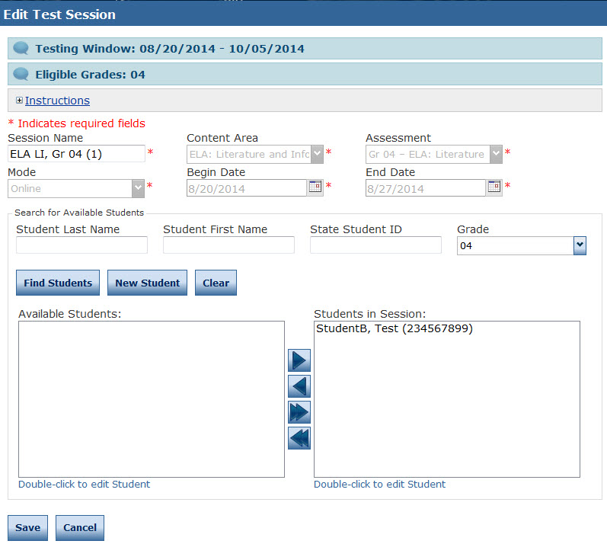
Creating and Editing Test Sessions
To create a Test Session:
Click on Add Session from the Test Session screen.
Populate the session details, then click on Find Students. This will display all the available students for the test session, by grade and content area.
To add the students to the test session, select the student, then click on the right facing arrow to add the students to the session.
Complete the above steps until all students are added to test sessions.
Note: The Upload Multiple Test Sessions option will be available in addition to creating individual test sessions.

Slide 58
Multiple Test Session Upload
DTCs and STCs can set up all test sessions at one time by using the Multiple Test Session Upload file steps below:
Select Test Management
Select Manage Test Session
Select Upload Multiple Test Sessions
Download the file layout and sample CSV File
Create the file for all students needing a testing session
Upload the file
Note: Student accommodations and TA numbers must be in the system prior to creating test sessions.

Slide 59
LEAP 2025 Manuals
There are two Test Coordinator and Test Administrator manuals: paper-based and computer-based.
Manuals are posted in eDIRECT and printed versions will arrive in districts on March 9.
The next slides include highlights regarding:
Testing Alerts
Test security
Test Schedules
Materials
Other Reminders

Slide 60
Testing Alerts
Accommodated Versions
Each content area has an accommodated version consumable test booklet for use with specific accommodations.
To help ensure the correct form is being administered, the accommodated version is identified on the cover page as “Accommodated Form” and is distributed as single books that are separate from the packs of 10 for consumable test booklets.
The accommodated version is included in the initial materials shipment and available to order as additional materials for students with any read aloud or transferred answers accommodation only. This will also be kitted with braille, CAS, and large print for transferring answers.
Students with read aloud by a human reader, Kurzweil file, or audio file MUST use the accommodated version.
Students having answers transferred from a consumable booklet to another consumable booklet MUST use the accommodated version. Test administrators must also use the accommodated version to transfer answers.

Slide 61
Testing Alerts
Preidentified Students
For CBT, DRC will upload preidentified students who were identified in the Student Information System (SIS) database as of February 1, 2018.
For PBT, students who were identified in the SIS as of October 1, 2017, are considered preidentified. For preidentified students, districts will receive bar-code labels (for use on ELA, Math, Social Studies, and the Science Field Test consumable test booklets) that are preprinted with the student’s information. Nonpreidentified students must have their information hand-coded on the document and then the school system bar code label added. Nonpreidentified bar-code labels must be affixed to consumable test booklets for students who were not preidentified
Accommodations
Student accommodations must be added prior to putting students in a test session; if accommodations are assigned after a student is put in a test session, the student will not receive the accommodated form.
Students with accommodations in SER and SIS will be uploaded by DRC.
Spanish directions and the calculator accommodation in eDIRECT will go live for Spring assessments.

Slide 62
Testing Alerts
Accommodations
STCs should review and verify accommodations for all students in eDIRECT.
School test coordinators must manually select accommodations or accessibility features in eDIRECT for students that have PNP or English Learner accommodations.
Spanish mathematics test materials are only available through an additional materials request.
School test coordinators MUST manually enter Read Aloud accommodations for students with accommodations in SIS. Students with Read Aloud accommodations in SER will be populated in eDIRECT.
Student accommodations will display on the Test Rosters so STCs can verify accommodations before handing out tickets.
Test Read Aloud labels are for consumable test booklets that are used to administer the Read Aloud accommodations. Affix this label to the front cover of the consumable test booklet, on top of the U-Blank barcode on the lower left corner. Do not place over the Security Barcode or the document will not be able to be checked in to DRC. All consumable test booklets with the Test Read Aloud label will not be scored.

Slide 63
Testing Alerts
Void Forms
To report a testing irregularity that might result in a voided test, school test coordinators must complete and submit the updated Void Notification form (page 37) to the district test coordinator. A form should be completed for each student involved in an incident. Void Notification forms and the Void Verification form completed by the district test coordinator must be submitted to the LDOE with other necessary documentation by Wednesday, May 9. Please note that this form has been updated to comply with new student data privacy laws.
Search and Score
Check carefully to ensure all post-administration procedures are followed and tests are submitted to DRC within the designated time frames per the key dates. DRC will charge the school system $100 to research any missing or unsubmitted tests, and, if a test is found, $100 to score it. This will result in a delayed score memo for the student.

Slide 64
Testing Alerts
997 Students
997 students identified as either nonpublic or Tuition Donation Rebate will require payment to participate in LEAP 2025 Spring 2018.
The cost per content area (ELA, Math and Social Studies only) is $50 to receive materials or test online and to score/report.
The participation FAQ and form are posted in the Assessment Library.
998 Students
District test coordinators should set up home study students for CBT in eDIRECT through the 998 school.
District test coordinators must affix bar-code labels for PBT with site code 998.
Monitoring
Ensuring the Proper Monitoring of Students. It is strongly recommended that one test administrator and at least one proctor for every testing group be present in a room during testing. Adding a proctor to the testing situation, even for a small group of students, allows the test administrator to address any issues while still maintaining test security. This is especially important for the computer-based testing due to the nature of the online environment.

Slide 65
Testing Alerts
Scratch Paper
Students must be provided scratch paper (blank, lined, or graph) as directed in the Test Administration Manuals.
Scratch paper used during administration of the assessments must be collected at the end of the administration of each session and turned in to the school test coordinator to be destroyed.
Accountability Codes
A student’s testing codes information cannot be viewed or edited until the student has been added to a test session in eDIRECT.
Accountability codes must be entered by the end of the testing window.
Test Tickets
The ELA, Math and Social Studies assessments each include three sessions or parts.
The Science Field Test assessment includes two sessions or parts.
A separate Test Ticket is required to log in to each session.

Slide 66
Test Security
Training
All staff involved in testing must be trained in test security prior to assessment day. Test security training information for paper-based and computer-based testing can be found in the Assessment Library.
Monitoring
Bulletin 118 requires all LEAs to have a plan to monitor all sites during testing. Monitoring forms for paper- and computer-based testing can be found in the Assessment Library.
Alternate Testing Environment Forms
The Permission to Test in Alternate Environment form is available in the Assessment Library. Forms are due 30 days prior to testing in the alternate environment. Forms should only be submitted if more than 40 students are testing in a single testing setting; or students are testing offsite.

Slide 67
Test Security
Investigations
Districts are responsible to investigate all testing irregularities. Testing irregularities resulting from the following require submission of an investigation to LDOE:
Void
Lost secure material
The Investigation template and forms are available in the Assessment Library.

Slide 68
Test Security
Secure materials must never be left in open areas or unsupervised. Supervision requires a person trained in test security. Test administrators must not be given access to secure test materials before the test administration day.
To the extent it is practicable, precoding and labeling of assessments shall occur at two central locations in a district prior to the assessment.
Security numbers are used to track individual documents. Test booklets have security numbers on the back cover. Answer documents and consumable test booklets have security numbers on the front cover. Security numbers on test booklets and answer documents do not match.
Principals are required to sign each Pre-Administration and Post-Administration School Test Coordinator’s Oath of Security and Confidentiality Statement before and after testing is completed, ensuring that security and test administration procedures were followed.

Slide 69
Test Security
Student tests should be voided if there is an instance of cheating—whether by a student or by anyone else. In the case of student cheating:
The test administrator should give the School Test Coordinator a written account of the incident, with any available additional documentation, including the lithocode number of the answer document or consumable test booklet and the domain to be voided.
The School Test Coordinator should convene a school-level test security committee consisting at a minimum of the principal, the School Test Coordinator, and the test administrator to determine whether a test should be voided. The STC will complete the Void Notification form and notify the District Test Coordinator of any voided test.
The District Test Coordinator should complete and email the Void Verification form by May 10, 2017, to LDOE at assessment@la.gov.

Slide 70
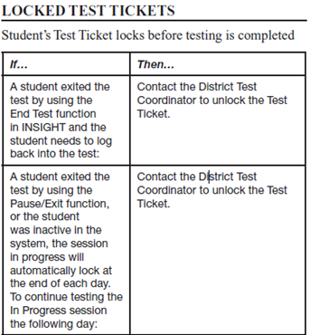
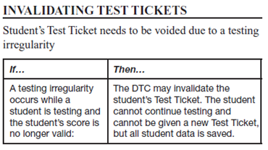
Test Security
Unlocking and Invalidating Test Tickets
Only the District Test Coordinator should have the permission to unlock and invalidate test tickets. Every time a DTC takes either of these actions a Testing Irregularity form must be sent to assessment@la.gov.

Slide 71
Test Schedules
All tests are strictly timed. No additional time is allowed except for students receiving the accommodation Extended Time. TAs will follow the directions in each Test Administration Manual.
Each test session must be administered and completed on the day it is scheduled.
For PBT, School Test Coordinators and principals will schedule makeup test sessions on the designated makeup date. Makeup testing must be completed before the final pickup of answer documents and consumable test booklets for the test administrations.
For CBT, users must enter the designated begin and end dates for each test session in eDIRECT.

Slide 72
PBT Schedule

Slide 73
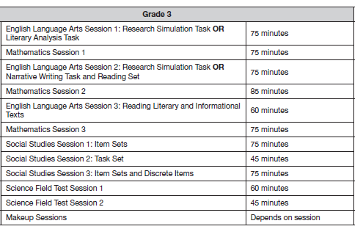
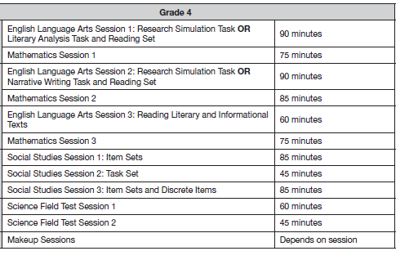
CBT Testing Times

Slide 74
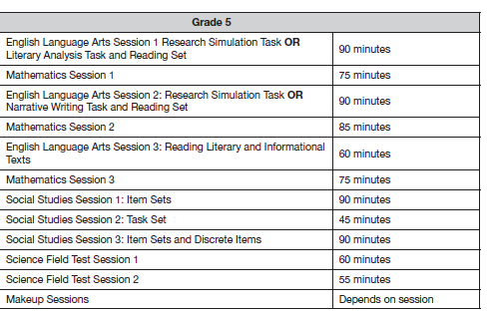
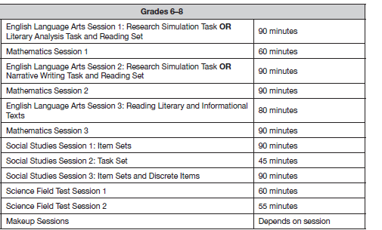
CBT Testing Times

Slide 75
Test Materials
PBT materials will be produced and packaged based on the October 1 enrollment. The ELA, Math, Science, and Social Studies test materials, including large print and braille and will arrive in districts according to the delivery schedule.
CBT uploads are based on February 1 enrollment.
To confirm accurate shipment of test materials, complete the Receipt Notice on eDIRECT immediately upon receipt of test materials. If there are any issues with the shipment (e.g., missing or damaged boxes), call DRC Customer Service at 1-888-718-4836 prior to completion of the Receipt Notice.
For each shipment, materials will arrive at the school system in boxes labeled with the district test coordinator’s name and the school system’s shipping address. Each box label references the school name and is sequentially numbered. A School Box Range Sheet indicates which school’s materials are contained in each box.
Boxes used for delivery of materials must also be used to return test materials. The additional shipping boxes may be provided to schools as needed.
District Test Coordinators will receive a packing list for all district materials in each shipment and a copy of each school’s packing list for each content area.

Slide 76
Test Materials
Large-print (PBT) and braille test materials will be boxed by school and delivered to the district in the same shipment as standard print materials. Exception: Spanish large print (PBT) will be provided as an additional materials request only.
Preidentified students using large print (PBT) or braille receive standard print consumable booklets preprinted with their student information and consumable test booklets with preidentified bar-code labels. The students’ responses must be transferred to these consumable test booklets.
For PBT, a Kurzweil DVD, Human Reader MP3 File DVD, Communication Assistance Scripts, and Social Studies accommodated version consumable test booklet (for students who have the Human Read Aloud or Text to Speech accommodation) must be requested as additional materials.
Each shipment of materials for schools includes overage. District Test Coordinators will also receive district overage materials, which must be inventoried and stored in the locked, secure storage area.
If an answer document, test booklet, or consumable test booklet is soiled, the District Test Coordinator should destroy the document by burning or by shredding if the document can be shredded. The Materials Accountability Form must also be completed in eDIRECT.
UPS is prescheduled to arrive at the district office on pickup days. There is no need to call UPS.

Slide 77
Test Materials
Before PBT begins, preidentified bar-code labels must be affixed to consumable test booklets for ELA, Math, and Social Studies by the STCs. Nonpreidentified bar-code labels must be affixed to answer documents and consumable test booklets for students who were not preidentified.
Colors for return labels and preidentified labels are listed below.

Slide 78
Other Reminders
Ensure your Technology Coordinator is aware of the following responsibilities:
Before Testing:
attending relevant monthly webinars
becoming familiar with Technology User Guide
installing secure web browser
ensuring computers are configured prior to testing
creating a Communication Plan with School Test Coordinator to support test
administrators during testing
During Testing:
being readily available while testing is in process

Slide 79
Other Reminders
DTCs should follow this following protocol regarding student transfers.
If… | Then…
A new student moves into the district | If it is just one student transferring, the designated DTC should email DRC customer support and request the transfer.If you are requesting a transfer for more than one student, the designated DTC should download the Student Transfer Form in eDIRECT, complete the form and then email it to DRC customer support. The DTC will receive an update on the request within 24 hours.
A student moves from one school to another school within the same district prior to testing | The DTC should edit the student’s information in eDIRECT before the student begins testing so that the student’s scores report to the correct school. The DTC must move the student to a different test session in eDIRECT.

Slide 80
Science Field Test for Grades 3-8

Slide 81
Features of the Science Field Test: Grades 3-8
All LEAs are required to participate in the science field tests.
Features of the Science Field Tests include:
two sessions
timed
same test window
online for all grades, district option for paper-based tests at grades 3 and 4
all items reviewed by educator committees
Grades | Session | Components | Time Allowed
3-8 | 1 | 2 item sets 3 discrete items | 60 minutes
3-4 | 2 | 1 task set | 45 minutes
5-8 | 2 | 1 task set | 55 minutes

Slide 82
Science Online Tools Training and Tutorials
The Science Online Tools Training (OTT) for grades 3-8 is currently available.
Students and teachers should practice the OTT prior to taking the Science field test.
The OTT can be accessed by clicking on the INSIGHT icon or using the web link in a Google Chrome Browser.
Tutorials are video overviews of the tools and are available in eDIRECT.

Slide 83
LEAP 2025 High School

Slide 84
Biology Embedded Field Test
The 4-level Biology EOC test will have embedded field test items aligned to the new LSS for Science.
All items will reviewed and approved by educator committees
This test remains untimed for 2017-2018.
Session | Number of Operational Items | Embedded Field Test | Suggested Time
1 | 23 MC | 1 item set 5 discrete items | 60
2 | 2 MC & 1 CR | 1 task set | 60
3 | 23 MC | 1 item set 4 discrete items | 60
Notes:
.

Slide 85
US History Teacher Survey
LDOE is beginning the collection of data from a US History teacher survey that will be used to inform the work of establishing the performance standards for each achievement level for new LEAP 2025 US History assessment.
It will be a representative sampling of 100 Louisiana US History teachers selected from across the state.
There will be required training through the Pearson Standard Setting website.
Using a list of approximately 30 students from their current classes, teachers will provide a judgment about the expected performance level in which each student would be classified, based on achievement level descriptors (ALDs).
Pearson will use the judgments collected to provide an analysis.
Information to selected teachers will be sent by March 13, 2018. The surveys will be conducted March 19-27, 2018.

Slide 86
Assessment Updates

Slide 87
New Online Graphing Calculator
What’s new:
Replaces DRC graphing tool
Fully functional Desmos graphing calculator
Desmos free online - access outside testing platform
What’s unchanged:
Online scientific calculator
Handheld calculators recommended
Calculator Policy
Available in all LEAP 2025 and LEAP 360 Algebra I and Geometry tests and resources.

Slide 88
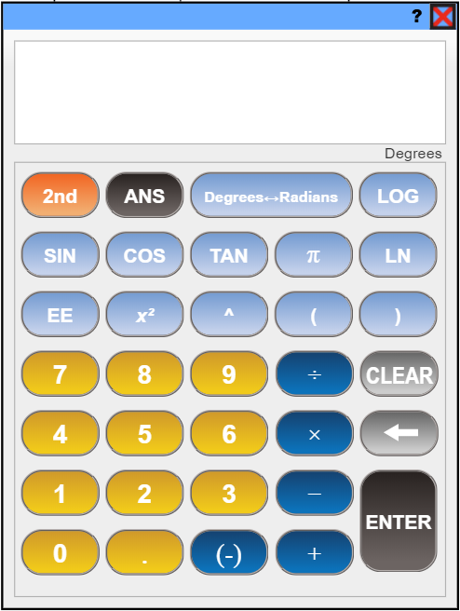
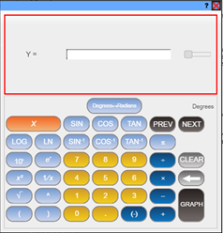
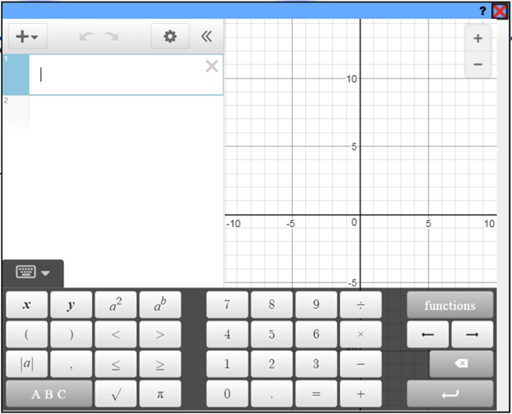
The Old vs The New
Same Scientific Calculator
Old DRC Graphing Tool
New Desmos Graphing
Calculator

Slide 89
New Desmos Graphing Calculator
Key Upgrades:
One screen
Coordinate plane, scale shown on axes
Allows all inputs of a graphing calculator
Is a fully functional graphing calculator

Slide 90
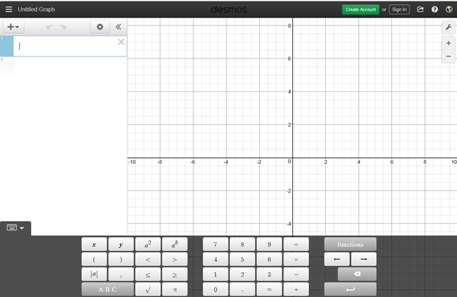
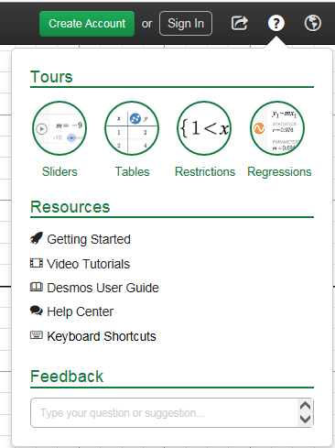
Desmos Online
https://www.desmos.com/calculator

Slide 91
Assessment Resources

Slide 92
LEAP 2025 Practice Tests
Practice Test library
Practice Test Quick Start Guide and guidance documents*
Webinars - presentations and recordings
Paper-based practice tests (grades 3 and 4)*
Practice test answer keys - paper-based and computer-based*
Accommodated practice test materials*
*Also found in eDIRECT
Practice Test Do’s | Practice Test Don’ts
Compare task approach with instructional approach Compare sources to those used instructionally Understand tasks associated with assessable content Guide selection of open-source materials Understand expectations for written responses Facilitate testing discussions with colleagues and students Practice timing/pacing | Gather cumulative data about overall student performance and preparedness Prioritize content based on the standards and GLEs represented on the practice tests Limit instructional strategies to those represented in the practice tests

Slide 93
LEAP 2025 Assessment Resources
Assessment Guidance library
LEAP 2025 Assessment Guides*
Science Field Test Guides*
Reference sheets, rubrics, and checklists*
Webinars - presentations and recordings
Sample social studies item sets and task sets
Equation builder guides
Link to Desmos online graphing calculator
Assessment library
LEAP 2025 Technology Enhanced Item Types
LEAP Accessibility and Accommodations Manual*
INSIGHT™
Computer-based practice tests
Online Training Tools
*Also found in eDIRECT

Slide 94
ACT and WorkKeys

Slide 95
ACT and WorkKeys: Important Dates
Dates | Resources
Jan. 29 – March 29 | Create test sessions and assign students to test sessions (ACT online only)
Feb. 5 – March 14 | Order additional WorkKeys accommodation materials in PearsonAccess^{next} (PANext)
Feb. 5 – March 16 | Request ACT-approved accommodations on the ACT for eligible examinees through Test Accessibility and Accommodations (TAA) using the ACT-approved Late Consideration Form
Feb. 9 – March 14 | Add students and update student information in PearsonAccess^{next} (PANext). Place additional orders for initial ACT test materials
February 16 | Request reconsideration of ACT-approved accommodations on the ACT in Test Accessibility and Accommodations (TAA)
Feb. 19 – 23 or Feb. 26 – March 2 | Receive ACT and WorkKeys test materials for initial testing, depending on which shipping date was selected in PANext
February 20 1:00 PM | Attend Q&A session about test administration. Registration link: https://act.ilinc.com/register/ypmvfvt
March 13 | Deadline to Validate configuration and lock down devices for ACT online testing only
March 19 | Deadline to conduct sessions for examinees to complete the non-test information on the answer documents for ACT paper testing
Mid-March | Updated ACT Match-No Match lists will be placed in the district FTP (See the district data coordinator for access)
The Schedule of Events for ACT and WorkKeys is posted on the ACT State Testing website. Refer to the ACT State Testing website for information on trainings, manuals, and other resources.

Slide 96
ACT Reminders
The Using PearsonAccess^{next™} for the ACT Test Guide provides instructions on how to submit a request to enroll or unenroll an examinee. This is only used to:
UNENROLL REQUESTS should only be placed when an 11th grade student or 12th grade student taking ACT for the first time transfers within the district AND can be verified in your local information system. Accountability codes must be applied for all other students no longer enrolled or not testing. This includes students who exited to a home study program or some type of adult education program (i.e., Youth Challenge, Job Corp)
ENROLL any 11th grade student or 12th grade student taking ACT for the first time who entered a school from anywhere not on the original roster.
SDU UPLOAD is used for 12th grade students retesting ACT.
The Using PearsonAccess^{next™} for the ACT Test Guide provides instructions on Student Data Upload (SDU) and the SDU template. This is only used to:
STCs and DTCs should check:
All 11th grade students and 12th grade students testing ACT for the first time are in PA Next and confirm that all demographic information is correct.
Enroll students for the state testing date who have previously been approved for accommodations in TAA.
Any 11th grade students appearing in PearsonAccess^{next™} who have already taken the ACT and do not wish to repeat the ACT may be removed from the rosters. These students do not need to remain or coded out. An ACT score is already documented.
Do not remove any student participating in LAA1 who has taken the LAA1 assessment. STCs will apply the appropriate accountability code in PearsonAccess^{next™} after testing. If a student has not taken a LAA1 assessment in high school, they must take the ACT by grade 12.

Slide 97
ACT Reminders
Students added to PearsonAccess^{next} after Feb. 2nd will not have pre-identified barcode labels. These answer documents must be hand coded.
The ACT Student Code is generated when students are entered into PearsonAccess^{next™}.
The ACT Student Code must be on the hand coded answer document for scoring.
Important Coding Information: The 9 digit ACT Student Code is used to match records. Pre-identified barcode labels will have this information. Hand coded documents will need this information coded.
* Block U on the answer document: Use the 9 digit ACT Student Code shown here.
Use the search function in Test Accessibility and Accommodations (TAA) to search for students who may have ACT-approved accommodations from prior administrations from either state or national testing dates.

Slide 98
ACT Online Reminders
Site Readiness
All proctor caching must be completed by February 2nd. If online testing was submitted and proctor caching was not completed by February 2nd, ACT will default the testing mode to paper.
To Do
Completing site readiness can take a few hours or several days, depending on the specific needs. To get started:
If students are testing with Text to Speech, STCs and IT staff should run a mock administration using the dummy students in the system to ensure that TTS is running correctly. Testing format may be changed to paper testing if TTS cannot be used. Orders must be placed by March 14th.
Make sure the test rooms used can meet the facility requirements.
If examinees need accommodations or English learner supports, identify what is available in the online vs. paper formats. Even if testing online, some examinees may need to test on paper.
Note: See your Schedule of Events for certain site readiness task deadlines.
Resources
The Site Readiness Plan presents a graphic overview of this process.
The technical requirements webpage contains hardware, software, and network requirements.
The Technical Guide provides proctor caching instructions.
The Mock Administration Guide has instructions for conducting a trial run.
The Administration Manual for Online Testing has information about accommodations, test rooms, and other preparations for online testing.
Your State testing website has more resources under Configuration, Verification, and Preparation in the ACT® section.
Preparing to take the ACT® has resources for students preparing to take the ACT®
For questions about the differences between administering ACT® online or on paper, please refer to The ACT Taken on Paper or Online document located on the ACT State Testing website.

Slide 99
ACT and WorkKeys: Support and Reminders
WorkKeys Reminders
Use only the 10 digit Louisiana Secure Identification Number (LASID) for the examinees ID number when enrolling students for WorkKeys tests.
DTCs and STCs need to update the materials quantities needed for ACT WorkKeys accommodations using PearsonAccess^{next}.
Allow 30 days between tests is to allow for remediation.
ACT and ACT WorkKeys Resources
Here are some resources for ACT and ACT WorkKeys that can be found on the ACT State Testing Website:
Verifying Student Information for Initial ACT Materials
Ordering Initial ACT WorkKeys Materials
Using PearsonAccess^{next™} for the ACT® Test

Slide 100
ELPT

Slide 101
Key Dates
Testing Window | February 5 – March 16
Additional Materials Window | February 5 – March 15
OTT | Available Now
Manage Users | Available Now
Manuals posted | TAM TA User Guide and TIDE User Guide ELPT Accessibility and Accommodations Manual Data Entry Interface (DEI) User Guide

Slide 102
ELPT Alerts
Security Checklists DTCs may access Security Checklists through TIDE. Go to Paper Ordering, choose Order History, choose the “+” next to the name of the school, click Reports, and open the file labeled “Online_SecurityChecklist.”
DEI User Guide The ELPT Data Entry Interface Guide (DEI) is posted in the ELPT portal. The DEI is a component of the Online Testing System that allows authorized users to enter student assessment data, such as item responses and scores. Entering student data is required only for the ELPT large print and Braille forms.
Secure Browser AIR is now supporting Mac OS X 10.13 for ELPT testing. A Secure Browser for use with Mac computers running OS X 10.13 is now available for download on the Secure Browser page of the portal.
Chromebook updates should be blocked throughout the ELPT testing window.

Slide 103
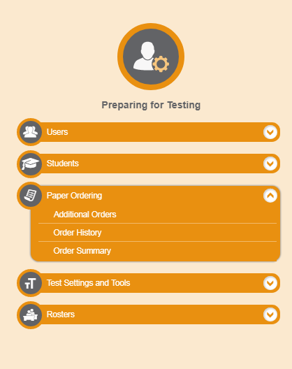
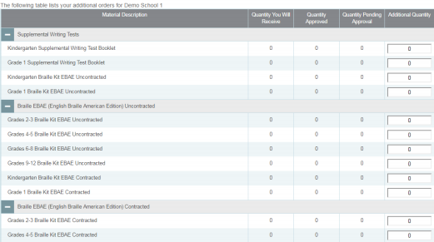
Additional Materials
District Coordinators can create and manage orders for paper-and-pencil test materials through “Preparing for Testing” column in TIDE.

Slide 104
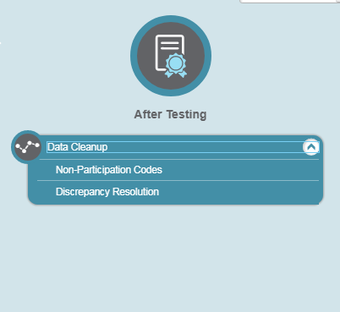
After Testing: Data Cleanup

Slide 105
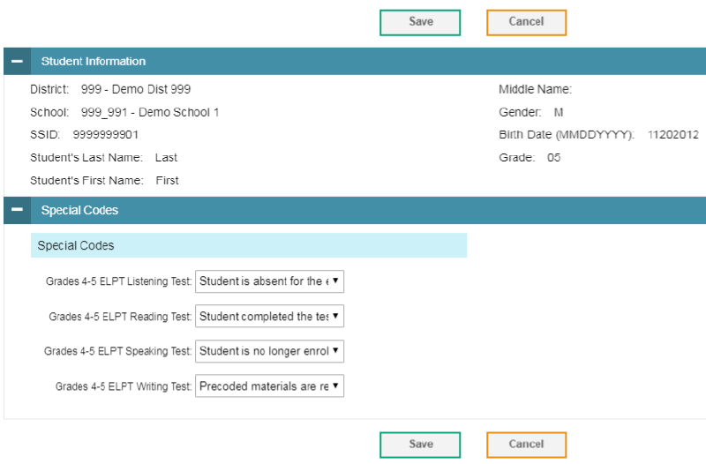
Non-Participation Codes

Slide 106
Training Modules
The following trainings modules are available in the Webinars and Trainings section of the ELPT portal:
Technology Requirements for Online Testing
Test Delivery System-Online Test Administration
Data Entry Interface-Paper Test Administration
Participation Reports
Online Reporting System
Test Information Delivery Engine (TIDE)

Slide 107
ELPT Resources
ELPT Assessment Guide | overview of assessment design, rubrics, alignment, and more
ELPT Achievement Level Descriptors | guide to the achievement levels for each grade and domain
English Learners Library | LDOE website for English Learner Specialists/Teachers
ELPT OTT | access to the online testing platform for students/teachers to practice using the system
ELPT FAQ | list of Frequently Asked Questions for teachers and administrators
Parent Guide to ELPT | two-page document outlining the ELPT that is also available in Arabic, Spanish, and Vietnamese
TA User Guide | guide for ELPT Test Administrators
TIDE User Guide | guide for the ELPT TIDE system
ELPT TA Training | training for test administrators
ELPT DTC Training | Training for district test cooridnators
ELPT Portal | website that houses ELPT systems
ELPT Teacher Training | ELPT assessment guide training for teacher

Slide 108
LEAP Connect/LAA1

Slide 109
Key Dates
Testing Window | February 5 – March 16
Additional Materials Window | January 29 - March 15
OTT | Available Now
SRC | Available Now
Manage Users | Available Now
Manuals/Documents | LEAP Connect TCM LEAP Connect TAM Procedures for Assessing Students who are Blind, Deaf, or Deaf-Blind OTT DTA for ELA/Math TA Quiz

Slide 110
LEAP Connect Alerts
Directions for Test Administration
The Directions for Test Administration (DTA) provide the Test Administrator (TA) with specific instructions for administration of the particular test. Each DTA provides the exact wording of the items to be used by the TA, the materials needed in preparation of the test, and guidelines for how to present the items to the student. Prior to testing, this must be reviewed in a controlled setting with the school test coordinator. After the review, the school test coordinator must collect the Directions for Test Administration and securely store until testing begins. After testing, these secure materials must be returned to DRC.
Verbal and Nonverbal Assessments for ELA Grades 3 and 4
Students in grades 3-4 will have a Foundational Reading section on the ELA assessment. eDIRECT test sessions will need to be assigned by students who are verbal or nonverbal. When creating test sessions, under the Assessment dropdown, select either the verbal or nonverbal assessments to ensure the group of students who are verbal or nonverbal receive the correct form. Students in grades 5-8 do not have this section on the ELA test, so there is not two options for test setup for ELA.

Slide 111
LEAP Connect Alerts
Test Delivery Method
Test administrator provides a one-to-one test administration using the online test platform (INSIGHT) and Directions for Test Administration for grade specific item presentation and response collection. All passages, items, and response options are designed to be read to the student through text-to-speech or by the test administrator. Administration of Tasks If after attempting at least four tasks in a content area the student is unresponsive on all of the items, you may exit and close the test. Note: If the student is unresponsive because he or she is having a bad day, try administering the test on another day.
End of Test Survey
At the end of each student’s test in INSIGHT, there is a survey for TAs to complete and submit. This will provide useful feedback on the experience of each TA administering LEAP Connect.

Slide 112
Accountability Codes
District and school test coordinators should wait until the very end of the testing window to do all accountability coding in the eDIRECT system.
At the end of the testing window, students who do not test must be placed into a test session for each subject and coordinators must apply the appropriate accountability code for the student (should have documentation on file). Failure to apply a code could result in a forced zero for each subject test that the students did not complete.
Steps to pull up list of applied accountability codes:
Manage Test Session
Select District and School
Export student details
Applied accountability codes will be in the column labeled Testing Codes.

Slide 113
LEAP Connect/LAA1 Resources
LEAP Connect Webinar-the recording of the assessment overview webinar presented in December.
LEAP Connect Assessment Guide—access the LEAP Connect Assessment Guide
LEAP Connect Achievement Level Descriptors—a guide to the Achievement Levels with a list of the skills and knowledge students at each level are generally able to demonstrate
LEAP Connect Sample Items-a webinar/presentation with sample items
LEAP Connect Online Tools Training-a chance to preview the testing platform and practice the online tools that will be available during testing.
Strategies for Success: A Guidebook for Supporting Students with Disabilities-the SPED Guidebook
LA Connectors for Students with Significant Disabilities—list of SWSD connectors for K-12 ELA and math
LA Connectors Essential Elements Cards—cards that assist educators with individualizing instruction for SWSD both in inclusive and self-contained environments
Parent Guide to LEAP Connect-a two page guide for parents on the LEAP Connect

Slide 114
LEAP 360

Slide 115
LEAP 360 (2018-2019)
The Department is preparing for the second year of LEAP 360 implementation. School systems that signed a LEAP 360 Memorandum of Understanding (MOU) for the 2017-2018 school year may choose to continue using LEAP 360 through June 30, 2019, under the same terms and conditions.
LEAP 360 will be available to districts in the 2018-2019 at no cost.
Year two provides school systems with an opportunity to:
re-evaluate existing practices,
reduce duplicative testing, and
transition to a more comprehensive assessment system that yields valid and reliable information on student performance throughout the school year.

Slide 116
LEAP 360 (2018-2019)
Next Steps
The LDOE is continuing to gather feedback from school systems and school level users through focus groups, site visits, and assessment@la.gov. Enhancements across usability, administration, and reporting will be implemented for the 2018-2019 school year.
To opt-in and amend your school system’s existing agreement, each Superintendent must sign an amendment to the original agreement.
Please click here to download the LEAP 360 MOU Amendment (2018-2019) form. Complete, sign, and return an electronic copy to assessment@la.gov by July 7, 2018.
Note: School systems should anticipate a cost for the 2019-2020 school year.

Slide 117
LEAP 360 Resource Availability Timeline
Resource | Available | Purpose
K-2 Formative Tasks | Currently available in eDIRECT Kindergarten, grade 1: 6 math tasks, 6 ELA tasks Grade 2: 4 math tasks, 4 ELA tasks | Aid and enhance student learning while allowing teachers to make timely interventions to adjust instruction throughout the year
Diagnostics | Currently available in eDIRECT Grades 3-8: ELA and math, English I, English II, Algebra I, and Geometry | Help educators identify prerequisite skills students need for success in the current grade level
Interims | Form 1: currently available in eDIRECT Form 2: currently available in eDIRECT Form 3 (HS): currently available in eDIRECT | Help educators identify students’ misconceptions and learning patterns to adjust instruction and target support (grades 3-8 ELA and math, English I, English II, Algebra I, and Geometry)

Slide 118
Support and Communication

Slide 119
DTC and Accountability Contact Update
If during the academic year the person appointed as district test coordinator changes, the district superintendent must notify the LODE. The notification must be in writing and must be submitted within 15 days of the change in appointment.
Due to the secure nature of the data accessed by accountability contacts and district test coordinators, changes have been made to the submission process for any updates to DTC and accountability contacts:
Superintendent signature now required
The DTC and Accountability Contact Update Form must be submitted from the superintendent’s district email account.
The revised DTC and Accountability Contact Update Form is located under the Resources + Forms section in the Assessment Library.

Slide 120
District Support
The Assessment team offers multiple avenues of support to districts, schools, and teachers seeking information or assistance about assessment administration and accountability.
Weekly Newsletters
Assessment and accountability information and deadlines are released each week in the district newsletter.
Weekly Assessment & Accountability Calls
Each Tuesday at 1:00 PM these webinars are held to provide training, updates, and important information to DTCs and Accountability Contacts.
Assessment Library and Accountability Library
The Assessment Library contains resources for DTCs including the Assessment Schedule and the Assessment and Accountability Month-by-Month Checklist. The Accountability Library contains resources for accountability contacts including the School Performance Score (SPS) calculators as well as information on data certification and federal accountability.

Slide 121
District Support
Monthly Educational Technology Calls
Each month a webinar is held for district technology personnel to provide training, updates, and important information related to technology readiness and digital literacy.
Assessment@
All stakeholders are encouraged to email assessment and accountability questions and/or concerns to assessment@la.gov.
Assessment Hotline
For immediate assistance regarding assessment and accountability, district-level staff may call the Assessment Hotline at 1-844-268-7320.
EdTech@
All stakeholders are encouraged to email technology readiness questions and/or concerns to edtech@la.gov.

Slide 122
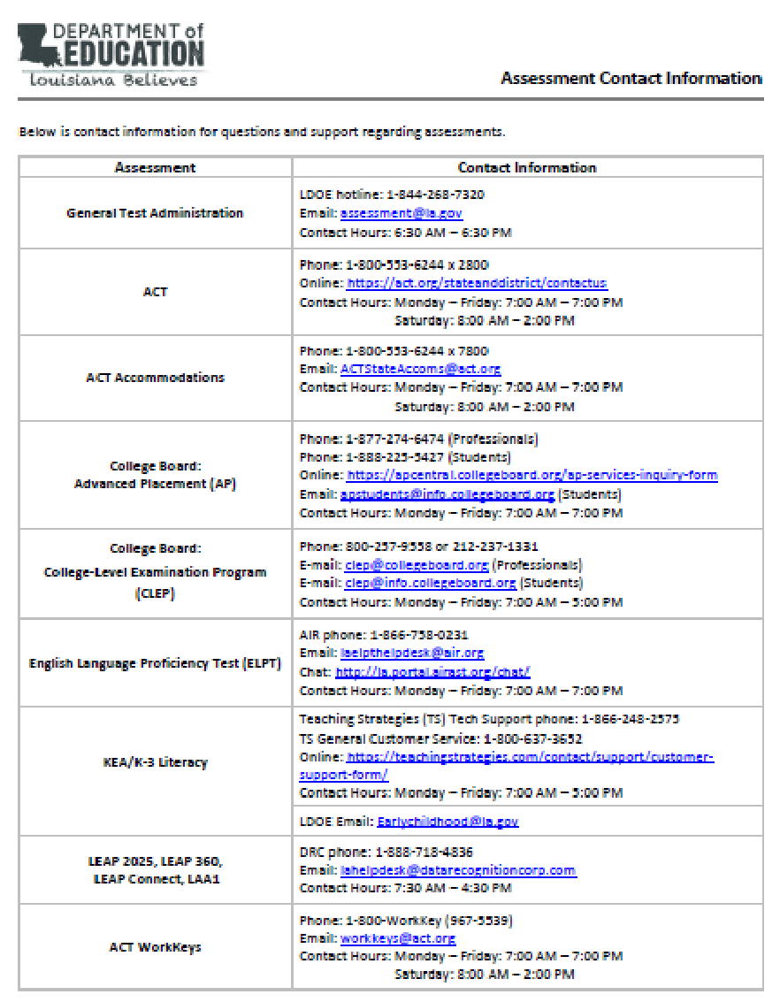
Assessments Customer Service
The Assessments Customer Service Contact Information has been posted to the Assessment Library. This provides all customer service contact information for all assessments.

Slide 123
Next Steps

Slide 124
Next Steps
Key Dates | Action
February | Train STCs for ELPT and LEAP Connect Students and teachers must use the ELPT and LEAP Connect OTT prior to testing Use LEAP 2025 Practice Test resources to make district and school planning decisions Update contact list for new accountability or testing staff Verify graduation dates on transcripts for all students in 2016-2017 graduation cohort. Upload Jump Start credentials to STS for all students in 2016-2017 graduation cohort. Request reconsideration of ACT-approved accommodations on the ACT in Test Accessibility and Accommodations (TAA) Send all ELPT and LEAP Connect voids to assessment@la.gov at the conclusion of each week of testing.
Next Assessment and Accountability Monthly Call: March 13, 2018

