Slide 1
Assessment and Accountability Monthly Call
June 2018

Slide 2
Agenda
Month-by-Month Checklist
Accountability
Assessment Administration
Assessment Updates
Support and Communication

Slide 3
Month-by-Month Checklist
The 2017–2018 Assessment and Accountability Month-by-Month Checklist
identifies key dates and deadlines for statewide assessment programs and accountability processes for next school year;
provides action steps to ensure readiness for administering statewide assessments; and
recommends resources for district and school staff.
The checklist includes information on the following areas:
Communication and Support
Accessibility and Accommodations
Assessment Preparation and Administration
Accountability
Reports
NEW: The 2018-2019 Assessment Month-by-Month Checklist is located in the Assessment Library.

Slide 4
June Assessment and Accountability Checklist
Communication and Support
June 19: Monthly Assessment and Accountability Call
Accountability and Assessment Preparation
Early June: Ensure that INSIGHT has been installed on all devices that will be used for Summer high
school LEAP 2025 testing
Early June: Set up TSMs for high school LEAP 2025 testing
Early June: Utilize scheduling guidance to determine final Summer high school LEAP 2025 test schedules
prior to setting up test sessions in eDIRECT
Early June: Complete test setup within eDIRECT in preparation for Summer high school LEAP 2025
June 18: LEAP 360 for the 2017-2018 year will close.
June 22: Report all LEAP 2025 high school test irregularities to assessment@la.gov
Mid-June: NCRCs (WorkKeys certificates) will begin arriving at schools
By June 30: 2017-18 ACT/WorkKeys invoices will be emailed to superintendents, financial contacts, and copied to DTCs
Assessment Administration and Reporting
June 18–22: Administer LEAP 2025 Summer 2018 tests

Slide 5
Accountability

Slide 6
2017-2018 Reporting: Adjusted Prior Year Science Indices
This spring, items for a new science assessment were field tested.
Since field test results are not used to calculate a science index for the 2018 school performance score, the Department will use the higher of the two prior-year science indices, 2015-2016 or 2016-2017.
The science index that is used will be adjusted to reflect the points awarded at each achievement level on the 2017-2018 assessment index scale.
The Department will post the adjusted science index scores to the secure ftp by end of June.
Achievement Level | Prior Years | 2017-2018
Advanced | 150 | 150
Mastery | 125 | 100
Basic | 100 | 80
Unsat/Approaching Basic | 0 | 0

Slide 7
2017-2018 Reporting: New Accountability Policies
In response to feedback from local superintendents, accountability directors, and school leaders over the past few months, the Department is recommending three technical clarifications to Bulletin 111. These will be considered by BESE at its June meeting so that they can be implemented in the 2017-2018 SPS and letter grade release this fall.
Allowing K-3 schools to receive progress indices from a paired school
Allowing accountability points for fifth year graduates who earn associate degrees
Clarifying language regarding the subgroup performance component to better reflect the intent that schools with at least 10 students in a subgroup are scored
In addition, Bulletin 118, specifies that students shall be subject to a 30-day wait period before testing on WorkKeys assessments. This policy was scheduled to take effect in Spring 2018 for purposes of school and district accountability. However, per the request of school systems, the Department is recommending that BESE approve a waiver for the 2017-2018 school year for purposes of accountability.

Slide 8
2017-2018 Reporting: Release of School Report Cards
2017-2018 school report cards and early childhood performance profiles will be released in the fall in the Louisiana School Finder. School Finder will report an overall School Performance Score and letter grade, as well as a score and letter grade equivalent for achievement and progress.
In order to ensure full transparency and to allow families to compare school performance over time, the Department will publish 2017-2018 school ratings using the previous accountability formula as well as the new formula.

Slide 9
2018 School and Center Performance Release Timeline
Key Milestones | Date
Cohort Graduation Rate and Strength of Diploma data certification in LA Data Review | March 19-April 13
LEAP online cleanup for progress index | June 11-15
Released: 2017-2018 teacher-level VAM results (CIS); 2017-2018 final student progress index results (Louisiana Data Review); 2018-2019 student growth to Mastery targets (Louisiana Data Review) | early August
ACT Highest Score/WorkKeys; Dropout/Credit Accumulation Index (DCAI); Assessment Data Certification: LEAP 2025,EOC, LAA 1/LEAP Connect, ELPT data certification in LA Data Review | August
School system leaders preview updates to School Finder at Supervisor Collaborations and resources to communicate results with families and community leaders | September 10, 13, 17, and 18
Department hosts calls with Lead Agencies and Superintendents to preview performance data | Prior to release in late fall
2018 report cards and early childhood performance profiles released in School Finder | Late fall
Principals provided support in understanding and communicating SPS results, new progress index, and use of Principal Profiles at Principal Collaborations | November 8, 13, 14, 15
Release of Superintendent and Principal secure portal, schools and systems use data to guide 2019-2020 academic planning | Early winter
Schools and centers hold parent nights to discuss performance results | Winter

Slide 10
2018 School Performance Score Resources: For Teachers
Audience | Resources | Release Timeline
Teachers | Using Measures of Student Progress to Strengthen Practice and Increase Learning Deliberately Addressing Student Growth to Mastery Mastery or Growth Additional guidance for teachers on how to use student growth data to make adjustments to instruction (coming this fall) | Teacher Leader Summit Teacher Leader newsletter Training at the September Teacher Leader Collaborations

Slide 11
2018 School Performance Score Resources:
For School and System Leaders
Audience | Resources | Release Timeline
School System Leaders, Lead Agencies and Principals | Accountability Policy Update: guidance on 2017-2018 accountability updates Early Childhood performance updates and improvement strategies: Summit Sessions E008, E009, E010, E017, E019, E021, E023, E024, E040, E046, E056, E057, E068, E017 Communications Toolkit (coming this fall) Customizable presentation for communicating this year’s district and school performance scores, and Comprehensive and Targeted Intervention designations Social media and website graphics celebrating school growth and Top Gains schools Louisiana Accountability System information card for families Media Support Guide with sample news releases and talking points for reporters Animated videos explaining school performance scores, including the new “Student Progress” Index Louisiana School Finder flyer: information on how to access School Finder; should be sent home with the printed report card Superintendent and Principal Secure Portal FAQ (coming this fall) | Teacher Leader Summit September and October school system planning calls LDOE weekly newsletter Training at the September and November Collaborations

Slide 12
2017-2018 Reporting: Certifying SPS Data
Prior to the release of school performance scores, school systems and schools are provided with opportunities to review all data.
Timeline | Data Element | System Used to Deliver Data and Receive Requests for Changes
March 19-April 13 CLOSED | Cohort Graduation Rate and Strength of Diploma | La Data Review
June 11-15 CLOSED | Test records used for Progress Index | DRC eDIRECT Portal: Student Correction System
Early August | ACT Highest Score/WorkKeys Dropout/Credit Accumulation Index (DCAI) | La Data Review
Early to Mid August | Assessment Data Certification: LEAP 2025,EOC, LAA 1/LEAP Connect, ELPT | La Data Review

Slide 13
LEAP Connect in Accountability
LEAP Connect/LAA 1 scores are:
Calculated in the SPS in the same way as regular tests
Included in SPS for all students who meet full academic year rules
Weighted double for grades 3-8 ELA and math as are LEAP 2025 regular testing for grades 3-8
Included only if the student meets the requirements and is identified on a current IEP prior to the opening of the testing window (students assigned zeros if they are determined ineligible)
Achievement Level | AI Points
Exceeds Standard or Level 4 | 150
Meets Standard or Level 3 | 100
Level 2 | 80
Working towards Standard or Level 1 | 0

Slide 14
ESSA Requirements for English Language Proficiency
Under Title III of No Child Left Behind (NCLB), districts were required to report progress (AMAO 1) and status (AMAO 2) on the state English Language Proficiency (ELP) assessment. Because ELP was part of Title III, consequences for not meeting AMAOs were not applicable to districts not receiving Title III funding and were not included in SPS.
ESSA changed this.
Under ESSA, “progress in achieving ELP” must be used as one of four mandatory indicators in school accountability systems. Progress in achieving ELP (and the three other mandatory indicators) must have “much greater weight” in the accountability system than “school quality or student success.”

Slide 15
English Language Proficiency in Louisiana’s ESSA Plan
In Louisiana’s ESSA plan, as approved by the USDOE, Louisiana proposed to measure school success with English language learners in two ways:
Progress towards English language proficiency, as measured by the English language proficiency exam, will be included within the assessment index of each school beginning in 2018-2019 (2017-2018 is baseline).
This ensures all student scores are included regardless of the number of English language learners in a school, and that all such scores are weighted equally with the assessment results of all students in the school.
As provided for in ESSA, the measure of progress towards English language proficiency will consider a student’s ELP level at the time of identification and may also account for other characteristics such as age, grade, native language proficiency level, and time in formal education.
Both the English language proficiency results and English learner subgroup results on all other SPS indicators will be publicly reported on school report cards.

Slide 16
Preliminary Timeline for ELPT in Accountability
Activity | Timeline
Working Group Meeting #1 | April 2018
Working Group Meeting #2 | May 2018
Analyze ELPT results | May-June 2018
Working Group Meeting #3 (with analysis of ELPT data) | June 2018
Accountability Commission | Summer 2018
BESE | Summer/Fall 2018
ELP progress measure included in SPS | 2018-19 (2019 SPS)

Slide 17
2017-2018 Assessment Administration

Slide 18
2017-2018 Reporting: Communicating Assessment Results
Assessment | Student Reports | School System-Level Results | Public Release
ELPT | May 15 in AIR Portal | May in AIR Portal | N/A
LAA 1/LEAP Connect | May 15 in eDIRECT | May in eDIRECT | N/A
CLEP | ongoing | Spring in FTP | Early July
LEAP 2025 (3-8, HS) | Grade 3-8: By June 30 in eDIRECT HS: 5-level ELA and math at end of testing window | By June 30 in eDIRECT | Early July
EOC (Eng III, Bio, US History) | HS 4-level all subjects: In window | summer in eDIRECT | N/A
ACT | spring, state administered student and school results from ACT sent to schools | iCD and district profile from ACT in summer; additional reporting in FTP | August
Advanced Placement | summer, sent to schools | August in FTP | August
LEAP 2025 US History | Summer in eDIRECT | early fall in eDIRECT
Please contact assessment@la.gov with questions.

Slide 19
Technology Readiness

Slide 20
Technology Preparation
There are a number of actions that must occur
to prepare devices in schools prior to the
testing administration including setting up the
Testing Site Manager (TSM) and installing INSIGHT
on testing devices.
The following steps can be used to ensure that the
TSM and devices are connected and are working
properly.
Launch the Insight application.
Click on Test Sign In underneath an assessment.
Use the generic log in from one of the text-to-speech OTTs to log in. If the TSM is set up correctly then the text-to-speech will launch successfully.
Staff should check at least 1 device per TSM and Org Unit to ensure each the devices within each device organizational unit is set up correctly.

Slide 21
System Readiness Check
Before testing begins each day, students should run the system readiness check by following the steps below:
Open DRC INSIGHT.
Select the purple check mark in the bottom left corner.
Type 7745.
If the screen does not show all green check marks, STCs or technology coordinators should be alerted.

Slide 22
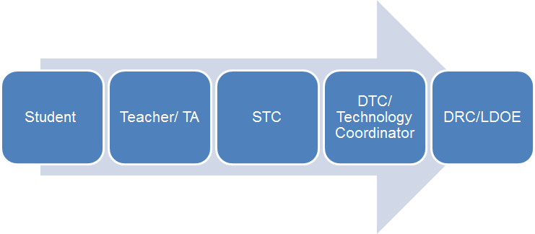
Technical Assistance
If technical problems occur during testing, school and district staff should follow the Assessment Technical Assistance reporting protocol presented below. Technical problems include, but are not limited to, problems connecting INSIGHT, the inability to load test items, or missing buttons.

Slide 23
Online Scheduling Guidance
The Online Scheduling Guidance in available in the Assessment Library. The guidance allows schools and districts to view best practices for reducing testing time. Districts can decide how long they want their computer-based testing window to be based on the following:
Number of devices
Internet speeds
Number of sessions given in a day
The following guidelines for online administration still apply:
No more than 3 sessions in a day
Extended response sessions should not be given on the same day
Sessions within a content area must be given in order

Slide 24
Technology FAQ
District Test and Technology Coordinators can access the Statewide Assessments FAQ about Technology document. The information contained in this document should be used to guide District Technology and Test Coordinators as they prepare for Spring assessments. It is suggested to review the eDIRECT Technology User Guide before reviewing this document. The questions represent questions District Technology Coordinators frequently have after reviewing the Technology User Guides. The Frequently Asked Questions are sorted into the following sections:
Testing Site Manager
Insight Client
Netbook Devices
Android Devices
iPad Devices
Chromebook Devices
nComputing Devices
eDirect
Load Simulation and Ping Trends
Error Messages

Slide 25
Troubleshooting
Districts and schools can use the Technical Troubleshooting Tips if technical issues occur during testing. This document is for school sites to use in order to eliminate common errors prior to contacting DRC for technical support.

Slide 26
DRC INSIGHT Update
During the week of June 25th DRC will release the INSIGHT update that will be needed for the 2018-2019 school year.
Devices that are set to automatically update will need to be on and connected to the internet in order to receive the update.
Devices not set for automatic updates will need to be manually updated prior to testing.

Slide 27
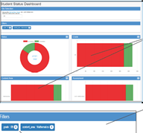
Student Status Dashboard
The Student Status Dashboard allows you to display student testing status by school and administration. You can filter information on the Dashboard by testing status, grade, content area and assessment (or any combination of these). The Student Status Dashboard User Guide is located in eDIRECT.
Note: Dashboard data displays in real time as test scores are populated in the database. You need the student status permission in eDIRECT to use the Dashboard.

Slide 28
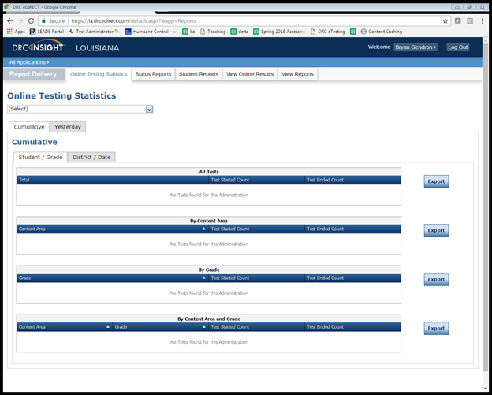
Testing Statistics Reports
eDIRECT has a number of reports to help District Test Coordinators assess the status of their schools during testing. These reports are located in the Online Testing Statistics tab. These reports include:
Online Testing Statistics
Shows the number of students
by school and subject that have
completed testing for the current
and previous day only.

Slide 29
Testing Statistics Reports
Below are other reports that are located under the Status Reports tab.
Daily Cumulative Student Status Reports
Displays all students in a test session and the ticket status of those students
Daily Student Status Report
Displays the start and submit times of each student that logs into a test
Daily School Resets Report
Displays all unlocked test sessions
Excessive Login Report
Shows the number of times a student logged in
Daily State Summary of Test Times Report
Displays the duration in which students completed the test
Daily District Report of Testing Status by School
Displays the number of tests started and ended for the district and school

Slide 30
Online Tools Training
The Online Tools Training (OTT) should be utilized in order to become familiar with the online testing tools (e.g., highlighter, magnification, etc.) used for the operational test. Additionally the OTT:
may be reviewed as many times as desired;
is not to be considered representative of an actual test; and
is available once INSIGHT is installed or by link using Google Chrome browser.

Slide 31
Test Security

Slide 32
Test Security Updates
BESE directed the LDE to create a mechanism for school systems wishing to appeal test security decisions by the LDE. The draft revisions to Bulletin 118, Statewide Assessment Standards and Practices, contain the following:
School systems are no longer required to investigate every void. However, school systems wishing to contest a void must submit a request in writing, including a report resulting from an investigation pursuant to Bulletin 118 §5305.A.3.
The LDE shall provide a list of recommended investigators that may be used by school systems to support this process.
The investigation shall produce verifiable evidence that corroborates, with a high degree of certainty, that a testing irregularity did not occur.
Annually, at a public meeting, the test irregularity review committee shall conduct a records review of the investigative results from the school system as well as any relevant evidence from LDE.
The test irregularity review committee - made up national, state, and district experts and representatives - will make recommendations regarding any potential void reversals.

Slide 33
Caveon Test Security Services
In order to help districts and schools improve test security, the LDOE has negotiated an agreement with Caveon, the nation’s leading test security experts, to provide the following services:
Monitoring
Provides two Caveon monitors on campus on one day of testing
Provides districts with accurate information of every testing room at the school
Investigations
Provides districts with professional investigators to investigate and report on any testing irregularity that occurred in the district
Training
Provides districts with active online training modules created by Caveon
A full explanation of the services and the fee schedules can be found here. Districts and schools can purchase these services by contacting Caveon directly.

Slide 34
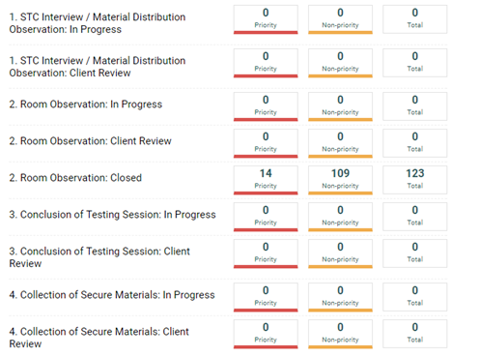
Caveon Core
LEAs utilizing Caveon will receive access
to Caveon Core. Caveon Core allows
DTCs to track the findings of the Caveon
monitors in real time. Caveon Core is
the only way for DTCs to receive real
time monitor feedback.

Slide 35
Test Security
Student tests should be voided if there is an instance of cheating—whether by a student or by anyone else. In the case of student cheating:
The Test Administrator should give the School Test Coordinator a written account of the incident, with any available additional documentation, including the lithocode number of the answer document or consumable test booklet and the domain to be voided.
The School Test Coordinator should convene a school-level test security committee consisting at a minimum of the principal, the School Test Coordinator, and the test administrator to determine whether a test should be voided. The STC will complete the Void Notification form and notify the District Test Coordinator of any voided test.
The District Test Coordinator should complete and email the Void Verification form to LDOE at assessment@la.gov.

Slide 36
Test Security Policy Audits
In order for school systems to be in compliance with Bulletin 118, school systems must develop a test security policy. All school systems should have their test security plans accessible and available at all times.
For 2018–2019, the Department will only require the following types of school systems to submit a test security policy:
New school systems participating in statewide assessments
School systems that experienced a break of one or more years in participation in statewide assessments
School systems involved in the monitoring/audit process
School systems that voluntarily submit a test security policy
All submitted policies will be reviewed using the checklist available here. The Department will review test security policies and provide feedback. August 31, 2018 is the deadline to submit test security policies to assessment@la.gov.

Slide 37
Test Security Accommodations Audit
DTCs and STCs must ensure the accommodations students receive on statewide assessments are the accommodations documented on accommodations plans and SER or SIS.
LDOE will be performing an audit of Spring assessments to ensure students received proper accommodations. Students who receive incorrect accommodations may have their test voided.

Slide 38
Birth - Pre-K

Slide 39
Early Childhood: GOLD by Teaching Strategies
All at-risk publicly-funded children birth to five attending public and nonpublic pre-K, Head Start, and child care must be assessed with GOLD or an approved alternate assessment.
Checkpoints are finalized on the last day of October, February, and May.
This past year, the Department piloted an abbreviated item set. Based on the results of this pilot, the Department is making changes to the statewide GOLD license for early childhood programs:
The default item list for all programs in GOLD will be 70%, which is the minimum number of items required for reports to function and for checkpoints to be finalized.
Sites will have the option to add items for a more comprehensive set, or leave items blank or mark not observed to continue with the abbreviated item version.
To learn more information, please watch the recording of this webinar from Wednesday, June 12.

Slide 40
KEA and K–3 Assessments

Slide 41
KEA and K-3 Literacy Assessments
Public schools must administer a kindergarten-readiness screener and a K-3 Literacy screener within the first 30 days of school.
A KEA must be given to all first-time kindergarten students. Two KEA assessment options are approved: DRDP and TS Gold.
A K-3 Literacy screener must be administered to all kindergarten, 1st, 2nd, and 3rd grade students. Three assessment options are approved: DIBELS Next, STEEP, and STEP.
School systems will submit KEA and K-3 Literacy data with the SIS October 1 MFP Collection.
The 2018-2019 Guidance on the Kindergarten Entry Assessment and K-3 Literacy Screening Assessment can be found here.

Slide 42
KEA and K-3 Literacy Assessments
Grade Band | Available Assessments | Key Skills Measured | Resources | Testing Window | Reporting
K-Readiness (First-time Kindergarten children) | DRDP Gold | Language/Literacy Math Social-Emotional Approaches to Learning Physical | KEA FAQs | First 30 days of school | Submit with SIS October 1 MFP Collection
K-3 Literacy Screening (All children) | DIBELS Next STEEP STEP | Social-Emotional First Sound Fluency (K) Work Fluency (1st)* Oral Reading Fluency (2nd) Comprehension (3rd**) *Nonsense Words for DIBELS and STEEP **DIBELS Daze for 3rd grade | Guidelines for Students with Special Needs Score Guidelines

Slide 43
K-3 Literacy Assessments
Schools should implement sound assessment practices that include:
screening and diagnostic measures,
formative assessments embedded in curriculum and instruction, and
using K-3 screening results to guide instruction.
Instructional guidelines based on K-3 screening are included in the Tier 1 Curriculum and the K-3 Assessment Guidance for 2018-2019.

Slide 44
K–3 Literacy Assessments
K–3 literacy screeners
support student comprehension of text, not mastery of a skill or strategy;
determine if students are meeting expectations; and
identify specific weaknesses.
Assessment Type | Purpose
Screening Assessments (Required in fall only) | To determine students at risk of experiencing reading difficulties May be used for universal screening, dyslexia screening, and fall legislative and BESE screening requirements
Diagnostic Assessments (Optional) | Administered only when they will offer new or more reliable information about a child’s difficulties May be used to help plan more powerful literacy instruction
Benchmark Assessments (Optional) | To measure what children must learn at each grade level To identify if students are on track to meet grade-level literacy goals

Slide 45
K-3 Literacy Assessment
Flow Chart
The K-3 Assessment Guidance for 2018-2019 is located in the Assessment Library.

Slide 46
Summary of KEA and K-3 Screening Assessment Options
Kindergarten Entry Assessment
LEAs administer an approved k-readiness screening to all first-time kindergarten students
Teaching Strategies GOLD Survey©
Desired Results Developmental Profile© (DRDP-K) -Abbreviated version
KEA administration window begins 1 week after the first day of school and continues for 30 days
School systems will submit KEA data on October 1
Report Teaching Strategies GOLD Survey©data using the Teaching Strategies GOLD database
Report DRDP-K data with the SIS October 1 MFP Collection.
K-3 Literacy Screener
LEAs administer an approved screening assessment to all kindergarten, first, second, and third grade students
DIBELS Next
STEEP
STEP
K-3 administration window begins 1 week after the first day of school and continues for 15 school days
School systems will submit KEA and K-3 Literacy data with the SIS October 1 MFP Collection.
Resources for KEA and K-3 Screening Assessments are located in the K-3 Assessment section of the Assessment Library.

Slide 47
LEAP 2025

Slide 48
High School Summer LEAP 2025

Slide 49
Summer High School LEAP 2025
Key Dates
TAM and TCM posted in eDIRECT | Available
Manage users | May 24
Assign and enter TA numbers | May 29-June 22
Test setup available | June 7-22
Additional materials window | June 7-20
End-of-Course/LEAP 2025 HS testing window | June 18-22
Test Ticket invalidations must be completed | June 25
All secure accommodated materials returned to DRC | June 27
All rescore requests are due to DRC | July 20

Slide 50
Preparing for Summer 2018 High School Testing
The summer testing window for high school students is June 18-22. District Test Coordinators must work with District Technology Coordinators to ensure preparation for testing is completed. A plan for support should be in place prior to and during spring assessments. Technology Coordinators should use the Technology User Guide for steps to prepare devices and the TSM. Technology Coordinators should be aware of the following responsibilities:
Before Testing:
attending relevant monthly webinars,
becoming familiar with Technology User Guide,
installing secure web browser,
ensuring computers are configured prior to testing,
completing the System Readiness Check in INSIGHT to ensure computers are ready for testing, and
creating a Communication Plan with School Test Coordinator to support test administrators during testing.
During Testing:
being readily available while testing is in process.

Slide 51
Summer High School LEAP 2025
Reminders
STCs must assign and/or verify accommodations BEFORE students are placed into eDIRECT test sessions. STCs MUST manually enter the Tests Read Aloud accommodation for students in SIS.
DTCs must place orders for braille or CAS during the additional materials window. These materials are not sent in an initial shipment.
EOC tests are not timed; LEAP 2025 tests are timed.
The only students who are eligible to take the 4-level U.S. History EOC are students who are graduating in 2017–2018 and retesters who are not repeating the course.

Slide 52
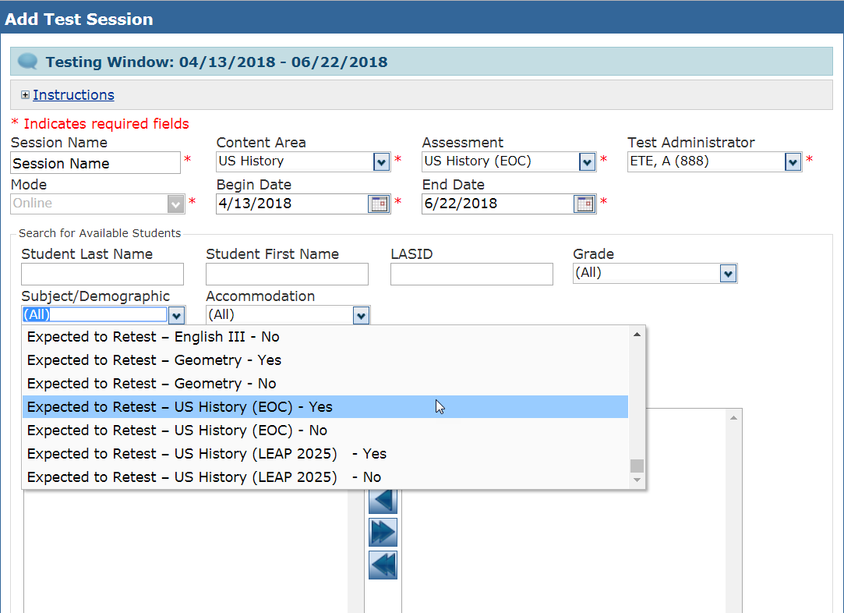
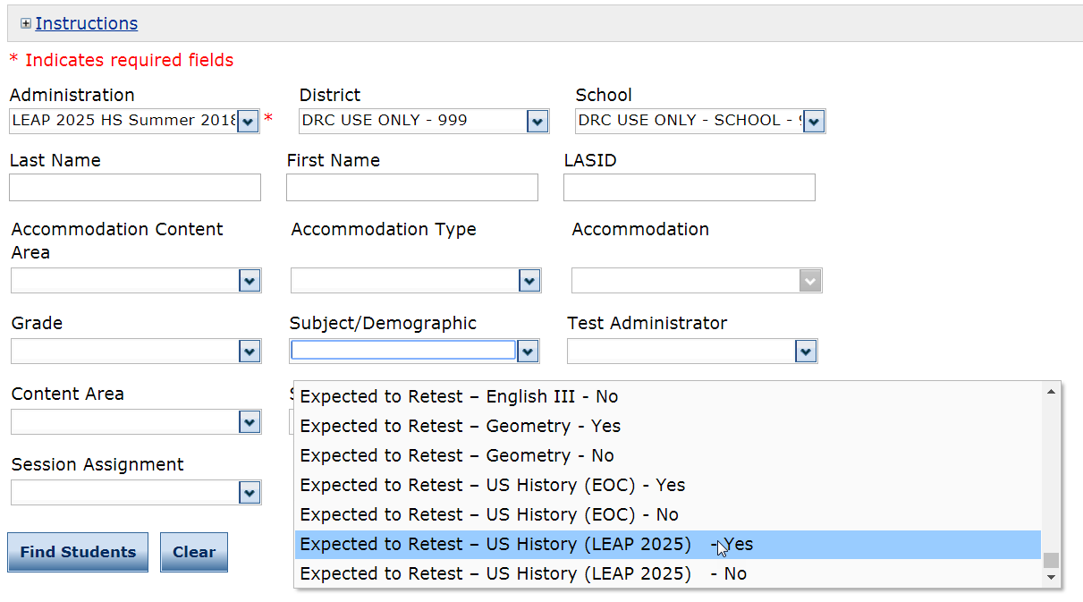
Summer High School LEAP 2025
Update: Beginning with the summer window, “Expected to Retest” will be part of the drop down filter to manage test sessions and students. This also can be exported to Excel and used to verify which students take the 4-level or 5-level US History tests.

Slide 53
ACT and WorkKeys

Slide 54
ACT and WorkKeys Important Dates
Date | Event
Mid-June | Schools will begin receiving WorkKeys NCRCs in the mail from ACT
Now-June 30 | Student online scores are available through ACT student accounts
By June 30 | 17-18 ACT/WorkKeys invoices will be emailed to superintendents, district financial contacts, and DTCs will be copied on the email

Slide 55
ACT and WorkKeys Resources
Superintendents and financial contacts will receive a reconciliation invoice for ACT and/or WorkKeys no later than June 30, 2018. DTCs will be copied on the email.
The invoice will indicate either a refund for an overpayment or require payment for the remaining balance.
The Districts will remit the payment for the remaining balance by July 15, 2018 to:
Louisiana Department of Education
Division of Appropriation Control
PO Box 94064
Baton Rouge, LA 70840-9064
The State will refund the overpayment to the District by July 30, 2018.

Slide 56
ACT and WorkKeys Resources
The Score Report Schedules and the ACT WorkKeys Score Reports Available in Online Reports Portal document describe the reports schools and districts will receive. Reports for the ACT will be available in PearsonAccess^{nextTM}. Reports for ACT WorkKeys will be available in the Online Reports Portaland some reports will be received by mail.
The ACT Test Score Report Schedule has information about the reports and when to expect them.
The ACT WorkKeys Score Report Schedule has information about the reports and when to expect them.
The ACT WorkKeys Score Reports Available in Online Reports Portal document tells you what score reports are available in the portal.
The State Testing website has information about score reports, including how to understand and use the test results, under Interpretation in the ACT and ACT WorkKeys sections.
The ACT website has resources to help educators and administrators learn more about ACT score reports, including webinars, tutorials, and workshops.

Slide 57
LEAP Connect/LAA 1

Slide 58
LEAP Connect 2018-2019
Beginning in 2018-2019, LEAP Connect will include Grades 3-8 and 11 for both ELA and math.
The LEAP Connect Online Tools Training (OTT) is now updated to include items for grade 11 ELA and math.
The OTT can be accessed through the INSIGHT Portal or through the OTT site in Google Chrome.
The Directions for Test Administration (DTA) which includes detailed, scripted directions for administering all items in the OTT, is available through eDIRECT.
Reference Materials which include all answer options for each item in the ELA and math OTT are also available in eDIRECT. These can be reproduced and cut out for use with eye gaze boards or other related communication devices.

Slide 59
LEAP Connect OTT Math Sample Item

Slide 60
ELPT/ELPS

Slide 61
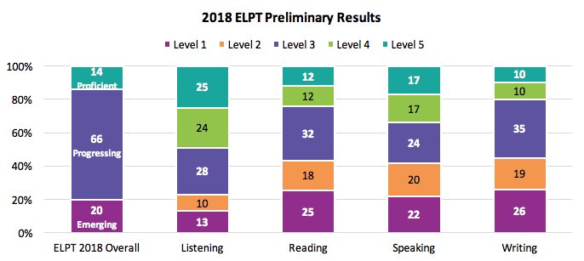
2018 ELPT Results
Nearly 25,000 students participated in the 2018 ELPT assessment with 14 percent demonstrating English proficiency by scoring Level 4 or 5 across all four domains. Students scored highest on listening and struggled most with reading and writing.

Slide 62
ELPT/ELPS Reminders
The ORS will be down from July 18 - July 20 and during the first few weeks of August.
Access to ELPT scores will be unavailable during these time periods.
Have all ELPT results downloaded if data will be needed during these time periods.
Initial ELPS results will be delayed until the ORS reopens.

Slide 63
ELPS Overview
Under the Every Student Succeeds Act (ESSA), standardized entrance and exit criteria are required for English Learners (ELs). In Louisiana, one component of the entrance criteria is a standardized screener called the English Language Proficiency Screener (ELPS).
Beginning in 2019-2020, the ELPS will be required for Louisiana students to begin receiving EL services, and it will be at no cost. Districts are strongly encouraged to use the ELPS during the 2018-2019 school year with the screener being available for district use August 1, 2018.
ELPS will be delivered in the same testing system as English Language Proficiency Test.
The 2018-2019 ELPS Guidance document is now posted to the Assessment Library.

Slide 64
ELPS Overview
The ELPS is a tool for determining if students entering Kindergarten through grade 12 are English Learners (ELs) who require language support services to continue developing proficiency in English.
A student who does not score proficient on the ELPS will be identified as an EL and can receive an EL Accommodations Plan.

Slide 65
ELPS Key Dates
Key Dates
AIR Secure Browser Install | Available Now
ELPS training modules | Mid June
ELPS administration manuals posted | Mid July
TIDE closed | July 16
ORS closed | July 18 - July 20
TIDE opens for user and student management | July 23
ELPS opens for district use | August 1
ELPS Additional Materials Ordering (Braille, large print) | August 1 (orders placed through assessment@la.gov)
ORS closed for initial ELPS score processing | First few weeks of August

Slide 66
ELPS Test Setup
The ELPS is a computer-based assessment that will be taken in the AIR Portal, the same testing system used for the English Learner Proficiency Test (ELPT). Prior to testing, the AIR Secure Browser must be installed on computers. Reference the Secure Browser Installation Manual for detailed directions.
Test administrators, students, and accommodations are managed in the TIDE Portal. See the TIDE User Guide for detailed directions on test setup requirements.
Students must have a LASID in order to be entered into TIDE and take ELPS.
Students taking the ELPS will need headsets with microphones for interacting with the online platform. The headsets are the same ones required for taking the ELPT. Specifications for headsets are located on pages 5-6 of the Technology Requirements document in the Assessment Library.

Slide 67
ELPS Administration
ELPS is administered in 3 steps with a student and test administrator who is trained in online test security.
Step | Student… | Test Administrator… | Mode of Administration
Step 1 | Orients to test. Does headset and microphone check. Learns test navigation. Takes practice items | Assists student. Determines student comfort with technology. Starts testing session. | One-on-one
Step 2A | Takes one set of speaking items. | Assists student with recording. Scores speaking set “on-the-fly”. | One-on-one
Step 2B | Takes remaining Step 2 items. | Assists student if needed; otherwise step away. | Student may work independently if assistance is not needed.
Only students who scored proficient on Steps 1 and 2 will move on to step 3.
Step 3 | Continues testing. | Assists if needed, especially on CR items | Student may work independently if assistance is not needed.

Slide 68
ELPS Administration
Additional Materials
Large Print and Braille ELPS materials will be available to order beginning on August 1, 2018. Orders should be placed by emailing assessment@la.gov.
SIFE
Students with Interrupted Formal Education (SIFE) are students who have not received or cannot show proof of a formal education. This data will be collected in TIDE when entering student demographics beginning on August 1, 2018.

Slide 69
English Language Proficiency Screener Trainings
There will be an ELPS Administration Webinar on July 11 from 2:00 - 3:00 p.m. This webinar will review:
Determining if a student should take ELPS
ELPS setup in TIDE
Steps to administer ELPS
TA scoring
Future information and updates on ELPS can be found in:
Monthly Assessment and Accountability webinars
The Department’s weekly newsletter
2018-2019 collaborations
Scoring/reporting
Classifying a student as EL
Resources for support

Slide 70
ELPS Resources
For more information on the ELPS:
ELPS Screener Guidance
ELPS Summit Presentation
ELPT Portal: has the resources for ELPS administration
Louisiana English Learner site
“On The Fly” Scoring Guidance
TIDE User Guide
ELPS Test Administrator (TA) User Guide
ELPS Test Administration Manual (TAM)
2018 - 2019 ELPT FAQ

Slide 71
LEAP 360

Slide 72
2018-2019 Key Dates
LEAP 360 will close for the 2017-2018 school year on June 18. The dates below outline the opening of each LEAP 360 component for the 2018-2019 school year.
When EAGLE reopens, tests will carryover, but any discontinued items will be removed. Science items will no longer be available.
LEAP 360 Component | Closes | Opens
Diagnostic | June 18 | July 16 (Test Setup)
Interim | June 18 | July 16 (Test Setup)
EAGLE | June 18 | June 25

Slide 73
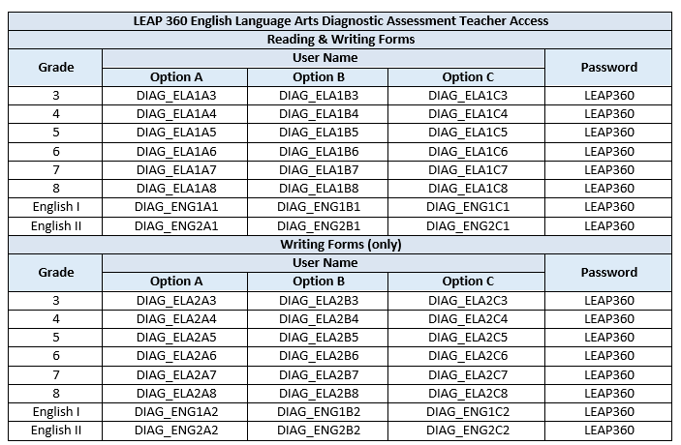
Diagnostic Quick Start Guide 2018-2019
The Diagnostic Quick Start Guide will be updated for the 2018-2019 school year. Using Google Chrome, teachers may use the LEAP 360 Teacher Access link.

Slide 74
LEAP 360 Improvements
During the first year of LEAP 360 implementation, feedback was collected from focus groups, site visits, district and school leaders, and teachers. Feedback was categorized into five focus areas:
Data Management
Educator Scoring
Reporting
Content
EAGLE
The next few slides will highlight some of the improvements in these areas. For more information, districts should review the Teacher Leader Summit sessions.

Slide 75
LEAP 360 Improvements
Data Management
Beginning in 2018-2019, student data will be uploaded directly to eDIRECT from eScholar.
Districts will use existing procedures to upload files to eScholar. Student data will then be uploaded to eDIRECT.
New students and student transfers will be managed through eScholar.
Student updates should be made in the district’s Student Information System and the data uploaded to eScholar.
Updates to eScholar data will be refreshed in eDIRECT nightly.
eDIRECT will begin populating with student data from escholar on July 16th.
Accommodations uploaded by districts to SIS and SER will be uploaded with student data to eDIRECT.

Slide 76
LEAP 360 Improvements
Data Management
Student Group Upload
Flexible groupings of teachers-to-students called “student groups” can be created in batches.
Allows test results for students to be reported together.
Teacher/Test Administrator Upload
For LEAP 360, teachers/test administrators can be uploaded using the Test Administrator Upload file.
Allows teachers to be tied to test sessions and student groups similar to LEAP 2025.
Test Session Creation
Schools and school systems can still manually create test sessions in eDIRECT or use the Test Session Upload file. The format of this file is unchanged for 2018-2019.
Teachers and test sessions can be linked in eDIRECT during test session creation.
Copying Test Sessions will allow users to create Interim sessions from existing Diagnostic sessions.

Slide 77
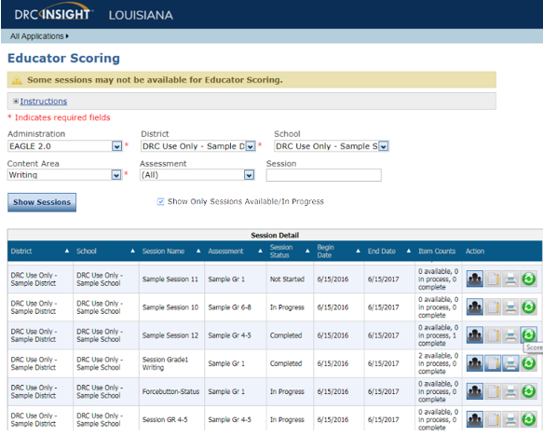
LEAP 360 Improvements
Educator Scoring
On the Educator Scoring page, teachers can select to only view items that need scoring.

Slide 78
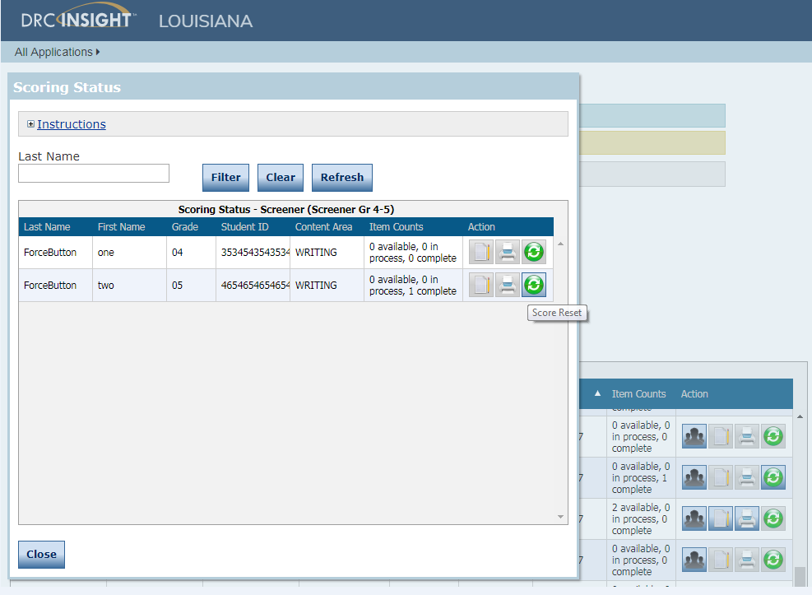
LEAP 360 Improvements
Educator Scoring
Student responses can be printed in one batch.

Slide 79
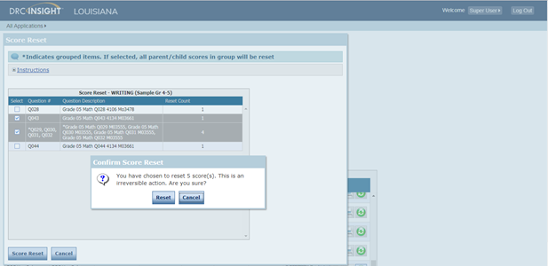
LEAP 360 Improvements
Educator Scoring
Item scores can be reset by the test session or by the individual student.

Slide 80
LEAP 360 Improvements
Reporting
New School List Report
New Test Session List Report
Improvements to existing reports: Reports will have teacher name, standards for math, percent of points earned by student, and ELA text complexity.
EAGLE
Additional items will be added throughout the year.
Updated list of available items will be available in A Teacher’s Guide to LEAP 360.
Student responses will be accessible.

Slide 81
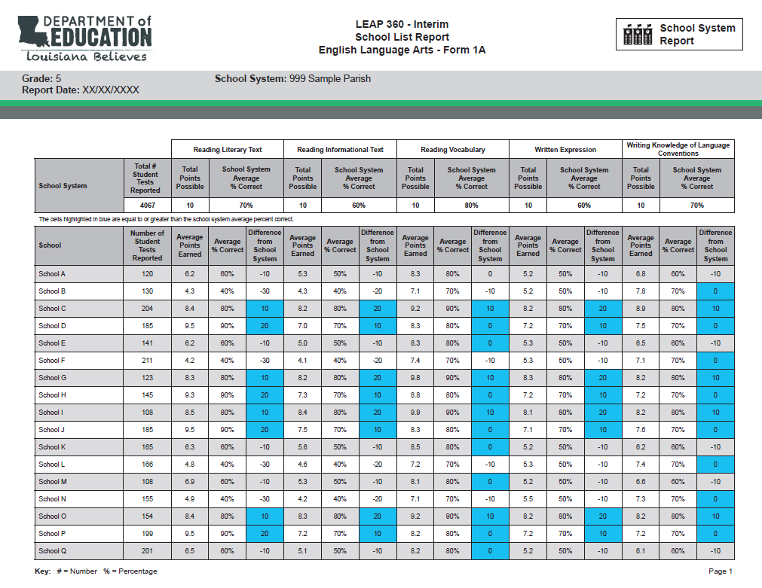
Draft School List Report

Slide 82
LEAP 360 Improvements
Content
LEAP 360 Teacher Study Guide (available in eDIRECT) *New resource
Answer key (including alignment information)
Scoring Guides
Sample papers (when applicable)
PDF of assessment
Diagnostic ELA Forms
Reading and Writing combined into 1a, 1b, and 1c.
Writing will also be separate forms labeled 2a, 2b, and 2c.

Slide 83
LEAP 360 Improvements
Math Interim Forms
Math Grades 6 and 7 will have alternate pathways.
Subject | Grade | Alternative Sequence | Eureka Sequence
Math Form 1 | Grade 6 | Form 1A | Form 1B
Math Form 2 | Grade 6 | Form 2A | Form 2B
Math Form 1 | Grade 7 | Form 1A | Form 1B
Math Form 2 | Grade 7 | Form 2A | Form 2B

Slide 84
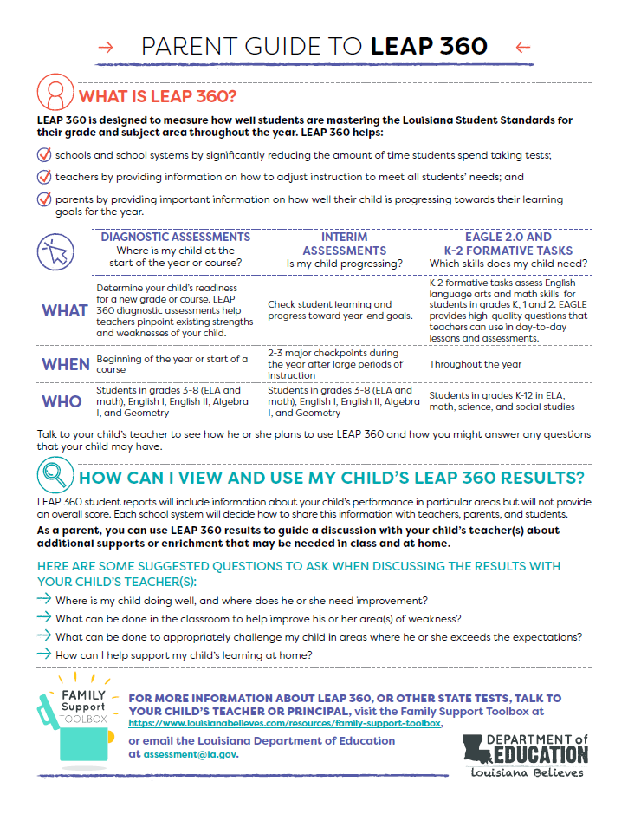
LEAP 360 Improvements
A Parent Guide to LEAP 360 answers the following for parents:
What is LEAP 360?
How can I view and use my child’s LEAP 360 results?
What questions can I ask my child’s teacher when discussing LEAP 360 results?
Where can I go for more information?

Slide 85
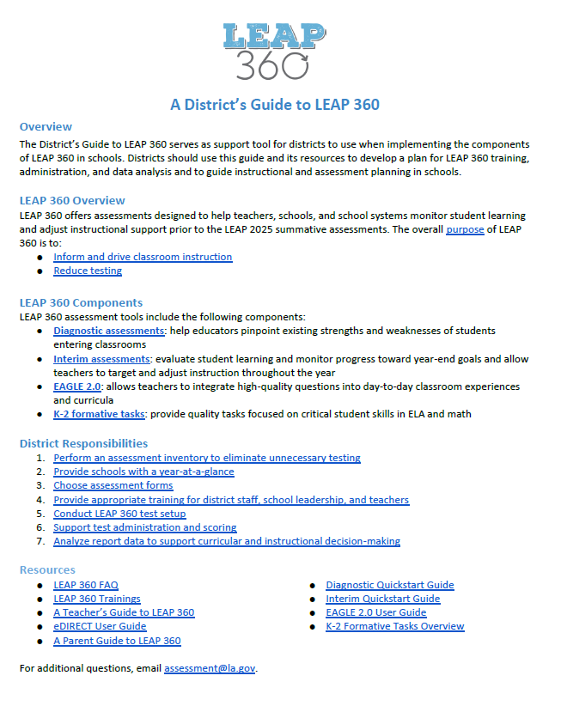
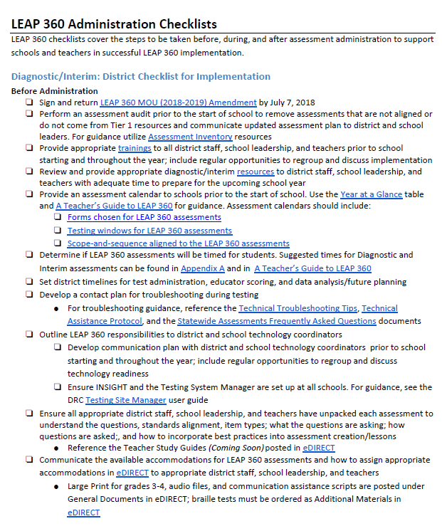
What is the District Guide?
A District’s Guide to LEAP 360 serves as support tool for districts to use when implementing the components of LEAP 360 in schools. Districts should use this guide and its resources to develop a plan for LEAP 360 training, administration, and data analysis and to guide instructional and assessment planning in schools.
A District’s Guide to LEAP 360 is located on the LEAP 360 and Assessment Library pages.

Slide 86
Structure of the District Guide
A District’s Guide to LEAP 360 is structured into the following sections:
Overview of the Guide
Purpose of LEAP 360
Year at a Glance
LEAP 360 Trainings
Administration Checklists
Diagnostic and Interim (before, during, and after)
EAGLE 2.0 (before, during, and after)
K-2 Formative Tasks (before, during, and after)
Do’s and Don’ts
Reports and Data Analysis
Frequently Asked Questions
Appendices
Diagnostic and Interim Test Designs
EAGLE 2.0 Items

Slide 87
Features of the District Guide
The format and contents of this document were created from feedback from DTCs, teachers, curriculum coordinators, and other school and district level employees.
The features of this guide include:
One page overview
Hyperlinks within document and to external sources
Headings of sections will also be full length webinars
Mini Trainings will have links to matching one pager
Living document
Checklist format
Important information from A Teacher’s Guide to LEAP 360

Slide 88
LEAP 360 (2018-2019)
The Department is preparing for the second year of LEAP 360 implementation. School systems that signed a LEAP 360 Memorandum of Understanding (MOU) for the 2017-2018 school year may choose to continue using LEAP 360 through June 30, 2019, under the same terms and conditions.
LEAP 360 will be available to districts in the 2018-2019 at no cost.
Year two provides school systems with an opportunity to:
re-evaluate existing practices,
reduce duplicative testing, and
transition to a more comprehensive assessment system that yields valid and reliable information on student performance throughout the school year.

Slide 89
LEAP 360 (2018-2019)
Next Steps
The Department is continuing to gather feedback from school systems and school level users through focus groups, site visits, and assessment@la.gov. Enhancements across usability, administration, and reporting will be implemented for the 2018-2019 school year.
To opt-in and amend your school system’s existing agreement, each Superintendent must sign an amendment to the original agreement.
Please click here to download the LEAP 360 MOU Amendment (2018-2019) form. Complete, sign, and return an electronic copy to assessment@la.gov by July 7, 2018.
In addition to the MOU, all school systems wishing to participate in LEAP 360 must submit a non-summative data sharing agreement .
Note: School systems should anticipate a cost for the 2019-2020 school year.

Slide 90
Planning for LEAP 360 in 2018-2019
Decisions should be made prior to the start of the school year regarding LEAP 360 administration. Over the summer, districts can prepare for LEAP 360 administration by:
Performing an assessment audit prior to the start of school to remove assessments that are duplicative, not aligned, or do not come from Tier 1 resources.
For guidance utilize Assessment Inventory resources.
Attending all trainings and creating a plan to redeliver to appropriate district staff, school leadership, and teachers.
Reviewing and providing LEAP 360 resources to district staff, school leadership, and teachers with adequate time to prepare for the upcoming school year.

Slide 91
Planning for LEAP 360 in 2018-2019
Developing a communication plan with district and school technology coordinators prior to school starting and throughout the year, including regular opportunities to regroup and discuss technology readiness.
Ensuring INSIGHT and the Testing System Manager are set up at all schools.
For guidance, see the DRC Technology User Guide posted under General Information in eDIRECT.
Creating an assessment calendar that includes:
Forms chosen for LEAP 360 assessments,
Testing windows for LEAP 360 assessments, and
Scope-and-sequence aligned to the LEAP 360 assessments.

Slide 92
State Placement Test

Slide 93
2018-2019 Assessments: State Placement Test
The Department will be releasing a state placement test for school systems to use for students seeking to transfer to a public school in grades 5 or 9 from any in-state nonpublic school, approved home study program, or out-of-state school.
The computer-based test is designed to measure students’ knowledge and skills in ELA and math pursuant to Louisiana Student Standards in grades 4 and 8, and is consistent with the LEAP 2025 test.
DTCs will be responsible for managing the state placement test administration in eDIRECT. All functionality of testing systems and test security will be the same as LEAP 2025 assessments.
The state placement test will be available for test set-up on July 18, and students can begin to complete testing in INSIGHT beginning August 6. Test administration access will be available the entire school year.
School systems must notify the Department at least 30 days in advance of any school system planned testing day to ensure scoring and reporting are completed within normal turn-around times.

Slide 94
2018-2019 Assessments: State Placement Test
Using the achievement levels in the chart below, school systems will place students in the appropriate grade.
Test results will typically be available in eDIRECT no later than 4-7 days after a student completes all test sessions.
Achievement Level | Enrollment
Pass: Basic, Mastery, or Advanced | Enroll in Grade 5 or Grade 9
Fail: Approaching Basic or Unsatisfactory | Enroll in Grade 4 or Grade 8 or T9

Slide 95
National and International Assessments

Slide 96
NAEP
The National Assessment of Educational Progress (NAEP) is the largest continuing and nationally representative assessment of what our nation’s students know and can do in subjects such as mathematics, reading, science, and writing.
Schools selected to participate in NAEP for the 2018-2019 school year will receive participation notifications in June.
Selected schools will receive information throughout the year related to preparation and administration.

Slide 97
Other National and International Assessments
Districts will be notified if they have schools that have been selected for participation in other national and international assessments.
The International Early Learning Study (IELS) is an international play-based assessment of five-year-olds’ emerging numeracy, literacy, self-regulation, and social emotional skills.
The Progress in International Reading Literacy Study (PIRLS) is an international comparative assessment that measures student learning in reading. PIRLS documents worldwide trends in the reading knowledge of 4th-graders as well as school and teacher practices related to instruction.
The Program for International Student Assessment (PISA) is an international online assessment conducted every three years of 15-year-old students that measures how well students apply their knowledge and skills in reading, mathematics, and science.
The Trends in International Mathematics and Science Study (TIMSS) enables countries around the world to measure how effective they are in teaching mathematics and science for the 4th and 8th grade students.

Slide 98
Assessment Updates

Slide 99
Testing Key Dates
 | Diagnostic | Interim | Practice Test | Placement Test | Fall HS | LEAP Connect | LEAP 2025 3-8 | Spring HS | Summer HS | ELPS
Manage Users | July 16 | July 16 | July 16 | July 16 | July 23 | July 23 | July 23 | July 23 | July 23 | July 23
Test Setup | July 16 | July 16 | July 16 | August 3 | October 29 | January 2 | March 18 | March 25 | June 7 | July 23
Materials Delivered | N/A | N/A | N/A | N/A | November 9 | January 22 | March 1 (Manuals) March 15 (CBT) April 8 (PBT) | April 1 | N/A | N/A
Additional Materials | July 22 | TBD | August 17 (HS) December 19 (3-8) | August 3 | November 12 | January 23 | March 4 (Manuals) March 16 (CBT) April 9 (PBT) | April 2 | June 7 | August 1 (order via assessment @la.gov)
Post Manuals | N/A | N/A | N/A | July 6 | October 26 | January 4 | March 1 | March 15 | May 17 | July 11

Slide 100
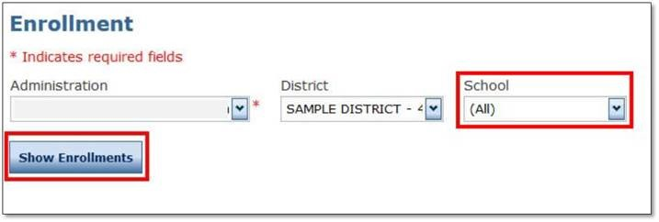
2018-2019 Enrollment Window
From October 1 - October 31, each school system is required to enter enrollments for each school for paper or online testing in grades 3-4 into the eDIRECT Enrollment System. School systems will also verify enrollment numbers.
To enter enrollments in eDIRECT:
Select All Applications and then select Materials.
Select Enrollments within Materials.
Under the Administration drop‐down box, select the appropriate Administration.
Under School, select the school for which enrollments will be entered.
Click Show Enrollments.

Slide 101
2018-2019 Enrollment
Confirm all schools’ testing mode for grades 3 and 4.

Slide 102
2018-2019 Enrollment
Confirm or update counts in the grid.
Enrollment numbers are prepopulated with 2018 initial enrollments.
Verify or update the 2018 counts with the enrollments for 2019. This will ensure that accurate materials quantities are available for your schools and included in your schools’ initial shipment.
If a school no longer hosts a grade, zero out any numbers that appear.
Note: It is important to include all students that require the consumable test booklet accommodated version, including English Learner and PNP students requiring test read aloud.
Click Complete.

Slide 103
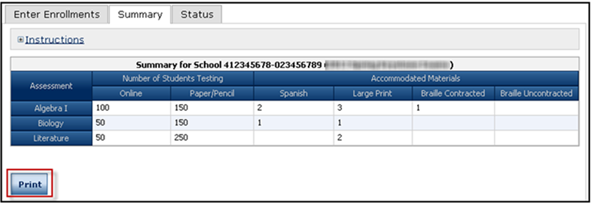
2018-2019 Enrollment
Select the Summary tab to view the information you have previously designated for your school.
Click Print if you would like to print the screen you are currently viewing.

Slide 104
2018-2019 Enrollment
Select the Status tab to view the progress of your schools’ registration process.
Click Export to Excel if you would like to view this information in Microsoft Excel.

Slide 105
Assessment Resources

Slide 106
LEAP 2025 Assessment Resources 2018-2019
Available Summer 2018
Updated LEAP 2025 Assessment Guides
New LEAP 2025 Assessment Guides for Science
Available Fall 2018
Updated US History Practice Test
New Biology Practice Test
New Science Practice Test Guidance
Available January 2019
Updated Social Studies Practice Tests for grades 3-8
New Science Practice Tests for grades 3-8

Slide 107
LEAP 2025 Teacher Leader Summit Sessions
All LEAP 2025 sessions focused on helping students develop skills in written communication of content knowledge and conceptual understanding.
ELA | ELA Assessment Results Make the Case: How to Build ELA Knowledge in Writing and Reading (grades 3-5; grades 6-10)
Math | Math Assessment Results Make the Case: Creating Type II and Type III Tasks (grades 3-5; grades 6-8; Algebra I and Geometry)
Science | New LEAP 2025 Grades 3-8 Science & Biology Assessment Overview
Social Studies | Social Studies Assessment Results Make the Case: Scoring Student Responses to Extended-Response Tasks (grades 3-5; grades 6-8 & U.S. History)

Slide 108
2018-2019 LEAP 2025 Resource Availability Timeline
Resource | Available | Purpose
Updated LEAP 2025 Assessment Guides | Summer 2018 | Explain the test designs and types of items included on the assessments. The guides also include information about testing times as well as sample items and links to additional resources.
New LEAP 2025 Assessment Guides for Science
Math, ELA, and Social Studies Practice Tests | Currently available in INSIGHT and eDIRECT | Grade- or course-level, paper-based (grades 3 and 4 ELA, math, social studies, science) and computer-based (grades 3-8 ELA, math, social studies, science, English I, English II, Algebra I, Geometry, US History, Biology) help prepare students for the spring assessments; accessed through INSIGHT.
New Biology Practice Test | Fall 2018
Updated US History Practice Test

Slide 109
2018 - 2019 LEAP 2025 Resource Availability Timeline
Resource | Available | Purpose
Updated Social Studies Practice Tests for Grades 3-8 | January 2019 | Grade- or course-level, paper-based (grades 3 and 4 ELA, math, social studies, science) and computer-based (grades 3-8 ELA, math, social studies, science, English I, English II, Algebra I, Geometry, US History, Biology) help prepare students for the spring assessments; accessed through INSIGHT.
New Science Practice Tests for Grades 3-8
Updated Math, ELA, and Social Studies Practice Test Guidance | Fall 2018 | Provide teachers with information regarding best practices when using the practice tests. Updated to include information about the new high school practice tests.
New Science Practice Test Guidance

Slide 110
Support and Communication

Slide 111
End of Year Survey
The DTC and Accountability Contact End-of-Year Survey collects feedback from the current school year on various assessment and accountability topics. This feedback is used to make improvements for next school year.
DTCs, Backup DTCs, Accountability Contacts, and Backup Accountability Contacts should complete the survey by July 10, 2018. The survey will be released in the weekly newsletter.

Slide 112
2018-2019 School System Planning Calendar
The Department released the 2018-2019 school system planning calendar containing dates for:
Supervisor, Principal and Teacher Leader Collaborations
Monthly Planning Calls: School System, Assessment & Accountability, Data Coordinator, Special Education, Ed Technology
Newsletter distribution: Superintendents, Charter, Nonpublic, Teacher Leader, Believe and Prepare, Counselor Connect and Early Childhood
BESE and Advisory Council meetings

Slide 113
DTC and Accountability Contact Update
If during the academic year the person appointed as district test coordinator changes, the district superintendent must notify the LDOE. The notification must be in writing and must be submitted within 15 days of the change in appointment.
Due to the secure nature of the data accessed by accountability contacts and district test coordinators, changes have been made to the submission process for any updates to DTC and accountability contacts:
Superintendent signature now required
The DTC and Accountability Contact Update Form must be submitted from the superintendent’s district email account.
The revised DTC and Accountability Contact Update Form is located under the Resources + Forms section in the Assessment Library.

Slide 114
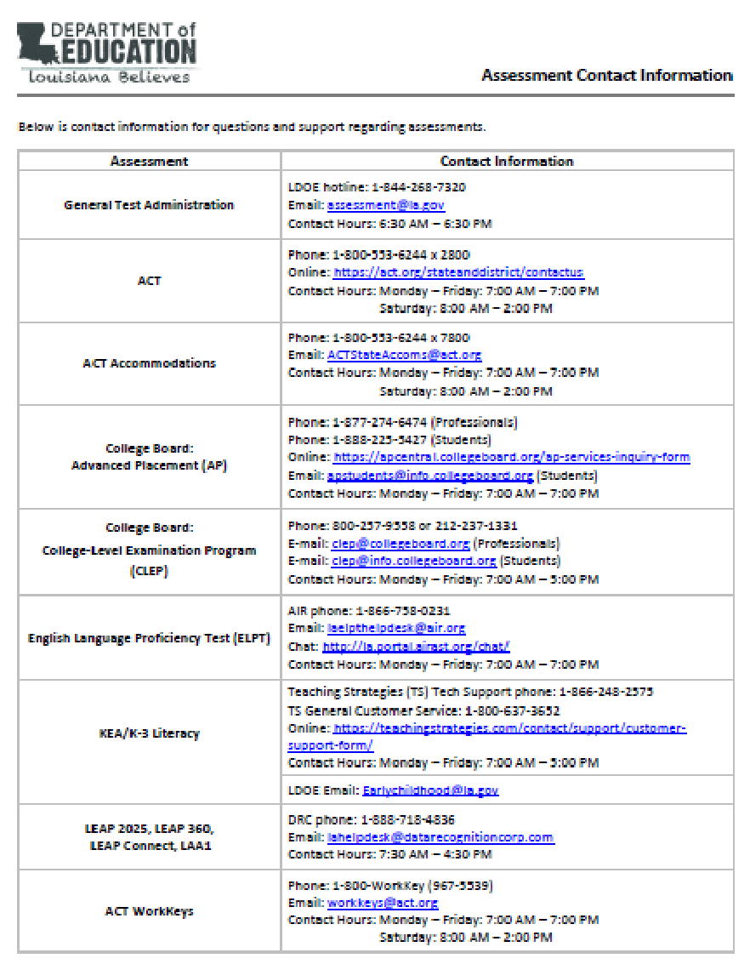
Assessments Customer Service
The Assessments Customer Service Contact Information has been posted to the Assessment Library. This provides all customer service contact information for all assessments.

Slide 115
District Support
The Assessment team offers multiple avenues of support to districts, schools, and teachers seeking information or assistance about assessment administration and accountability.
Weekly Newsletters
Assessment and accountability information and deadlines are released each week in the district newsletter.
Weekly Assessment & Accountability Calls
Each Tuesday at 1:00 PM these webinars are held to provide training, updates, and important information to DTCs and Accountability Contacts.
Assessment Library and Accountability Library
The Assessment Library contains resources for DTCs including the Assessment Schedule and the Assessment and Accountability Month-by-Month Checklist. The Accountability Library contains resources for accountability contacts including the School Performance Score (SPS) calculators as well as information on data certification and federal accountability.

Slide 116
District Support
Monthly Educational Technology Calls
Each month a webinar is held for district technology personnel to provide training, updates, and important information related to technology readiness and digital literacy.
Assessment@
All stakeholders are encouraged to email assessment and accountability questions and/or concerns to assessment@la.gov.
Assessment Hotline
For immediate assistance regarding assessment and accountability, district-level staff may call the Assessment Hotline at 1-844-268-7320.
EdTech@
All stakeholders are encouraged to email technology readiness questions and/or concerns to edtech@la.gov.

Slide 117
Next Steps

Slide 118
Next Steps
Key Dates | Action
June 18-22 | Summer High School Testing Window
July 7 | Deadline for LEAP 360 MOU Amendment (2018-2019) form. Complete, sign, and return an electronic copy to assessment@la.gov.
July 10 | Deadline to complete End of Year Survey
Reminders:
There will not be any Office Hours calls during June and July. Office Hours will resume in August.
Starting in July, all calls will have a new meeting link. The call-in information will be released in the weekly newsletter.
Next Assessment and Accountability Monthly Call: July 17, 2018

