Slide 1

Assessment and Accountability Monthly Call
May 2018

Slide 2
Agenda
Month-by-Month Checklist
Accountability
Assessment Administration
Assessment Updates
Support and Communication

Slide 3
2017-2018 Month-by-Month Checklist
The 2017–2018 Assessment and Accountability Month-by-Month Checklist
  identifies key dates and deadlines for statewide assessment programs and accountability processes for next school year;
  provides action steps to ensure readiness for administering statewide assessments; and
  recommends resources for district and school staff.
The checklist includes information on the following areas:
  Communication and Support
  Accessibility and Accommodations
  Assessment Preparation and Administration
  Accountability
  Reports
The 2017-2018 Assessment Month-by-Month Checklist is located in the Assessment Library.

Slide 4
May Assessment and Accountability Checklist
Communication and Support
May 3: Data Coordinator Monthly Webinar
May 9: School System Monthly Planning Call
May 10: 2018-19 System Enhancements Call at 10:00 AM
May 15: Monthly Assessment and Accountability Call
May 30-June 1: Teacher Leader Summit
Accountability and Assessment Preparation
May: ELPT and LEAP Connect School Rosters, Student Reports, and CSV files available
May 5: Contact courier agency. Scheduled pickup of ACT secure and non-secure make up
materials from LEA/district office
May 10: Deadline for ACT to receive answer documents to be scored
May 11: Last day for College Level Examination Program (CLEP) test scores included in SPS
for graduation cohort members

Slide 5
May Assessment and Accountability Checklist
Assessment Administration and Reporting
Apr 2-May 31: ICILS and TIMSS testing for selected schools
Apr 9–May 4: Administer grades 3–8 LEAP 2025 computer-based testing
Apr 23–May 18: Administer high school LEAP 2025 Spring 2018 tests
Apr 30–May 4: Administer grades 3–4 LEAP 2025 paper-based tests
May 7-18: Administer Advanced Placement (AP) test
May 9: Report all LEAP 2025 3-8 test irregularities to assessment@la.gov
May 21: Students should begin receiving ACT score reports from ACT mailed to the address
provided on the answer documents (3-8 weeks after ACT received answer
documents for scoring
May 21: Districts will begin receiving the ACT High School Checklist Report, ACT High School
Report (student level data report), printed labels for college reportables
May 23: Report all LEAP 2025 high school test irregularities to assessment@la.gov

Slide 6
June Assessment and Accountability Checklist
Communication and Support
June 19: Monthly Assessment and Accountability Call
Accountability and Assessment Preparation
Early June: Ensure that INSIGHT has been installed on all devices that will be used for Summer
high school LEAP 2025 testing
Early June: Set up TSMs for high school LEAP 2025 testing
Early June: Utilize scheduling guidance to determine final Summer high school LEAP 2025 test
schedules prior to setting up test sessions in eDIRECT
Early June: Complete test setup within eDIRECT in preparation for Summer high school LEAP 2025
June 18: LEAP 360 for the 2017-2018 year will close.
June 22: Report all LEAP 2025 high school test irregularities to assessment@la.gov
Assessment Administration and Reporting
June 18–22: Administer LEAP 2025 Summer 2018 tests

Slide 7

Accountability

Slide 8
DRC Student Corrections System
(Online Cleanup): Timeline
IMPORTANT: The final opportunity for schools/districts to clean up impending zeroes prior to the calculation of the new progress index and value-added results is during DRC Online Cleanup, which will open on June 11 and close on June 15 (rather than typical July timeline).
NO EXTENSIONS CAN BE GRANTED.
Student records from LEAP 2025, EOC, LEAP Connect, and LAA 1 will be available to correct limited demographics and eliminate impending zeroes.
Accountability codes 1-44, 97 can be applied if there is a matching exit code in SIS that indicates student exited from enrollment prior to or during the testing window.
For all other codes, schools should maintain documentation to verify use of codes that will be audited by LDOE.
Code 81 for EL students cannot be applied at this time.
Schools should not wait until the August assessment data certification to request corrections for impending zeroes.

Slide 9
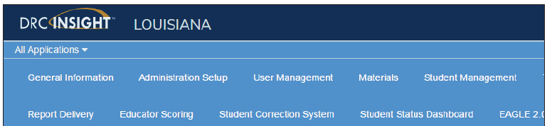
DRC Student Corrections System (Online Cleanup): Process
Access to the DRC Student Corrections System (Online Cleanup)
The Student Corrections System is accessed through DRC eDIRECT.
Schools have access to their own data and should complete all changes.
District test coordinators/accountability contacts should monitor daily progress and approve changes.
Documentation is not submitted with
this cleanup, but must be available
for potential auditing of accountability
codes in coming months.
User Guide Availability: A user guide will be posted under the Documents tab in eDIRECT.

Slide 10
DRC Student Corrections System (Online Cleanup): Data
Types of data changes available in the DRC Student Corrections System (online cleanup)
Impending zeros assigned to students
Name corrections
Incorrect/Incomplete Dates of Birth
Incorrect/Incomplete Louisiana Secure ID
Access to score reports and rosters
In the past, school rosters and csv files were distributed at the same time that the corrections system opened. This year, schools will not have rosters or scores, but DRC is providing a csv file that will provide data for each student, including a validation that the student took and completed a subject test.

Slide 11
School Finder
Louisiana School Finder Updates
The following fields can be updated in Sponsor Site (SPS) for School Finder:
Administrator Name
Website Links (School Website, Facebook, Twitter)
Clubs/Sports
All updates should be completed by the last day of each month in order to be reflected in School Finder the following month.

Slide 12
Superintendent and Principal
Secure Reporting System
Next Round of Updates: For those LEAs who have not responded to the request for updating/adding users to the Superintendent and Principal Secure Reporting System, please review the guidelines listed in the Data section of the March 13 Weekly Newsletter.
  Data management FTP coordinators should retrieve the file from your FTP folder and provide to superintendents and security coordinators.
  Directions on how to complete any necessary updates are included in the file.
  Please respond accordingly if updates are needed. All file revisions should be finalized by May 15th in order to be reflected in the next round of updates (round 3).

Slide 13
Staff Attendance Data
Staff Attendance Data in School Finder:
Beginning with the 2017-18 school year, end-of-year Profile of Educational Personnel (PEP) data collected on staff absences will be publicly shared in the School Finder application.
Absences for all staff members should be reported to PEP in half or whole-day increments and are for the entire year (September 1st – June 30th).

Slide 14
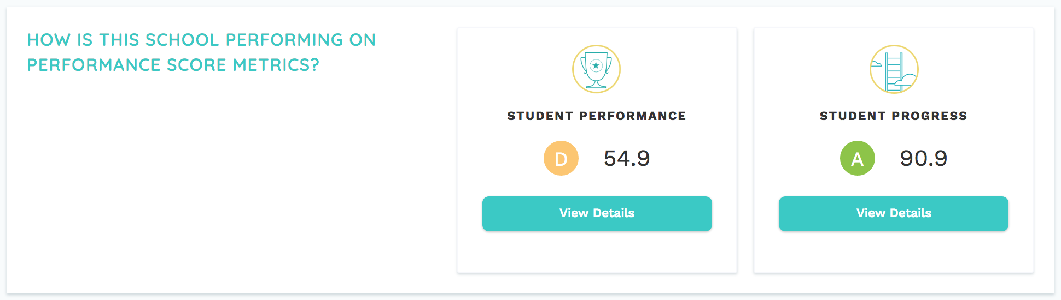
2017-2018 Reporting: School Report Cards
2017-2018 school report cards and early childhood performance profiles will be released in the fall on the Louisiana School Finder (www.louisianaschools.com). School Finder will report an overall School Performance Score and Letter Grade, as well as a score and “letter grade equivalent” for achievement and progress.

Slide 15
2017-2018 Reporting:
Revisions to Louisiana’s Accountability System
The 2017-2018 school performance score (SPS) formulae will represent two critical shifts in the design of Louisiana’s accountability system as a result of the Every Student Succeeds Act.
Ensuring an “A” in Louisiana’s letter grade system signals mastery of fundamental skills. This will be achieved by raising expectations, over time, for what is required in order for a school to earn A-level points based on student achievement and growth.
Adjusting school rating calculations to value more the progress of every individual child, including (a) measuring whether students are on a path to master fundamental skills; and (b) measuring how effectively students are advancing relative to their peers. This progress index replaces progress points.

Slide 16
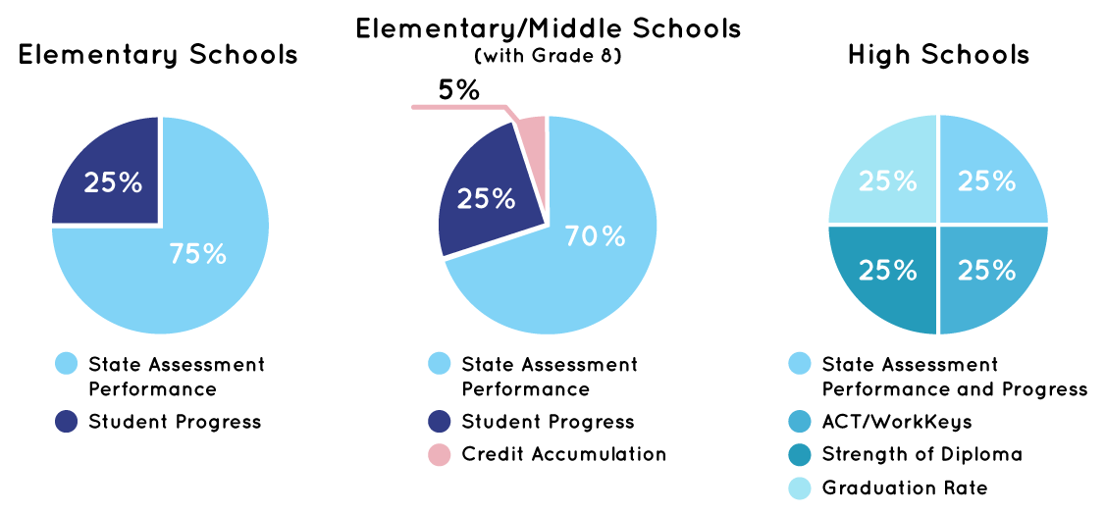
2017-2018 Reporting: SPS Formulae
NOTE: The interests and opportunities measure will not be included within annual results until 2019-2020.

Slide 17
2017-2018 Reporting: Letter Grade Scale
Beginning in the 2017-2018 school year (2018 SPS), the overall grading scale will be adjusted to allow schools time to respond to higher expectations in each index.
Letter Grade | 2017-18 through 2020-21 | 2021-22 through 2023-24 | 2024-25 and beyond
A | 90.0 - 150.0 | 95.0 - 150.0 | 100.0 - 150.0
B | 75.0 - 89.9 | 80.0 - 94.9 | 85.0 - 99.9
C | 60.0 - 74.9 | 65.0 - 79.9 | 70.0 - 84.9
D | 50.0 - 59.9 | 50.0 - 64.9 | 50.0 - 69.9
F | 0.0 - 49.9 | 0.0 - 49.9 | 0.0 - 49.9

Slide 18
2017-2018 Reporting: Reporting Student Progress
By early August, schools and school systems will have the following progress data:
2017-2018 teacher-level VAM results (CIS) and preliminary student progress index results (MMCS La. Data Review)
2018-2019 student Growth to Mastery targets (MMCS La. Data Review)
Additionally, final progress index results will be released in the fall with the School Performance Score release.

Slide 19
2017-2018 Reporting: Teacher Leader Summit Sessions
What's New in Louisiana's School and School System Accountability Policies - This session will provide educators with an overview of the critical shifts in the design of Louisiana's school and school system accountability system in the 2017-18 school year.
Using Measures of Student Progress to Strengthen Practice and Increase Learning - This session is designed for school system and school personnel who support school accountability and teacher goal setting. Also, suited for managers of assessment data, student enrollment data, or CIS. Participants will be encouraged to engage in discussion and ask questions about the models used to assign points in the school performance score progress index and to calculate value-added results for educators.

Slide 20
2017-2018 Assessment Administration

Slide 21
Communicating 2018 Assessment Results
Below is the timeline for the release of the 2017-2018 school- and school system-level assessment results. School systems should develop a plan for communicating these results to principals, teachers, and families.
Assessment | Student Report Timeline and Location | District-Level Results Time and Location
ELPT | May in the ELPT Online Reporting System | May in the ELPT Online Reporting System
LAA 1/LEAP Connect | May in eDIRECT | May in eDIRECT
LEAP Online Cleanup | not applicable | June in eDIRECT
LEAP 2025 (3-8, HS) | Grade 3-8: June in eDIRECT HS: 5-level ELA and math at end of testing window | June in eDIRECT
EOC (Eng III, Bio, US History) Final Reports | HS 4-level all subjects: In window | summer in eDIRECT
ACT | spring, state administered student and school results from ACT sent to schools | summer iCD and district profile from ACT in summer; additional reporting in FTP
Advanced Placement | summer, sent to schools | early fall in FTP
LEAP 2025 US History | early fall in eDIRECT | early fall in eDIRECT

Slide 22
Technology Readiness

Slide 23
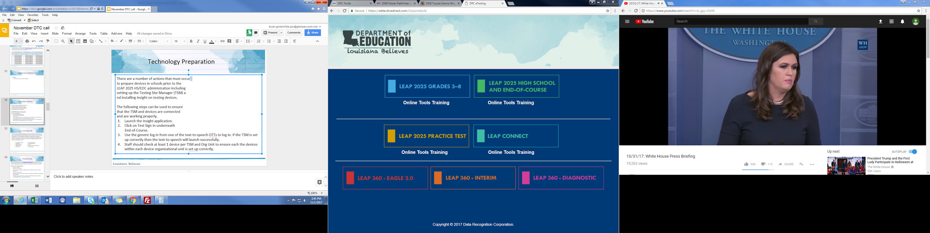
Technology Preparation
There are a number of actions that must occur
to prepare devices in schools prior to the
testing administration including setting up the
Testing Site Manager (TSM) and installing INSIGHT
on testing devices.
The following steps can be used to ensure that the
TSM and devices are connected and are working
properly.
Launch the Insight application.
Click on Test Sign In underneath LEAP 2025 and End-of-Course.
Use the generic log in from one of the text-to-speech OTTs to log in. If the TSM is set up correctly then the text-to-speech will launch successfully.
Staff should check at least 1 device per TSM and Org Unit to ensure each the devices within each device organizational unit is set up correctly.

Slide 24
System Readiness Check
Before testing begins each day, students should run the system readiness check by following the steps below:
Open DRC INSIGHT.
Select the purple check mark in the bottom left corner.
Type 7745.
If the screen does not show all green check marks, STCs or technology coordinators should be alerted.

Slide 25
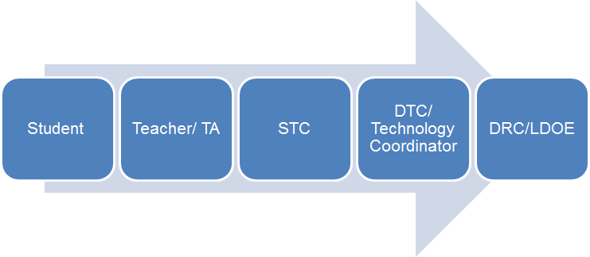
Technical Assistance
If technical problems occur during testing, school and district staff should follow the LEAP 2025 reporting protocol presented below. Technical problems include, but are not limited to, problems connecting INSIGHT, the inability to load test items, or missing buttons.
DRC Louisiana Customer Service LDOE
1-888-718-4836 1-844-268-7320 LAHelpdesk@datarecognitioncorp.com assessment@la.gov

Slide 26
Online Scheduling Guidance
The Online Scheduling Guidance in available in the Assessment Library. The guidance allows schools and districts to view best practices for reducing testing time. Districts can decide how long they want their computer-based testing window to be based on the following:
Number of devices
Internet speeds
Number of sessions given in a day
The following guidelines for online administration still apply:
No more than 3 sessions in a day
Extended response sessions should not be given on the same day
Sessions within a content area must be given in order

Slide 27
Technology FAQ
District Test and Technology Coordinators can access the Statewide Assessments FAQ about Technology document. The information contained in this document should be used to guide District Technology and Test Coordinators as they prepare for Spring assessments. It is suggested to review the eDIRECT Technology User Guide before reviewing this document. The questions represent questions District Technology Coordinators frequently have after reviewing the Technology User Guides. The Frequently Asked Questions are sorted into the following sections:
Testing Site Manager
Insight Client
Netbook Devices
Android Devices
iPad Devices
Chromebook Devices
nComputing Devices
eDirect
Load Simulation and Ping Trends
Error Messages

Slide 28
Troubleshooting
Districts and schools can use the Technical Troubleshooting Tips if technical issues occur during testing. This document is for school sites to use in order to eliminate common errors prior to contacting DRC for technical support.
If you run into a system message…
Reboot the machine
Does the error still occur?
Can you move the student to another computer within the same lab or mobile laptop cart?
Does the error still occur?
Mark the affected computer with a sticky note and notify your Information Technology (IT) department.
If IT staff cannot resolve the issue, have them call DRC Customer Service with the reporting information on page 3 of the document.

Slide 29
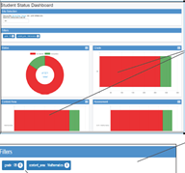
Student Status Dashboard
  The Student Status Dashboard allows you to display student testing status by school and administration. You can filter information on the Dashboard by testing status, grade, content area and assessment (or any combination of these). The Student Status Dashboard User Guide is located in eDIRECT.
  Note: Dashboard data displays in real time as test scores are populated in the database.
  You need the student status permission in eDIRECT to use the Dashboard.

Slide 30
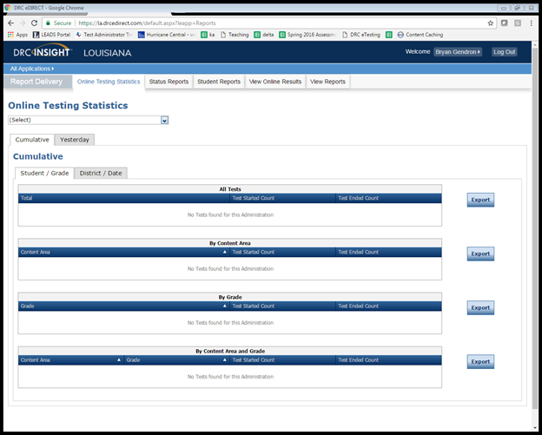
Testing Statistics Reports
eDIRECT has a number of reports to help District Test Coordinators assess the status of their schools during testing. These reports are located in the Online Testing Statistics tab. These reports include:
Online Testing Statistics
Shows the number of students
by school and subject that have
completed testing for the current
and previous day only.

Slide 31
Testing Statistics Reports
Below are other reports that are located under the Status Reports tab.
Daily Cumulative Student Status Reports
Displays all students in a test session and the ticket status of those students
Daily Student Status Report
Displays the start and submit times of each student that logs into a test
Daily School Resets Report
Displays all unlocked test sessions
Excessive Login Report
Shows the number of times a student logged in
Daily State Summary of Test Times Report
Displays the duration in which students completed the test
Daily District Report of Testing Status by School
Displays the number of tests started and ended for the district and school

Slide 32
Online Tools Training
The Online Tools Training (OTT) should be utilized in order to become familiar with the online testing tools (e.g., highlighter, magnification, etc.) used for the operational test. Additionally the OTT:
may be reviewed as many times as desired;
is not to be considered representative of an actual test; and
is available once Insight is installed or by link using Google Chrome browser.

Slide 33
Technology Readiness Tool
Technology Footprints have been released. These documents summarize each district’s technology readiness.
The TRT System is being fully redesigned and is planned for release in late summer.
The next TRT data collection is planned for August 2018.
The current TRT system will be reopened for districts in late June to continue to update and track their data.
More information will be provided to Technology Directors about the new TRT system during the Technology monthly webinars.
Districts should use this data to plan for 2018-2019 assessments.

Slide 34
Test Security

Slide 35
Investigation Support
Student tests should be voided if there is an instance of cheating or significant irregularity—whether by a student or by anyone else. In the case of student cheating:
The Test Administrator should give the School Test Coordinator a written account of the incident, with any available additional documentation, including the lithocode number of the answer document or consumable test booklet and the domain to be voided.
The School Test Coordinator should convene a school-level test security committee consisting at a minimum of the principal, the School Test Coordinator, and the test administrator to determine whether a test should be voided. The STC will complete the Void Notification form and notify the District Test Coordinator of any voided test.
The District Test Coordinator should mark the test invalid in the appropriate online system and email a completed testing irregularity form to assessment@la.gov.

Slide 36
Investigation Support
The following items are required by Bulletin 118 for any test security investigation:
Explanation of the incident in complete detail.
A list of all people involved.
Description of the secure storage area and a list of people with access to the secure storage area.
Transcripts of interviews with the following people:
  Principal
  School Test Coordinator
  Test Administrator(s)
  Proctor(s)
Transcripts of interviews with multiple students regarding the information below:
  Testing procedures
  Layout of the classroom
  Access to test materials before the test
  Access to unauthorized materials during testing

Slide 37
Investigation Support
The following are recommendations based on best practices in conducting investigations:
Collect/view all evidence prior to conducting any interviews.
Schedule a plagiarism/answer change analysis viewing by emailing assessment@la.gov, if applicable.
View security camera footage if available.
Obtain oaths of security and confidentiality, test security and administration sign-in sheets and training materials.
Interview test administrators, proctors, and students in question last. Interview other personnel first.
Questions should include general procedures and about the incident.
Ask as many open-ended questions as possible; limit the number of yes and no questions.

Slide 38
Investigation Support
Interview all individuals who were in the room but not directly involved in the event.
All interviews should be conducted at least twice across multiple days.
Questions should include general procedures and questions about the incident.
Ask as many open-ended questions as possible; limit the number of yes and no questions.
Individuals in this group should not be told who is being investigated.
Interview all individuals who were directly involved in the event.
All interviews should be conducted at least twice across multiple days.
Questions should include general procedures and questions about the incident.
Ask as many open-ended questions as possible; limit the number of yes and no questions.
Individuals in this group should not be told they are under investigation until absolutely necessary.
Avoid being overly aggressive. Investigators who are friendly and helpful get better results.

Slide 39
Caveon Test Security Services
In order to help districts and schools improve test security, the LDOE has negotiated an agreement with Caveon, the nation’s leading test security experts, to provide the following services:
Monitoring
Provides two Caveon monitors on campus on one day of testing
Provides districts with accurate information of every testing room at the school
Investigations
Provides districts with professional investigators to investigate and report on any testing irregularity that occurred in the district
Training
Provides districts with active online training modules created by Caveon
A full explanation of the services and the fee schedules can be found here. Districts and schools can purchase these services by contacting Caveon directly.

Slide 40
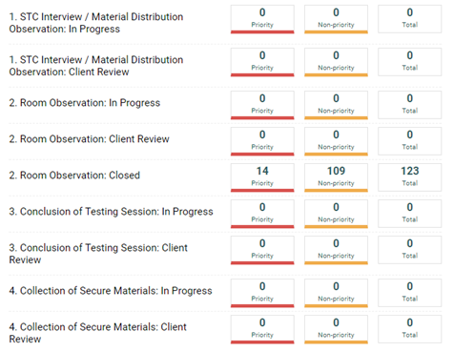
Caveon Core
LEAs utilizing Caveon will receive access
to Caveon Core. Caveon Core allows
DTCs to track the findings of the Caveon
monitors in real time. Caveon Core is
the only way for DTCs to receive real
time monitor feedback.

Slide 41
Accommodations Audit
At the conclusion of each testing administration, the Louisiana Department of Education (LDOE) completes an audit to ensure students are receiving appropriate accommodations as documented on the student’s IEP/IAP.
Any student not receiving the appropriate accommodation will have their test voided for accountability purposes only. Additionally, high school tests may be eligible for an administrative error retest.

Slide 42
LEAP 2025

Slide 43
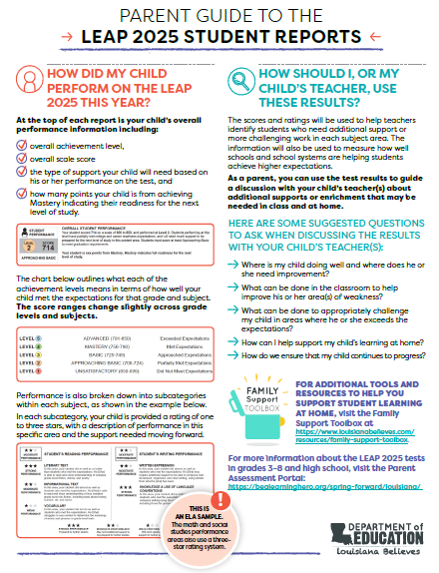
Parent Guide to the LEAP 2025 Student Reports
The Parent Guide to the LEAP 2025 Student Reports for grades 3-12 is now available in the Family Support Toolbox Library.
This guide helps parents read and interpret the LEAP 2025 student reports, with accompanying online resources.
The guide should be sent home with the student reports.
Translated versions are available in Spanish, Vietnamese and Arabic in the Toolbox library.
Translated versions of the student report text and performance levels for all subjects and grade levels are also available to support non-English speaking families in reading their child’s report.

Slide 44
High School Spring LEAP 2025

Slide 45
Spring High School Administration Key Dates
Window for ordering additional materials | April 11 - May 17
End-of-Course/LEAP 2025 HS testing window | April 23 - May 18
Test Ticket invalidations must be completed | May 21
All secure accommodated materials returned to DRC including braille instructions | May 23
All rescore requests are due to DRC | June 15

Slide 46
Accountability Codes
District and school test coordinators should wait until the very end of the testing window to complete all accountability coding in the eDIRECT system.
At the end of the window accountability code students should be placed into a test session for each subject and have the appropriate accountability code applied. Documentation for a code should be available for review during an audit.
Steps to pull up list of applied accountability codes:
Manage Test Session
  Select District and School
  Export student details
Applied accountability codes will be in the column labeled testing codes.

Slide 47
High School Summer LEAP 2025

Slide 48
Summer High School LEAP 2025
Key Dates
TAM and TCM posted in eDIRECT | Available
Manage users | May 24
Assign and enter TA numbers | May 29-June 22
Test setup available | June 7-22
Additional materials window | June 7-20
End-of-Course/LEAP 2025 HS testing window | June 18-22
Test Ticket invalidations must be completed | June 25
All secure accommodated materials returned to DRC | June 27
All rescore requests are due to DRC | July 20

Slide 49
Preparing for Summer 2018 High School Testing
The summer testing window for high school students is June 18-22.
District Test Coordinators must work with District Technology Coordinators to ensure preparation for testing is completed. A plan for support should be in place prior to and during spring assessments. Technology Coordinators should use the Technology User Guide for steps to prepare devices and the TSM. Technology Coordinators should be aware of the following responsibilities:
Before Testing:
attending relevant monthly webinars,
becoming familiar with Technology User Guide,
installing secure web browser,
ensuring computers are configured prior to testing,
completing the System Readiness Check in INSIGHT to ensure computers are ready for testing, and
creating a Communication Plan with School Test Coordinator to support test administrators during testing.
During Testing:
being readily available while testing is in process.

Slide 50
Summer High School LEAP 2025
Reminders
STCs must assign and/or verify accommodations BEFORE students are placed into eDIRECT test sessions. STCs MUST manually enter the Tests Read Aloud accommodation for students in SIS.
DTCs must place orders for braille or CAS during the additional materials window. These materials are not sent in an initial shipment.
EOC tests are not timed; LEAP 2025 tests are timed.
The only students who are eligible to take the 4-level U.S. History EOC are students who are graduating in 2017–2018 and retesters who are not repeating the course.

Slide 51
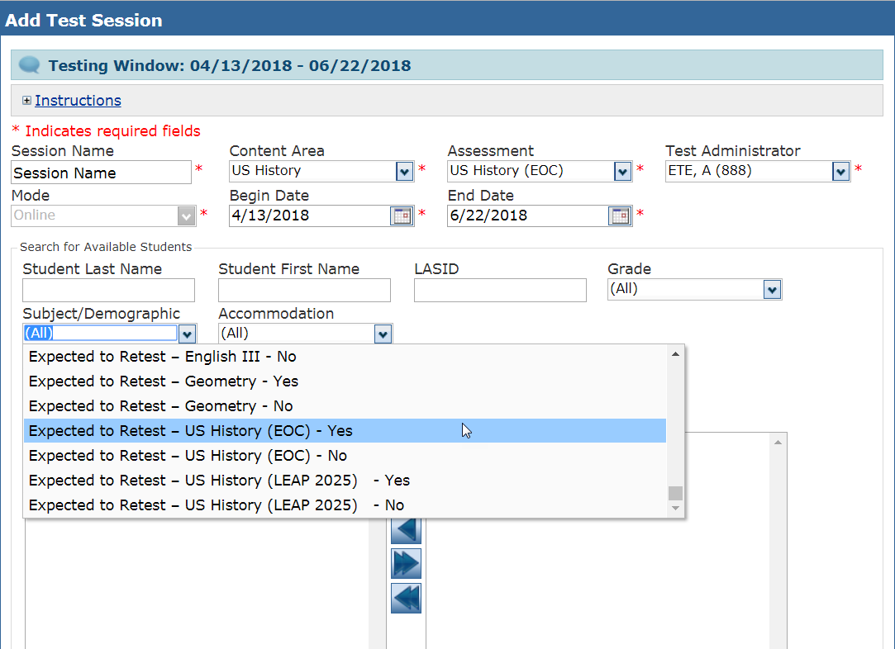
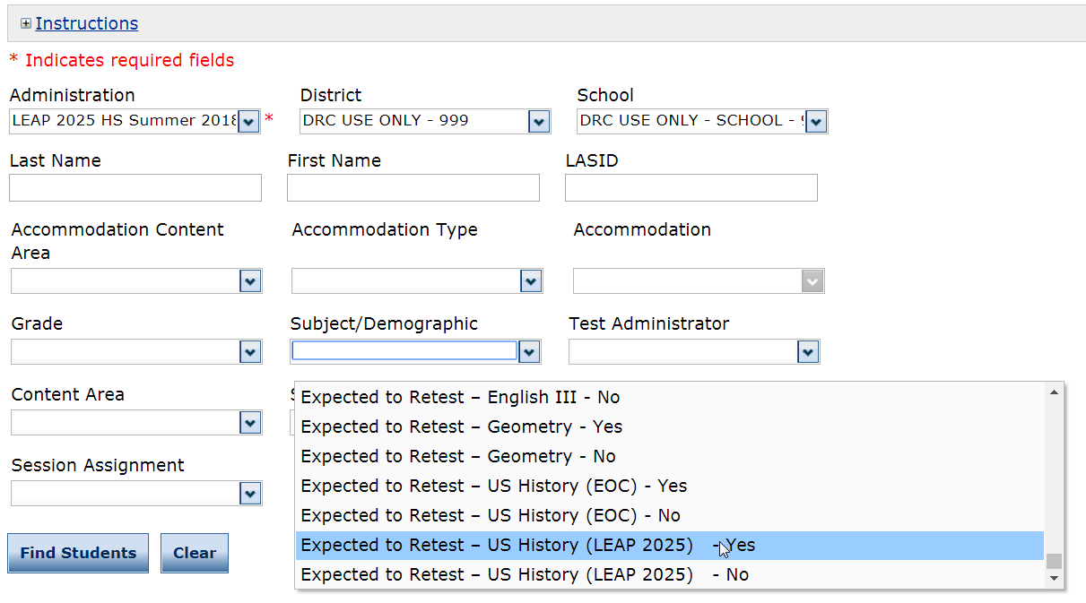
Summer High School LEAP 2025
Update: Beginning with the summer window, “Expected to Retest” will be part of the drop down filter to manage test sessions and students. This also can be exported to Excel and used to verify which students take the 4-level or 5-level US History tests.

Slide 52
NAEP

Slide 53
NAEP
Schools selected to participate in NAEP for the 2018-2019 school year received participation notifications in early June. The purposes of these assessments are:
NAEP: The National Assessment of Educational Progress (NAEP) is the largest continuing and nationally representative assessment of what our nation’s students know and can do in subjects such as mathematics, reading, science, and writing.
Selected schools will receive information throughout the year related to preparation and administration.

Slide 54
ACT and WorkKeys

Slide 55
ACT and WorkKeys Resources
The Score Report Schedules and the ACT WorkKeys Score Reports Available in Online Reports Portal document describe the reports schools and districts will receive. Reports for the ACT will be available in PearsonAccess^{nextTM}. Reports for ACT WorkKeys will be available in the Online Reports Portal. You will also receive some reports by mail.
The ACT Test Score Report Schedule has information about the reports and when to expect them.
The ACT WorkKeys Score Report Schedule has information about the reports and when to expect them.
The ACT WorkKeys Score Reports Available in Online Reports Portal document tells you what score reports are available in the portal.
Your State testing website has information about score reports, including how to understand and use the test results, under Interpretation in the ACT and ACT WorkKeys sections.
The ACT website has resources to help educators and administrators learn more about ACT score reports, including webinars, tutorials, and workshops.
General questions: www.act.org/stateanddistrict/contactus
Standard time testing questions: 800.553.6244, ext. 2800
Accommodations and supports questions: 800.553.6244, ext. 1788 or ACTStateAccoms@act.org

Slide 56
ELPT and LEAP Connect/LAA 1

Slide 57
2017-2018 Reporting:
LAA 1/LEAP Connect and ELPT Results
The English Language Proficiency Test (ELPT) and LEAP Connect tests were administered for the first time this spring.
The ELPT measures English learners ability to meet the increased language expectations required by grade-level content standards.
The LEAP Connect assessment measures the progress that students with significant disabilities are making while engaging in high-quality, standards-based content.
Results will be released this month.
Resources: LAA 1 Parent Guide, LEAP Connect Parent Guide, ELPT Parent Guide, and the 2018 Teacher Leader Summit

Slide 58
ELPT Results
Results will be posted in the AIR Online Reporting System (ORS) that is accessed through the ELPT portal.
Online Reporting System (ORS)
The Online Reporting System User Guide will be posted in the ELPT Portal under resources prior to results being released.
The user guide provides information about all ORS features, including instructions for viewing score reports, downloading student results, creating and editing rosters, and searching for students.
ORS login will be the same login as TIDE and the TA Interface.

Slide 59
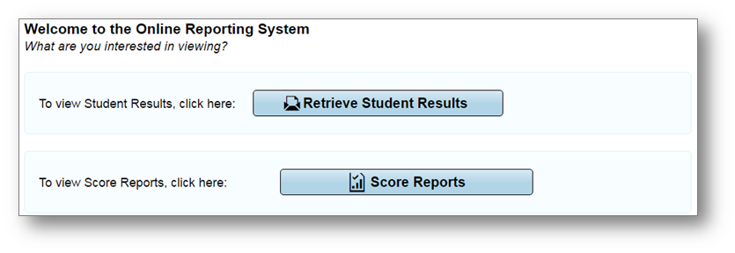
Overview of the ORS
ORS contains two major features: Score Reports and Reports and Files
Score Reports: Provides score data for each Louisiana ELPT. You can compare score data between individual students and the school, district, or overall state average scores. ORS also provides information about performance on domains when applicable.
Retrieve Student Results: Provides summary statistics (count and percentages) of students who tested in a selected subject and grade level. Enables you to download student data files containing test scores and demographic information.

Slide 60
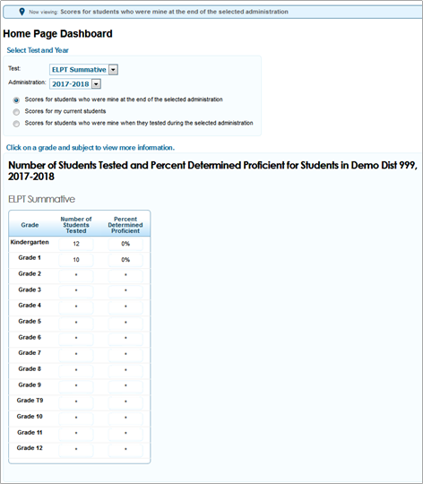
ORS: Score Reports
Score Reports: links to the Home Page Dashboard page which displays the overall summary of score data and testing progress for your state, district, or school, and is the starting point for data analysis.
An asterisk (*) on the summary table indicates that less than 10 students were reported in scoring.

Slide 61
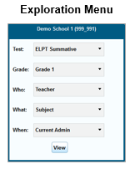
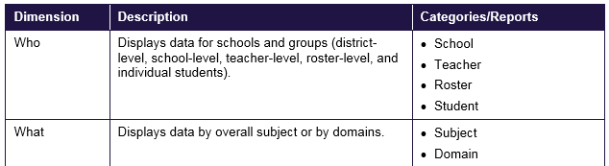
ORS: Score Reports
The Exploration Menu lets you navigate to different types of score reports by grade.
Reports can be navigated by making different selections from the Who and What drop-down lists.

Slide 62
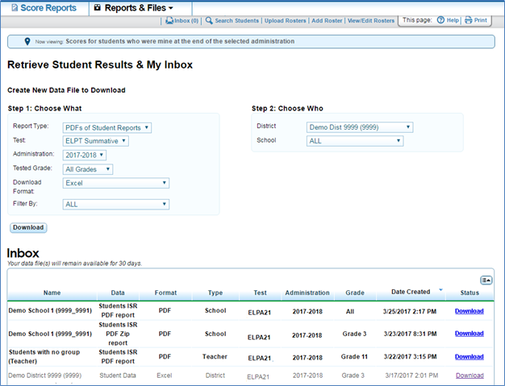
ORS: Reports and Files
Retrieve Student Results allows a user to download student data for a selected administration by district, school, teacher, or roster.
The data includes students’ information, including enrolled school and district, grade level, and the selected test scores and domain scores (if applicable).
You can also generate PDFs of Individual Student Reports in a Zip file.

Slide 63
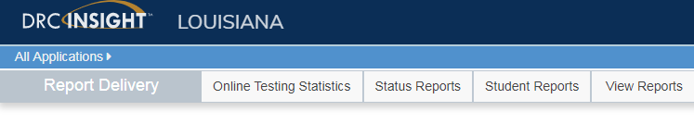
LEAP Connect/LAA1 Results
LEAP Connect/LAA1 results will be available in eDIRECT this months. Reports can be accessed through Report Delivery under All Applications.

Slide 64
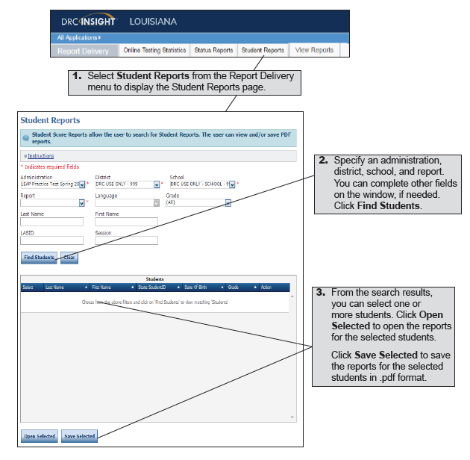
Report Delivery Options
Student Reports
eDIRECT users can display testing scores for students and save the results in Portable Document Format (.pdf).

Slide 65
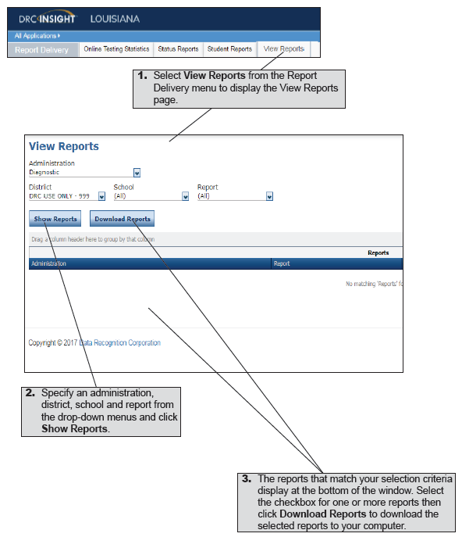
Report Delivery Options
View Reports
eDIRECT users can display reports by administration, district, school, and report name.

Slide 66
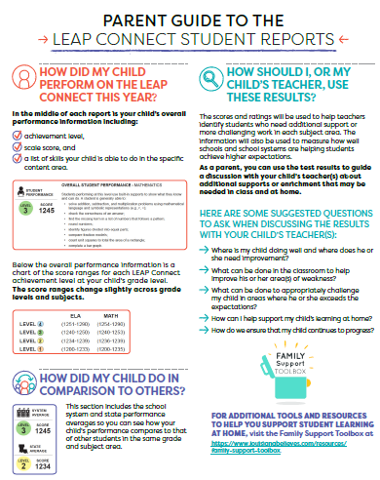
Parent Guides to the LEAP Connect and ELPT Student Reports
The Department released parent guides provides to the LEAP Connect student reports for grades 3-8 and the English Language Proficiency Test student reports for grades K-12.
The guides provide families with information on:
student achievement level by content or domain;
a comparison of the student’s progress to others; and
information to help parents understand how to use these results to guide discussions with their child’s teacher.
Schools should send the parent guides home to parents along with the student reports in May.
Both of these guides, and all other assessment resources, can be found in the Family Support Toolbox.

Slide 67
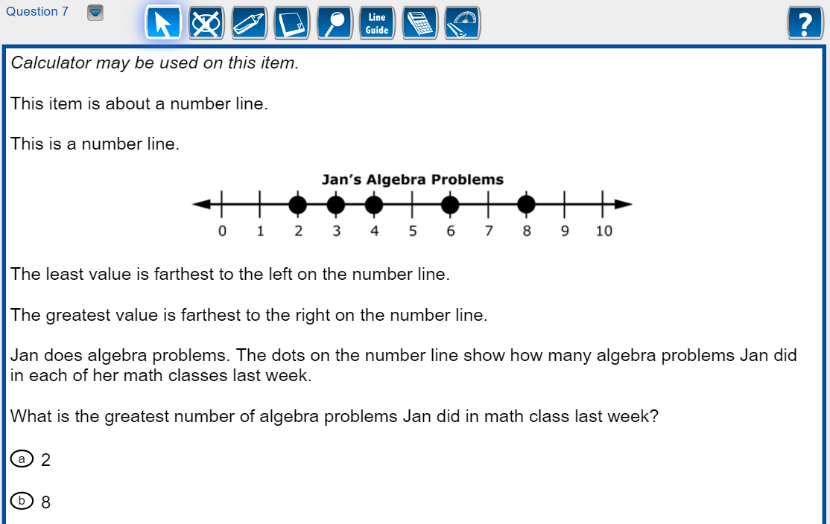
LEAP Connect 2018-2019
The LEAP Connect Online Tools Training (OTT) will be updated in the summer to include items for grade 11 ELA and math.
The OTT can be accessed through the INSIGHT Portal or through the OTT site in Google Chrome.

Slide 68
ELPS

Slide 69
What is ELPS?
Under the Every Student Succeeds Act (ESSA), standardized entrance and exit criteria are required for English Learners (ELs). In Louisiana, one component of the entrance criteria is a standardized screener called the English Language Proficiency Screener (ELPS).
Beginning in 2019-2020, the ELPS will be required for Louisiana students to begin receiving EL services, and it will be at no cost. Districts are strongly encouraged to use the ELPS during the 2018-2019 school year with the screener being available for district use August 1, 2018.
Further training on the screener design and administration will be provided at the 2018 Louisiana Teacher Leaders Summit and monthly Assessment and Accountability calls.
The ELPS Guidance document will be released this summer in the Assessment Library.

Slide 70
LEAP 360

Slide 71
2018-2019 Key Dates
LEAP 360 will close for the 2017-2018 school year on June 18. The dates below outline the opening of each LEAP 360 component for the 2018-2019 school year.
When EAGLE reopens, tests will carryover, but any discontinued items will be removed. Science items will no longer be available.
LEAP 360 Component | Closes | Opens
Diagnostic | June 18 | July 16 (Test Setup)
Interim | June 18 | July 16 (Test Setup)
EAGLE | June 18 | June 25

Slide 72
Planning for LEAP 360 in 2018-2019
Decisions should be made prior to the start of the school year regarding LEAP 360 administration. Over the summer, districts can prepare for LEAP 360 administration by:
Performing an assessment audit prior to the start of school to remove assessments that are duplicative, not aligned, or do not come from Tier 1 resources.
  For guidance utilize Assessment Inventory resources.
Attending all trainings and creating a plan to redeliver to appropriate district staff, school leadership, and teachers.
Reviewing and providing LEAP 360 resources to district staff, school leadership, and teachers with adequate time to prepare for the upcoming school year.

Slide 73
Planning for LEAP 360 in 2018-2019
Developing a communication plan with district and school technology coordinators prior to school starting and throughout the year, including regular opportunities to regroup and discuss technology readiness.
Ensuring INSIGHT and the Testing System Manager are set up at all schools.
  For guidance, see the DRC Technology User Guide posted under General Information in eDIRECT.
Creating an assessment calendar that includes:
  Forms chosen for LEAP 360 assessments,
  Testing windows for LEAP 360 assessments, and
  Scope-and-sequence aligned to the LEAP 360 assessments.

Slide 74
Assessment Updates

Slide 75
Data Systems: Closing Out the School Year
Forward to Data Coordinators: Key data coordinator action items in May include continuing to submit data to close out the school year and providing feedback/updates to the Department for next school year.
End-of-year data is important to:
students (demographic updates, final enrollment, attendance, discipline, dropout corrections, meeting graduation, TOPS, and/or post-secondary enrollment requirements),
Career/Tech work
Staff (Final teacher data including staff attendance)
Funding (updates to October and February enrollments),
It is important for school system program teams to work with data managers to ensure submissions are accurate. Since this is the final data collection for the school year, it is important that school system program teams work with data managers to ensure submissions are error-free, accurate and complete.

Slide 76
Data Systems: Preparation for 2018-19
Forward to Sponsor Site Coordinators: School systems may begin submitting requests to the Department for changes to their district and school information.
Online Sponsor Site (SPS) forms are now available for submitting Sponsor Site (SPS) new school, closure, and/or change requests. Note - Forms are not needed for changing information on school/LEA administrator, social media links, or clubs/sports. Those can be made directly in the system.
Deadline for submitting SPS forms for school closures is June 29, 2018.
Deadline for submitting SPS forms for new schools and other update requests is July 20, 2018.
Please refer to the 2018-19 Sponsor Site System (SPS) User guide posted on INSIGHT for guidance regarding the new electronic forms and how to certify.

Slide 77
Data Systems: 2018-19 Enhancements
Data Systems
Details about the upcoming enhancements were provided at the May 3 Data Coordinator’s webinar. This included enhancements reviewed at the March Collaboration and feedback provided by school districts via the feedback survey.
Additional details will be provided to vendors and data managers at the Data Coordinator’s webinar May 10 at 10:00am.
Changes of interest to DTCs include the following:
  Online Sponsor Site (SPS) update forms
  Clean LEADS Inquiry (LIQ) Assessment Data and Build Better Report Options
  eScholar and DRC Change
  504 Accommodations

Slide 78
Assessment Resources

Slide 79
LEAP 2025 Assessment Resources 2018-2019
Available Summer 2018
Updated LEAP 2025 Assessment Guides
New LEAP 2025 Assessment Guides for Science
Available Fall 2018
Updated US History Practice Test
New Biology Practice Test
New Science Practice Test Guidance
Available January 2019
Updated Social Studies Practice Tests for grades 3-8
New Science Practice Tests for grades 3-8

Slide 80
2018-2019 LEAP 2025 Resource Availability Timeline
Resource | Available | Purpose
Updated LEAP 2025 Assessment Guides | Summer 2018 | Explain the test designs and types of items included on the assessments. The guides also include information about testing times as well as sample items and links to additional resources.
New LEAP 2025 Assessment Guides for Science
Math, ELA, and Social Studies Practice Tests | Currently available in INSIGHT and eDIRECT | Grade- or course-level, paper-based (grades 3 and 4 ELA, math, social studies, science) and computer-based (grades 3-8 ELA, math, social studies, science, English I, English II, Algebra I, Geometry, US History, Biology) help prepare students for the spring assessments; accessed through INSIGHT.
New Biology Practice Test | Fall 2018
Updated US History Practice Test

Slide 81
2018 - 2019 LEAP 2025 Resource Availability Timeline
Resource | Available | Purpose
Updated Social Studies Practice Tests for Grades 3-8 | January 2019 | Grade- or course-level, paper-based (grades 3 and 4 ELA, math, social studies, science) and computer-based (grades 3-8 ELA, math, social studies, science, English I, English II, Algebra I, Geometry, US History, Biology) help prepare students for the spring assessments; accessed through INSIGHT.
New Science Practice Tests for Grades 3-8
Updated Math, ELA, and Social Studies Practice Test Guidance | Fall 2018 | Provide teachers with information regarding best practices when using the practice tests. Updated to include information about the new high school practice tests.
New Science Practice Test Guidance

Slide 82
Support and Communication

Slide 83
2018-2019 School System Planning Calendar
The Department released the 2018-2019 school system planning calendar containing dates for:
Supervisor, Principal and Teacher Leader Collaborations
Monthly Planning Calls: School System, Assessment & Accountability, Data Coordinator, Special Education, Ed Technology
Newsletter distribution: Superintendents, Charter, Nonpublic, Teacher Leader, Believe and Prepare, Counselor Connect and Early Childhood
BESE and Advisory Council meetings

Slide 84
DTC and Accountability Contact Update
If during the academic year the person appointed as district test coordinator changes, the district superintendent must notify the LODE. The notification must be in writing and must be submitted within 15 days of the change in appointment.
Due to the secure nature of the data accessed by accountability contacts and district test coordinators, changes have been made to the submission process for any updates to DTC and accountability contacts:
Superintendent signature now required
The DTC and Accountability Contact Update Form must be submitted from the superintendent’s district email account.
The revised DTC and Accountability Contact Update Form is located under the Resources + Forms section in the Assessment Library.

Slide 85
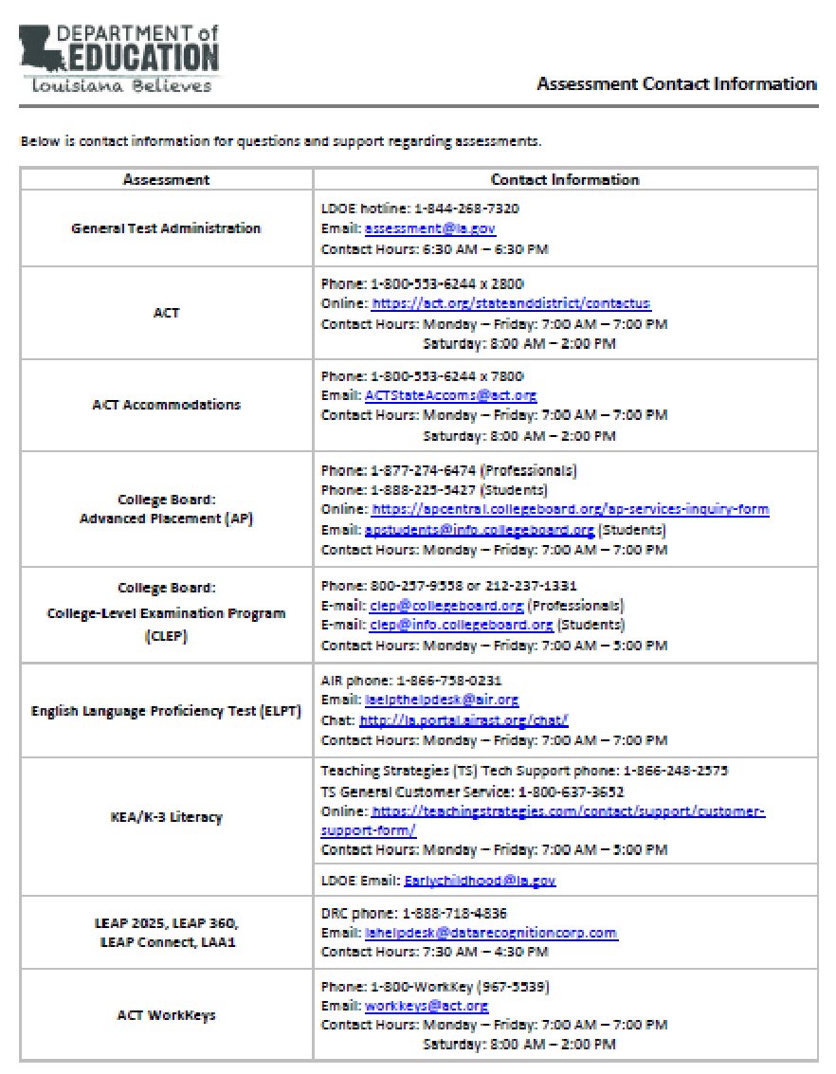
Assessments Customer Service
The Assessments Customer Service Contact Information has been posted to the Assessment Library. This provides all customer service contact information for all assessments.

Slide 86
District Support
The Assessment team offers multiple avenues of support to districts, schools, and teachers seeking information or assistance about assessment administration and accountability.
Weekly Newsletters
Assessment and accountability information and deadlines are released each week in the district newsletter.
Weekly Assessment & Accountability Calls
Each Tuesday at 1:00 PM these webinars are held to provide training, updates, and important information to DTCs and Accountability Contacts.
Assessment Library and Accountability Library
The Assessment Library contains resources for DTCs including the Assessment Schedule and the Assessment and Accountability Month-by-Month Checklist. The Accountability Library contains resources for accountability contacts including the School Performance Score (SPS) calculators as well as information on data certification and federal accountability.

Slide 87
District Support
Monthly Educational Technology Calls
Each month a webinar is held for district technology personnel to provide training, updates, and important information related to technology readiness and digital literacy.
Assessment@
All stakeholders are encouraged to email assessment and accountability questions and/or concerns to assessment@la.gov.
Assessment Hotline
For immediate assistance regarding assessment and accountability, district-level staff may call the Assessment Hotline at 1-844-268-7320.
EdTech@
All stakeholders are encouraged to email technology readiness questions and/or concerns to edtech@la.gov.

Slide 88
Next Steps

Slide 89
Next Steps
Key Dates | Action
May 18 | Last day for PBT Materials Pickup 3
June 11-15 | DRC Online cleanup for impending zeroes to determine final calculation for new progress index
June 18-22 | Summer high school testing window
Reminder: There will not be any Office Hours calls during June and July. Office Hours will resume in August.
Next Assessment and Accountability Monthly Call: June 19, 2018

