Slide 1
Eagle 2.0: Creating a Test Session/Viewing Test Status/Generating Test Tickets

Slide 2
Louisiana’s Approach
Louisiana believes access to the highest quality education allows all students, no matter their zip code, the opportunity for success.
Implementing a high-quality curriculum based on rigorous standards is one of the fastest ways to give this access to all students.
The curriculum must also be connected to standards-aligned assessments and professional development.

Slide 3
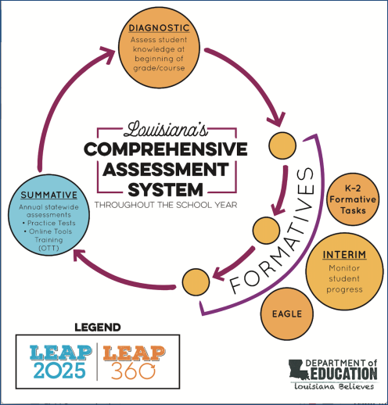
Overview of LEAP 360
There are three main purposes for classroom assessment:
Know where students are when they enter a classroom
Monitor how students are learning content over the year
Verify what students have learned
LEAP 360 pairs with LEAP 2025 to reduce overall testing time while realizing all three purposes.

Slide 4
Overview of LEAP 360
The goal of LEAP 360 is to deliver streamlined, high-quality assessments in a comprehensive system for classrooms, schools, and districts.
What is the impact on teachers, principals, and districts?
Teachers will have a more complete picture of student performance.
Principals will identify throughout the system where additional support is needed to focus on the learning that matters most for students.
Districts will reduce overall local testing while helping to monitor progress toward district goals.

Slide 5
Overview of LEAP 360
LEAP 360 is a formative assessment tool designed to help teachers, schools, and school systems monitor student learning and adjust instructional support. In addition, LEAP 360 offers school systems the opportunity to streamline testing and maximize instructional time.
LEAP 360 non-summative tools include the following components:
EAGLE 2.0: allows teachers to integrate high-quality questions into day-to-day classroom experiences and curricula
K-2 formative tasks: provide quality tasks focused on critical student skills in ELA and math
Diagnostic assessments: determine student readiness for new course work and assist teachers in setting meaningful and ambitious goals
Interim assessments: evaluate student learning and monitor progress toward year-end goals and allow teachers to target and adjust instruction throughout the year

Slide 6
Today’s Goals
At the end of this presentation, participants will understand how to:
Create a test session in EAGLE 2.0
View the test session status for a student group
View the test session status for individual students
Generate/print test tickets

Slide 7
Eagle 2.0 Creating a Test Session/Viewing Test Status/Generating Test Tickets

Slide 8
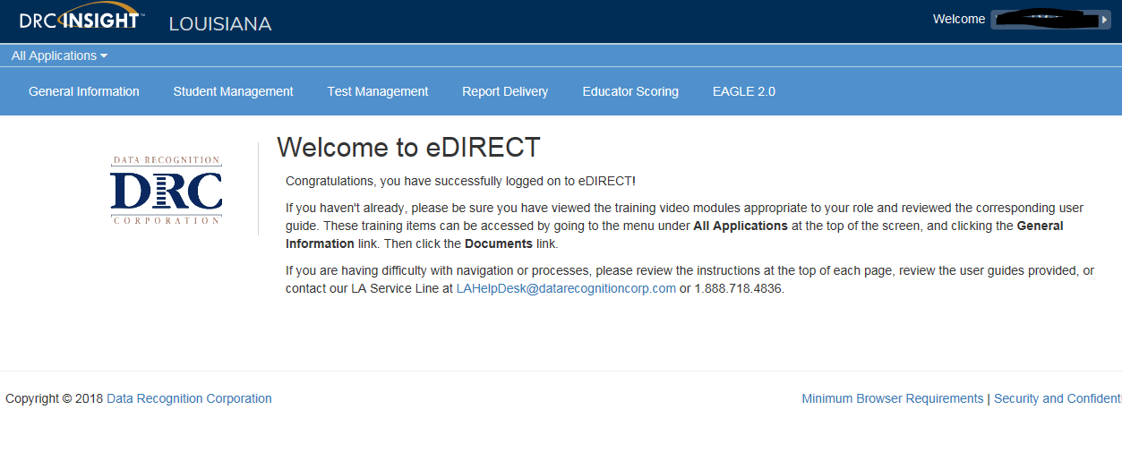
Accessing EAGLE 2.0
Once logged into eDIRECT, choose All Applications → EAGLE 2.0

Slide 9
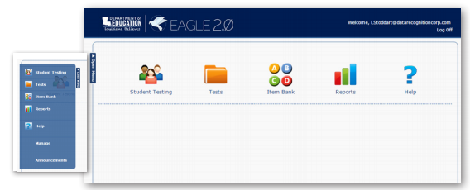
Creating a Test Session
From the EAGLE 2.0 dashboard, choose Student Testing

Slide 10
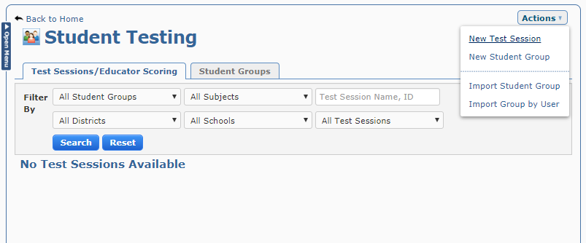
Creating a Test Session
From the Student Testing screen, select Actions and then New Test

Slide 11
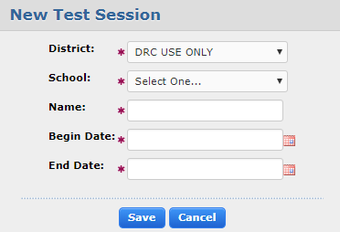
Creating a Test Session
The New Test Session dialog box displays
Specify a name for the test session, a date range, the test name, and the student groups that will be part of the test session
Note: Students must test between the Begin Date and the End Date

Slide 12
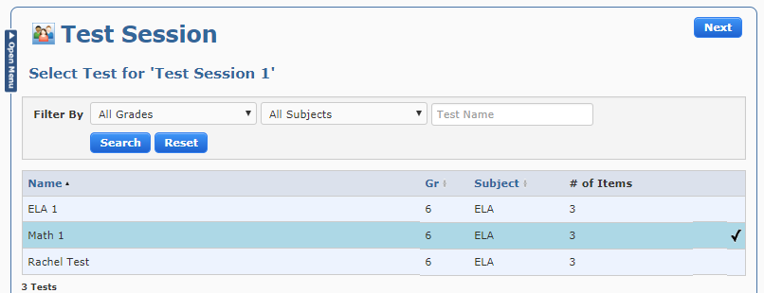
Creating a Test Session
The Test Session page displays a list of the tests that are currently in the system. Highlight a test to select it for the session. A check mark displays next to the test. Select Next to continue. A Preview Test page displays

Slide 13
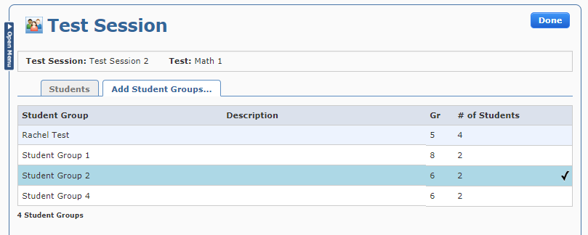
Creating a Test Session
The Test Session page displays a list of the student groups in the system. Highlight one or more student groups to include them in the test session. A check mark displays next to each student group you have selected. Select Done

Slide 14
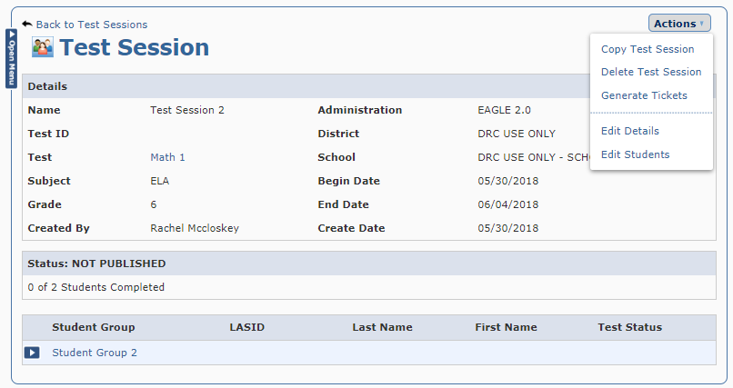
Creating a Test Session
The Test Session page displays the details of your new test session
Click the Actions drop down menu from the Test Session page to copy the test session, delete the test session, generate tickets for the test session, edit the details of the test session, or change the student groups that are part of the session

Slide 15
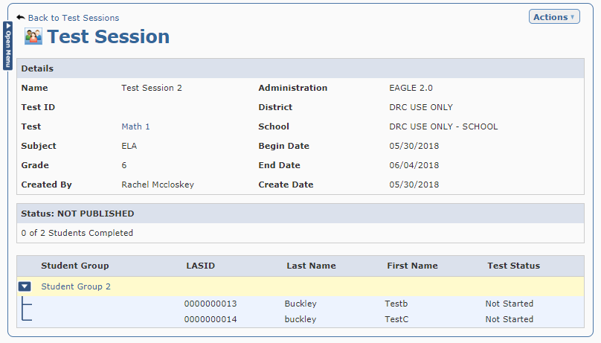
Viewing Test Status
From the Test Session page, the test status of the student group will display in the Status section. To view the test status for each student in a test session, click the arrow next to the student group name. The test status will appear next to each student’s name.

Slide 16
Generating Test Tickets
Click the Actions drop down menu from the Test Session page and select Generate Tickets

Slide 17
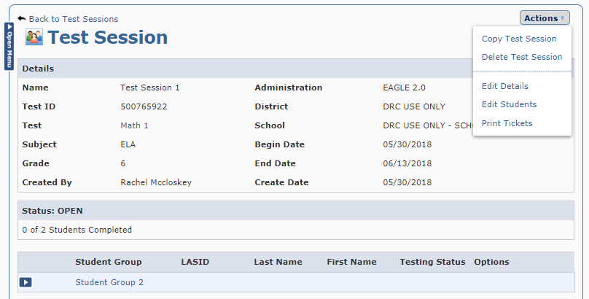
Generating Test Tickets
A Test ID will be developed for the test session
Click the Actions drop down menu from the Test Session page and select Print Tickets

Slide 18
Printing Test Tickets
A PDF will generate with the test tickets to print for student use.

Slide 19
Support

Slide 20
User Guides
The following user guides are posted in eDIRECT under General Information:
eDIRECT User Guide
Technology User Guide
EAGLE 2.0 User Guide

Slide 21
LEAP 360 Assessments: Resources
The following resources are available to help teachers understand, access, and use the the LEAP 360 assessment tools:
LEAP 360 webpage
A Teacher’s Guide to LEAP 360
A District’s Guide to LEAP 360
EAGLE 2.0 Quick Start Guide: How to Create a Test
EAGLE 2.0 Quick Start Guide: How to Create a Test Session
eDIRECT
Accessibility Features and Accommodations Overview
Teacher Study Guides (available in eDIRECT)
Webinars and Mini-trainings available on the LEAP 360 page

Slide 22
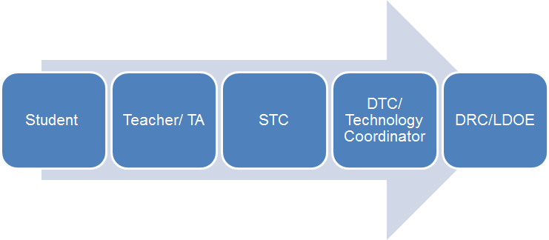
Technical Assistance Protocol
If technical problems occur, school and district staff should follow the protocol presented below.
DRC Louisiana Customer Service
1-888-718-4836 LAHelpDesk@datarecognitioncorp.com
LDOE
1-844-268-7320
assessment@la.gov

