Slide 1
LEAP 360: Eagle 2.0 Creating a Test

Slide 2
Louisiana’s Approach
Louisiana believes access to the highest quality education allows all students, no matter their zip code, the opportunity for success.
Implementing a high-quality curriculum based on rigorous standards is one of the fastest ways to give this access to all students.
The curriculum must also be connected to standards-aligned assessments and professional development.

Slide 3
Overview of LEAP 360
There are three main purposes for classroom assessment:
Know where students are when they enter a classroom
Monitor how students are learning content over the year
Verify what students have learned
LEAP 360 pairs with LEAP 2025 to reduce overall testing time while realizing all three purposes.

Slide 4
Overview of LEAP 360
The goal of LEAP 360 is to deliver streamlined, high-quality assessments in a comprehensive system for classrooms, schools, and districts.
What is the impact on teachers, principals, and districts?
Teachers will have a more complete picture of student performance.
Principals will identify throughout the system where additional support is needed to focus on the learning that matters most for students.
Districts will reduce overall local testing while helping to monitor progress toward district goals.

Slide 5
Overview of LEAP 360
LEAP 360 is a formative assessment tool designed to help teachers, schools, and school systems monitor student learning and adjust instructional support. In addition, LEAP 360 offers school systems the opportunity to streamline testing and maximize instructional time.
LEAP 360 non-summative tools include the following components:
EAGLE 2.0: allows teachers to integrate high-quality questions into day-to-day classroom experiences and curricula
K-2 formative assessments: provide quality tasks focused on critical student skills in ELA and math
Diagnostic assessments: determine student readiness for new course work and assist teachers in setting meaningful and ambitious goals
Interim assessments: evaluate student learning and monitor progress toward year-end goals and allow teachers to target and adjust instruction throughout the year

Slide 6
Today’s Goals
At the end of this presentation, participants will understand how to:
Create a test in EAGLE 2.0
Add items/passages to a test in EAGLE 2.0

Slide 7
Eagle 2.0 Creating a Test

Slide 8
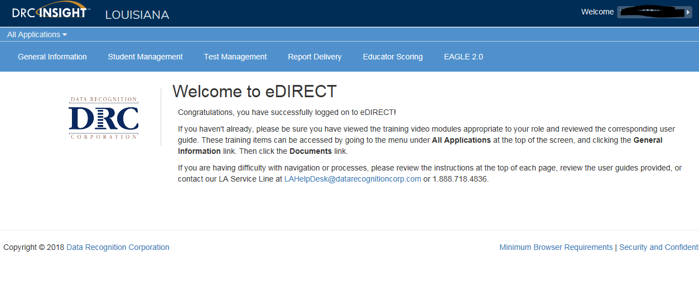
Accessing EAGLE 2.0
Once logged into eDIRECT, choose All Applications → EAGLE 2.0

Slide 9
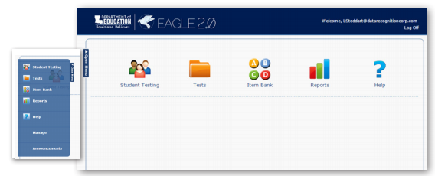
Creating a Test
From the EAGLE 2.0 dashboard, choose Tests

Slide 10
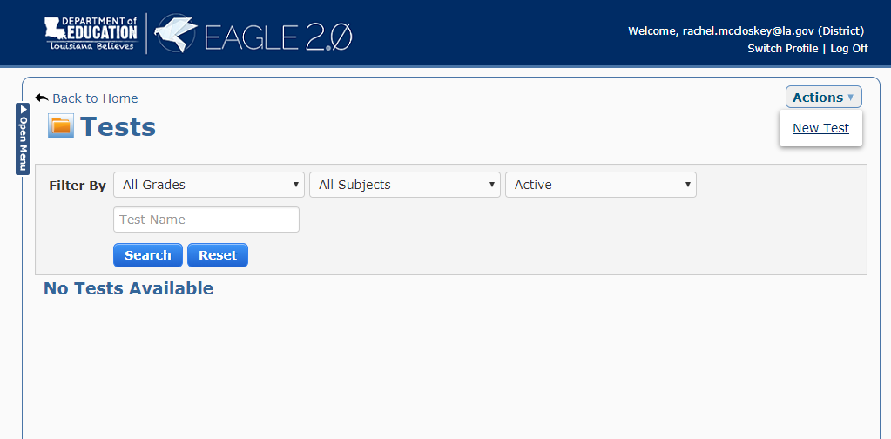
Creating a Test
From the Tests screen, select Actions → New Test

Slide 11
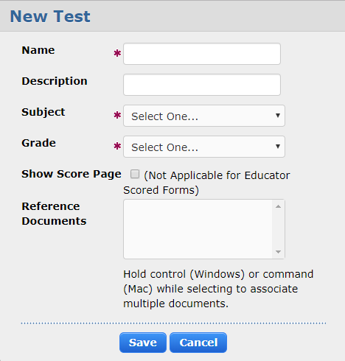
Creating a Test
Enter a Name, Description, Subject, and Grade
Check the Show Score page checkbox if you want the students to see their score when they have finished the test
Select Save when you are finished or Cancel to cancel the process

Slide 12
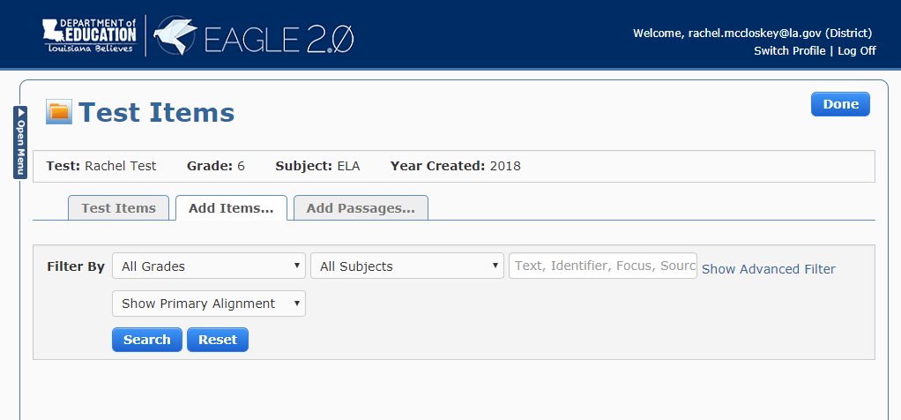
Creating a Test
The Test Items page displays
Choose Add Items/Add Passages to add items and passages to your test.
Filter by grade, subject, and keyword/item identifier

Slide 13
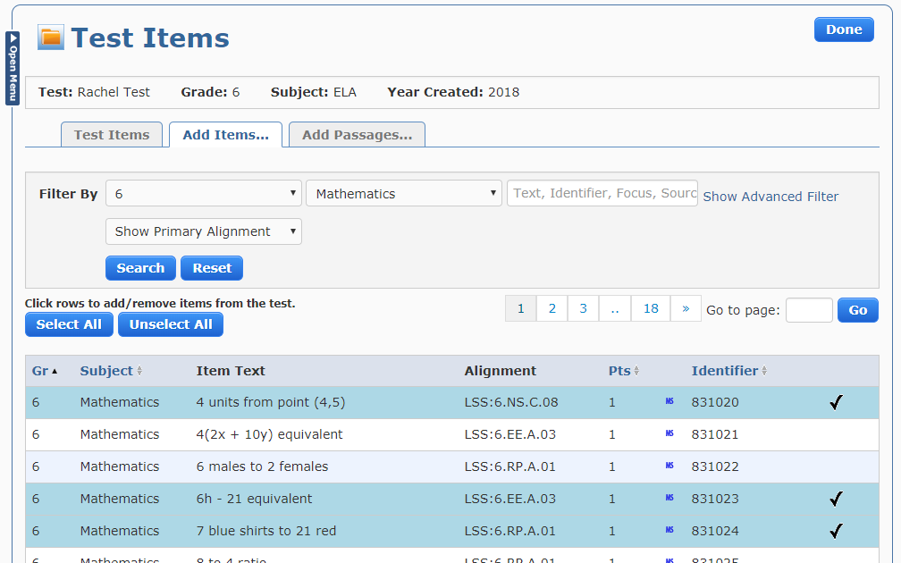
Creating a Test
Click each item you want to add to the test. A check mark is displayed next to each item (to deselect, click the item again)
Use the same process for Adding Passages
When you are finished adding passages, click on the Done button, on the top right of page

Slide 14
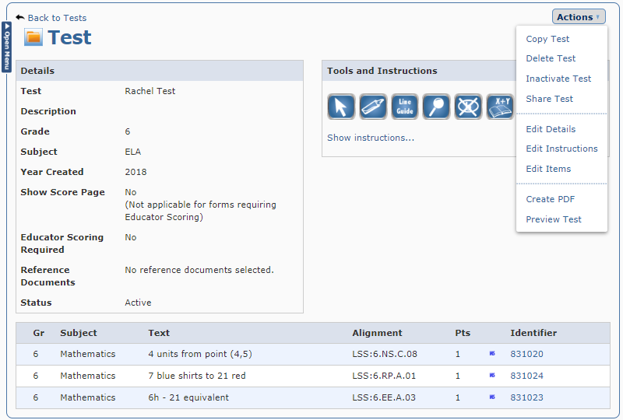
Creating a Test
The completed test displays in the Test page. Users can view, work with, add, and delete items and passages in the test
Selecting Actions displays a menu of available options

Slide 15
Support

Slide 16
User Guides
The following user guides are posted in eDIRECT under General Information:
eDIRECT User Guide
Technology User Guide
EAGLE 2.0 User Guide
Additional resources:
Assessment Library
Assessment Guidance Library

Slide 17
LEAP 360 Assessments: Resources
The following resources are available to help teachers understand, access, and use the the LEAP 360 assessment tools:
eDIRECT
LEAP 360 webpage
A Teacher’s Guide to LEAP 360
A District’s Guide to LEAP 360
EAGLE 2.0 Quick Start Guide: How to Create a Test
EAGLE 2.0 Quick Start Guide: How to Create a Test Session
Accessibility Features and Accommodations Overview
Teacher Study Guides (available in eDIRECT)
Webinars and Mini-trainings available on the LEAP 360 page

Slide 18
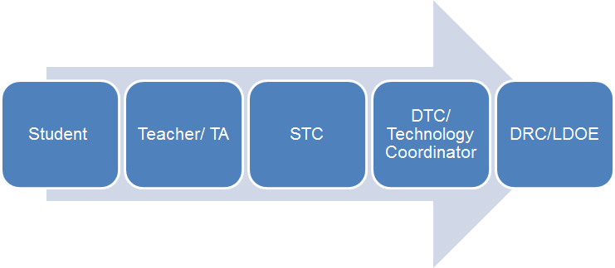
Technical Assistance Protocol
If technical problems occur, school and district staff should follow the protocol presented below.
DRC Louisiana Customer Service
1-888-718-4836 LAHelpDesk@datarecognitioncorp.com
LDOE
1-844-268-7320
assessment@la.gov

