Slide 1
eDIRECT: Accessing Reports

Slide 2
Outcomes
By the end of today’s session, you should be able to:
Understand the different tabs under Report Delivery
Know how to view reports in eDIRECT
Know the types of testing results reports available for nonsummative and summative assessments

Slide 3
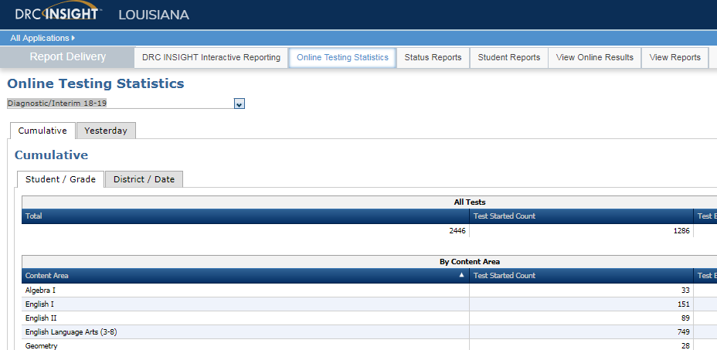
Reports Overview
From the Report Delivery menu, eDIRECT users can access online testing statistics, status reports and results reports.
Detailed directions for Test Management can be found in the eDIRECT User Guide posted in eDIRECT under General Information.

Slide 4
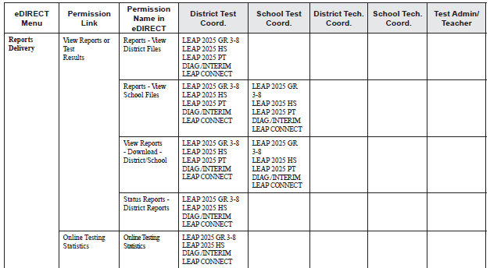
Reports Permissions
Pre-assigned permissions for reports access are defined in the permissions matrix in the eDIRECT User Guide posted in eDIRECT under General Information.
Additional permissions will need to be added to user roles. User roles and permissions are managed through the User Management tab

Slide 5
Viewing Reports
Once logged into eDIRECT, choose All Applications → Report Delivery

Slide 6
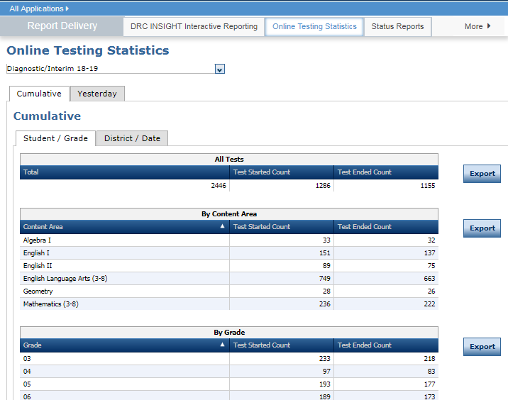
Accessing Online Testing Statistics
eDIRECT users can display testing statistics for the entire test period up to the previous day, or statistics for the previous day, sorted by student and grade, or by district and date. To view online testing statistics:
Select Online Testing Statistics from the Report Delivery menu to display the Online Testing Statistics page
Select an administration
Select Cumulative to view reports for the entire testing period up to the previous day or select Yesterday to view reports for the previous day

Slide 7
Accessing Online Testing Statistics
Select Student/Grade to view reports sorted by student and grade, or District/Date to view reports sorted by district and date

Slide 8
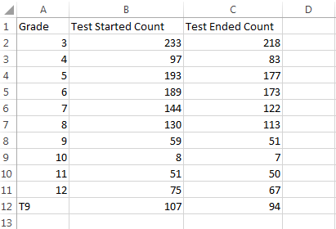
Accessing Online Testing Statistics
For a .csv of online testing statistics, click Export.

Slide 9
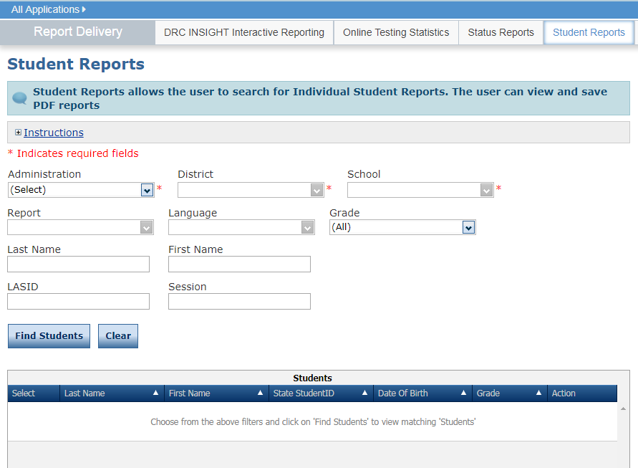
Accessing Student Reports
Student Reports allows the user to search for Individual Student Reports and Student Repsonse Maps. The user can view and save .pdf reports
To view student reports:
Select Student Reports from the Report Delivery menu to display the Student Reports page
Specify an administration, district, school, and report. Click Find Students

Slide 10
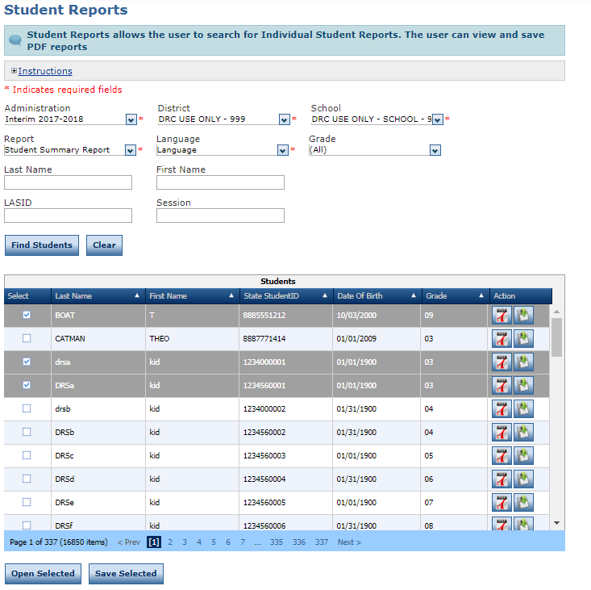
Accessing Student Reports
From the search results, you can select one or more students.
Click Open Selected to open the reports for the selected students
Click Save Selected to save the reports for the selected students in .pdf format
Click Export to PDF to open a .pdf of the report
Click Export to CSV to open a .csv of the report

Slide 11
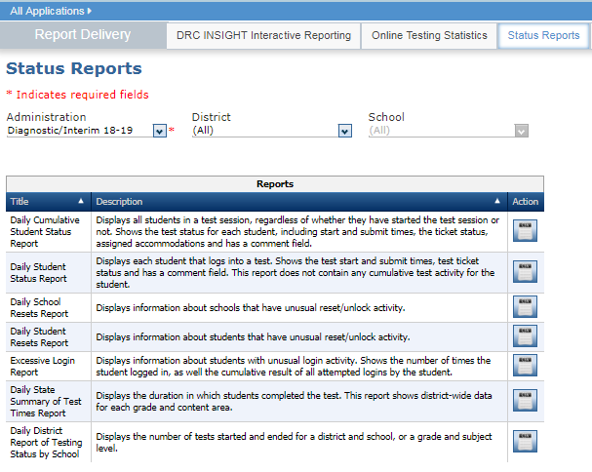
Accessing Status Reports
eDIRECT users can use status reports to track testing activity for a test administration in a particular district and school. During testing, these reports are updated daily at the end of each testing day.
To view status reports:
Select Status Reports from the Report Delivery menu to display the Status Reports page
Select an administration and district/school
Click the Report icon next to the report you want to display

Slide 12
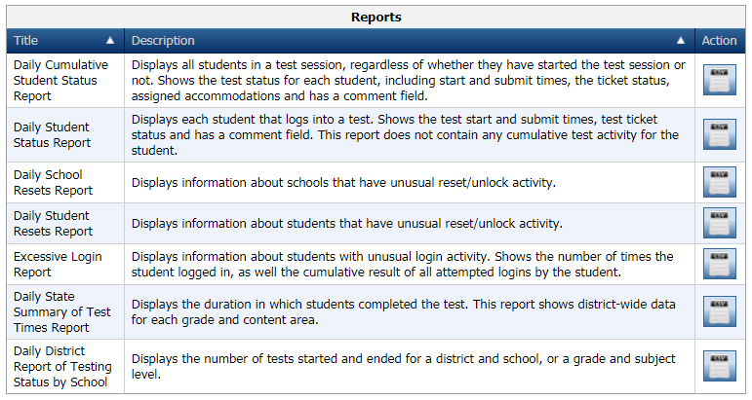
Accessing Status Reports

Slide 13
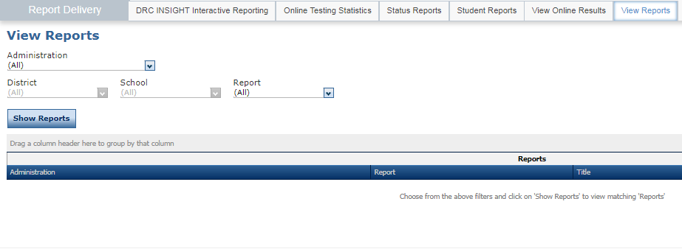
Accessing View Reports
Select View Reports from the Report Delivery menu to display reports by administration, district, school, and report name. To view reports:
Select View Reports from the Report Delivery menu to display the View Reports page
Specify an administration, district, school and report from the drop-down menus and click Show Reports

Slide 14
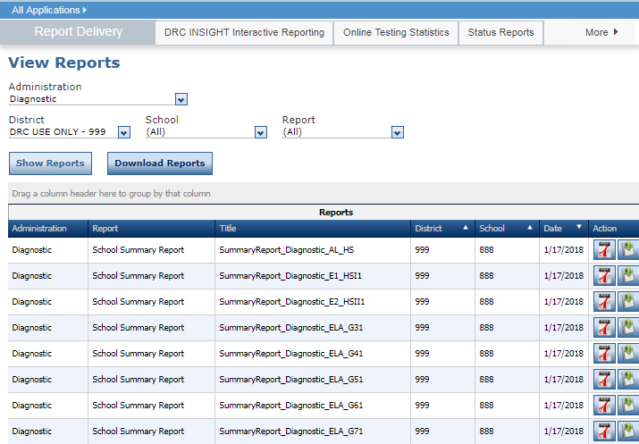
Accessing View Reports
The reports that match your selection criteria display at the bottom of the window.
Click Download Reports to download the selected reports to your computer
Click Export to PDF to open a .pdf of the report
Click Export to CSV to open a .csv of the report

Slide 15
Available Testing Results Reports
Summative Reports:
Student Report
Class Roster Report (HS only)
School Roster Report
Data .csv File
Nonsummative Reports:
Student Response Map
Student Summary
Test Session Response Map
Test Session Summary
Test Session Roster Report
Test Session List Report
School Summary Report
School List Report
Data .csv File

Slide 16
Support

Slide 17
User Guides
The following user guides are posted in eDIRECT under General Information:
eDIRECT User Guide
Technology User Guide
EAGLE 2.0 User Guide

Slide 18
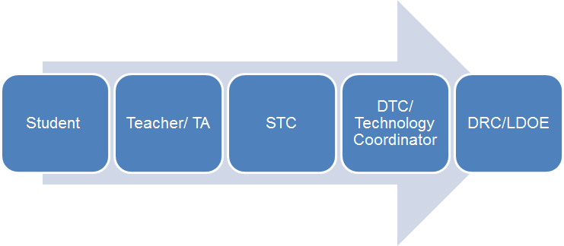
Technical Assistance Protocol
If technical problems occur, school and district staff should follow the protocol presented below.
DRC Louisiana Customer Service
1-888-718-4836 LAHelpDesk@datarecognitioncorp.com
LDOE
1-844-268-7320
assessment@la.gov

