Slide 1
eDIRECT: Accessing the eDIRECT Dashboard

Slide 2
Today’s Goals
At the end of this presentation, participants will understand:
How to log into eDIRECT
The eDIRECT dashboard for test coordinators
The administrative functions in the eDIRECT platform

Slide 3
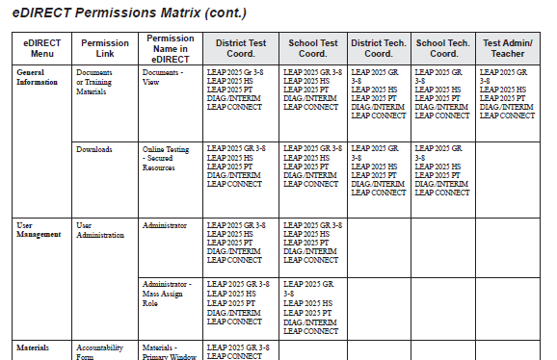
eDIRECT Dashboard Overview
Access to tabs and functions in the eDIRECT dashboard is managed through User Management.
Pre-assigned permissions for specific user roles within eDIRECT are defined in the permissions matrix in the eDIRECT User Guide posted in eDIRECT under General Information.
Additional permissions can be added to user roles through User Management to give access to additional tabs and/or functions in eDIRECT

Slide 4
eDIRECT First Time Log On
Test setup is managed through the eDIRECT administrative portal.
District Test Coordinators (DTCs) will be uploaded to eDIRECT via the email on record with the Department of Education. If you are a new DTC, complete the DTC and Accountability Contact Update Form and email to assessment@la.gov
School Test Coordinators (STCs) must be added to eDIRECT by the District Test Coordinator. For detailed instructions on adding users, reference the eDIRECT User Guide posted in eDIRECT under General Information
Once added to eDIRECT, users will receive an email notice to complete user setup.

Slide 5
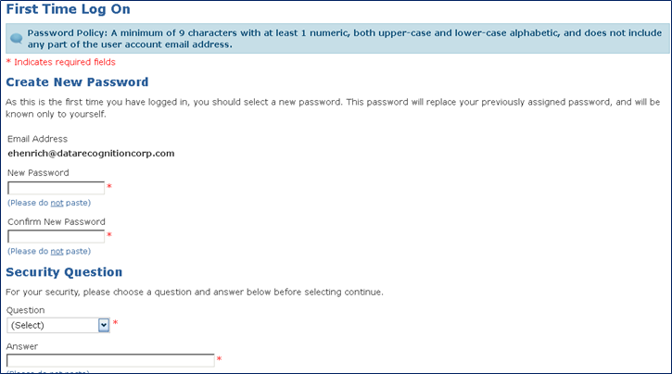
eDIRECT First Time Log On
Once users click on the URL in the email notice, they will be routed to eDIRECT where they will be required to complete the auto-prompt password reset.

Slide 6
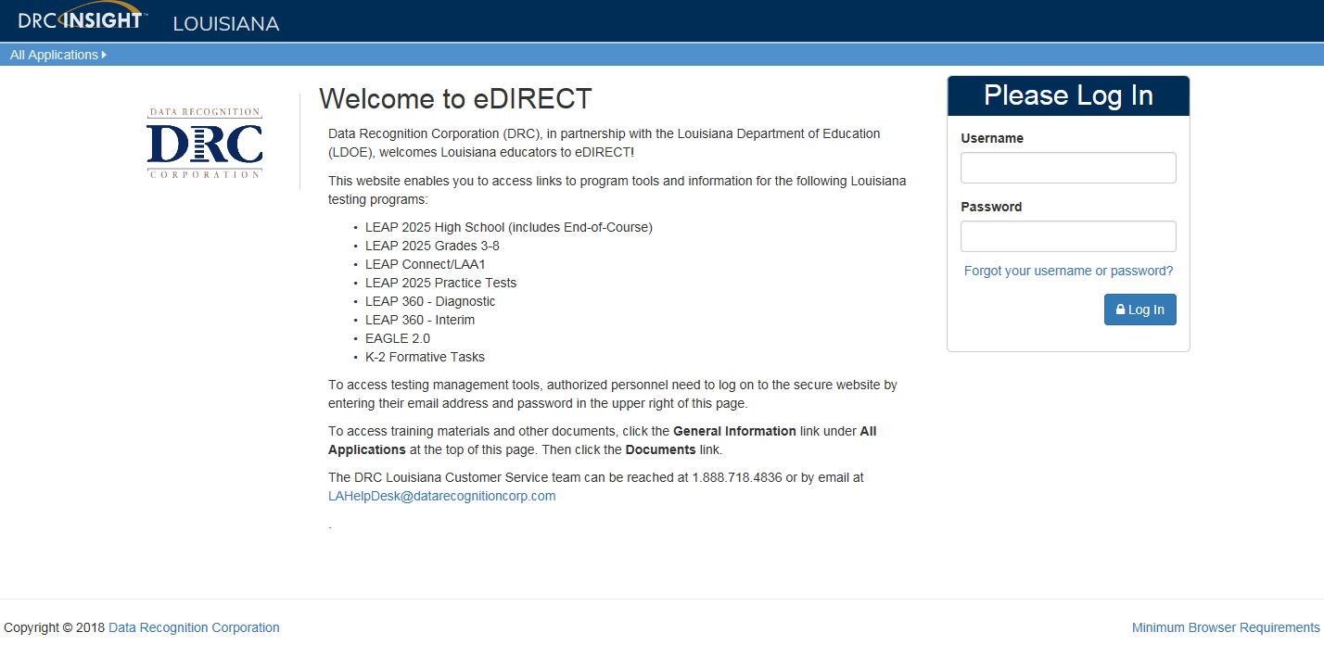
Accessing eDIRECT
Use a web browser to navigate to the eDIRECT website at https://la.drcedirect.com. Log in with Username and Password.

Slide 7
eDIRECT Dashboard
Device Toolkit
Report Delivery
Educator Scoring
EAGLE 2.0
K-2 Formative Tasks
The eDIRECT dashboard has tabs with multiple functions within the administrative system.
General Information
User Management
Materials Management
Student Management
Test Management
Test Administrator Management

Slide 8
General Information

Slide 9
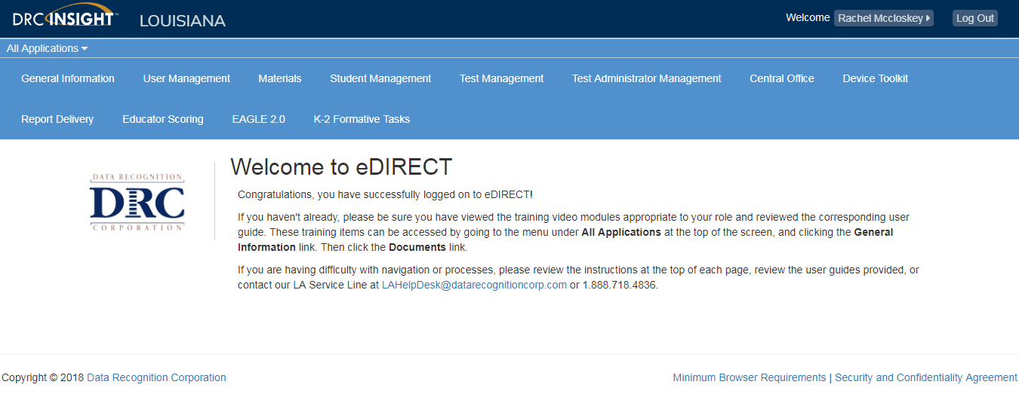
General Information

Slide 10
General Information: Announcements
The Announcements tab under General Information contains:
times eDIRECT/EAGLE 2.0 will be unavailable for scheduled maintenance
solutions for a known problem that DRC is actively working to correct
dates when reports will be available for LEAP 360 assessments and Practice Tests.

Slide 11
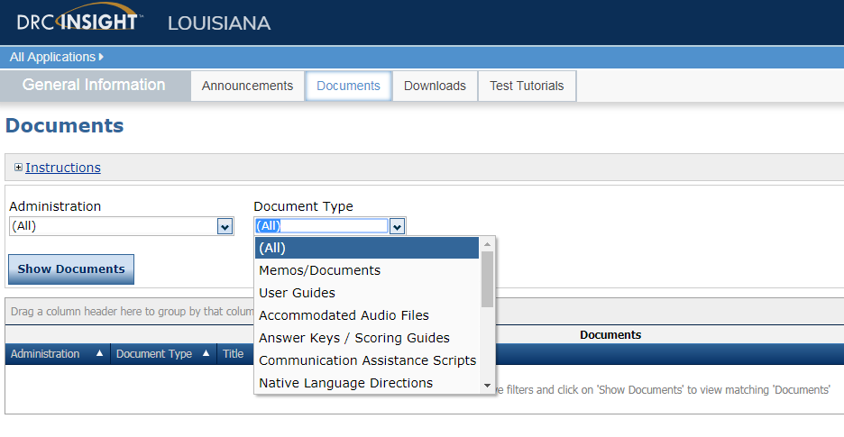
General Information: Documents
The Documents tab in eDIRECT to include more options, making locating specific documents easier. The Document Type drop down now contains the following filter options:
Memos/ Documents
User Guides
Accommodated Audio Files
Manuals
Math Reference Sheets
Forms and Processes
Reference Sheet
Teacher Study Guides
Communication Assistance Scripts
Native Language Directions
Paper Tests
Graphics
Manipulatives List
Social Studies Extended Response Checklist

Slide 12
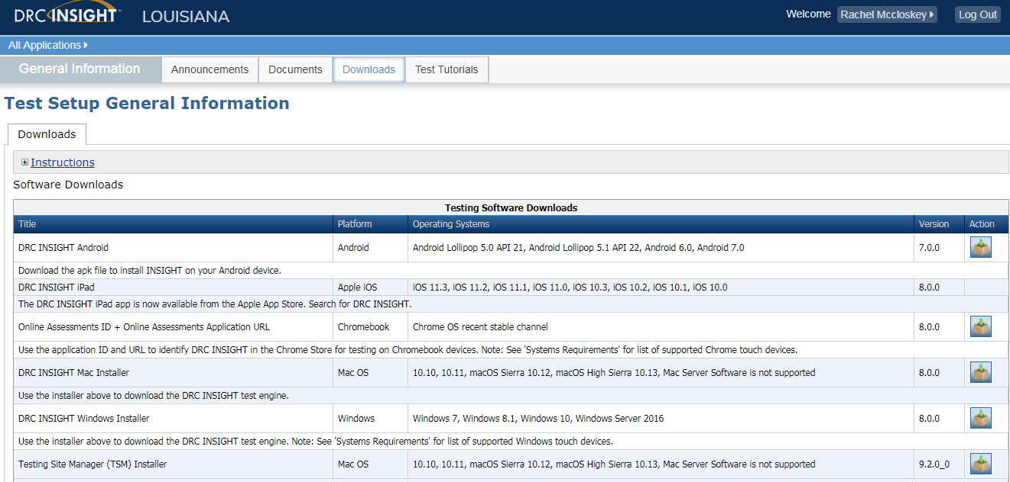
General Information: Downloads
In the Downloads tab, school and district technology coordinators have access to general information in order to get the software downloads required to set up the DRC testing platform.

Slide 13
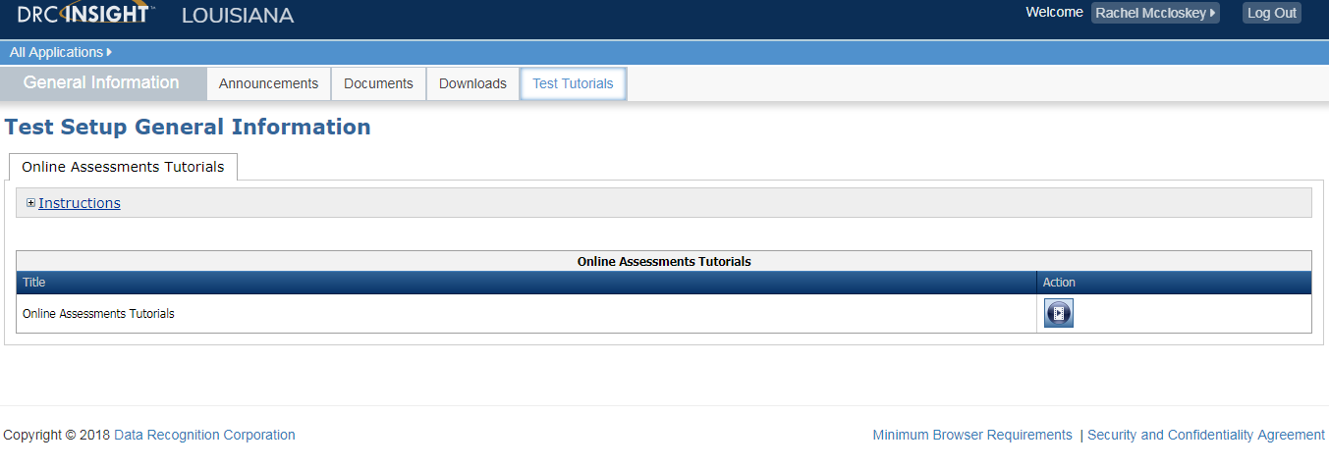
General Information: Test Tutorials
The Test Tutorials tab contains short video walkthroughs of the online tool trainings (OTTs) that may be viewed by students prior to taking the assessment.

Slide 14
User Management

Slide 15
User Management

Slide 16
User Management
Under User Management, users may either be created individually or in an upload for multiple users. Once users are created they will receive an email with a link to set up their password.
Permissions will be set during the creation process but can be updated. The system will make recommendations based on user role.
Detailed directions for user management can be found in the eDIRECT User Guide posted in eDIRECT under General Information.

Slide 17
Materials

Slide 18
Materials

Slide 19
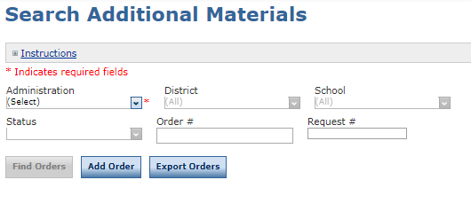
Materials: Additional Materials
The Additional Materials System allows districts the ability to enter, track, view, change, export, and delete Additional Materials Orders. The paper Additional Materials Request Form for School Test Coordinators will be used to communicate school orders to District Test Coordinators.
To manage the Additional Materials system:
Select the appropriate Administration
To enter a new order, click on Add Order and enter order quantities per material. Shipping notes can be added in the Notes tab
To find an existing order, click on Find Orders
Note: Existing orders can be updated or deleted if they are in the “Submitted” status.

Slide 20
Student Management

Slide 21
Student Management

Slide 22
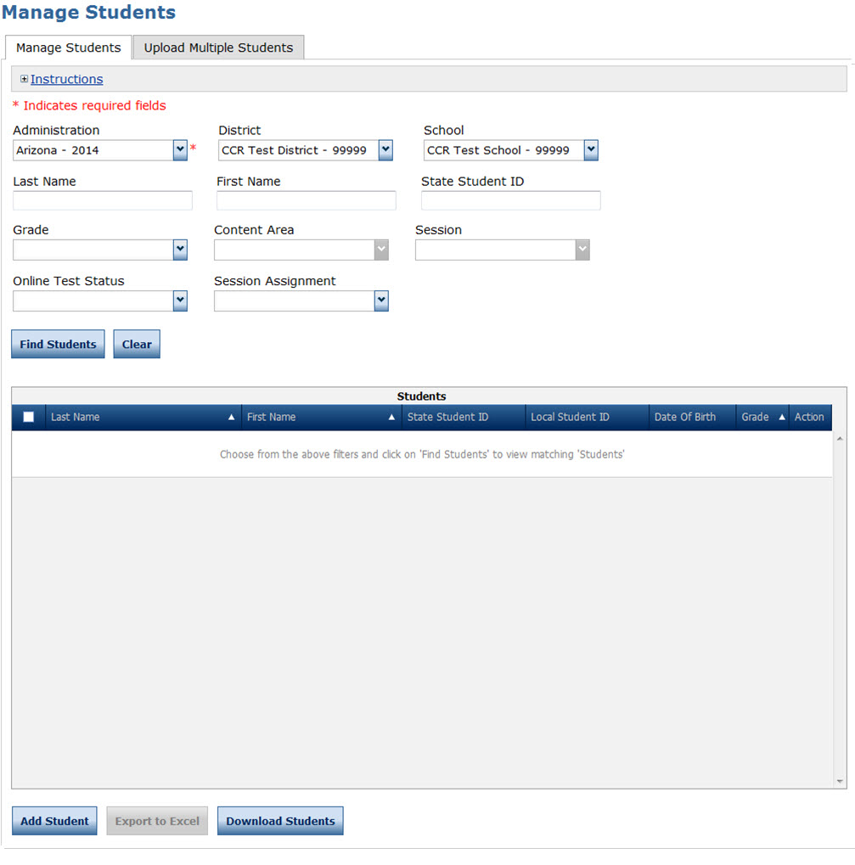
Student Management
Students may either be added individually or in an upload for multiple users.
Test coordinators can edit certain fields (e.g., 504, LEP, Sped status).
Additionally test coordinators will need to document certain accommodations within the system.
Detailed directions for student management can be found in the eDIRECT User Guide posted in eDIRECT under General Information.

Slide 23
Test Management

Slide 24
Test Management

Slide 25
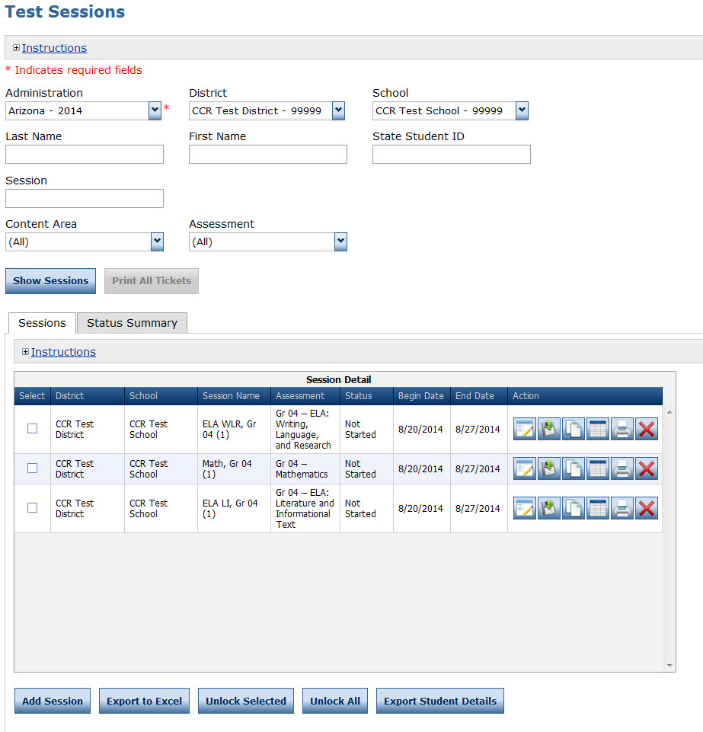
Test Session Management
Once all students are uploaded to eDIRECT, test administrators numbers have been created and student accommodations have been added/checked, test sessions must be created. One test session is created within the system for each group of students taking a test.
For example, a group of students taking Algebra I would be grouped into one test session which would generate a test ticket for each student for each part of the test.
Detailed directions for test management can be found in the eDIRECT User Guide posted in eDIRECT under General Information.

Slide 26
Test Administrator Management

Slide 27
Test Administrator Management

Slide 28
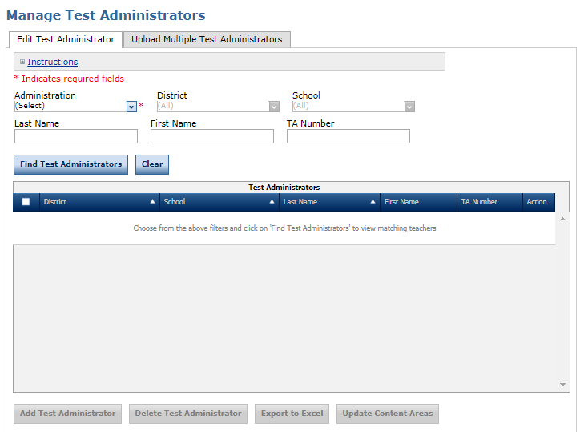
Test Administrator (TA) System
Test Administrators may either be created individually or in an upload for multiple TAs.
Each TA must have a 3 digit TA number in eDIRECT for both computer-based and paper-based testing.
Detailed directions for user management can be found in the eDIRECT User Guide posted in eDIRECT under General Information.

Slide 29
Device ToolKit

Slide 30
Device ToolKit

Slide 31
Device ToolKit
The Device Toolkit dashboard allows districts to see all configurations at one time. For district users to see all configurations, enter the district name in the site bar..
Users can also see all configurations at a school site by typing the school’s name into the site bar.

Slide 32
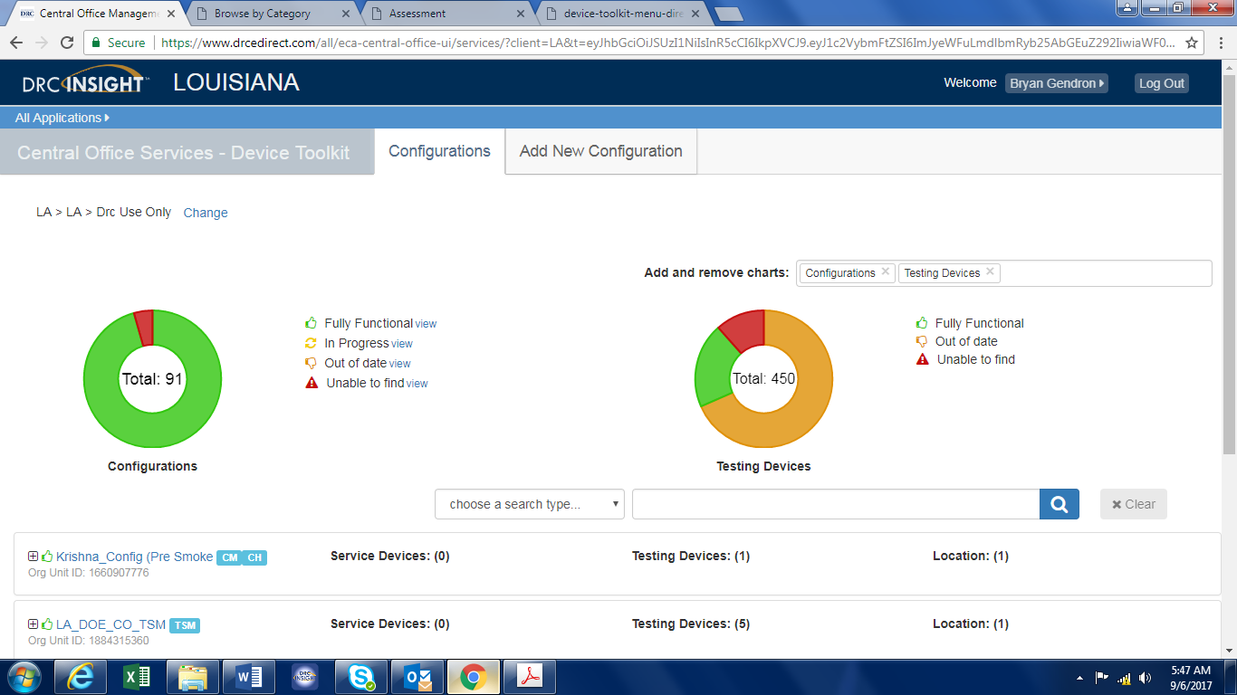
Device ToolKit Dashboard
The dashboard allows users to see the status of all configuration and testing devices.

Slide 33
Report Delivery

Slide 34
Report Delivery

Slide 35
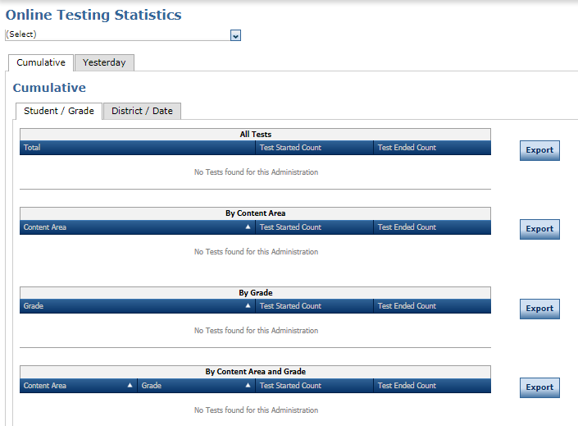
Report Delivery: Online Testing Statistics
This tab allows DTCs to see the number of times a test has been logged into in their LEA. DTCs can sort by:
All tests
Content Area
Grade
Content Area and Grade
Please note this is not an accurate list of how many tests or test sessions were taken.

Slide 36
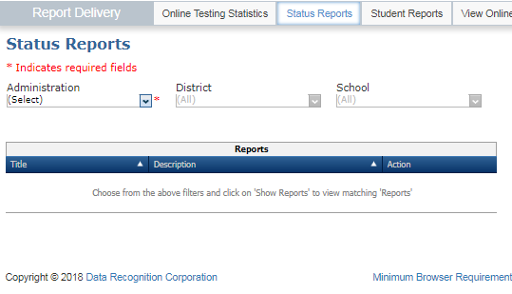
Report Delivery: Status Reports
Under the Status Reports tab, DTCs can pull reports to check the following:
Status of all students in a test session (cumulative and daily)
Report of unlocked test sessions (cumulative and daily)
Summary of testing time (cumulative only)

Slide 37
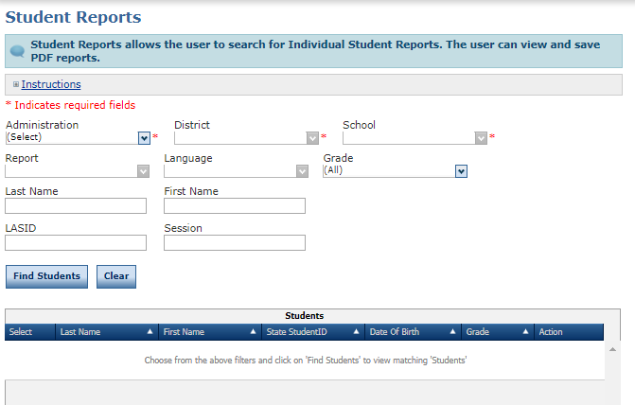
Report Delivery: Student Reports
All individual student level non-summative reports are found under the Student Reports tab.

Slide 38
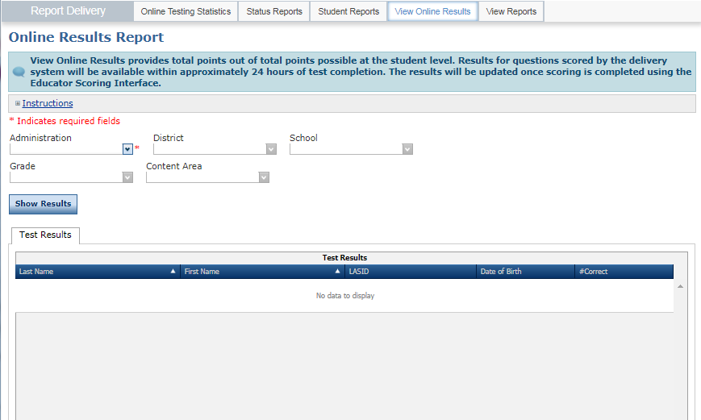
Report Delivery: View Reports
All non-summative test session reports and all summative reports can be found here.

Slide 39
Educator Scoring

Slide 40
Educator Scoring

Slide 41
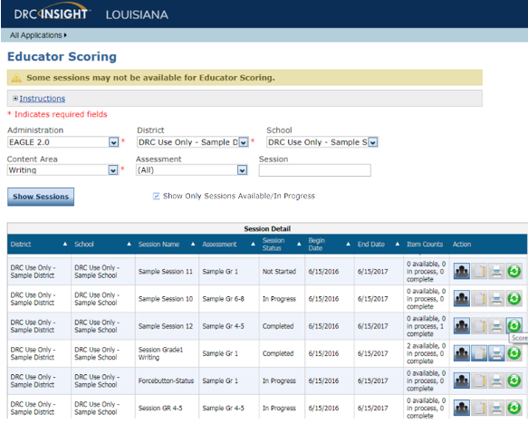
Educator Scoring
Educator Scoring is used with the Diagnostic, Interim, and LEAP Practice Test administrations.
Students’ written responses to constructed response questions must be scored by Test Administrators using the Educator Scoring application.
Detailed directions for Educator Scoring can be found in the eDIRECT User Guide posted in eDIRECT under General Information.

Slide 42
EAGLE 2.0

Slide 43
Eagle 2.0

Slide 44
EAGLE 2.0
When you access the EAGLE 2.0 system, the home page displays with icons along the top of the page and in the drop-down menu on the left side of the page (the Open Menu button).
Use the icons to access the various areas of the EAGLE 2.0 system: Student Testing, Tests, Item Bank, Reports, and Help.
Detailed directions for Educator Scoring can be found in the EAGLE 2.0 User Guide posted in eDIRECT under General Information.

Slide 45
K-2 Formative Tasks

Slide 46
K-2 Formative Tasks

Slide 47
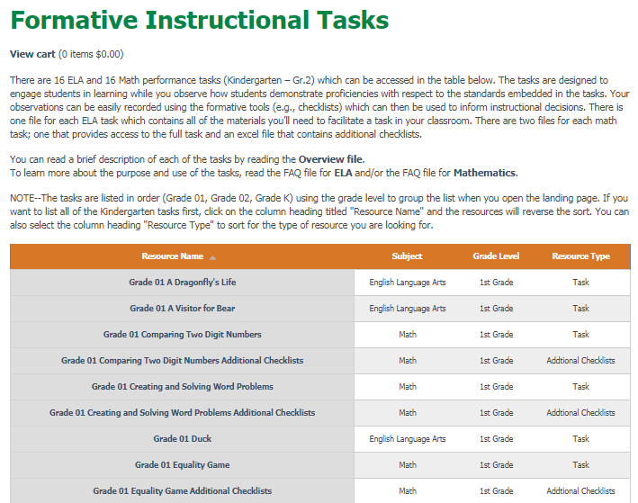
K-2 Formative Tasks
The K-2 formative tasks are a set of student-centered and engaging tasks, aligned to Louisiana’s K-2
Student Standards, that focus on essential skills in ELA and mathematics.

Slide 48
Support

Slide 49
User Guides
The following user guides are posted in eDIRECT under General Information:
eDIRECT User Guide
Technology User Guide
EAGLE 2.0 User Guide

Slide 50
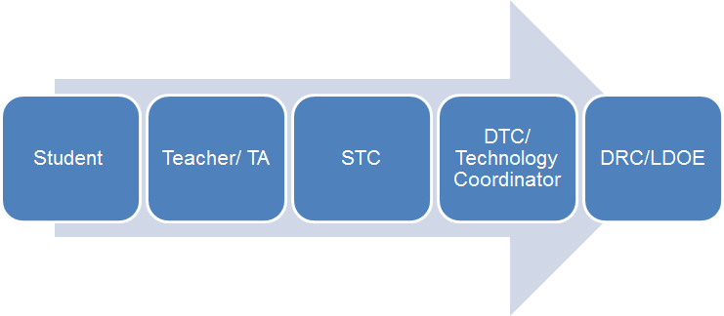
Technical Assistance Protocol
If technical problems occur, school and district staff should follow the protocol presented below.
DRC Louisiana Customer Service
1-888-718-4836 LAHelpDesk@datarecognitioncorp.com
LDOE
1-844-268-7320
assessment@la.gov

