Slide 1
eDIRECT: Unlocking Test Tickets

Slide 2
Today’s Goals
At the end of this presentation, participants will understand how to:
Unlock test tickets for an entire test session
Unlock test tickets for selected students

Slide 3
Unlocking Test Tickets
If either the Test Administrator or the student needs to log back into a test, the student’s test ticket must be unlocked. Only a DTC can unlock a test ticket.
For summative assessments, test tickets lock at midnight. If a test ticket is unlocked for a summative assessment, an Irregularity Report must be completed.
For nonsummative assessments, test tickets do not lock at midnight. Test tickets may need to be unlocked if a student exited the test by using the End Test function in INSIGHT. No Irregularity Report needs to be completed for nonsummative assessment tickets.
When the student logs in after the ticket is unlocked, the student can use the login information from the original test ticket.
For a detailed explanations of unlocking test tickets, reference the eDIRECT User Guide posted in eDIRECT under General Information.

Slide 4
Unlocking Test Tickets
Once logged into eDIRECT, choose All Applications → Test Management.

Slide 5
Unlocking Test Tickets
Choose Manage Sessions

Slide 6
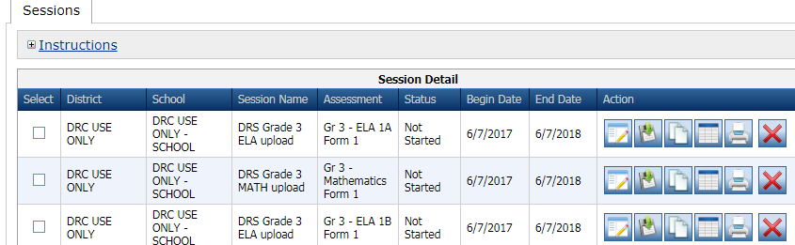
Unlocking Test Tickets
From the Manage Test Sessions screen, choose Show Sessions, and click the Edit/Print Ticket Status icon.

Slide 7
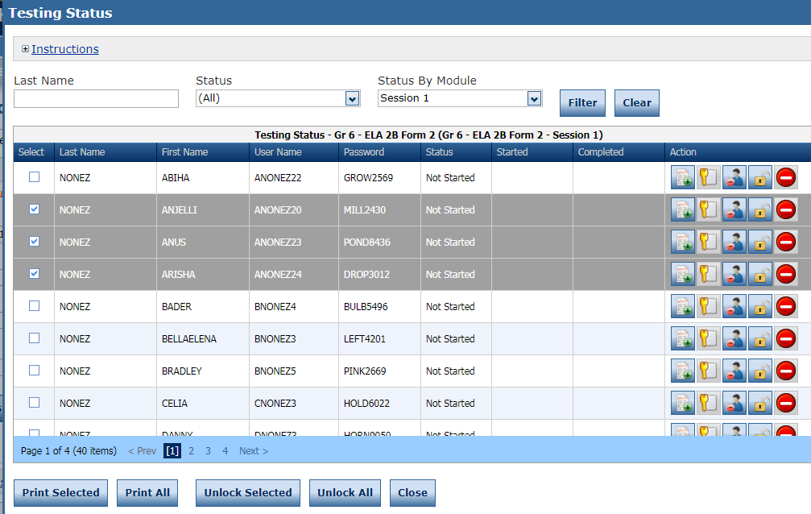
Unlocking Test Tickets
From the Edit/Print Ticket Status page:
Unlock one student ticket by clicking the Unlock icon
To unlock multiple students, click the checkbox in the Select column then click Unlock Selected
Unlock all tickets for a session by selecting Unlock All
Once unlocked, students will be allowed to login with their existing username/password on the testing ticket.

Slide 8
Support

Slide 9
User Guides
The following user guides are posted in eDIRECT under General Information:
eDIRECT User Guide
Technology User Guide
EAGLE 2.0 User Guide
Additional resources:
Assessment Library
Assessment Guidance Library

Slide 10
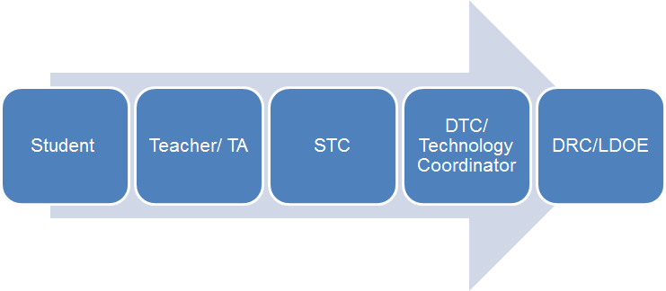
Technical Assistance Protocol
If technical problems occur, school and district staff should follow the protocol presented below.
DRC Louisiana Customer Service
1-888-718-4836 LAHelpDesk@datarecognitioncorp.com
LDOE
1-844-268-7320
assessment@la.gov

