Slide 1
English Language Proficiency Test (ELPT) DTC Training

Slide 3
Objectives
During this sessions, testing coordinators will know how to:
Access the ELPT Portal
Navigate the ELPT administrative systems
Manage students and users
Manage additional materials orders
Monitor testing in progress
Create and manage appeals
Enter non-participation codes
Administer the ELPT
Download the CAI Secure Browser
Access resources for administration

Slide 4
ELPT Overview
The ELPT is a computer-based assessment that will be taken in the EL Portal by all students identified as EL in grades K-12. Prior to testing, the 2021-2022 CAI Secure Browser must be installed on computers. Reference the Secure Browser Installation Manual for detailed directions.
Test administrators, students, and accommodations are managed in the TIDE Portal. See the TIDE User Guide for detailed directions on test setup requirements.
Students taking the ELPT will need headsets with microphones for interacting with the online platform. Specifications for headsets are located on pages 2-3 of the Technology Requirements document in the Assessment Library.
*Enable pop-up windows and microphone settings on all ELPT computers prior to testing

Slide 5
ELPT Portal Overview

Slide 6
ELPT Portal
The ELPT Portal is a centralized location for all information about administering ELPT. You can register to receive EL updates by clicking the link in the top right of the ELPT Portal.

Slide 7
Navigating the Portal
(Bottom of the ELPT portal)

Slide 8
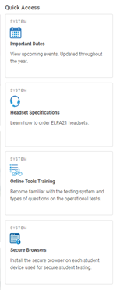
Navigating the Portal
Quick Access, located in the middle of the homepage, includes navigation tabs for following resources:
Important Dates
Headset Specifications
Online Tools Training
Secure Browsers
Districts are not required to order headsets directly from CAI. Any headsets meeting the specifications can be used.

Slide 9
ELPT Administrative Systems

Slide 10
ELPT Dashboard
The ELPT tab in the ELPT portal will be the link to all required ELPT administration systems and documents.

Slide 11
ELPT Administration Systems Overview
All ELPT systems can be accessed in the ELPT Portal under the ELPT tab.
Testing Information and Distribution Engine (TIDE)
•Stores student demographic information and test settings
•Used to manage user accounts for all systems
Operational Test Administration
•Used by TAs to create session IDs, administer tests, and monitor student progress
Reporting
•Used to view and download student assessment reports
Data Entry Interface (DEI)
•Used by TAs to enter responses for students using accommodated forms of ELPT.

Slide 12
ELPT Administration Documents
All ELPT administration documents can be found in the ELPT Portal under the ELPT tab.
TIDE User Guide
Provides directions for registering students for assessments, establishing test settings and accommodations, associating students with districts, schools, and rosters, and creating and approving testing appeals
TA User Guide
Directions to help users navigate the Test Delivery System (TDS) including the Student Interface and the Test Administrator Interface, and help support Test Administrators manage and administer ELPT.
ELPT TAM
Provides specific instructions for the administration of the ELPT. Details include information on test security, logistical requirements, and the Test Administrator directions to students.

Slide 13
ELPT Administration Documents
All ELPT administration documents can be found in the ELPT Portal under the ELPT tab.
Reporting System User Guide
Provides information on how to use Reporting to view student performance and participation data.
Data Entry Interface (DEI) Manual
Provides specific instructions for using the DEI which allows authorized users to enter student assessment data, such as item responses and scores. Entering student data is required for the ELPT Braille forms
Accessibility and Accommodations Manual
Used to guide the selection and administration of appropriate universal features, designated features, and accommodations for individual students to produce valid assessment results
ELPT Accommodation Information
•Test administrators cannot translate test content.
•No EL accommodations are permitted.

Slide 14
ELPT Technology Documents
All ELPT technology manuals can be found in the ELPT Portal under Technology Coordinators.
Secure Browser Installation Manual
Provides instructions for installing the secure browsers on computers and devices used for online assessments
System Requirements for Online Testing
Used to verify that all devices to be used for testing meet the minimum technology specifications
Technical Specifications Manual for Online Testing
Used to verify that your school’s network and Internet are properly configured for testing.

Slide 15
Test Administration and Distribution Engine (TIDE)

Slide 16
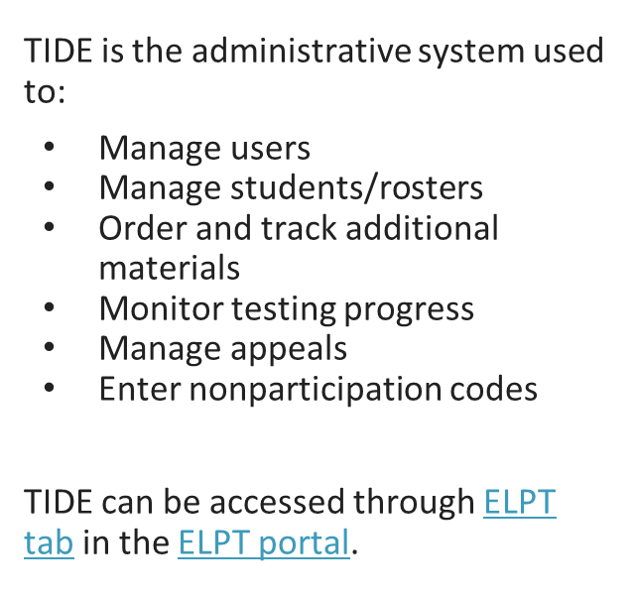
Accessing TIDE

Slide 17
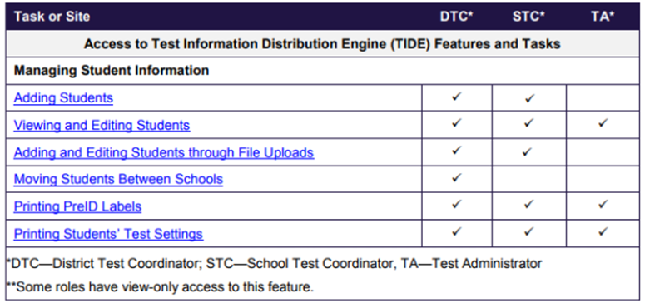
ELPT: Preparing to Test
Each user in TIDE has a role, such as a district coordinator or a test administrator. Each role has an associated list of permissions to access certain features within TIDE.

Slide 18
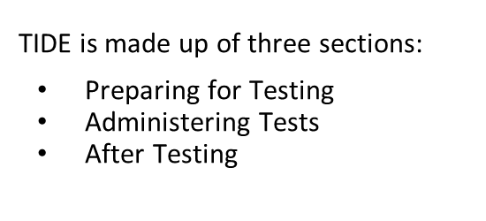
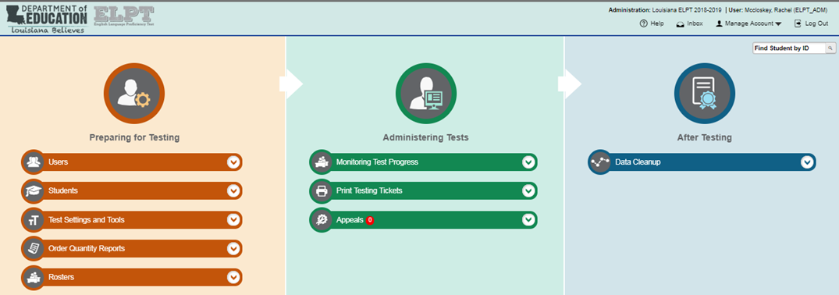
TIDE Home Page

Slide 19
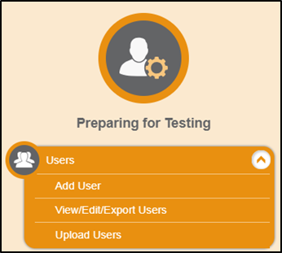
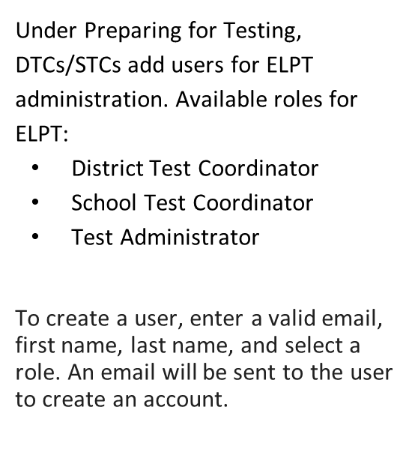
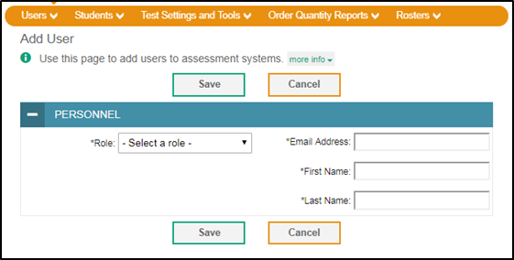
TIDE: Adding Users

Slide 20
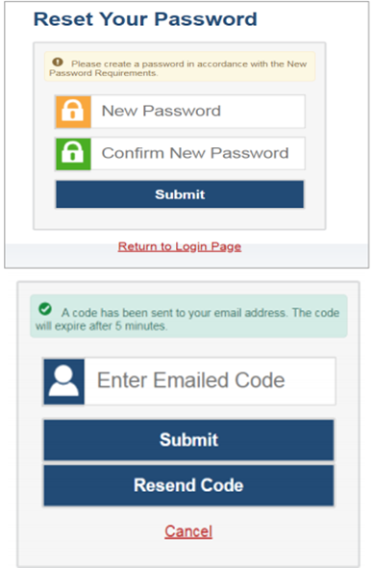
Logging into TIDE
To set up the new account, the user will receive an email from DoNotReply@cambiumast.com to set up the account. Click the link in the activation email. The Reset Your Password page appears.
When logging in, if you have not logged in using this browser before, of if you have cleared your browser cache, the Enter Code page appears and an email is sent to your address. This applies every time you access TIDE with a new browser

Slide 21
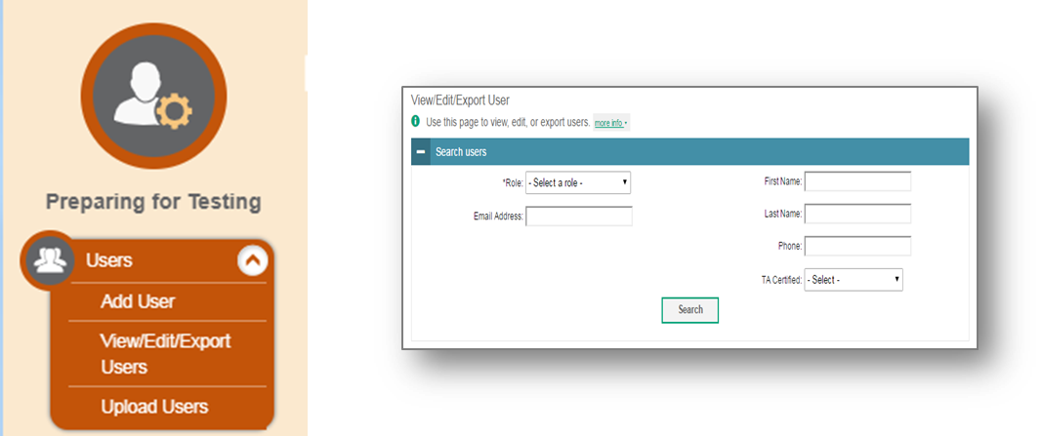
TIDE: View/Edit/Export Users
DTCs and STCs may use the View/Edit/Export User page to retrieve users who match particular search criteria.

Slide 22
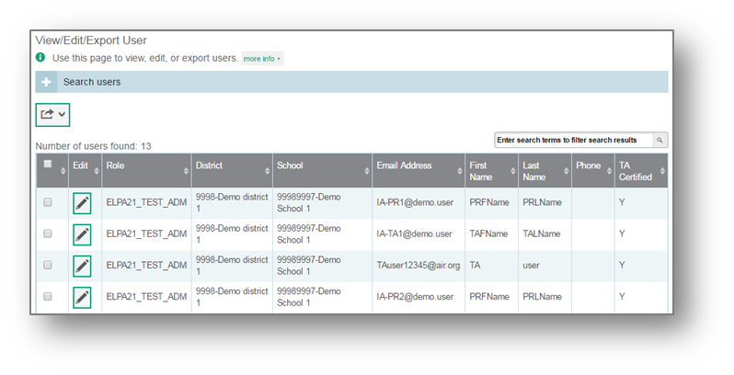
TIDE: View/Edit/Export Users
After clicking Search, TIDE will display all the users satisfying the search criteria.
To export user information, mark the checkboxes next to the users you wish to export and click the export button above the search results.

Slide 23
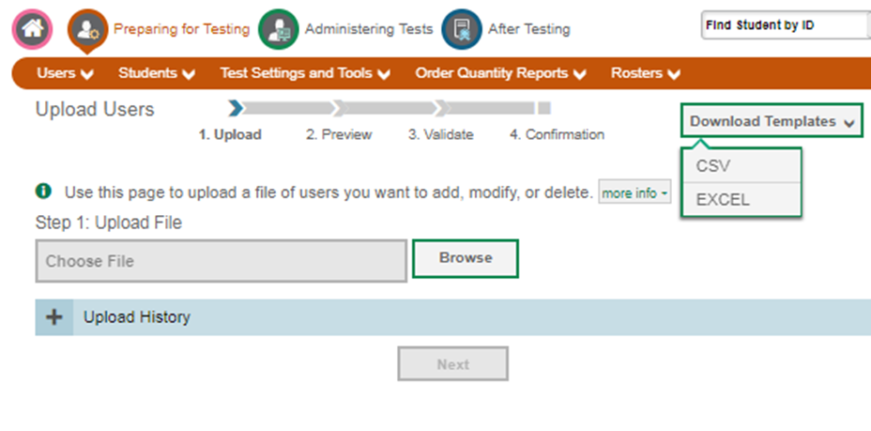
TIDE: Upload Users
DTCs and STCs may upload users through a CSV or Excel file. Detailed directions on uploading users can be found in the TIDE User Guide.

Slide 24
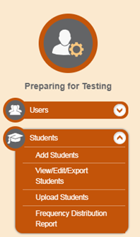
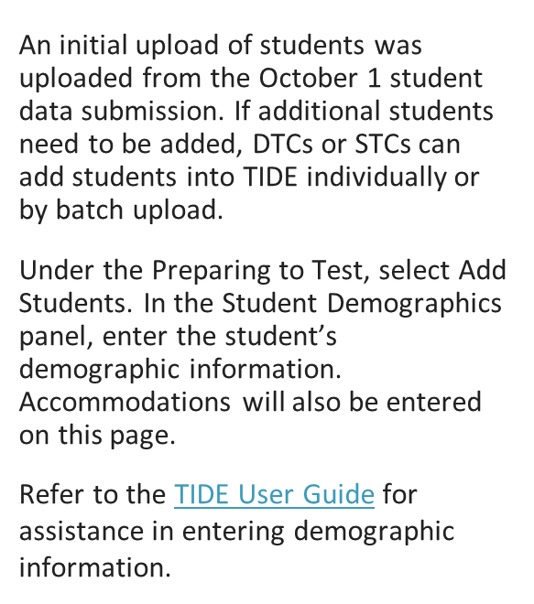
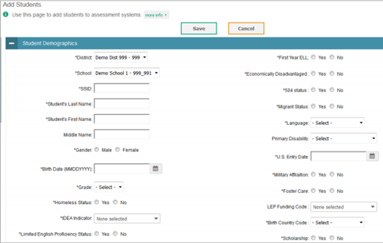
TIDE: Adding Students

Slide 25
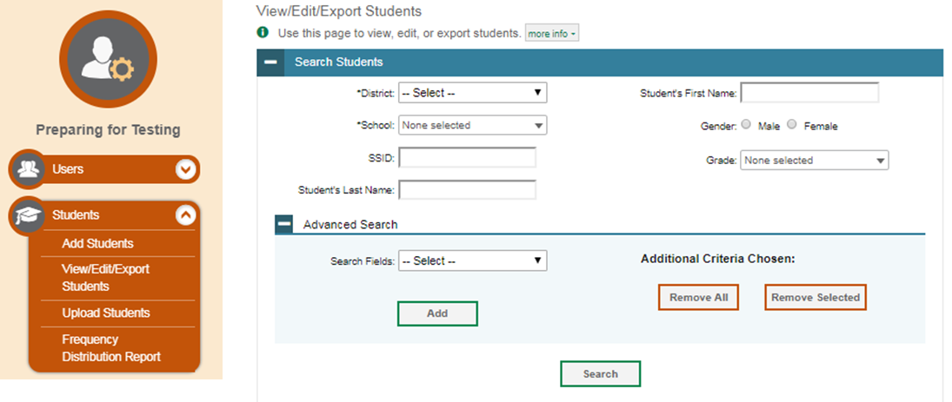
TIDE: View/Edit/Export Students
DTCs and STCs may use the View/Edit/Export student page to retrieve students who match particular search criteria.

Slide 26
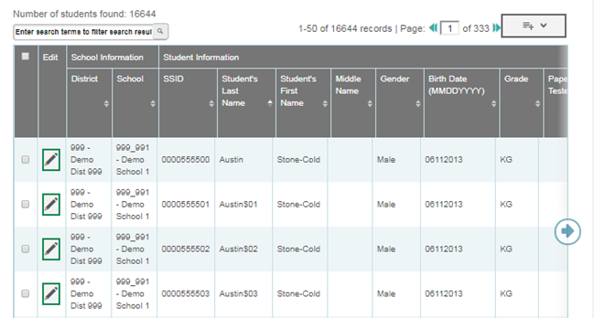
TIDE: View/Edit/Export Students
After clicking Search, TIDE will display all the students satisfying the search criteria.
To export user information, mark the checkboxes next to the students you wish to export and click the export button above the search results.

Slide 27
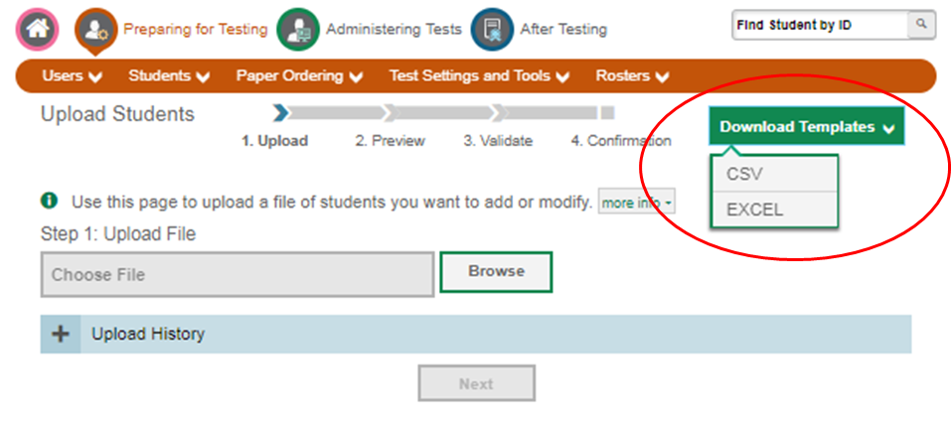
TIDE: Upload Students
DTCs and STCs may upload students through a CSV or Excel file. Detailed directions on uploading students can be found in the TIDE User Guide.

Slide 28
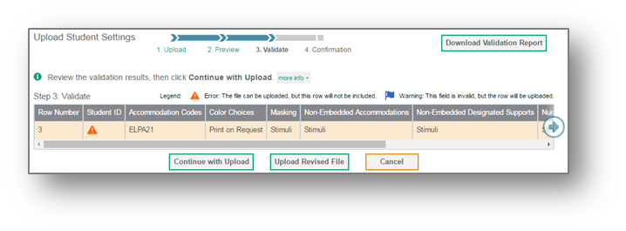
Upload Student Settings
TIDE will validate the file and display any errors or warnings accordingly to the legend on the page. Click the orange error icons and blue warning icons in the validations results to view the reason a field is invalid. if a record contains an error, that record will not be included in the upload. If a record contains a warning, that record will be uploaded, but the field with the warning will be invalid.
If your file contains a large number of records, TIDE will process it offline and send you a confirmation email when complete.
When the upload is complete, a confirmation page will appear with a message that summarizes how many records were committed and how many were excluded.

Slide 29
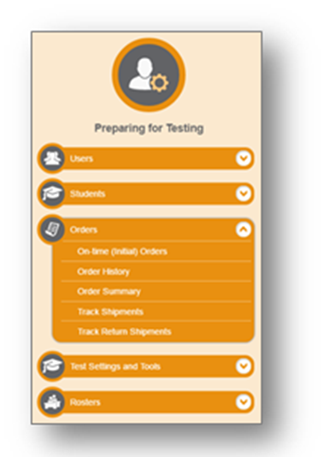
TIDE: Additional Materials Ordering
The Orders task menu allows DTCs to manage orders for paper and pencil materials in their district.

Slide 30
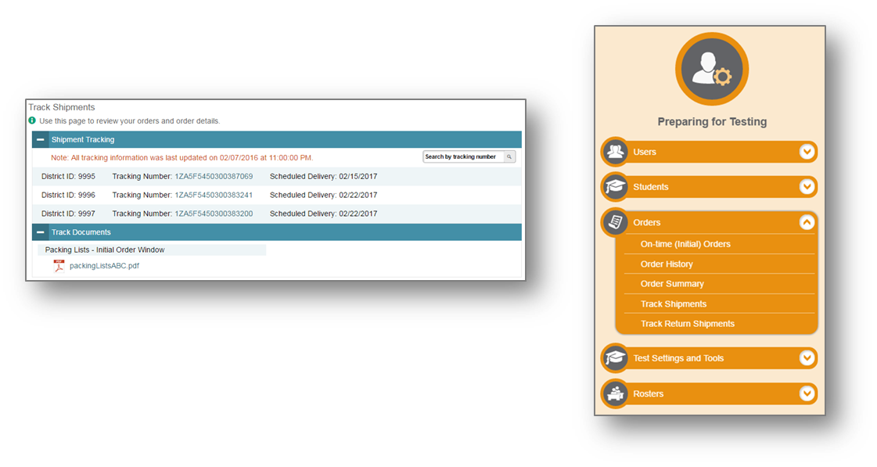
TIDE: Track Shipments
DTCs can track shipments of paper materials on the Track Shipments page. Click a tracking number to view the current tracking status of a shipment.

Slide 31
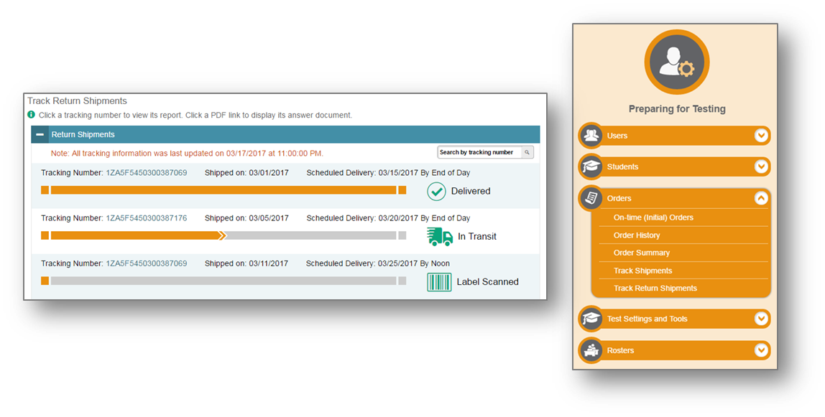
TIDE: Track Return Shipments
DTCs may track shipments as they are returned on the Track Return Shipments page. Tracking information for each return shipment is displayed in the Return Shipment panel, with delivery status appearing on the right side.

Slide 32
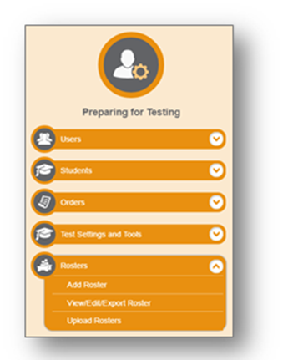
TIDE: Rosters
The Rosters task menu allows you to add rosters; view, edit, or export rosters; and upload rosters from an external file.
Once test scores are calculated, roster information is used to generate reports in Reporting indicating how students in the roster performed as a group.

Slide 33
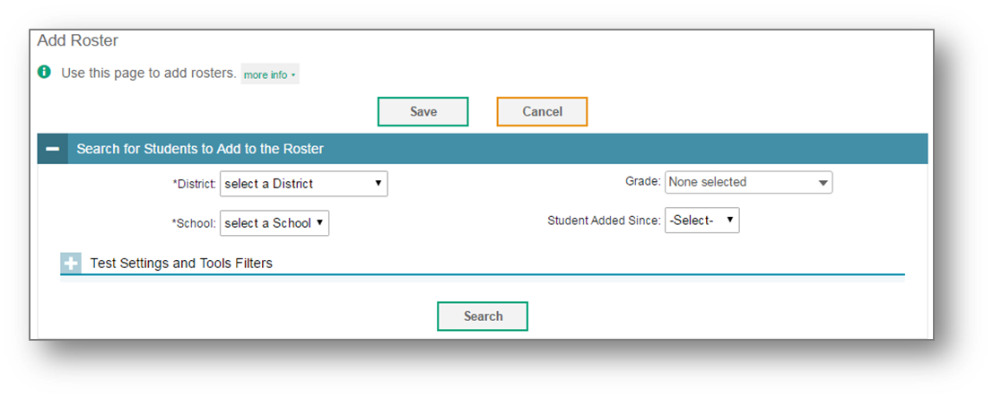
Add Roster
You can manually create a roster on the Add Roster page. Rosters are used by the Online Reporting System to group students’ assessment results for users who want categories below the schools and district level.
To search for students with specific test settings enabled, expand the Test Settings and Tools Filters panel by clicking the plus sign.

Slide 34
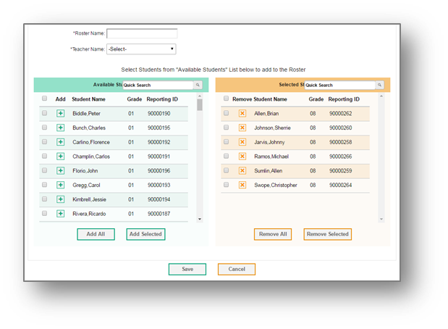
Add Roster
In the Add/Remove Students to the Roster section, enter a roster name and select the name of the teacher who should be associated with the roster.
In the table below, the students in the left column are available to be added to the roster, and the students in the right column are currently in the roster.

Slide 35
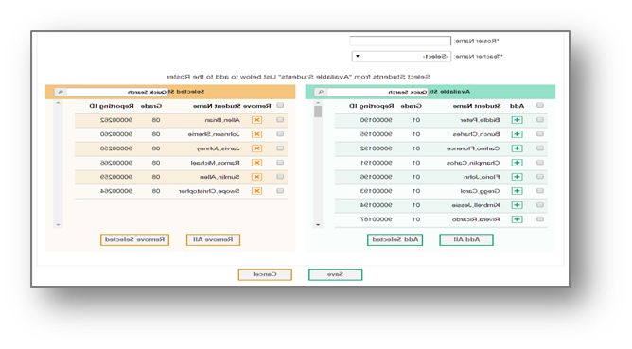
Add Roster
To add a single student to the roster, click the green plus sign next to a student in the left column. You can add multiple students to the roster by marking checkboxes next to the students you want to add, and then clicking Add Selected.
To move a single student from the roster, click the orange X next to a student in the right column. You can remove multiple students from the roster by marking checkboxes next to the students you want to remove, and then clicking Remove Selected.

Slide 36
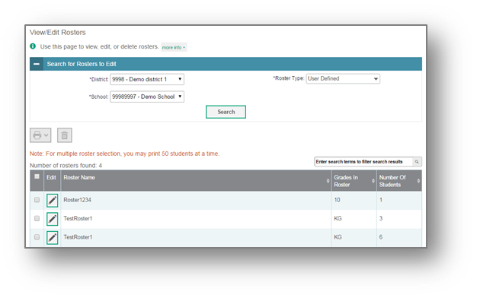
View/Edit/Export Rosters
The View/Edit/Export Rosters page include a form for setting selection criteria to retrieve rosters.
Print or delete rosters from TIDE by selecting the desired rosters and clicking the Print or Delete button above the search results.
Click the pencil icon next to a roster to view or edit its details. The Edit Roster form will appear.

Slide 37
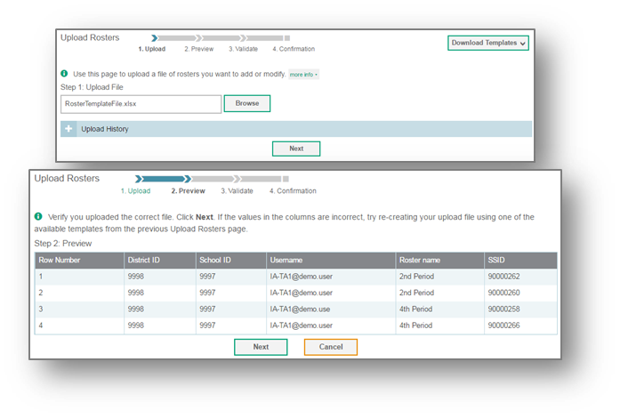
Upload Rosters
Another way to add new rosters into TIDE is to use the Upload Rosters page to compose an upload file in Excel or CSV file.
Click Next to upload the file. A file preview page will appear, allowing you to verify that you are uploading the correct file. If the preview is correct, click Next to continue.

Slide 38
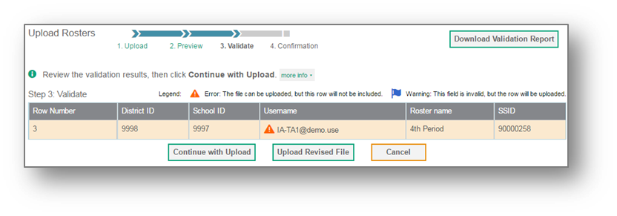
Upload Rosters
TIDE will validate the file and display any errors or warnings according to the legend on the page. Click the orange error icons and blue warning icons in the validation results to view the reason a field is invalid. If a record contains an error, that record will not be included in the upload. If a record contains a warning, that record will be uploaded, but the field with the warning will be invalid.
When the upload is complete, a confirmation page will appear with a message that summarizes how many records were committed and how many were excluded.

Slide 39
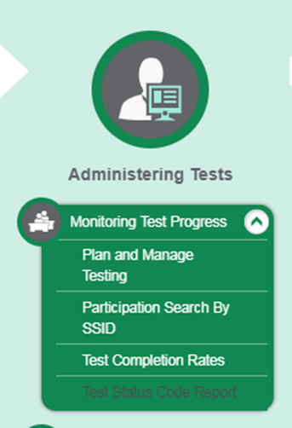
TIDE: Monitoring Test Progress
The Monitoring Test Progress task menu provides reports about a test administration’s progress.
The following reports are available in TIDE:
Plan and Manage Testing Report: Details a student’s test opportunities and the status of those test opportunities. You can generate this report from the Plan and Manage Test page or the Participation Report by SSID page.
Test Completion Rates Report: Summarizes the number and percentage of students who have started or completed a test.
Test Status Code Report: Displays all non-participation codes for a test administration
See the TIDE User Guide for detailed instructions on accessing testing reports.

Slide 40
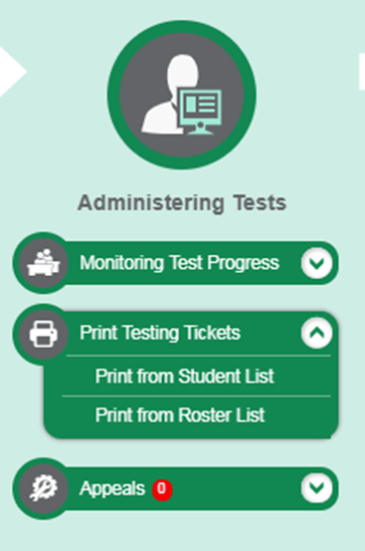
TIDE: Testing Tickets
DTCs, STCs, and TAs can print test tickets through the Administering Test section of TIDE.
A test ticket is a hard-copy form that includes a student’s LASID for logging in to a test.
Students will use their first name, LASID, and the Session ID to login to the TDS.
See the TIDE User Guide for detailed instructions on printing the testing tickets.

Slide 41
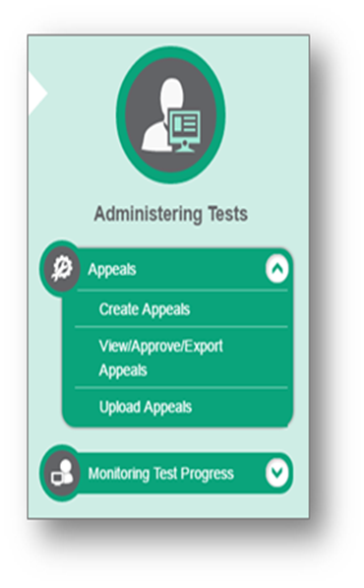
TIDE: Appeals Process
In the Administering Tests section of the TIDE dashboard, the Appeals task menu allows you to view pending appeals; create new appeals; view, approve, or export appeals; and upload appeals.

Slide 42
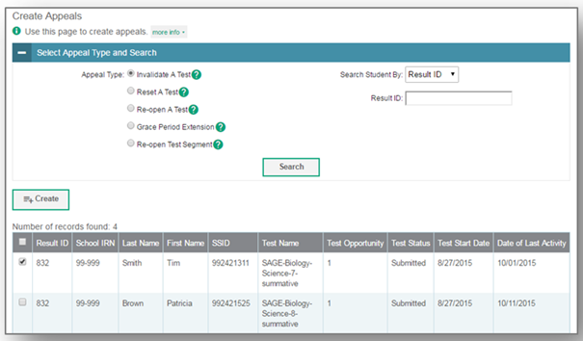
TIDE: Creating Appeals
The Create Appeals page is where DTCs and STCs can create an appeal for a test.
Steps to creating an appeal:
Select the type of appeal
Search for the test result
Mark the checkbox next to each test result
Enter a reason for the appeal and hit submit

Slide 43
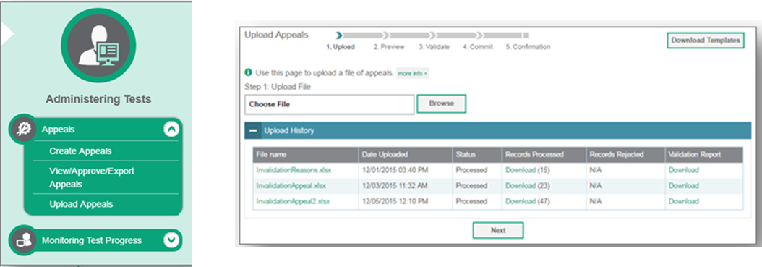
Upload Appeals
DTCs may also create new appeals in TIDE by using the Upload Appeals page to compose and upload a file in Excel or CSV format.
Detailed directions on uploading appeals can be found in the TIDE User Guide.

Slide 44
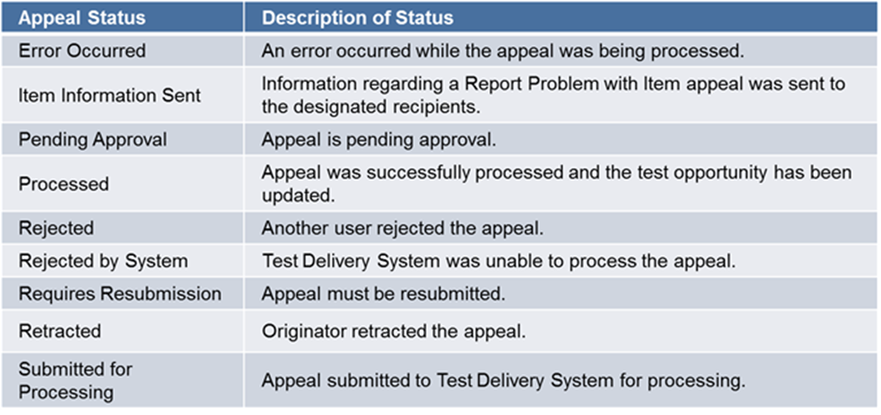
TIDE: Status of Appeals
The TIDE User Guide has an overview of the appeals process and the status of appeals.

Slide 45
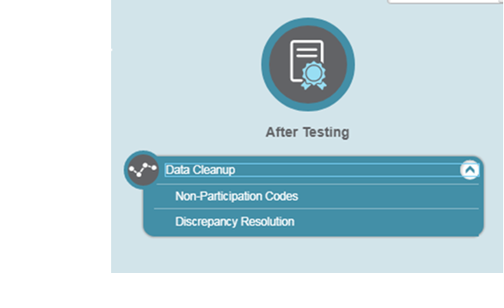
TIDE: Data Cleanup
Non-participation codes are entered in the After Testing section of TIDE.
All students who are entered in TIDE and did not take an ELPT summative test must have a nonparticipation code assigned for each domain by the end of the ELPT administration window.
Detailed directions on entering nonparticipation codes can be found in the TIDE User Guide.
NOTE: Non-participation codes will align with our Accountability Codes.

Slide 46
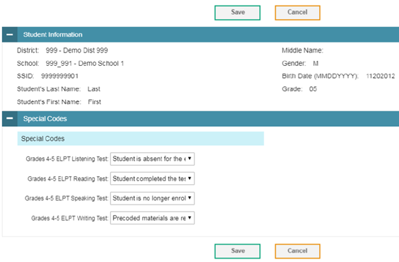
TIDE: Non-Participation Codes
Within the non-participation code screen, the Student Information panel provides the student’s demographic information.
The student’s available tests and special codes are listed in the Special Codes panel.
To edit the student’s non-participation code, from the drop-down lists in the Special Codes panel, select the special code for each available test, as required, and click Save.

Slide 47
Training Modules
The following TIDE trainings modules are available in the Resources tab of the ELPT portal:
TIDE: Activating Your Account and Navigating Through TIDE
TIDE: Adding and Editing Users
TIDE: Adding and Editing Students and Student Test Settings
TIDE: Managing Rosters
TIDE: Printing Testing Tickets and Pre ID Labels
TIDE: Appeals Process
TIDE: Entering Reason-Not-Tested Codes

Slide 48
CAI Secure Browser

Slide 49
Secure Browser
The CAI Secure Browser must be installed on all devices being used for ELPT.
To download, click on the Secure Browsers link in the ELPT Portal to access the Secure Browser download page.
Directions can be found in the Secure Browser Installation Manual.

Slide 50
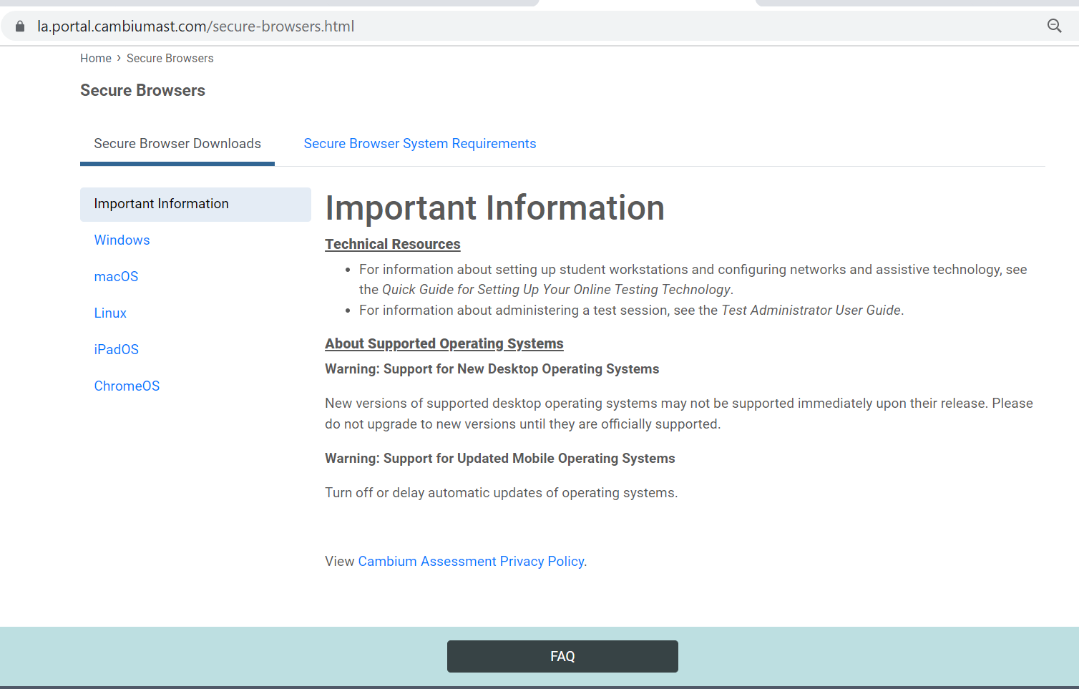
Downloading the Secure Browser
Scroll down the Secure Browser page and choose the appropriate tab for information about downloading the Secure Browser for your operating system.
Each tab on the Secure Browsers page of the Portal includes a link to download the Secure Browser and an overview of the process for installing that Secure Browser.

Slide 51
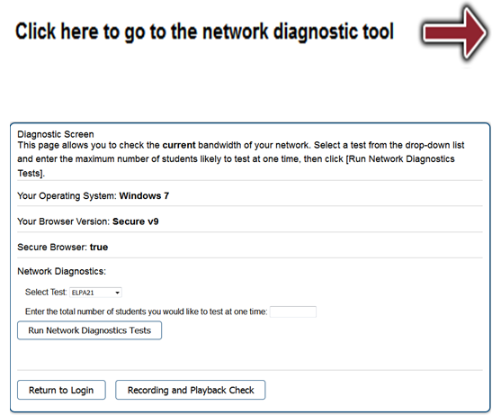
Network Diagnostic Tool
The main page of the Secure Browser includes a link to a network diagnostic tool.
The network diagnostic tool allows you to run two checks:
•Network Diagnostics Test checks for bandwidth
•Recording and Playback checks confirm that your computer’s recording system is working correctly for testing ELPT speaking.

Slide 52
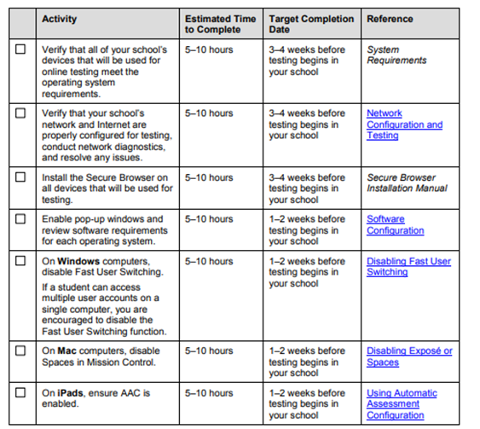
Technology Coordinator Checklist
The Technology Coordinator Checklist can be found in Appendix B of the the ELPT Technical Specifications Manual.

Slide 53
Accessing the Operational
Test Administration Interface

Slide 54
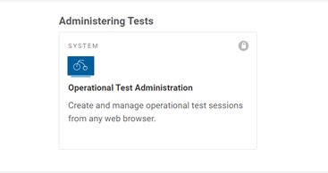
Accessing the Operational Test Administration Interface
Operational Test Administration is the administrative system that allows TAs to:
Select the tests students will take
Create Session IDs
Select testing settings
Monitor testing progress
The Operational Test Administration system can be accessed through ELPT tab in the ELPT portal.
Reference the ELPT Summative TAM and TA User Guide for detailed information on administering the ELPT.

Slide 55
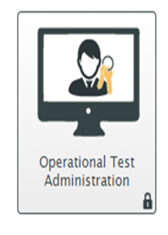
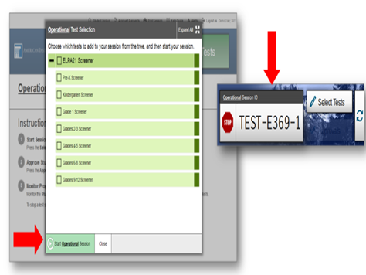
Creating a Test Session
Test Administrators will administer the test through the Operational Test Administration icon accessed through the ELPT tab in the ELPT portal.
TAs will login to the TA Interface with their TIDE Username and Password.
Test sessions must be created less than 20 minutes prior to starting the test in order to prevent the system from timing out.
In the TA Interface, the TA will select the grade band of the student taking ELPT: Kindergarten, Grade 1, Grades 2-3, Grades 4-5, Grades 6-8, or Grades 9-12.
T9 students will test in the 9-12 grade band.

Slide 56
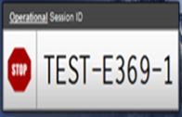
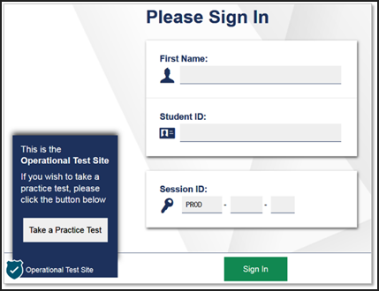
Student Login: Accessing ELPT
Once a grade band is selected, the ELPT Session ID will be generated in the TAs Operational Test Administration screen.
Provide the Session ID to the student for the student to access the test.
Student will access the ELPT through the CAI Secure Browser icon using the first name, LASID, and teacher provided Session ID.
Student will be required to conduct an Audio Playback Check and Recording Device Check prior to the beginning of the test.

Slide 57
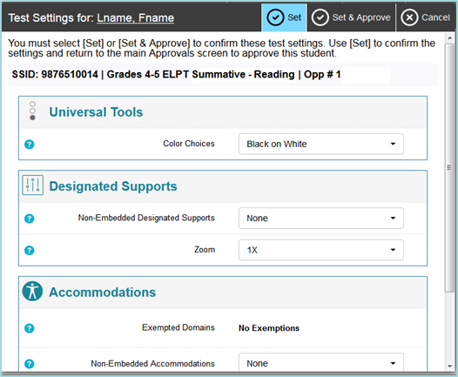
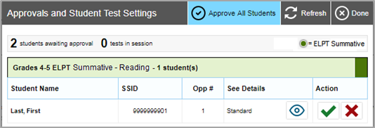
Approving Student Entry
Once the Test Administrator starts the test session and students log in, the TA must approve or edit students’ test settings on the Operational Test Administration screen before the student can access the ELPT. It is very important to pay close attention to the test name prior to approving to be sure that the appropriate test was selected.

Slide 58
Reporting

Slide 59
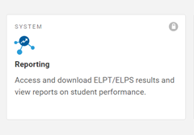
Accessing the Reporting
ELPT score reports are available in Reporting which can be accessed through the ELPT tab in the ELPT portal.
Reference the Reporting Manual for detailed steps on navigating Reporting.

Slide 60
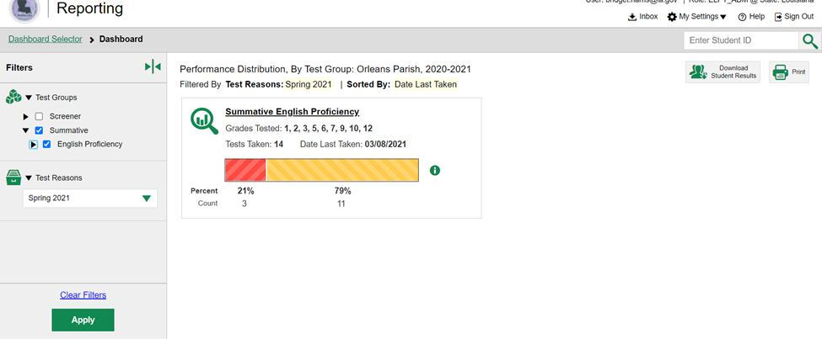
Reporting: Accessing Student Results
Use the Filters to the left of the screen to select the desired data.

Slide 61
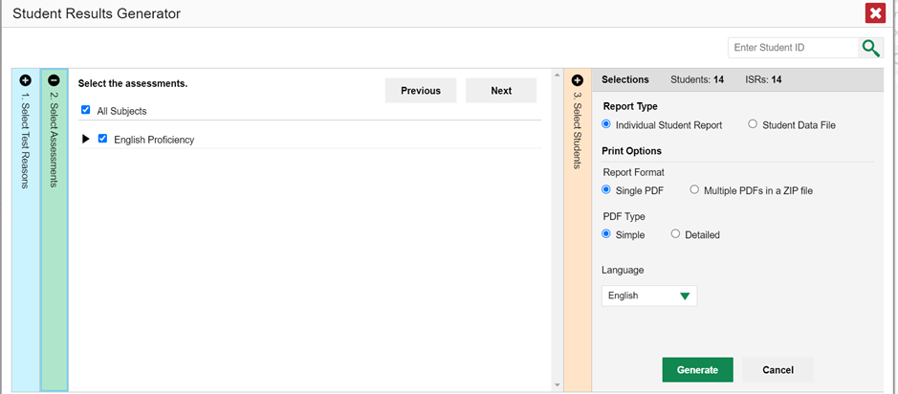
Reporting: Accessing Student Results
Use Selections to determine the Report Type. Individual Student Report provides options for Report Format and PDF Type.

Slide 62
Reporting: Accessing Student Results
Selecting Student Data File provides options for Report Format and Output.

Slide 63
Reporting: Retrieve Student Results
To download student scores under Retrieve Student Results,
Step 1: Choose What
3. Choose the report type to download
Student Data (Download Format: Excel or CSV)
PDF of Student Reports (Download Format: IRS as a single PDF by grade, one PDF per ISR in a zip file)
4. Complete all other Step 1 information based on desired download.

Slide 64
Reporting: Retrieve Student Results
To download student scores under Retrieve Student Results,
Step 1: Choose Who
5. Select a District and a School
Reports will be organized by grade level for both report types
6. Choose Export to Inbox
Reports can be accessed through the “Inbox” link on the Reporting dashboard
An email will be sent when reports are available for download

Slide 65
Reporting: Score Report
Under Score Reports, student data can be compared by school, roster/TA, and individual student
Select Change Student Selection to indicate the student scores, test, and administration you would like to view
Click on a grade level data point under Number of Students or Percent Determined Proficient to narrow results

Slide 66
Reporting: Score Report
The District Overall Performance screen will display. Here you can see how each school did in comparison with state and district proficiency rates.
3. To narrow a school results to view Teacher, Roster, or Student results, click the school name to display the Exploration Menu

Slide 67
Reporting: Score Reports
The Exploration Menu allows you to navigate to different types of score reports by grade.
Reports can be navigated by making different selections from the Who and What drop down lists
By selecting Roster or Student in the Who menu, a single PDF can be generated with all ISRs for the group.

Slide 68
Resources

Slide 69
Accessing Resources
Each manual can also be accessed by clicking on the Resources link in the ELPT Portal home page and then choosing ELPT Resources and then User Guides and Manuals.

Slide 70
ELPT Resources

Slide 71
District Support
The Assessment team offers multiple avenues of support to districts, schools, and teachers seeking information or assistance about assessment administration and accountability.
Weekly Newsletters
Assessment and accountability information and deadlines are released each week in the district newsletter.
Weekly Assessment & Accountability Calls
Each Tuesday at 3:45 PM these webinars are held to provide training, updates, and important information to DTCs and Accountability Contacts.
Assessment Library and Accountability Library
The Assessment Library contains resources for DTCs including the Assessment Schedule and the Assessment and Accountability Month-by-Month Checklist. The Accountability Library contains resources for accountability contacts including the School Performance Score (SPS) calculators as well as information on data certification and federal accountability.

Slide 72
District Support
Monthly Educational Technology Calls
The third Thursday of each month a webinar is held for district technology personnel to provide training, updates, and important information related to technology readiness and digital literacy.
Assessment@
All stakeholders are encouraged to email assessment and accountability questions and/or concerns to assessment@la.gov.
Assessment Hotline
For immediate assistance regarding assessment and accountability, district-level staff may call the Assessment Hotline at 1-844-268-7320.
EdTech@
All stakeholders are encouraged to email technology readiness questions and/or concerns to either edtech@la.gov.

Slide 73
Technical Assistance Protocol
If technical problems occur during testing, school and district staff should follow the ELPT Technical Assistance Protocol presented below. Technical problems include, but are not limited to, problems connecting to the CAI Secure Browser, the inability to load test items, or missing buttons.
Cambium Contact Info
7:00 AM –7:00 PM
1-866-758-0231
laelpthelpdesk@cambiumast.com
Chat:https://la.portal.cambiumast.com/chat.stml

