Slide 1
Student of the Year Guidelines - 2020
Notes:
Before we begin, please place your phone on mute, If you experience audio issues, contact me through the Q & A box on the right side of the computer screen. unless you are contributing to the on-line conversation.
Good Morning. Welcome to our webinar concerning the selection of the student of the year candidates for 2020. I am Marian Johnson, the Student of the Year Program Coordinator for the Department of Education. I ask that if you have questions as I progress through the presentation to please post in the chat box and I will answer them as we go through the presentation. The Student of the Year Program is a wonderful opportunity to highlight and celebrate the accomplishments of the top students in your districts and in our state. We want to commend those students who have excelled as scholars, leaders, and service volunteers for their school, church, and community.
(click to next slide)

Slide 2
Webinar Objectives
By the end of this webinar, the participants will understand:
the revisions impacting all grade level submissions
the selection process used for student of the year in Grades 5, 8, and 12
the revisions to the scoring forms
the role each Local Education Agency plays in the selection process
the components the students must complete at the district, regional, and state levels
the paperwork that must be submitted to the regional and state coordinators
Notes:
So, by the end of this webinar you will understand
➢The revisions impacting charter school submissions. (This is in response to the evolution of more charter management organizations and schools throughout the state. All charter schools will submit their nominees to the charter management organization rather than directly to regional committee or to the parish in which the school is located.)
➢the selection process used for student of the year in Grades 5, 8, and 12 (This includes timeline, individual components, district responsibilities, and scoring forms.)
➢The revisions to the scoring forms (The academic weighting has been slightly adjusted so that more emphasis is on leadership, activities and service, and honors and recognition rather than test scores and the student’s GPA.)
➢The role each Local Education Agency plays in the selection process (Each district or charter management organization is responsible for nominating 1 student for each of the three grade levels from the schools under their supervision. Districts and charter management organizations will also need to volunteer to host a zone or regional competition. If districts or CMOs do not volunteer to host all or part of a zone or regional competition, then no student from that zone or region may participate at the state level.
➢The components the students must complete at the district, regional, and state levels include: the portfolio components, the essay at regional and state levels, and the interview process.)
➢The paperwork that must be submitted to zone or regional coordinators and the LDE. (ALL Districts and charter management organizations will need to submit their District Information Form to the LDE by October 1 to my e-mail address, marian.Johnson@la.gov ; this can also be found in the logistics memo. District/ LEA nomination forms will be sent to district coordinators once their district/LEA information forms are submitted to the LDE.) By November, Zone and regional coordinators will be identified, and all LEAs will be provided with contact information. By the end of December, each Charter Zone Selection Committee will need to have selected their nominees’ names to submit in January to the regional charter school coordinator.
(click to next slide)

Slide 3
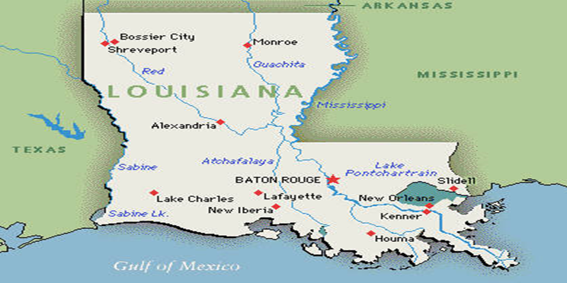
Student of the Year - 2018
Notes:
Last year our state winners, that were selected by three independent panels, were from the northwestern and southeastern parts of our state. Our fifth grade winner was from the Northwest Louisiana public school districts comprising Region 1. Miss Mallory Byrd attended Hayden R. Lawrence Elementary in Rapides Parish. Hailing from the coastal area of our state, our eighth grade winner, representing non-public Louisiana schools was the as Region 6 nominee from the Diocese of Houma-Thibodaux nominee, was Miss Ashley Green. Ashley currently attends Houma Christian High School located in Terrebonne Parish. Our twelfth grade winner represented from Region 7 comprised of charter schools from across the state. This senior, Ms. Keyanna Zahiri, graduated from Benjamin Franklin High School and plans to pursue a medical career. These three young ladies all aspire to make a difference for the Louisiana residents in the future.
Outstanding students like these are attending public, private, and charter schools throughout our state. This student of the year competition gives you the opportunity to recognize and honor the accomplishments and contributions of young men and women on your campuses..
The 2020 Student of the Year Guidelines have been revised this year to better reflect the changes in school dynamics, assessments, and career pathways.
(click to next slide)

Slide 4
Starting the Selection Process
Download the revised 2020 Student of the Year Guidelines from the website
Designate an LEA Chairperson and submit the District/LEA Information Form
Notes:
The first agenda item for your selection process should be to download the revised 2020 Student of the Year Guidelines found on our website. We encourage you to read the bulletin to be aware of the changes and to understand the revisions in the selection process. The criteria for the senior nominee has been revised to encourage districts to consider the career and technical achievements of students, not just the traditional academic accolades for college bound students.
If you do not have a hard copy of the document, the URL for the guidebook is posted on our website.
You will need to designate someone from your LEA as the contact person responsible for receiving information and submitting information to and from the regional and the state coordinators. This form is due to me by October 1. If you do not submit, I will call to verify your non-participation in the process.
Let’s take a closer look at the revised district/LEA information form. (click to next slide)

Slide 5
LEA/CMO Information Form
School District (LEA):
District Contact/Coordinator: __________
Position/ Title:
Mailing address: __________
City: _______ State: _______ Louisiana Zip:__________
Coordinator’s e-­mail: ______
Telephone Number: ________ FAX Number: __________
Please indicate your preference below:
_____Our LEA or Charter Management Organization will submit Student of the Year Nominations for
Grade(s) _______________(Please write in the grades.) Public _____ Charter _______
_____There will be no representative from my school system participating in the Regional Student of the Year Selection Committee or
Charter Zone Selection Committee.
_____ My district would be interested in hosting all or part of the Regional Students of the Year Competition or Charter Zone Selection
Committee. Districts within a region may share hosting duties,i.e. sponsoring only one grade level.
Grade level preference _________
Signed: __ Date: ___________________
(Superintendent)
Notes:
The purpose of the district information form is so that one person in each Local Education Agency or LEA is designated as coordinator for the district or LEA selection committee and selection process. The contact information requested on the document provides the LDE with the LEAs information that will be used by the zone and regional coordinators and the LDE to furnish information about the zone, state, and regional competitions. (briefly go over the first part of the form and point using the cursor)
An educational agency with charter schools and traditional public schools should submit two nominees—one representing charter schools and one representing public school. Only 1 district information form should be submitted to the state with the appropriate boxes checked off. We will organize the lists for charter zone selection committees and traditional regional selection committees.
This is also the form that indicates if your LEA would like to host a zone or regional competition for the grade levels in your zone or region. Last year all of our seven regions divided the grade level selection process among their members. When the process is shared in this manner, it requires only 5 judges and less meeting room space. It may be an option you would like to consider. If your region does not have someone to host a zone or regional competition, then your zone or region will not be represented at the next level of the selection process. We would like to thank all of the districts and charter management organizations who volunteered in the past who have helped to coordinate this process. Your efforts were very much appreciated.
You will need to check off your district’s decision concerning their level of involvement. (point to using the cursor)
Click to the next slide.

Slide 6
LEA/CMO Information Form
The following community members and/or staff have expressed an interest in serving on a Zone Selection Committee, a Regional Selection Committee or a State Selection Committee:
Name/ Position
Grade Level Preference
Mailing Address
Phone Number
E-mail Address
Notes:
Last year, regional committee chairman had difficulty locating individuals to serve on the selection committee. It would be so helpful if you included at least one person from your district or charter management organization to serve on the zone or regional committee so that more CMOs or districts are represented on the zone or regional selection committees. These people could include a teacher, CTE instructor, administrator, supervisor, a junior college or university instructor or administrator, or someone from your community.
If you recommend someone for the regional committee, then it relieves some of the stress the regional coordinators experience in locating qualifying judges that are outlined in the guidelines. (point to using the cursor)
Now on to the next step in the process—determining your timeline based on LDE timeline. (click)

Slide 7
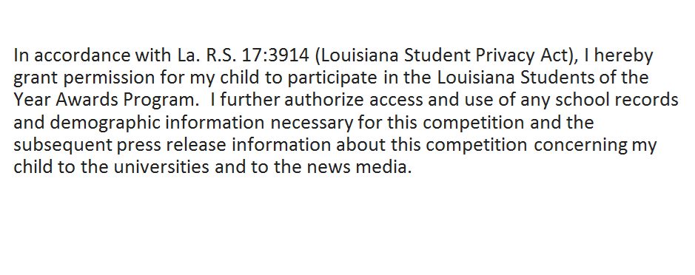
Parent or Guardian Statement
Notes:
In accordance with La. R.S. 17:3914 (Louisiana Student Privacy Act), the parent permission statement was changed several years ago to meet the specifications identified in the law. Parents must sign the application provided so that information in the portfolio can be reviewed by our selection panels.

Slide 8
Timeline
October 1, 2019 LEAs/ CMOs/ Dioceses submit local and regional chairpersons to the LDE or the Diocesan Office.
Nov.—Dec. 2019 Schools and districts select nominees and submit to the LEA for LEA nominations.
Nov. 15, 2019 The LDE will send the names of the zone and regional chairpersons to the LEA and CMO Coordinators.
By Dec. 19, 2019 Each Charter Management Organization selects and electronically submits 1 nomination form per grade
level to the Charter Zone Selection Committee Chairman.
By Jan. 21, 2020 Each LEA and Charter School Zone Committee electronically submits district nomination forms for the three LEA/CMO nominees (one from grades 5, 8, and 12) to the regional student selection committee chairperson.
Jan. 24-Feb. 28, 2020 The seven regional student selection committees collect and review academic portfolios, conduct interviews, a
and score new regional writing samples of the nominees.
By Mar. 2, 2020 The regional committee chairpersons electronically submit the nomination form(s) and mail the portfolios of
their three regional nominees (grades 5, 8, and 12) to the State Selection Committee to Mrs. Marian E. Johnson at
the LDE.
Mar. 4-6, 2020 The Louisiana Department of Education releases the names of the twenty-one regional nominees. Non-winning
portfolios are returned to the district. Winning portfolios are sent to the state coordinator.
Mar.31-Apr. 1, 2020 The state selection committee reviews the academic portfolios of the regional nominees, conducts interviews
with regional finalists, and scores the writing samples.
April 1, 2020 The State Selection Committee names the Elementary School Student of the Year (grade 5), Middle /Junior High
School Student of the Year (grade 8), and High School Student of the Year (grade 12).
Notes:
This timeline was included in the logistics memo posted on our website. We will briefly go over the dates listed.
Oct. 1, 2019 LEAs will need to submit to the LDE the district/ LEA chairperson information and zone and regional hosting request that is listed on the District Information Form. LEAs/ CMOs may volunteer to host a zone or regional competition by indicating that on the district information form. An LEA or CMO may choose to host all grades or just host one grade level. Last year all of the regions shared grade level hosting responsibilities, and it seemed to flow easier. Fewer judges and spaces were needed since only 12-14 students were involved, instead of 36 to 50 students. Regional hosts basically used the same process used in determining a state winner. The state will provide regions electronic copies of all rubrics, scoring sheets, and interview questions. The writing prompts for the essay are completed at the district level and sent to regional or state coordinator.
November-December Schools will select nominees and submit student portfolios to their district/ LEA for consideration.
Nov. 15, 2019 As soon as all zone and regional coordinators have been established, that information will be sent to the district coordinators.
By Dec. 19, 2019 All Charter Schools (Types 1, 2, 3, 3B , 4 and 5) will submit their nominees to their Zone Charter School Selection
Committee. All LEAs will need to follow the guidelines for selection that are outlined in the Student of the Year bulletin. Winners from each zone will be submitted to the regional zone committee for selection of the Region 7 nominees during the first two weeks of January.
Jan. 2-17, 2020 Charter Zone Committees determine their zone nominations to submit by the Jan. 21 deadline.
By January 21, 2020 The LEA Coordinator, on behalf of the Superintendent or CEO of an LEA will submit the nomination forms for the three
district nominees (one from grades 5, 8, and 12) to their regional student selection committee chairperson. Each Zone Charter School Committee will also submit their nominees to the Region 7 Student Selection Committee.
Jan. 24 - Feb. 28, 2020 The regional coordinators will determine when and where the competition will occur for their zone or region as well as
notify district coordinators and the state of their deadlines. All regional competitions will use the same interview questions, essay prompts, rubrics, and scoring forms to ensure equality of scoring. LEAs will send their nominees’ portfolios to the appropriate grade level chairman for their region by the designated date. Regions will hold onto those portfolios until the state releases the names of the regional nominees (March 4-6). Regions will not announce their selections to the parents.
By March 2, 2020 The regional committee chairpersons then must electronically submit the names of their nominees to Marian Johnson and
place in the mail the portfolios of their three regional candidates (grades 5, 8, and 12) to the State Selection Committee via Marian
E. Johnson to the physical mailing address indicated in the logistics memo.
March 4-6, 2020 The Louisiana Department of Education releases the names of the twenty-one regional nominees.
March 31-April 1, 2020 The state selection committee reviews the academic portfolios of the regional nominees,and scores the new state writing
samples. State provides overnight lodging for the candidates on March 31 and April 1 due to the start and ending times of the activities the nominees are required to attend.
April 1, 2020 The State Selection Committee conducts interviews with regional finalists and names the Elementary School Student of the Year
(grade 5), Middle/Junior High School Student of the Year (grade 8), and High School Student of the Year (grade 12). The nominee’s family, school principal, and Superintendent receive a personal invitation to the reception and awards program that will be held that evening as well as the regional and district coordinators of the nominees.
(click to next slide)

Slide 9
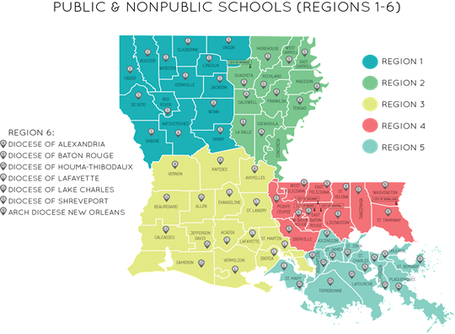
Student of the Year Regions
Notes:
Last year in an effort to equalize the number of schools in each of the 5 public school regions, three districts were moved. Rapides and Vernon Parishes were placed in Region 1, and Avoyelles Parish is was placed in Region 2. Region 6 included all non-public schools and Region 7 included all type 2 and type 5 charter schools.
With the increase in the number of charter schools across the state, all charter schools have now been placed in Region 7. This includes all type 1, 2, 3, 3B, 4 and 5 charter schools.

Slide 10
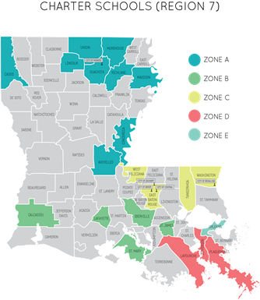
Charter School Zones
Notes:
Charter School Zones were created based on the number of charter management organizations and the number of schools in a geographic area.
Zones A through D will submit 1 nominee from their zone to the Region 7 Regional Selection Committee. Zone E will submit 3 nominees to the Region 7. Regional Selection Committee because the number of schools in E are equal to the total number of schools in zones A through D.
The following information will be sent directly to the charter schools so they know what zone they are in.
Zone A includes charter schools located in: Avoyelles, Caddo, Concordia, Lincoln, Madison, Morehouse, Ouachita, Richland, and Union Parishes.
Zone B includes charter schools located in Calcasieu, Lafayette, St. Landry, Iberville, St. James, and St. Mary Parishes.
Zone C includes charter schools located in East Baton Rouge, Tangipahoa, Washington, and West Feliciana Parishes.
Zone D includes charter schools located in Lafourche, Jefferson, and Plaquemines Parishes.
Zone E includes charter schools in Orleans Parish.
Public schools systems that will be submitting charter school nominees for the first time, and they are not on the highlighted map, contact Marian Johnson to determine which zone your nominee will be placed in.
(click to next slide)

Slide 11
Student of the Year Selection Process
Each Charter School
1 nominee per grade level
Each Public School
1 nominee per grade level
Each Non-Public School
1 nominee per grade level
Each Charter Management Organization 1 nominee per grade level
Parish/ city School System
Selection Committee
1 nominee per grade level
Non-Public School Diocesan Selection Committee
1 nominee per grade level
Charter Zone Selection Committee
1 nominee per grade level - Zones A-D
3 nominees - Zone E
Public School Regional Selection Committee
1 nominee per grade level
Non-Public School Diocesan Selection Committee
1 nominee per grade level
Charter Selection Committee
1 nominee per grade level
State Student of the Year Selection Committee
1 finalist per grade level
Notes:
This slide provides a flow chart of the selection process, illustrating how nominees are selected at the school, district, zone, regional, and state levels.

Slide 12
Revised Scoring
The number of total points will remain the same.
Academic points awarded decreased as well as the GPA for each grade level to 3.1 on a 4 point scale.
Each nominee will use three and a half years of academic performance to determine their GPA.
The twelfth grade scoring components have been adjusted to include college and career bound coursework that is offered.
Last year, we increased the points awarded for leadership, service activities, community involvement, honors, and recognitions earned.
This year we have specifically included career-based organizations and competitions as examples to be considered.
Writing sample and interview points remain the same.
Selection Panel for grade 12 should include a CTE instructor, Louisiana Community and Technical college System, or University personnel.
Notes:
The scoring forms can be found in the later pages of the 2020 Student of the Year Guidelines.
First, the number of total points awarded will remain the same.
In reviewing the guidelines, it was noted that the grade levels were not equitable in terms of the number of years used to determine the GPA for the nominees.
To that point, the following adjustments were made:
Grade 5 will use Grades 2, 3, 4, and current grade 5 scores.
Grade 8 will use Grades 5, 6, 7, and current grade 8 scores.
Grade 12 will use 9, 10, 11, and current grade 8 scores.
In previous years, more emphasis was placed on the academic performance of the student rather than what the student had accomplished. Academic performance was awarded twice the value of the student’s accomplishments.
In an effort to bring more balance to the portion of the scoring, the academic points were altered in the following manner:
Grade 5: Grade Point average is worth 5 points instead of 10.
Test scores are worth 5 points instead of 10.
Total points for the fifth grade academic component went from 20 points to 10 points.
Grade 8: Grade Point average is worth 7 points instead of 10.
Test scores are worth 7 points instead of 10.
Total points for the eighth grade academic component went from 20 points to 14 points.
Grade 12: Grade Point average is worth 3 points instead of 5.
Difficulty level of courses is worth 3 points instead of 5.
Test scores are worth 2 points instead of 5.
Credentials of coursework or certification was added and is worth 3 points.
Technical/ Associated Degree or Work-based Learning Experience was added and is work 3 points.
Total points for this twelfth grade academic component went from 30 points to 14 points.
The portfolio components were adjusted in the following manner:
Grade 5: Activities, service, and citizenship is worth 10 points instead of 5.
Recognitions and awards are worth 10 points instead of 5.
Total points for the grade 5 portfolio component went from 10 points to 20 points
Grade 8: Leadership is worth 7 points instead of 5
Activities, service, and citizenship is worth 7 points instead of 5.
Recognitions and awards are worth 7 points instead of 5.
Total points for the grade 8 portfolio component went from 15 points to 21 points
Grade 12: Leadership is worth 7 points instead of 5
Activities, service, and citizenship is worth 7 points instead of 5.
Recognitions and awards are worth 7 points instead of 5.
Total points for the grade 12 portfolio component went from 15 points to 21 points.
Points awarded for the writing samples and interview remained the same.
The Selection panel composition for Grade 12 was revamped also to include a CTE instructor, La. Community and technical college and University personnel due to the incorporation of career-based coursework and credentials in the scoring rubric.
These new scoring rubrics will be sent to districts to aid in the selection of their nominees. These rubrics should be kept in-house and not openly shared with parents in order to keep some degree of reliability and validity to the scoring process. Some parents work diligently to keep all of the boxes checked so their child will be nominated.

Slide 13
Regional and State Writing Samples
Regional and state level writing prompts and articles will be sent by the LDOE directly to each LEA that has a nominee submission.
Students will have 75 minutes to read the articles and respond to the writing prompt. Typing the draft is not included in the time allotment, and someone other than the student may type the draft. It is typed exactly the way it is handwritten.
(Keep the original document on file in the district.)
The typed final draft of the nominee’s essay is submitted electronically to the regional coordinator following the parameters given in the administrators directions. The same process will be used to administer the state level writing prompt.
The letter of assurance attached to the writing prompt should be scanned and sent in the same file as the essay at both regional and state levels of competition.
Notes:
In an effort to shorten the competition day for regional and state competitions, the writing samples for the regional and state nominees will be sent directly to each LEA that has a nominee submission. Each LEA will be responsible for administering and proctoring this 75 minute writing session for the regional and state levels of competition. Students will be given 75 minutes to read the articles provides and respond to the writing prompt. The student may handwrite or type the essay. All graphic organizers, rough drafts, and final drafts are kept on file at the LEA level. A typed final draft is electronically submitted to the regional or state coordinator along with the letter of assurance that is provided. LEAs with regional nominees will receive their writing prompts no later than January 24, 2020.
LEAs with state nominees will receive their writing prompts no later than March 9.
Districts or LEAs will submit the essays and the portfolios no later than one week prior to the interview day. This will allow judges more time to score the portfolios and writing samples prior to the students arrival. On the regional competition day, the student will only need to complete the face to face interview with the judges. Winning portfolios will be sent to LDOE and writing samples will be retained with the regional scoring forms. Non-winning portfolios will not be returned until the state announces the 21 finalists some time between March 4 and March 6.

Slide 14
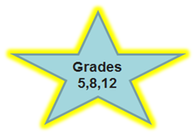
Nominee Attributes
Academics/
Career Education
Citizenship
Leadership
Recognitions & Awards
Communication Skills
Notes:
So far we have discussed the district information form , the timelines and the revisions to be used in this selection process for 2020.
The purpose of our Student of the Year Program is to recognize outstanding elementary, middle/ junior high, and high school students enrolled in grades 5, 8, and 12 who have demonstrated :
❖ exemplary academic achievements
❖ leadership abilities
❖ citizenship
We are going to review each of the attributes that should be considered in your selection process.
Academics: Nominees must have a cumulative grade point average of a 3.1 or higher. This is a change from previous years. This was to allow for a greater diversity of students and accomplishments. The grade points are calculated in the following manner.
Grade 5: use grades 2, 3, 4, and 5 (current grades)
Grade 8: use grades 5, 6, 7, and 8 (current grades)
Grade 12: use grades 9, 10, 11, and 12 (current grades)
Also a change this year, is the addition of points being awarded for CTE certification or scores earned for AP or IB coursework as well as credentials earned towards an Associates Degree.
Leadership: Nominees should list positions of leadership held at school, church, and community. Fifth grade students may include this type of information, but it is not directly scored on the evaluation document. Since students at the elementary level have limited opportunities, it would be unfair to rate this attribute. We still want that information noted as it could be used as part of the tie-breaking process. Serving on district, regional, or state board should be considered. Leadership a wide variety of school or community organizations, including FFA, 4-H, Skills USA, Honor Societies, BETA, FBLA , Drama, FCA, Phi Mu Alpha, etc., volunteer groups, prevention programs, teams, etc. should be considered as leadership opportunities.
Citizenship/ Activities: Nominees should list activities that demonstrate contributions to the school (including honors societies, BETA, Phi Mu Alpha, FBLA, Skills USA, FFA , FCA, drama or other school based organizations, or community organizations, such as Boy or Girl Scouts, volunteer activities at school (such as service club activities, peer tutoring, charity drives, etc. ), church involvement (such as youth group services, altar server, reader, choir, etc.) and involvement in community service (such as fundraising for non-profit groups, volunteering to assist the elderly, local committees or boards that impact the community in which they live.
Recognitions and awards: It is best to list this type of information from the most recent to the oldest. It is your decision as to how “far back” to include.
Communication Skills: All candidates at the regional and state levels will be interviewed by a panel of judges using the same set of interview questions. Students will also be asked to complete writing samples at each level also. Prompts and articles will be provided at the regional and state level competitions. (click to next slide)

Slide 15
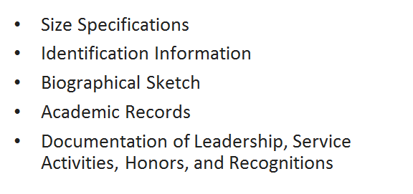
Portfolio Requirements
Notes:
1.The guidelines specify specific binder sizes that may be submitted (11.5 x 11 is the largest) and a maximum number of pages (25). This is a standard binder size. One page can be both back and front. If clear sleeves are used, the front and back sheets are considered one page. Font size should be no smaller than a 12 point font. If the portfolio exceeds the page limit, uses a smaller font size, or too large of a binder, points are deducted from the overall score. Excessively decorated binders are discouraged. (click)
2.The current student information page must be completely filled out and signed by the appropriate parties. If you are recreating a form, the verbiage must be exact. The application has text fields so inserting the information should not be an issue. A current photo should be included or attached in some way. (click)
3.Students should prepare a biographical sketch which will serve as a writing sample at the school or charter zone level. This sample may be handwritten or typed. The sketch for all students should information about their family history, interests, and career aspirations. The students should be encouraged to address 3 issues that are important to them or have had an influence on their lives. For the elementary students, a teacher may wish to pose specific questions for their students to address. (click)
4.Students will need to include a photocopy of their cumulative academic records (cumulative card) or electronic academic record, their current semester grades, appropriate report card, high school transcripts (if applicable), all prior statewide assessments prior to the current grade level, and their AP, CLEP, ACT, PSAT, SAT, WorkKeys scores, High School Jump Start Certifications, TOPS-aligned Dual Enrollment coursework, TOPS/TOPS Tech eligibility status, work-based experience documentation from employer, Associates Degree coursework / status, and/or other pertinent academic test results your request has been added. (click)
5.Items listed for Leadership, Service Activities, and Recognitions and Awards should be listed chronologically from the most recent to the oldest. If more lines need to added to the tables, you may add lines to the tables as needed. (click)
6.If space in the portfolio permits, a student may include letters of recommendation or certificates or other artifacts. Remember to use the front and backs of the plastic sleeves to get maximum space. (click to next slide)

Slide 16
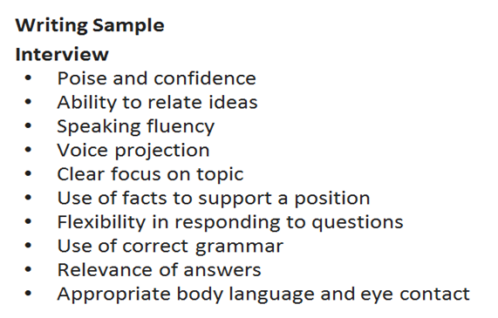
Other Scored Components
Notes:
The students writing skills are assessed at every level of competition.
The first writing sample all students will submit is the biographical sketch which we have already discussed. Districts may determine their own prompts at the district level. Prompts for the regional and state levels of competition will be provided by the LDOE. This component is 25-30% of the final score.
The interview is the next part of the process for districts, zones, regions, and state levels. This is 40% of the final score.
Judges will score:
1. Poise and confidence
2. Ability to relate ideas
3. Speaking fluency
4. Voice projection
5. Clear focus on topic
6. Use of facts to support a position
7. Flexibility in responding to questions
8. Use of correct grammar
9. Relevance of answers
10. Appropriate body language and eye contact
If a student has had little experience with being interviewed by a panel, schools or LEAs are encouraged to work with them
prior to the interview experience so they are not overly anxious about the process.
(click to next slide)

Slide 17
District or Zone Selection Committee Composition
Composed of 3-5 individuals from the following list:
Elementary teacher, Middle/junior high teacher or High school teacher
Supervisors/ Administrators
CTE Instructor/ CTE Supervisor (for Grade 12 only)
Community Members
Business
Industry
Labor or Civic Organization
Board of Regents University
La. Community and Technical College system
Notes:
Who should be on the student selection committee for Charter Zone committee and District Selection committee?
The LEA level selection committees should be composed of an appropriate grade level teacher, administrations central office administrators, and community members. High school committees should include a CTE instructor or supervisor and higher education personnel, if available.
We recommend 3-5 members for each grade level committee that follow the types of personnel described in the guidelines. The Community members may be from business/ industry, labor, or civic organizations . If you have higher education representatives in your community, we encourage you to include them at the district or charter zone level.
(click to next slide)

Slide 18
Regional and State Selection Committees
Composed of 5 individuals from the following list:
Elementary teacher, Middle/junior high teacher or High school teacher
Supervisors/ Administrators
CTE Instructor/ CTE Supervisor (for Grade 12 only)
Community Members
Business
Industry
Labor or Civic Organization
Board of Regents University
La. Community and Technical College system
Notes:
Who should be on the regional and state student selection committees?
The regional and state level selection committees should be composed of an appropriate grade level teacher, CTE instructor, supervisors or administrators, Jr. College or University personnel, and community members. We recommend at least 5 members for each grade level committee that follow the types of personnel described in the guidelines. The community members may be from business/ industry, labor, or civic organizations. If you have higher education representatives from a Junior College, Technical School, or University in your community, we encourage you to include them at the district level.
Regional and state level committees make every attempt to have representation from other districts in their region representing the people listed on the slide. District chairmen can assist greatly by finding people to represent their district in the regional selection process. Last year many regions had difficulties locating judges because fewer names were submitted on the district information form. Everyone needs to support the efforts to locate judges for these panels.
(click to next slide)

Slide 19
Scoring Forms
Component weighting has changed.
Scoring forms for each grade level are available in the guidelines document and should be used at all levels.
Rubrics for the regional essay and portfolio components will be made available to the regional coordinators.
These rubrics will also be used at the state levels.
Notes:
What scoring rubric should selection committees be using?
Since there is a shift in the weighting of the portfolio components, all districts, zones, regions and state selection committees should adjust their scoring documents to reflect the new weights. These revised scoring forms are available in the Student of the Year Guidelines.
The revised scoring rubrics for portfolios will be sent to all district/ LEA coordinators to assist them in the selection of the candidates.
Evaluation/ scoring forms have been included in the guidebooks and will be used for all district, region, and state levels of competition. The scoring rubrics for the essays and portfolios will be sent to the LEA coordinators once their district information form has been submitted to the LDOE to Marian Johnson. Regional and state committees will be use the same scoring rubric for essays, portfolios, and interviews.
(click to next slide)

Slide 20
Candidate Selection & Announcements
Nov.
-
Dec.
School
District
Zone
Jan. 24
-
Feb. 28
Region
April 1
State
Notes:
What are the levels of competition for these students?
● Each public, non-public, and charter school may nominate a candidate for district/ LEA consideration for the applicable grade level.
● Each district will select one nominee for each grade level to be considered at the regional level.
● Charter zones A – D will submit one nominee to the Region 7 Selection Committee and Zone E will submit 3 nominees to the Region 7 Selection Committee
The regional committee will select one nominee for each grade level to be considered at the state level.
For parochial and non-public schools,
● Each school may nominate a candidate for district consideration for the applicable grade level.
● The schools will submit their nominee to the school diocesan chairman who conducts the selection process in the same manner as a
district would.
● Each of the 7 dioceses will submit their candidate to the Diocesan regional chairman, Michael Miller, the Asst. Superintendent of the
Baton Rouge Catholic Diocese. This selection committee will submit one candidate for each grade level for state level consideration.
The regional competition window dates have only a slight variation. The State competition was moved to the first week of April in an effort to avoid conflicts with the spring breaks that vary across the state.
When are announcements of candidate selection made?
Schools and LEAs may determine the announcement dates for their district nominees.
Regional nominees will be released by the state between March 4 and March 6 in an official press release. Impacted districts will be notified prior to the official press release. All portfolios will held by the regional coordinators until the state announces the results. Portfolios for the state nominees will be sent to the LDE and the remaining portfolios will be returned to the districts after March 6.
All state finalists and district coordinators will be sent a logistics memo concerning the agenda for the day as well as housing arrangements for the finalists and their parents.
Formal invitations to the awards program will be sent the parents, school administration, district or charter management Superintendent or CEO, and the district and regional coordinators of the finalists. Louisiana legislators of the finalists and the legislative Education Committee members will also be invited to the awards program.
(click to next slide)

Slide 21
Competition Days
Tuesday, March 31
•Selection Panels review and score essays and portfolios.
•Lodging is provided for students and parents this evening.
Wednesday, April 1
•Nominees assemble at the Claiborne Building in the morning.
•Nominees are interviewed by a panel of five judges.
•Essay, portfolio, and interview scores are combined to determine a final score.
•Results are announced at an Awards Program at 6 p.m.
Notes:
When are the actual days of the competition, and what happens on those two days?
Read the slide.
(click to next slide)

Slide 22
Questions?
For any additional information or questions, please contact:
Marian E. Johnson
State Student of the Year Program Coordinator
marian.johnson@la.gov
225-219-7372

Slide 23
Thank you for your support
of this Student Recognition Program.

