Slide 1
Using High Quality K-2 Curriculum and Professional Development to Achieve Literacy Outcomes and CLASS Excellence
Super App Launch
November 2019

Slide 2
Objectives
Participants understand the need for both a foundations and language/literacy curriculum and the options available to prepare their Super App
Participants understand the high-quality PD options and the importance of on-going PD to prepare their Super App
Participants recognize the value of CLASS in supporting curriculum implementation and learn about potential future opportunities for Super App

Slide 3
Agenda
High-Quality K-2 ELA Curriculum and Options Available
High-Quality PD Options and the Importance
Connecting High-Quality Curriculum and CLASS

Slide 5
Academic Focus
In order to ensure students do the majority of the work every day,
All teachers—including special education, English language, and reading interventionists—are fully prepared to deliver high-quality lessons.
Principals, leadership teams, content leaders and mentor teachers use classroom observation, common planning time, and one-on-one coaching to support each teacher in delivering high-quality lessons.
School systems support principals and school teams as they provide support to teachers.
The Department supports school systems as they execute their improvement plans.
Notes:
2 minutes

Slide 6
Improvements to the 2020-2021 Strategy
CIR and UIR Improvements
Professional Development Plan: School systems submit a plan that includes content module redelivery and unit unpacking for CIR schools.
Post-secondary planning partner: Schools will have at least one partner to support Individual Graduation Plans (IGPs) at CIR high schools.
District leader responsible for UIR-D schools: School systems will have a leader to coordinate support and planning for UIR-D schools.
Other Strategy Improvements
Science: School systems can apply for funds to support the purchase of science curricula and the training of teachers on this curricula.
Early Childhood: The planning process for governance, access, and quality is now included in Super App.
Special Education: Funding for professional development on specialized supports is available for schools with a UIR label for the subgroup with students with disabilities.

Slide 7
School System Planning Framework
Area of Focus
Domain
Planning Questions
Domain and Row Number
Indicators

Slide 8
Core Academics
This session will provide information related to the School System Planning Framework area(s) below.
CA1 | High-Quality Curricula
 | Indicator | Application Question
 | Teachers in all grade levels and core content areas have access to and implement a high-quality curriculum. | 1. Which specific ELA and math curricula will be used in each grade band at CIR/UIR-Academics schools? Check the box below if different curricula are used in non-CIR/UIR-Academics schools. Please specify grade bands and curricula that differ from those used in CIR and UIR-Academics schools.

Slide 9
Core Academics
This session will provide information related to the School System Planning Framework area(s) below.
CA2 | High-Quality Teacher Professional Development
 | Indicator | Application Question
 | Teachers in all grade levels and core content areas receive orientation to the curriculum, content module redelivery, opportunities to prepare for units and lessons, and ongoing support. | 1. Which partner(s) will provide ELA and math teacher orientation to curricula and in-school coaching on the curricula in each grade band at CIR/UIR-Academics schools?

Slide 10
High-Quality K-2 ELA Curriculum and Options Available

Slide 11
K-2 ELA Curriculum Options
The goal of English language arts (ELA) is for all students to read, understand, and express their understanding of complex, grade-level texts.
To ensure all students enter 3rd grade reading at grade level, K-2 core ELA instruction should include high quality curriculum that addresses (1) Foundations and (2) Language and Literacy.
Features | Foundations | Language and Literacy
Focus | Skills-based decoding | Building knowledge
Organization | Explicit sequence of phonics skills | Text sets to build knowledge
Type of Texts | Words and groups of words in isolation, decodable texts | Complex texts (often read aloud)
Writing | Letter formation, spelling | Expression of ideas
Grade band | Primarily K - 2 | K - 12

Slide 12
K-2 ELA Curriculum Options
K-2 classroom in Louisiana could adopt either of the following:
One high-quality program that includes both foundations and language and literacy, or
Two high-quality programs, one for foundations and one for language and literacy.
Options | Foundation Programs | Language and Literacy Programs
1 | American Reading Company - IRLA Foundational Skills Toolkit Amplify - Core Knowledge Language Arts Skills Strand, 2nd Edition | Great Minds - Wit & Wisdom
2 | OpenUp Resources - EL Education
3 | American Reading Company - IRLA Foundational Skills Toolkit + ARC Core
4 | Amplify - Core Knowledge Language Arts Skills Strand + Language Arts, 2nd Edition

Slide 13
Components of High-Quality K-2 Foundations Curricula
Foundations
Small group instruction to address phonological awareness, phonemic awareness, and phonics needs
Use of modalities and manipulatives rhymes, chants, letter-sound cards, snapping/clapping syllables or sounds
Teacher modeling of letter-sound relationships (orally and in writing)
Practice opportunities for students to gain decoding automaticity and sight-based recognition of high frequency words, including reading connected text to build fluency
Teacher feedback as students practice
Reflection Questions
Which components do you observe happening more frequently in 1st and 2nd grade classrooms?
Less frequently?
Why is this?
What can you do to support and improve teachers’ implementation?
Curriculum Implementation Observation Tool

Slide 14
Components of High-Quality K-2 Curricula
Language and Literacy
Read-alouds with texts above the complexity level of what most students can read independently
Text-based questions
Small group, peer-to-peer, and whole group discussion about texts
Shared writing and independent writing about texts
Reflection Questions
Which components do you observe happening more frequently in 1st and 2nd grade classrooms?
Less frequently?
Why is this?
What can you do to support and improve teachers’ implementation?
Curriculum Implementation Observation Tool

Slide 15
High-Quality PD Options and the Importance

Slide 16
Components of Effective Professional Development to Support K-2 Teachers Effective Use of Curricula
Comprehensive Initial Training
Hands-on, highly interactive session about the structure of materials, key lesson elements, and how to plan and deliver lesson types successfully
Ongoing, Focused Coaching
Job-embedded support that includes model lessons, classroom observations, data study, and differentiation to support curriculum implementation and meeting needs of specific subgroups (e.g., ELs, special needs)
How many hours does your school/system plan for initial training? What is this based on?
How many days does your school/system plan for coaching? Who delivers the coaching? Who receives the coaching?
Reflection Questions

Slide 17
High-Quality PD Options
K-2 ELA Curriculum | Vendor Options in PD Vendor Guide
American Reading Company | American Reading Company
Core Knowledge | Amplify Instruction Partners Leading Educators TNTP
EL Education | EL Education Instruction Partners Leading Educators Open Up Resources Teaching Lab The Achievement Network TNTP
Wit and Wisdom | Great Minds TNTP

Slide 18
Connecting High-Quality Curriculum and CLASS

Slide 19
Connecting High-Quality Curriculum and CLASS®
A high-quality curriculum:
promotes great teaching - so does CLASS®!
fosters high-quality teacher-student interactions - so does CLASS®!
encourages positive interactions between students and their peers - so does CLASS®!
CLASS®
focuses on components in a high-quality curriculum
provides an infrastructure to help teachers use curriculum effectively
Several school systems are currently piloting CLASS® in K through the use of SRCL funds. Though Super App does not address CLASS®, attend the February Collaborations for information about future opportunities.

Slide 20
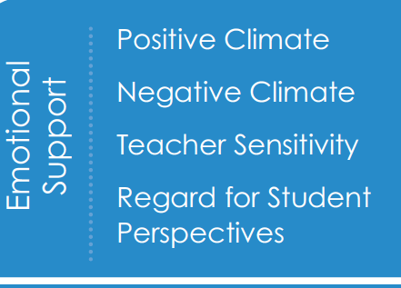
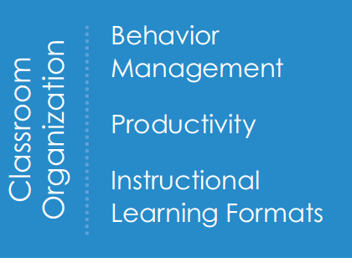
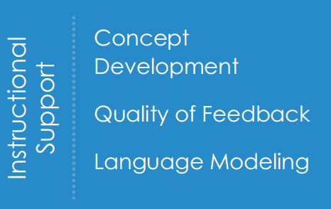
Components of CLASS Embedded in High-Quality Curriculum
Three domains: Emotional Support, Classroom Organization, and Instructional Support
Ten dimensions with indicators
Shows enthusiasm
Individualizes support
Uses students’ ideas
Sets clear expectations
Maximizes learning time
Uses various methods
Links concepts to familiar
Engages in feedback loops
Encourages conversations

Slide 21
Scale of Current CLASS Pilots
Kindergarten CLASS Pilot | 2016-2017 | 2017-2018 | 2018-2019 | 2019-2020
Number of school systems | 5 | 22 | 26 | 29
Number of schools | 15 | 37 | 73 | 84
Number of teachers | 35 | 80 | 280 | 331
First Grade CLASS Pilot | 2016-2017 | 2017-2018 | 2018-2019 | 2019-2020
Number of school systems |  |  |  | 4
Number of schools |  |  |  | 10
Number of teachers |  |  |  | 32

Slide 22
Current CLASS Pilot School Systems
Advantage Charter | Iberville | Sabine*
Bogalusa City | Jefferson Davis | St. Helena*
Caddo | Madison | St. Martin
Calcasieu | Morris Jeff* | St. Tammany
Catahoula | New Beginnings: Capdau | Tensas
Celerity: Dalton | Orleans: Plessey | Terrebonne
Celerity: Lanier | Ouachita | University View: Tallulah
Democracy Prep | Pointe Coupee | Vernon
DeSoto* | Rapides | Washington
Iberia | Red River
*Also piloting CLASS in first grade

Slide 23
Super App Support
Support for completing the Super App will be provided through
School Improvement Library
LDOE Weekly Newsletters
School System Planning and Superintendent Calls
Network Teams
Office Hours on scheduled Mondays at 11:00 AM (details via LDOE Weekly Newsletter)
Send all questions related to school system planning and Super App to LDOE.GrantsHelpDesk@la.gov and include “Super App” in the subject line.

