Slide 1
Providing Engaged Instructional Support for Learning – Focus on Language and Early Literacy
Created by
Dr. Renée Casbergue

Slide 2
Welcome, Session & Group Introductions

Slide 3
Learning Objectives

Slide 4
LEARNING OBJECTIVES
Explore and expand understanding of preschool literacy development
Learn specific interaction strategies and behaviors associated with the CLASS® Instructional Support domain
Identify/recognize use of those strategies in a demonstration literacy lesson
Plan read aloud and shared writing activities to incorporate instructional support strategies

Slide 5
Learning and Literacy in Preschool

Slide 6
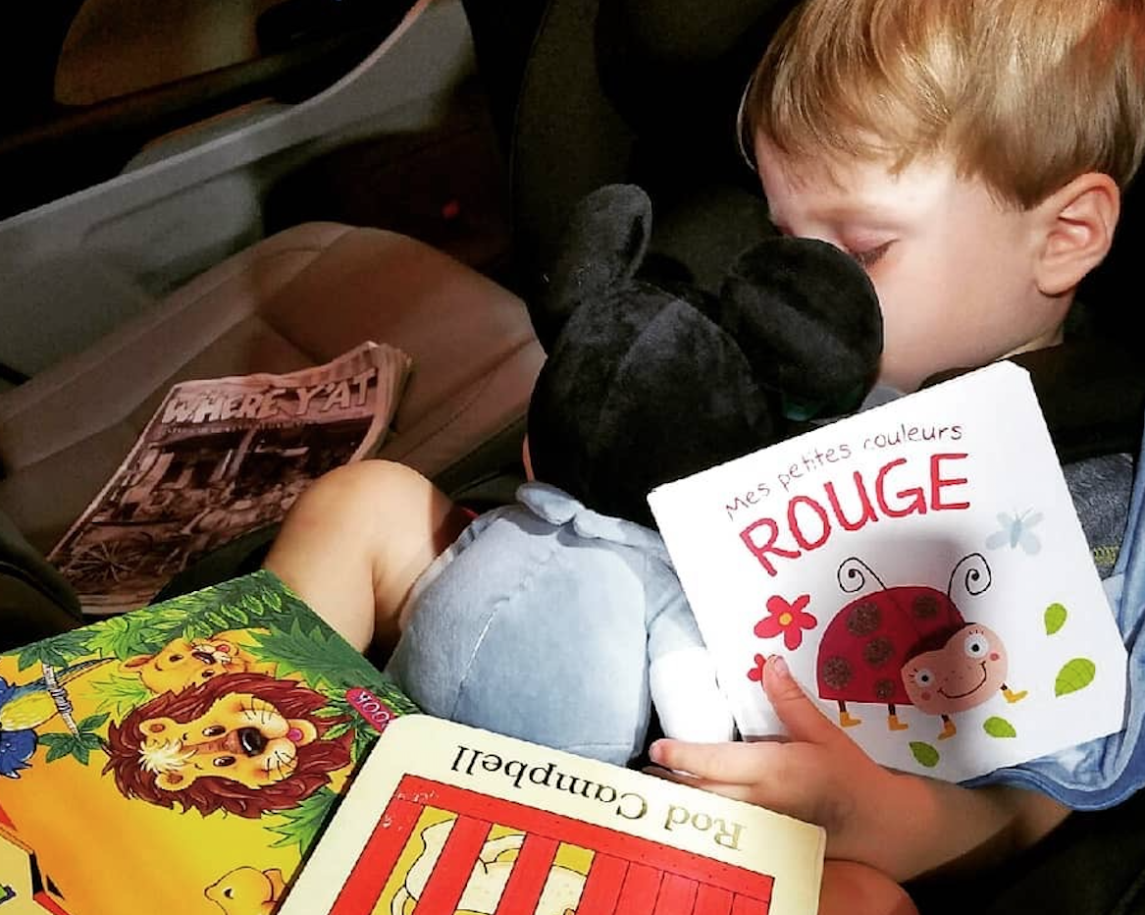
Most important preschool literacy skills?
What do you believe is most important for preschool children to learn to support their later literacy?
Make a list of the literacy skills you think are most important and that you spend the most time on when working with children.
Compare your list with a partner and briefly discuss similar and different items.

Slide 7
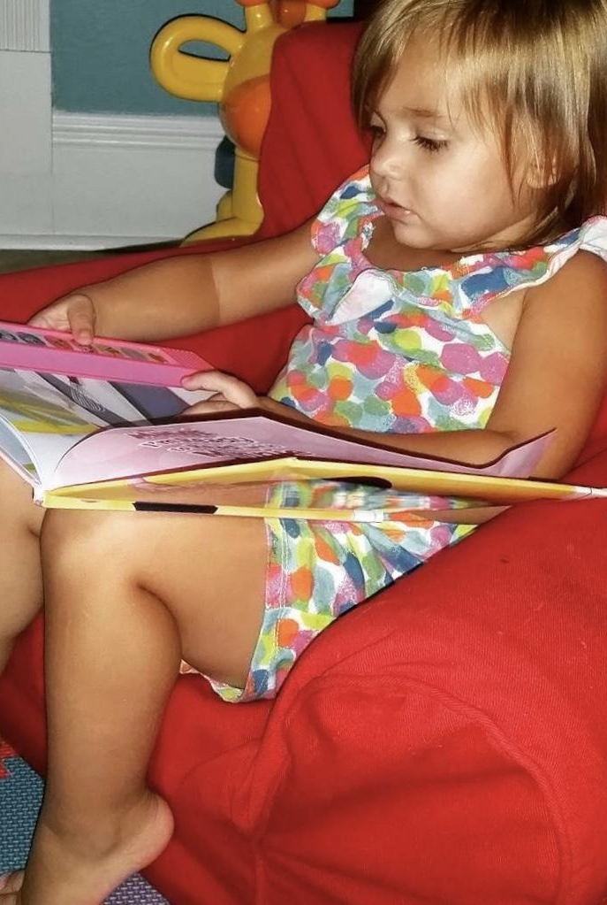
Print concepts vs. meaning?
Place a “P” next to each item on your list that is related to children’s learning about print and print conventions (letter names and sounds, uppercase and lowercase letters, writing from left to right and top to bottom, forming letters, etc.).
Place an “M” next to each item on your list that is related to children’s meaning-making with stories or informational text (vocabulary, comprehension, composing).
Discuss with a partner which aspect of early literacy (print or meaning making) dominates your list and why.

Slide 8
Louisiana early literacy standards

Slide 9
The national preschool literacy picture
Significantly more time is devoted to print concepts than to meaning making.
(Neuman & Roskos, 2005; Teale, Hoffman, and Pagacia, 2010; McKay & Teale, 2015)
Learning print concepts is a “constrained skill” with a finite quantity of things to learn.
(Paris, 2005)
Increased literacy demands in primary grades, particularly within PARCC assessments beginning in third grade, require much more focused attention to vocabulary and comprehension – skills that continue to develop over a lifetime.
(Casbergue, 2017)

Slide 10
Instructional Support: Teacher – Child Interactions

Slide 11
CLASS® INSTRUCTIONAL SUPPORT: CONNECTIONS TO EARLY LITERACY
Domain: Instructional Support
Dimensions:
Concept Development
Quality of Feedback
Language Modeling
Meaning-focused lessons (rather than lessons focused on print) more readily allow interactions that yield high Instructional Support CLASS® scores.

Slide 12
Concept Development

Slide 13
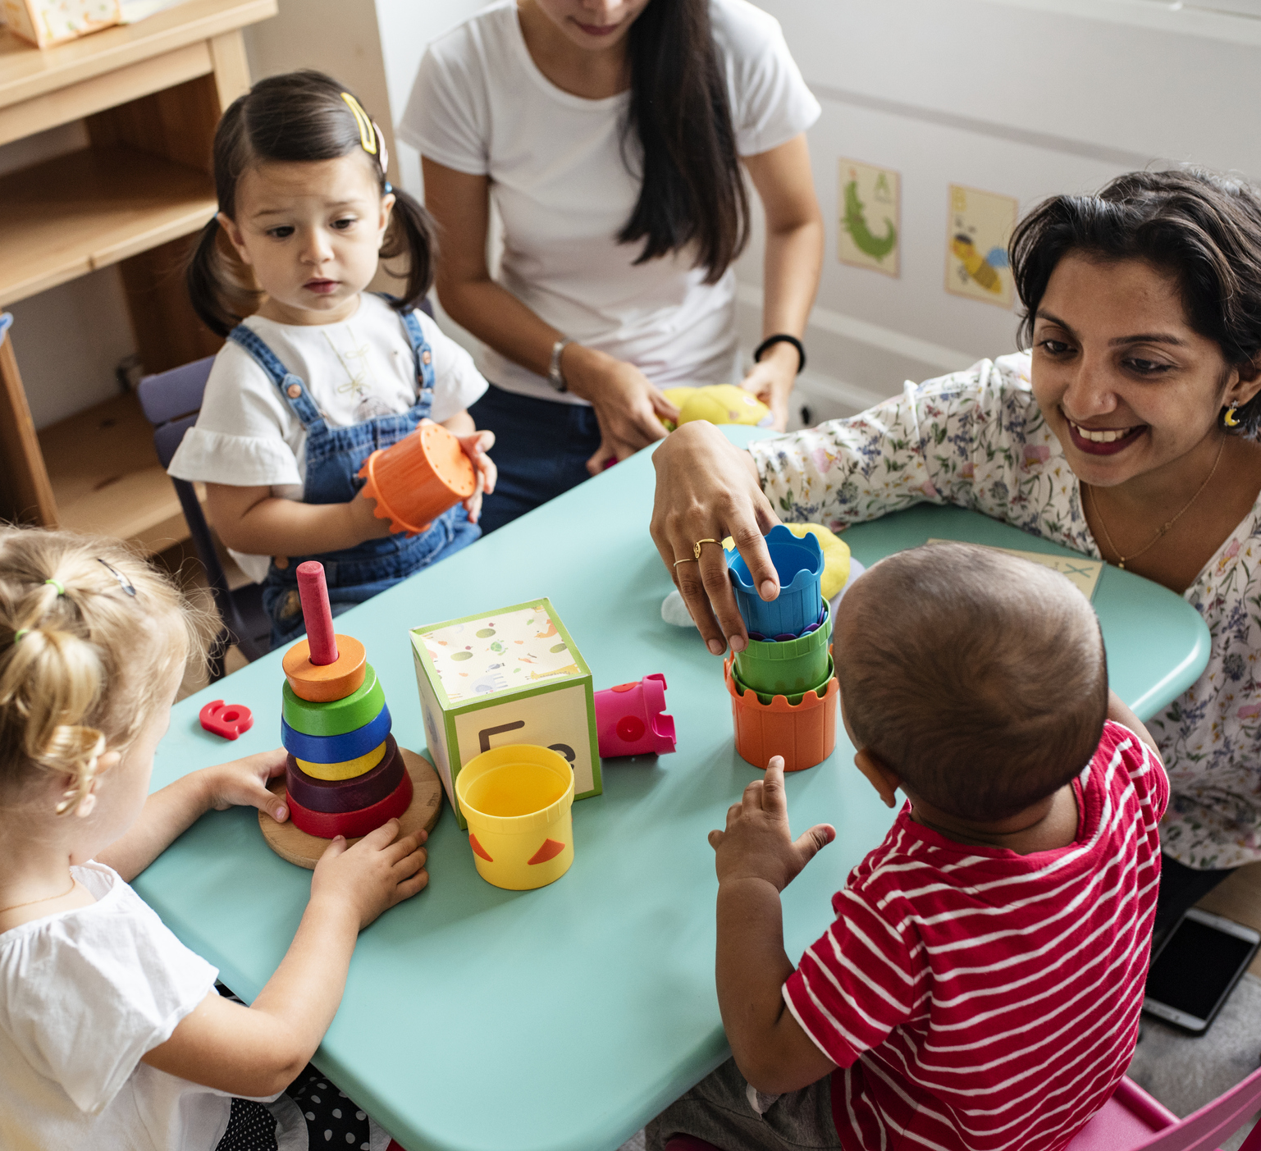
Concept development
This dimension of the CLASS® measures the teacher’s use of instructional discussions and activities to promote children’s higher-order thinking skills and cognition and the teacher’s focus on understanding rather than rote learning skills.
(CLASS® Pre K – K manual, pg. 61)

Slide 14
preschool class® tool
Dimension: Concept Development
Indicators:
Analysis and Reasoning
Creating
Integration
Connections to the Real World

Slide 15
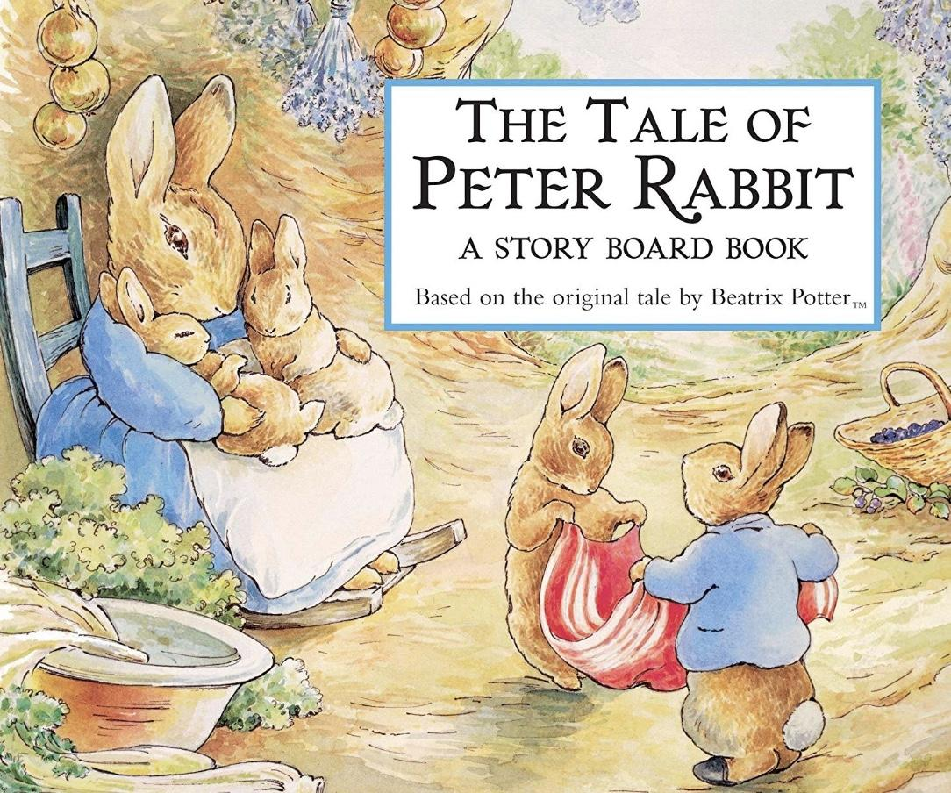
PRESCHOOL class® tool
Indicator: Analysis and Reasoning
Behavioral markers:
Why and how questions
Problem solving
Prediction/experimentation
Classification/comparison
Evaluation

Slide 16
PRESCHOOL class® tool
Indicator: Creating
Behavioral markers:
Brainstorming
Planning
Producing

Slide 17
PRESCHOOL class® tool
Indicator: Integration
Behavioral markers:
Connecting Concepts: Connect new concepts with other concepts children understand; Connect multiple concepts within the same discussion or activity
Integrating with previous knowledge: The teacher connect concepts to previously learned concepts

Slide 18
PRESCHOOL class® tool
Indicator: Connections to the Real World
Behavioral markers:
Real world applications
Relating to children’s lives

Slide 19
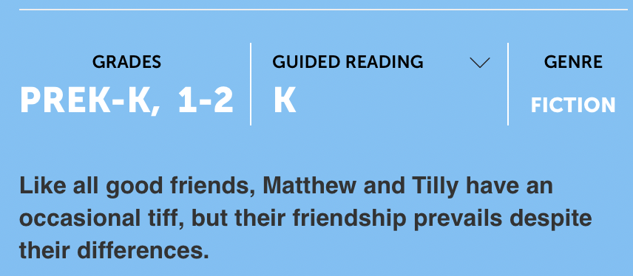
Concept development video
Preschool Read Aloud - Instructional Support
Hold CTRL and Click “Preschool Read Aloud…” to play video.
Notes:
https://www.youtube.com/watch?v=TYJBwKwgqpk&feature=youtu.be

Slide 20
Quality of Feedback

Slide 21
QUALITY OF FEEDBACK
This dimension assesses the degree to which the teacher provides feedback that expands learning and understanding and encourages continued participation.
(CLASS® Pre K – K manual, pg. 69)

Slide 22
preschool class® tool
Dimension: Quality of Feedback
Indicators:
Scaffolding
Feedback Loops
Prompting Thought Processes
Providing Information
Encouragement and Affirmation
Notes:
Stock photo ID:1022800766

Slide 23
PRESCHOOL class® tool
Indicator: Scaffolding
Behavioral markers:
Hints
Assistance
Notes:
Stock photo ID:1189121908

Slide 24
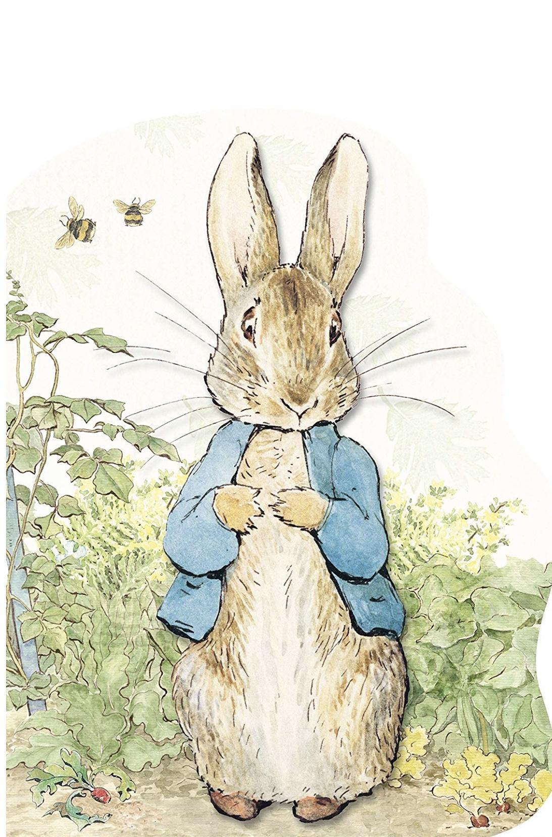
preschool class® tool
Behavioral marker: Hints
Examples:
“I see you wrote two rabbits’ names. Flopsy, Mopsy, and who’s this? /p/ /p/ …”
“Good job brainstorming vegetables in the garden. We’re leaving out one more. It’s something rabbits love to eat. It’s orange.

Slide 25
preschool class® tool
Behavioral marker: Assistance
Examples:
“You want to write Benjamin Rabbit? Let’s listen for the first letter in his name. /b/ /b/”
This is a “B” (point to letter on alphabet strip. You do line down, then curve, curve (tracing the letter as child writes).

Slide 26
PRESCHOOL class® tool
Indicator: Feedback Loops
Behavioral markers:
Back and forth exchanges
Persistence by teacher
Follow-up questions

Slide 27
PRESCHOOL class® tool
Indicator: Prompting Thought Processes
Behavioral markers:
Asks children to explain thinking
Queries responses and actions

Slide 28
preschool class® tool
Behavioral marker: Asks children to explain thinking
Examples:
Teacher: “Do you think we’ll have more pumpkins or more beans when our plants grow?” Child: “Pumpkins.”
Teacher: Why do you think there will be more pumpkins?” Child: “Because pumpkins are bigger.”

Slide 29
preschool class® tool
Behavioral marker: Queries responses and actions
Examples:
Teacher: “You’re finished sorting our seeds. How did you group them?” Child 1: “I put the smallest one, then the bigger ones.” Teacher: “So you sorted them by size.”
Child 2: “I put all the white ones together, then the yellow ones, and the black ones.” Teacher: “I see you. You sorted them by color.”

Slide 30
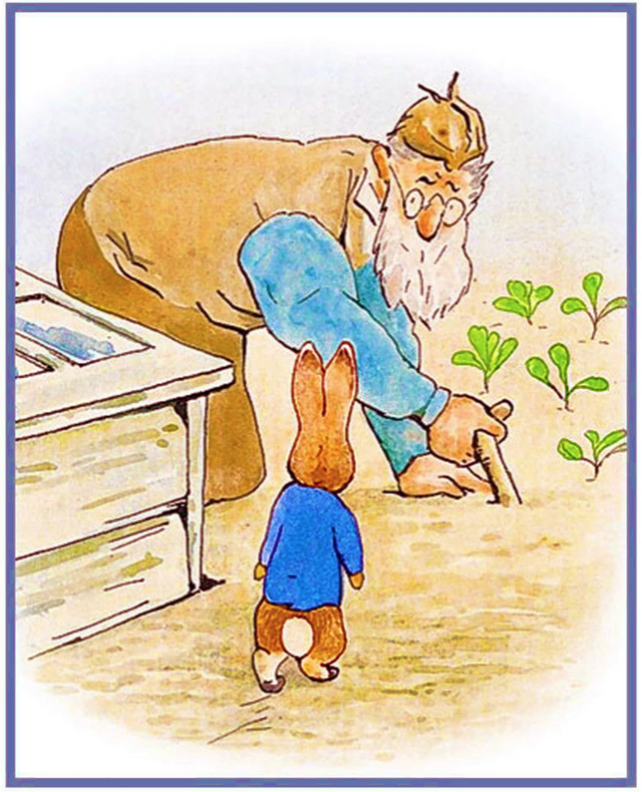
PRESCHOOL class® tool
Indicator: Providing Information
Behavioral markers:
Expansion
Clarification
Specific feedback

Slide 31
PRESCHOOL class® tool
Indicator: Encouragement and Affirmation
Behavioral markers:
Recognition: “You finished the first page of your story about Peter Rabbit. I like how you put the little blue jacket on Peter so we can tell which bunny he is!”
Reinforcement: “You’re doing such a good job with your book. I know you want to make two pages. Keep going and you can read it to me when you finish.”
Child persistence: “Wait! I’m not finished. I need to add one more page.”

Slide 32
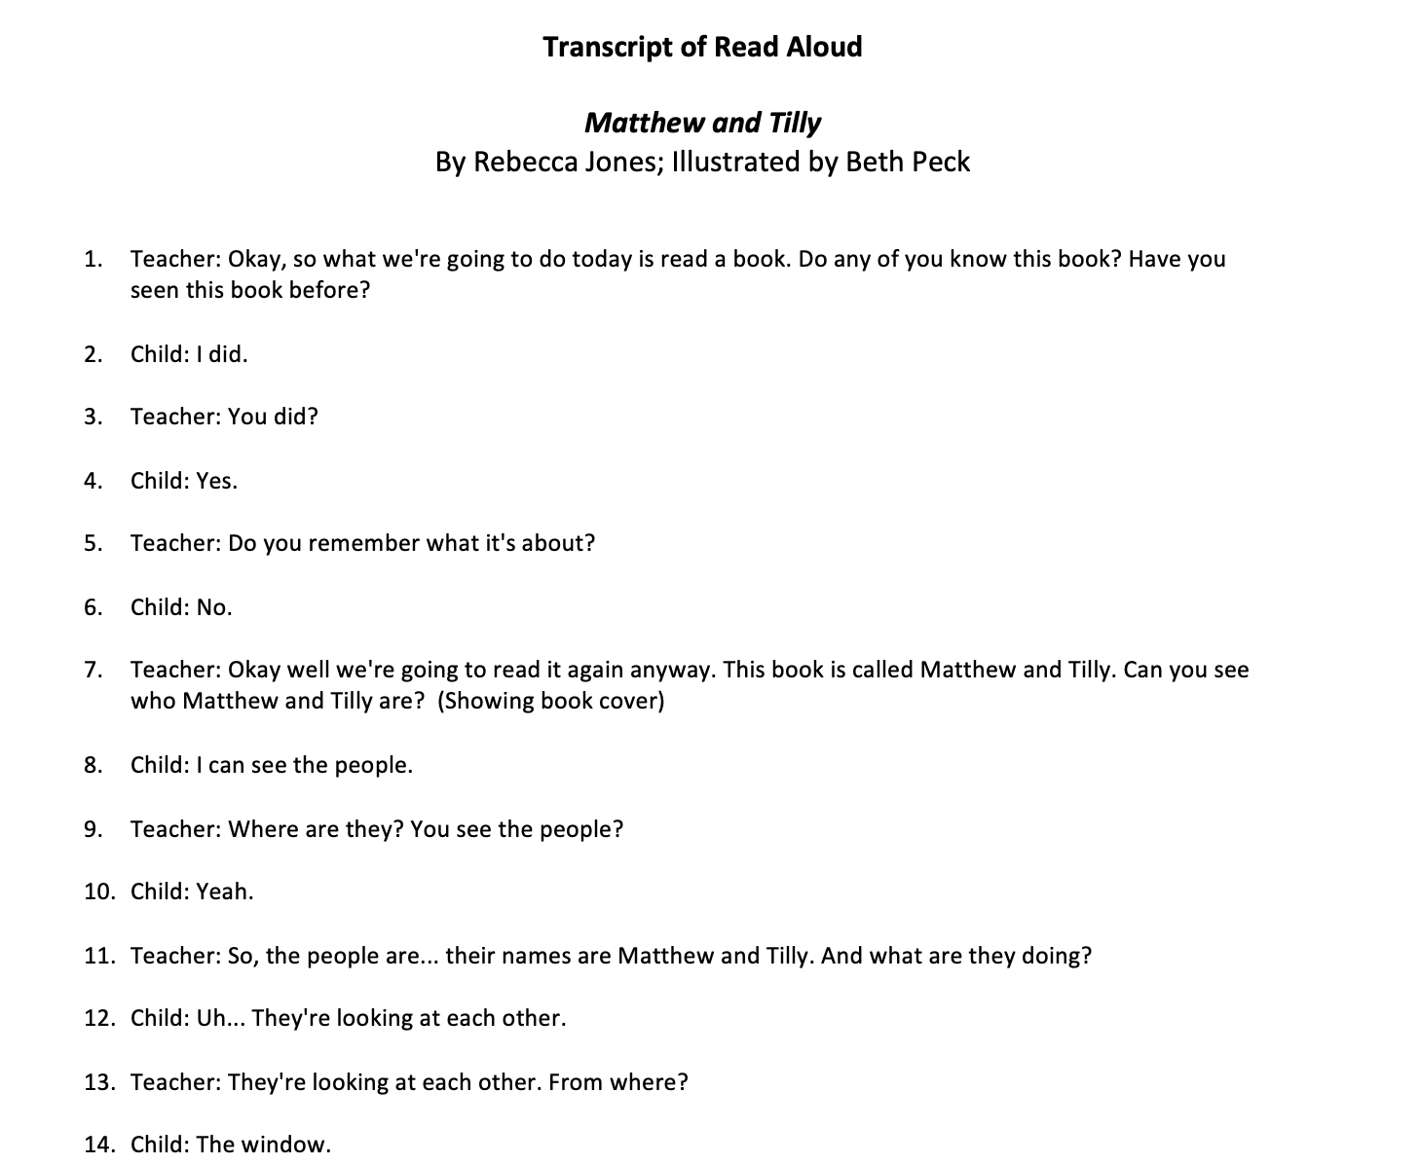
Recognizing quality of feedback

Slide 33
Language Modeling

Slide 34
LANGUAGE MODELING
This dimension captures the quality and amount of the teachers’ use of language-stimulation and language-facilitation techniques.
(CLASS® Pre K – K manual, pg. 75)
Notes:
Stock photo ID:642460612

Slide 35
preschool class® tool
Dimension: Language Modeling
Indicators:
Frequent conversation
Open-ended questions*
Repetition and extension
Self- and parallel talk
Advanced language*
*Most easily incorporated into read aloud.

Slide 36
PRESCHOOL class® tool
Indicator: Frequent conversation
Behavioral markers:
Back-and-forth exchanges and contingent responding
Peer conversations
Questions that require more than a single word response and children’s responses
Repeats
Extends/elaborates

Slide 37
preschool class® tool
Dimension: Language Modeling
Indicators:
Open-ended questions*
Repetition and extension

Slide 38
PRESCHOOL class® tool
Indicator: Self- and parallel talk
Behavioral markers:
Maps own actions with language: “I’m getting paints out so you can paint pictures of what you do with your friends. I’m putting out purple, pink, blue, green, red, and yellow so you can all use your favorite colors.
Maps child action with language: “I see you’re using red for your friend’s dress. You’re putting lots of colors on your page.”

Slide 39
PRESCHOOL class® tool
Indicator: Advanced language
Behavioral markers:
Variety of words: neighbor, rescued, reward, brave, crabby, sidewalk games, grouchy, stomped, customers
Connected to familiar words and/or ideas: “Stomped. That means he banged his feet really loud with every step, right?” (while stomping feet), “She wanted to reward them. She wanted to do something good for them because they did something good for her.

Slide 40
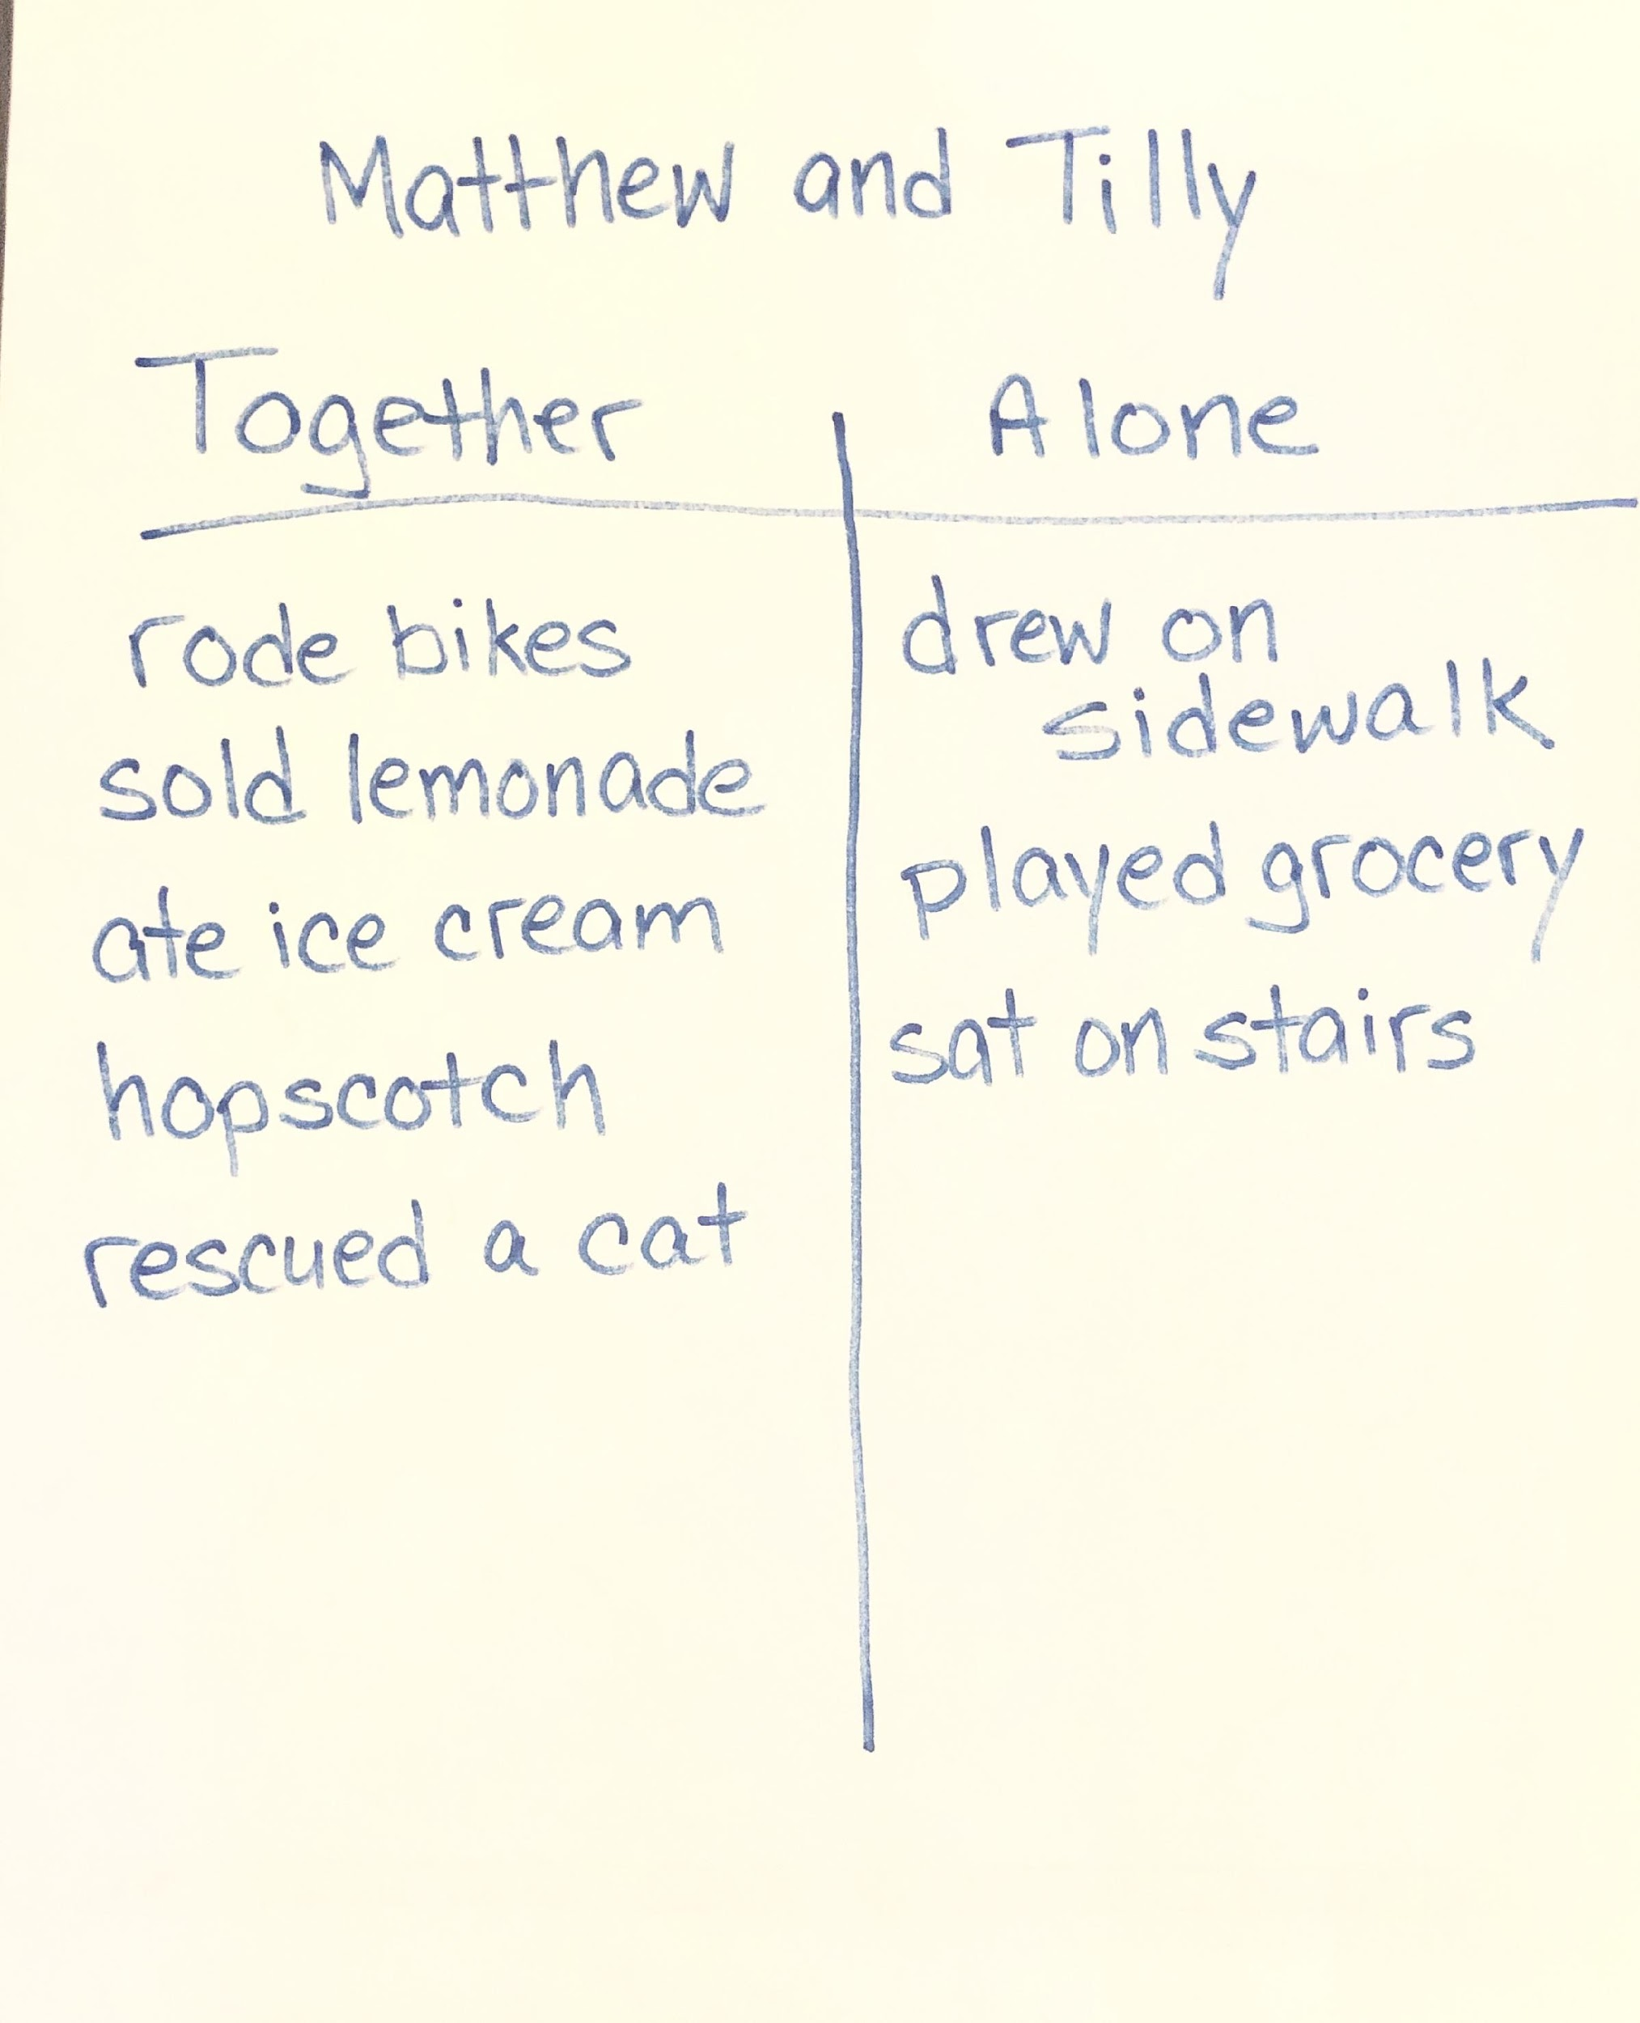
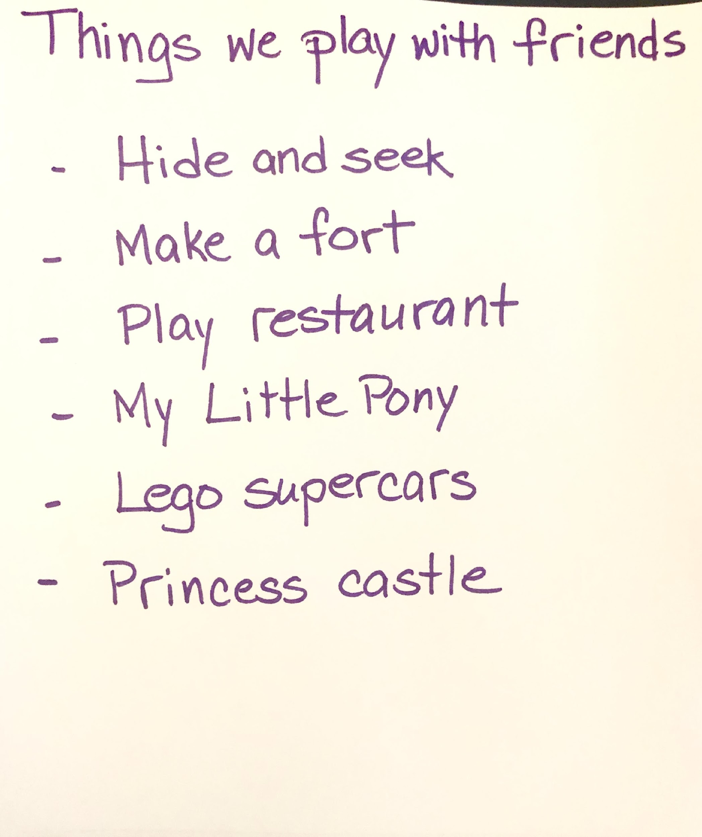
Language modeling after read aloud

Slide 41
Follow-Up Shared Writing
Notes:
Stock photo ID:675685578

Slide 42
Follow-up shared writing
Purpose:
Engage children in shared writing related to read aloud to reinforce print knowledge and skill
Extend children’s recall and understanding of the story
Incorporate concept development, quality of feedback, and language modeling as children help fill in a chart

Slide 43
Steps to follow-up shared writing
Choose a topic or prompt related to the story.
Write the title of the shared writing at the top of a chart, reading aloud as you write.
Invite the children to share their ideas in response to the prompt.
Repeat and clarify the children’s suggestions.
Say, “I’m going to write…” and condense or expand each child’s suggestion.
Write the child’s response on the chart as the children watch, using self-talk to describe what you are doing.

Slide 44
Next Steps

Slide 45
APPLYING WHAT YOU HAVE LEARNED
Select a book from your own classroom collection.
For Concept Development, plan analysis and reasoning questions, activities for creation, integration with previous lessons or other books, and connections to the real world.
For Quality of Feedback, identify specific parts of the book for which you can provide more information.
For Language Modeling, construct additional open-ended questions (beyond those used for concept development), identify words/phrases in the book that will be advanced language for your children, and create child-friendly definitions that connect the words to what children already know.
Plan two Shared Writing prompts that you can use after reading.

Slide 46
Then try it!
Use your plan to share you book and conduct follow-up shared writing with the children in your classroom.
Consider selecting two or three books each week for which you and a colleague work together to do this type of intentional planning.
Engage in these types of interactions around books often enough that they become habits.
Most of all, have fun sharing books and talking with children in ways that push them to use language and respond to books in more sophisticated ways!
Notes:
Stock photo ID:598098404

Slide 47
Session Review

Slide 48
REVIEW LEARNING OBJECTIVES
Explore and expand understanding of preschool literacy development
Learn specific interaction strategies and behaviors associated with the CLASS® Instructional Support domain
Identify/recognize use of those strategies in a demonstration literacy lesson
Plan read aloud and shared writing activities to incorporate instructional support strategies

Slide 49
Reflections, Questions, & Comments

Slide 50
Please complete the Post-Assessment Evaluation. Thank you!

