Slide 1
Providing Engaged Support for Learning: Focus on Toddler Language and Emerging Literacy

Slide 2
Welcome, Session & Group Introductions

Slide 3
Learning Objectives

Slide 4
LEARNING OBJECTIVES
Define what constitutes early literacy learning for toddlers
Establish an environment that offers emotional and behavioral support as they engage in literacy interactions
Facilitate classroom activities and interactions to expand toddlers’ thinking and active engagement
Embed feedback opportunities into instructional activities and interactions with children to scaffold their learning, provide information, and offer encouragement and affirmation of children’s responses
Model language in ways that support children’s language use and encourage their use of more advanced language

Slide 5
Toddler Language and Emerging Literacy

Slide 6
Turn and Talk
What is most important for toddlers to learn before they begin preschool literacy instruction?
What emerging literacy skills should one- and two-year-old children develop?
What kinds of knowledge and skills do toddlers need to support early literacy?

Slide 7
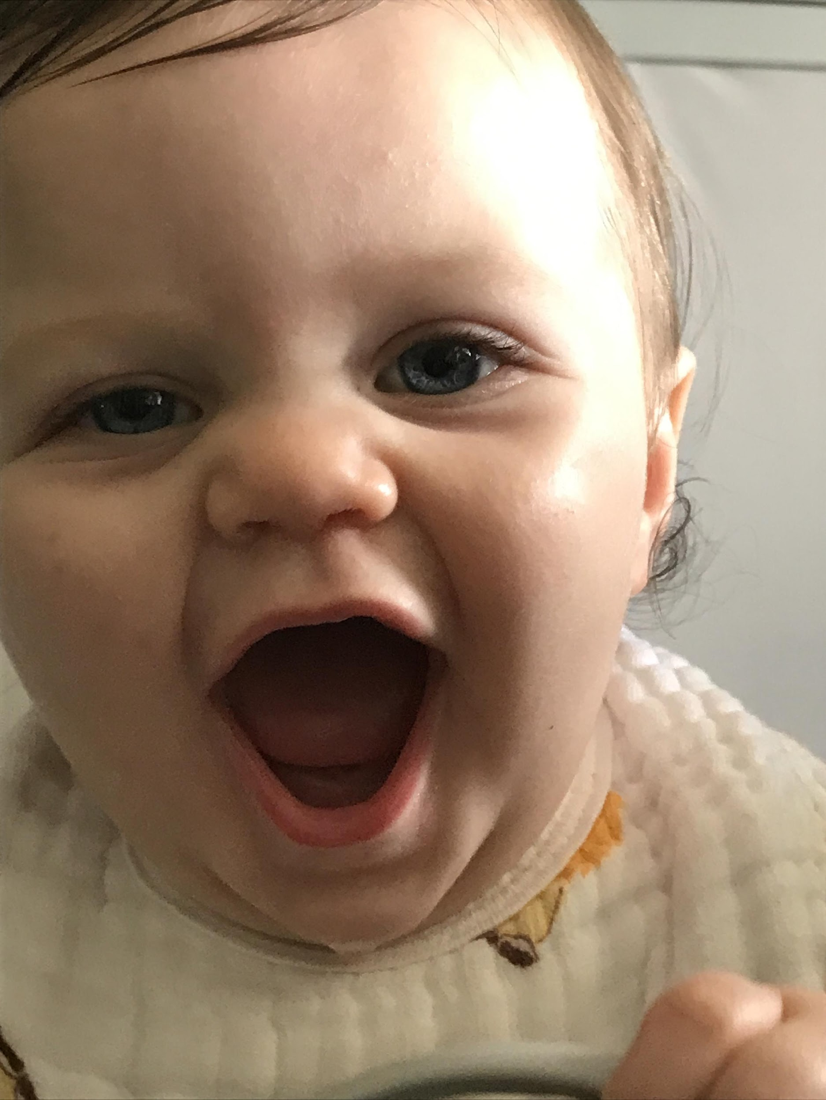
LITERACY IS LANGUAGE
Early literacy for toddlers, unlike for preschool age children, is less about print and written language.
For infants and toddlers, literacy begins with learning and using oral language.
Literacy begins to emerge when young toddlers first connect oral language to the content of simple books.
Literacy develops further when older toddlers engage in more interactive exploration of books and stories.

Slide 8
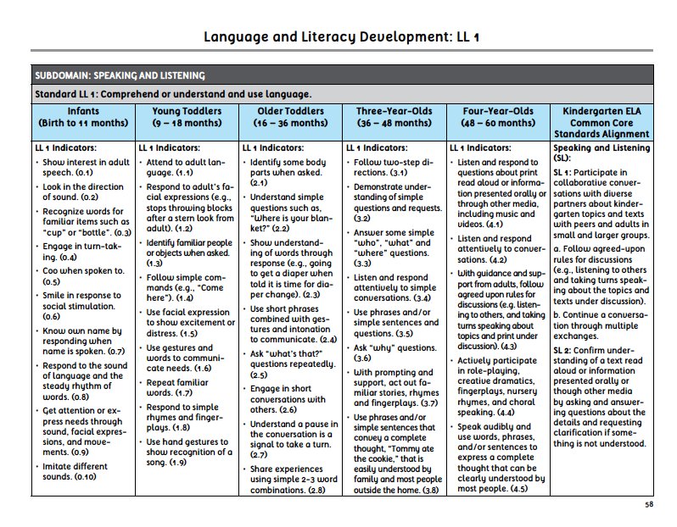
Early Learning and Development Standards

Slide 9
Overview of Toddler CLASS®

Slide 10
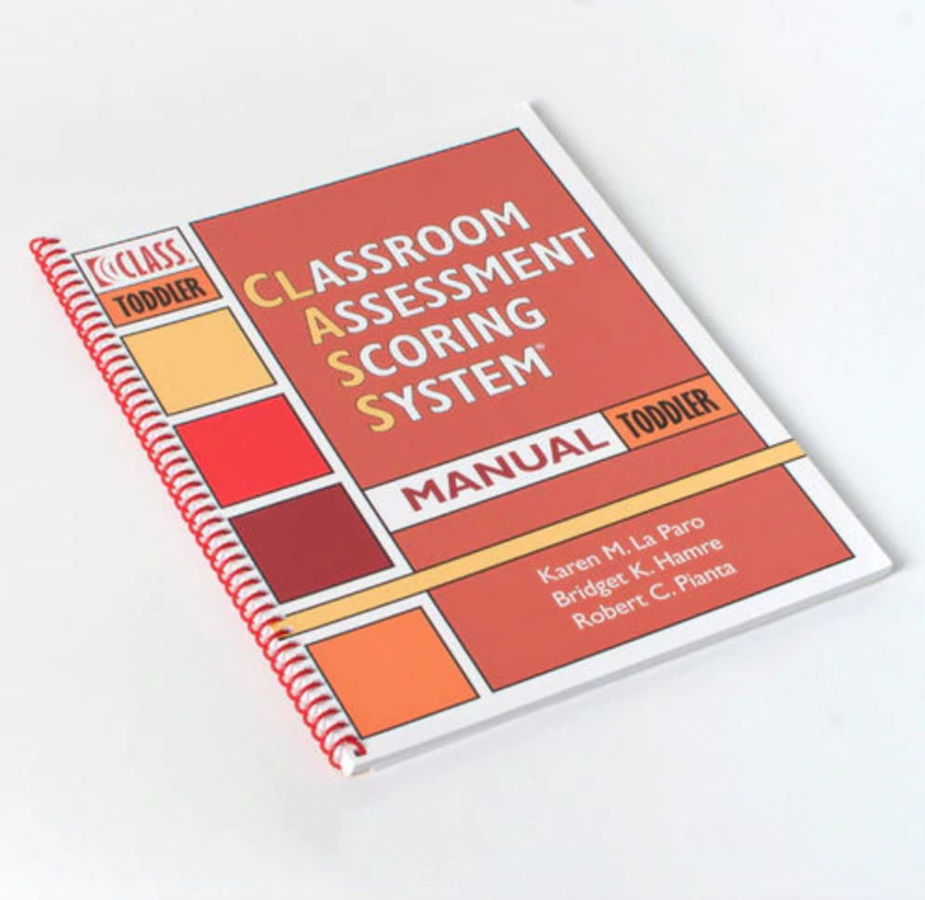
Connections to the Toddler CLASS®

Slide 11
STRUCTURE OF THE TODDLER CLASS®
Domain: Emotional and Behavioral Support
Domain: Engaged Support for Learning
Dimensions:
Dimensions:
Positive Climate
Facilitation of Learning and Development
Negative Climate
Quality of Feedback
Teacher Sensitivity
Language Modeling
Regard for Child Perspective
Behavior Guidance

Slide 12
Reflections
Take a few minutes to reflect on the kinds of interactions you have with children in your classroom that support their language and literacy development.
Be specific – jot down 3-5 things you do as part of your daily routines that encourage children to meet some of the early learning and development standards you explored earlier.

Slide 13
Emotional and Behavioral Support

Slide 14
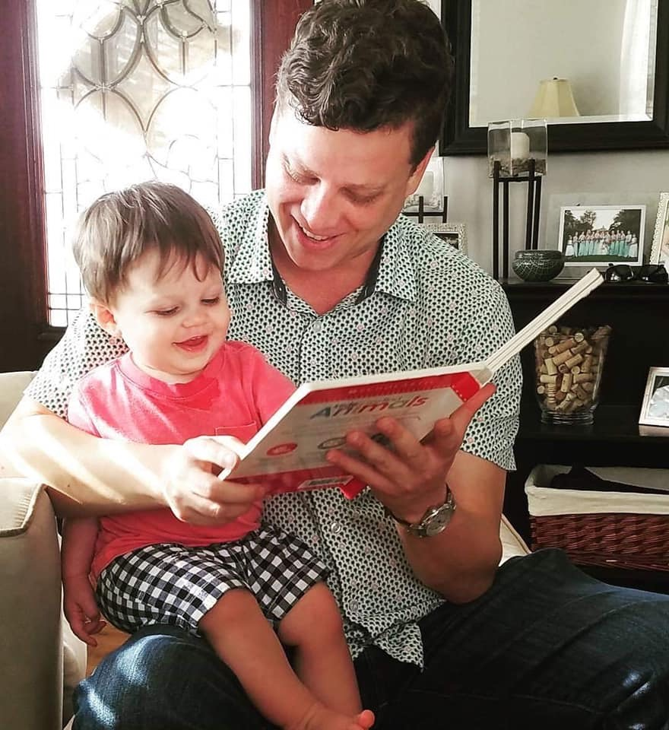
TODDLER BOOK SHARING
Remember – for toddlers, literacy is about language, not print!
Keep in mind interactions from the CLASS® Emotional and Behavioral Support Domain.
Toddlers seek pleasurable connections (PC)
Toddlers need to move (TS)
Toddlers will come and go (RCP)
Toddlers need guidance for book handling and listening to books. (BG)

Slide 15
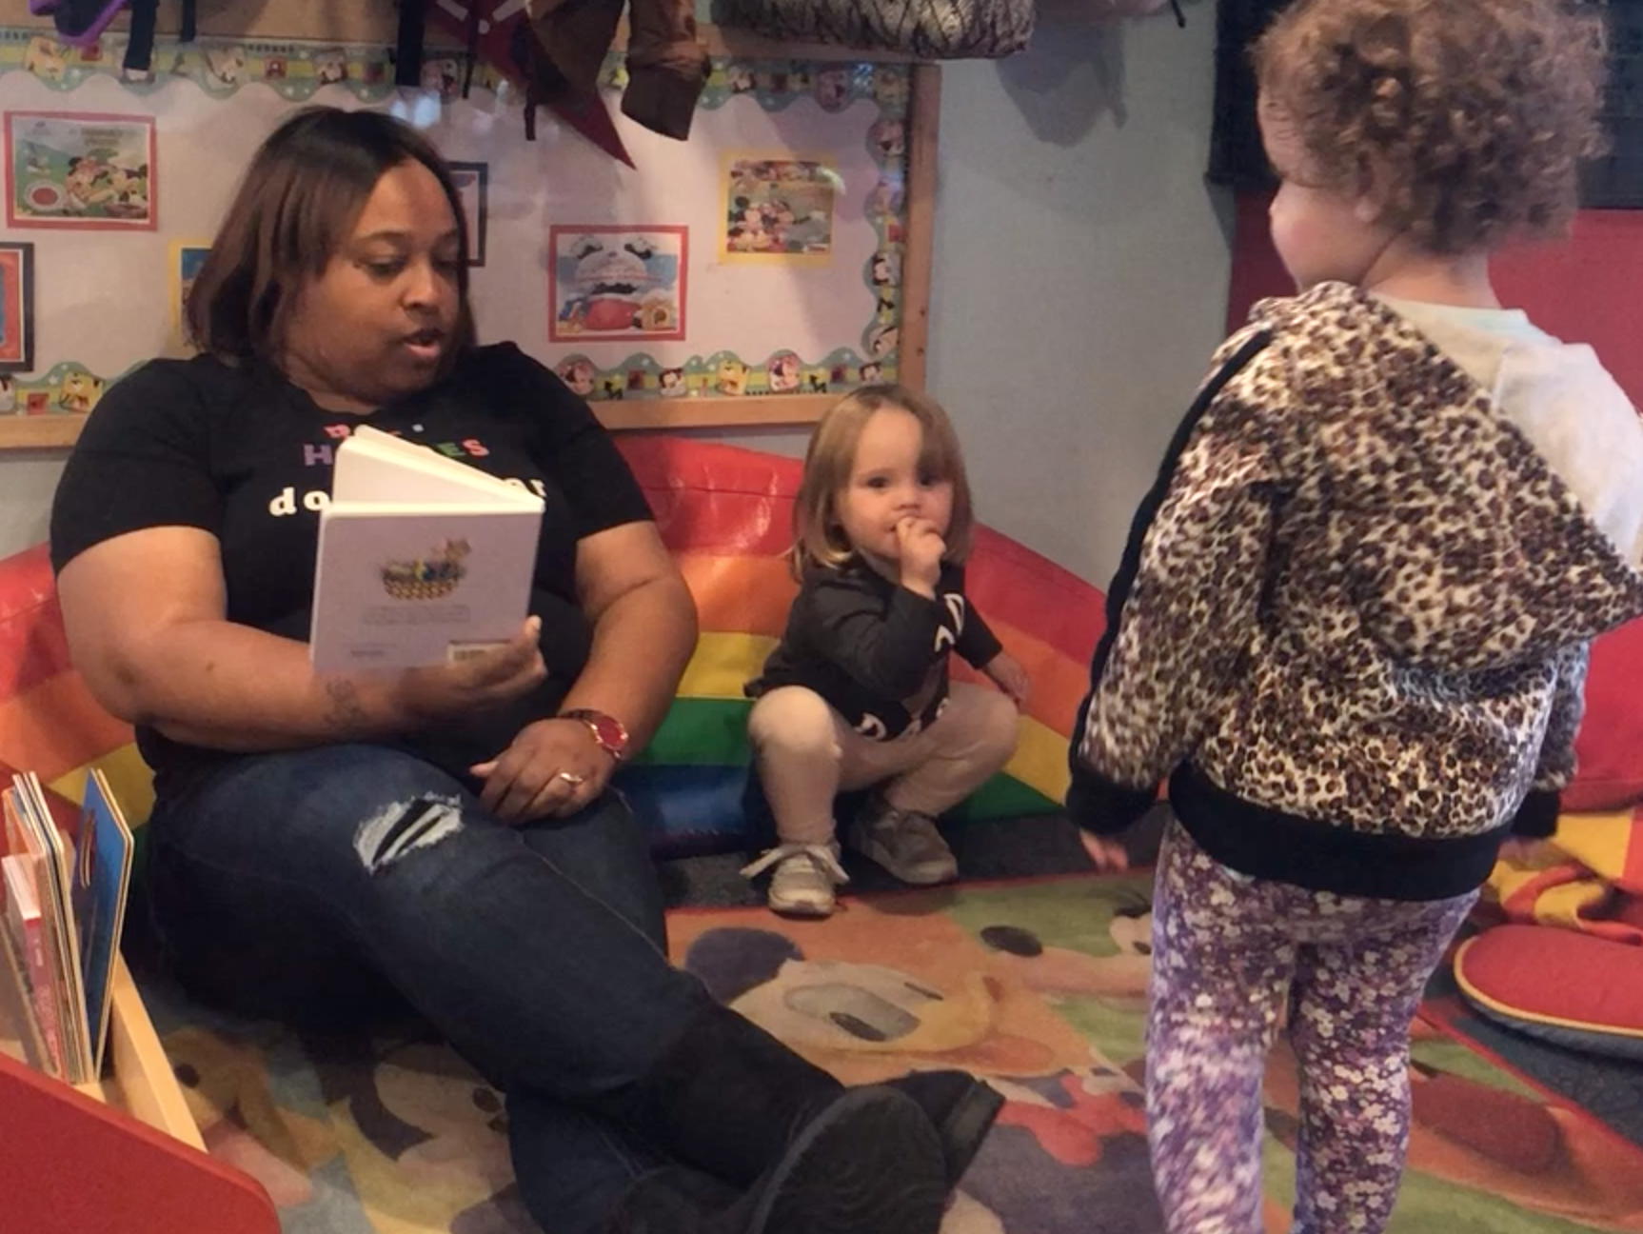
TODDLER BOOK SHARING
Hold CTRL and click the picture to play video.
Notes:
https://youtu.be/A3ekM-GyKGE

Slide 16
Engaged Support for Learning

Slide 17
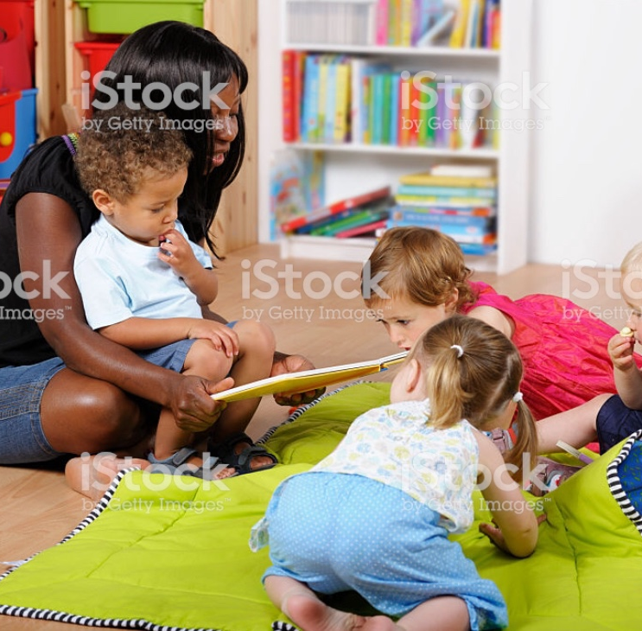
Facilitation of Learning and Development

Slide 18
Facilitation of Learning and Development
Dimension: Facilitation of Learning and Development
Indicators:
Active Facilitation
Expansion of Cognition
Children’s Active Engagement

Slide 19
ACTIVE FACILITATION
The teacher provides intentional opportunities for exploration and learning.
Provides props related to books or themes of study.
“It’s collar is too shiny. Does our puppy have a collar? Do you want to put this shiny collar on him?”
The teacher guides exploration.
Engages with the children by pointing out interesting pictures in books.
“That’s not my puppy. His nose is too squishy. Feel how soft and squishy this nose is. Squish, squish, squish.”

Slide 20
ACTIVE FACILITATION
The teacher is involved in children’s activities to support learning and development.
Shares ideas with children and elicits their ideas.
“This dog has shaggy ears. The hair is long on his ears. Does our dog have shaggy ears? Let’s feel the shaggy ears.”

Slide 21
EXPANSION OF COGNITION
The teacher provides and embeds information
“…it’s coat is too hairy.”
Can you feel his coat? It’s like your hair. This is his hairy coat.
The teacher relates information to children’s lives and experiences.
Do you have a dog at home? Tell me about your dog.
Does your dog have a collar? What does his collar look like?

Slide 22
EXPANSION OF COGNITION
The teacher integrates concepts across activities and tasks.
We have a dog like this in our housekeeping center.
Look at all the puppies you found! Can you count them with me? How many do we have?
The teacher encourages thinking skills.
Which puppy is bigger?
How will we know it’s the right puppy?

Slide 23
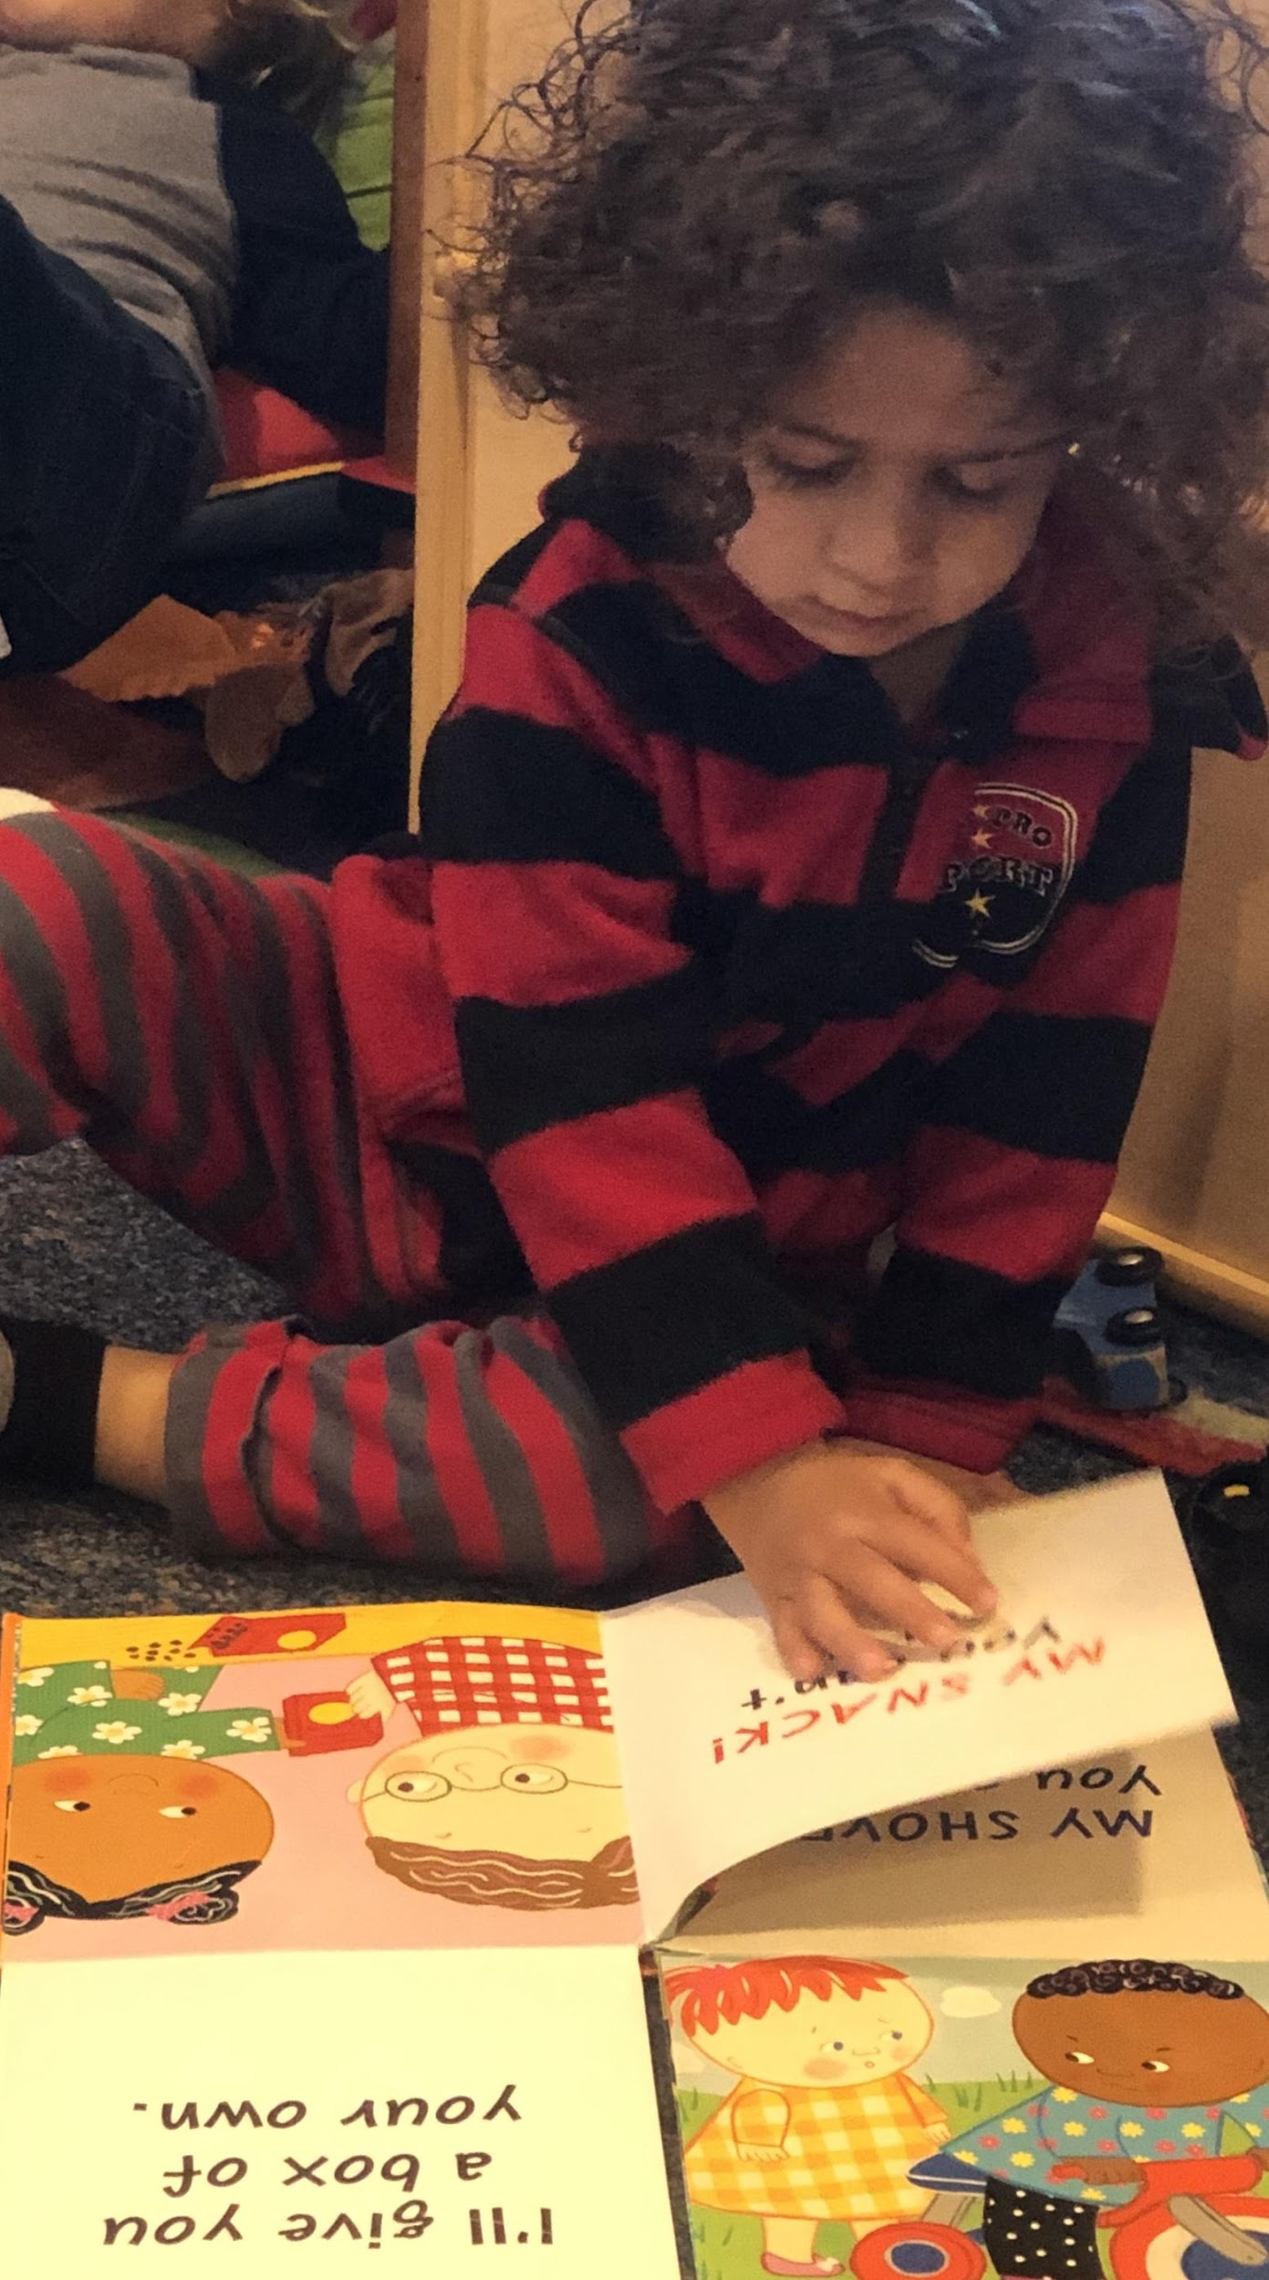
CHILDREN’S ACTIVE ENGAGEMENT
Manipulation of materials
Children bring book-related props or toys to the teacher
Children select books they want to read
Physical involvement
Children point to pictures in a book
Children turn pages
Children do motions to accompany the story

Slide 24
CHILDREN’S ACTIVE ENGAGEMENT
Verbal involvement
Children name items in pictures
Children ask questions
Children repeat favorite words or phrases from the book

Slide 25
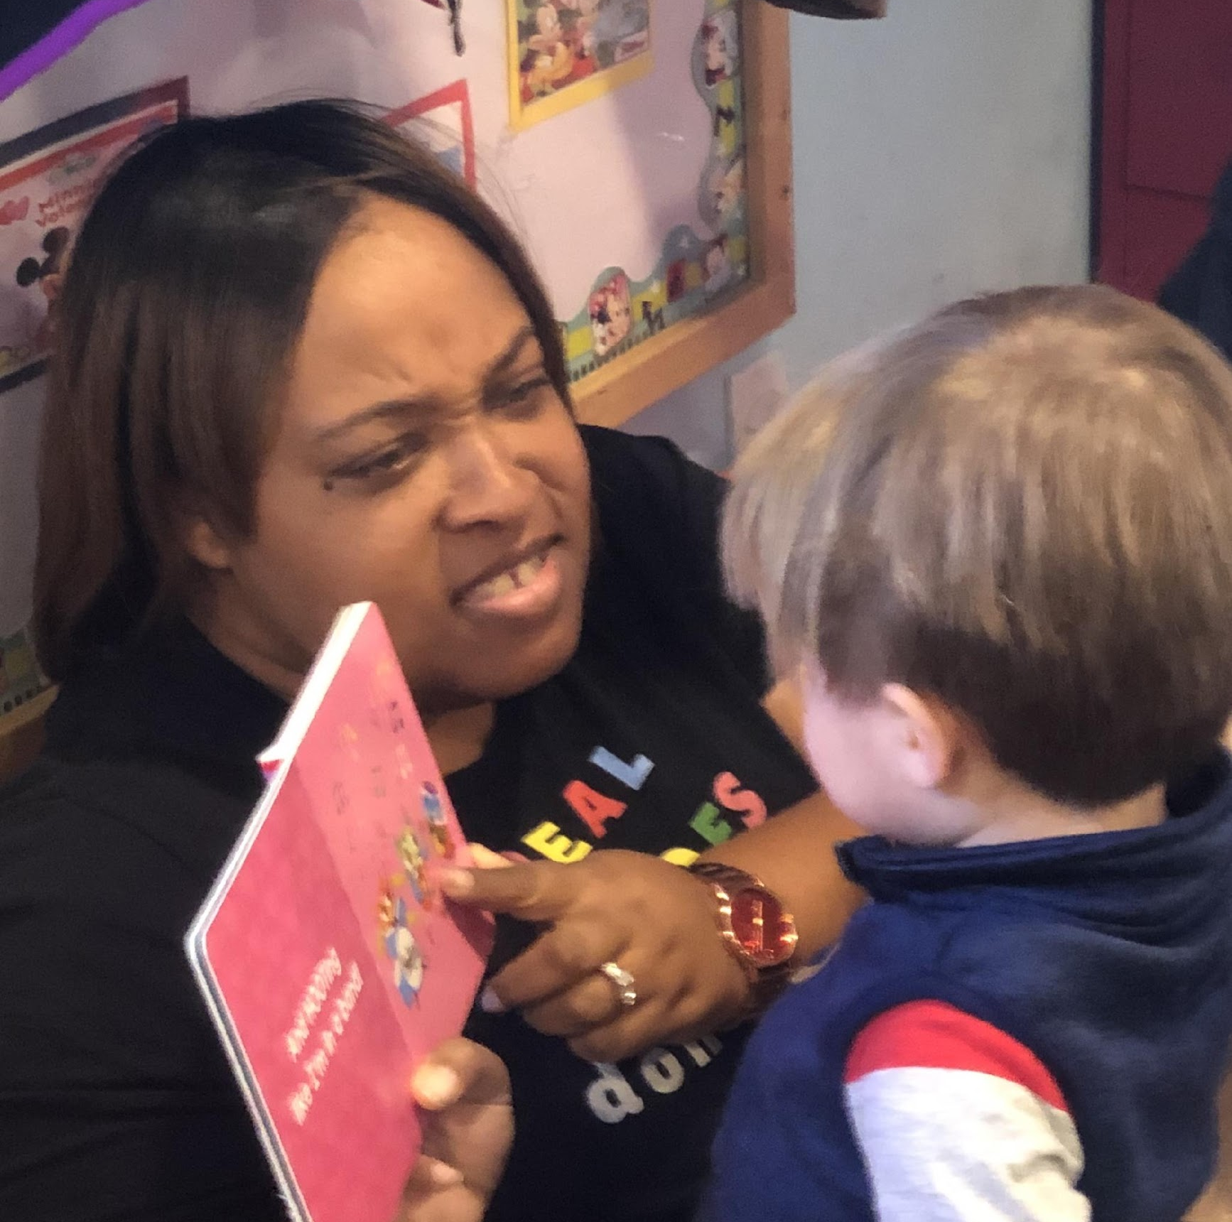
Quality of Feedback

Slide 26
Quality of Feedback
Dimension: Quality of Feedback
Indicators:
Scaffolding
Providing Information
Encouragement and Affirmation

Slide 27
SCAFFOLDING
Hints
Are you looking for the mouse on this page?
I see the mouse, just his head by one of the ears. Can you find it?
Verbal or physical assistance
I’ll help you trace the bumblebee lines with your finger.
Let’s count the bees together. (Counting as child points to each bee – one, two.)
What can you do if your dog’s ears get too shaggy?
Prompting thought processes
What can you do if your dog’s ears get too shaggy?

Slide 28
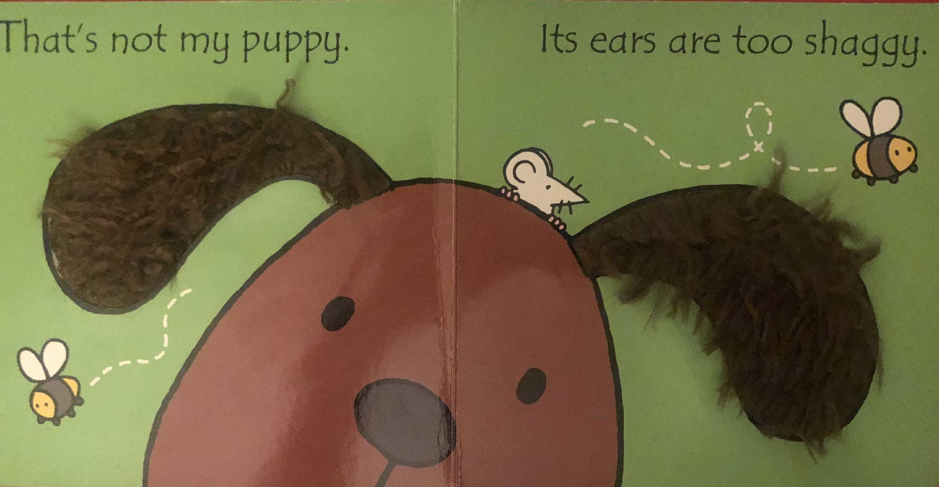
PROVIDING INFORMATION
Clarification of concept or task
Shaggy means the hair is long and kind of messy.
That’s not the mouse. That’s a bumblebee.
Expansion and elaboration
Bumblebees fly – see, these bumbles have wings. The mouse doesn’t fly.
Those dotted lines show where the bumblebee was flying.

Slide 29
ENCOURAGEMENT AND AFFIRMATION
Teacher provides individualized feedback
Jamal is counting the bumblebees. There are two bumblebees.
Reece, I like how you are turning the pages so carefully.
Teacher provides specific feedback
You’re feeling the shaggy ears. Can you feel how long these hairs are? These ears are really shaggy.
Teacher offers recognition of accomplishment or effort
You’re trying to find the mouse on every page. Keep looking. You’re finding so many mice!

Slide 30
Quality of Feedback Activity

Slide 31
Language Modeling

Slide 32
Language Modeling
Dimension: Language Modeling
Indicators:
Supporting Language Use
Repetition and Extension
Self- and Parallel Talk
Advanced Language

Slide 33
SUPPORTING LANGUAGE USE
Back and forth exchange
Teacher (T): Do you see the tail?
Child (C): (Points) Tail!
T: That tail is fluffy.
C: It’s fluffy.
Contingent responding
C: I saw that.
T: You have seen a dog like this one?
C: In the park.
T: You saw someone walking a dog like this in the park!

Slide 34
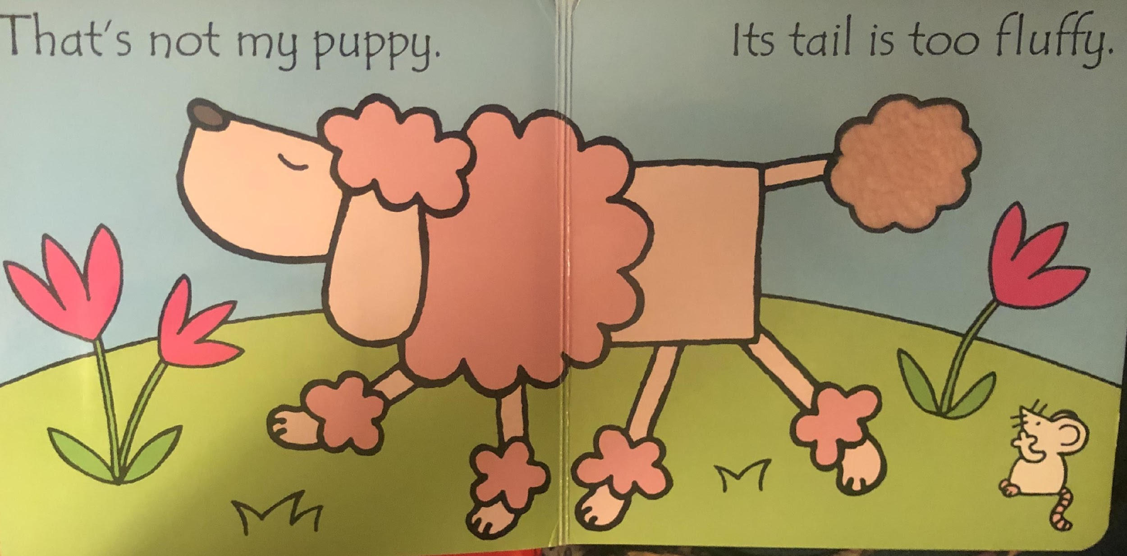
SUPPORTING LANGUAGE USE
Open-ended questioning
What else did you see in the park?
Why do you think people take dogs to the park?

Slide 35
REPETITION AND EXTENSION
Repeats
C: Puppy.
T: Yes, that is the puppy.
C: Fluffy.
T: The tail is fluffy.
Extends/Elaborates
C: Fluffy.
T: This puppy’s tail is fluffy. It’s really soft.

Slide 36
SELF- AND PARALLEL TALK
The teacher describes own actions with language.
I’m just turning one page so we see the next puppy.
I’m counting the flowers. One, two, three!
The teacher narrates child’s actions with language.
You’re feeling the fluffy tail. It’s soft.
You skipped a page.

Slide 37
ADVANCED LANGUAGE
Variety of words and/or descriptive vocabulary
That’s the dog’s tail. It’s soft and fluffy.
This dog has his eyes closed and his nose up in the air.
Labeling
I see three red flowers.
There’s the mouse.
Connection to familiar words and ideas
That’s the dog’s paws. Paws are dogs’ feet, like your feet. But dogs have four paws. You only have two feet.

Slide 38
TODDLER BOOK SHARING
Hold CTRL and click the picture to play video.
Notes:
https://youtu.be/A3ekM-GyKGE

Slide 39
Session Review

Slide 40
REVIEW LEARNING OBJECTIVES
Define what constitutes early literacy learning for toddlers
Establish an environment that offers emotional and behavioral support as they engage in literacy interactions
Facilitate classroom activities and interactions to expand toddlers’ thinking and active engagement
Embed feedback opportunities into instructional activities and interactions with children to scaffold their learning, provide information, and offer encouragement and affirmation of children’s responses
Model language in ways that support children’s language use and encourage their use of more advanced language

Slide 41
Reflections, Questions, & Comments

Slide 42
Please complete the Post-Assessment Evaluation. Thank you!

