Slide 1
Communicating School Performance and Improvement
The Department encourages all schools to hold parent nights in order to have open and honest conversations with families about school performance and improvements.
In conversations with families over the past few years about the development of the new report cards and Louisiana School Finder, many parents told us that they want to hear from their principal about how the school is doing.
They accept that their school may not be an A or B as long as school leaders has a clear plan for improvement, and that the school has been improving overall for the past few years.
The release of the 2018-2019 school report cards is an opportunity for schools to be proactive in addressing their school’s strengths and areas of opportunity with families, and to build partnerships that will result in increased student achievement.

Slide 2
How to Use This Presentation
This presentation is designed to provide school leaders with a template they can use in their conversations with families about school performance. Please customize it to best meet your school’s needs.
Slide directions and talking points are in the notes section of the slides.
All RED text, on both the slides and in the talking points, should be updated with your school-specific information.
This presentation uses screenshots from the Louisiana School Finder to highlight the model school’s performance. Please use one of the methods below to insert screenshots for your school.
- For PCs: https://support.microsoft.com/en-us/help/13776/windows-use-snipping-tool-to-capture-screenshots
- For Macs: https://support.apple.com/en-us/HT201361

Slide 3
How to Use This Presentation
Prior to preparing this presentation and holding your parent meeting, reflect on the following questions:
Data reflection:
How did all of our students perform last year?
In what subject areas are they excelling? Why?
In what subject areas are they struggling? Why?
Which students are struggling the most? Why?
What questions might families have about these data?
Improvement strategies:
What new programs, courses or enrichment opportunities did you provide students that helped them achieve their learning goals?
What will you do differently this year to sustain your success and address gaps?
Family engagement:
How engaged were families in their child’s education this past year?
What can you do to improve communication with families this year?

Slide 4
Pelican Academy
2018-2019 School Performance

Slide 5
Agenda
Looking Back at 2018-2019
2019-2020 Priorities
Supporting Student Learning at Home
Appendix

Slide 6
Pelican Pride in 2018-2019
Our Pelican nation had a great year in 2018-2019. Here are a few of our successes:
Our students grew from 17 percent mastering grade-level skills at the beginning of the year, to 34 percent mastering grade-level skills at the end of the year. That’s 100 percent improvement.
87 percent of our eighth graders successfully transitioned to high school.
Our fourth grade choir won the state choir competition.
Mr. Theodore was named the Louisiana Elementary School Teacher of the Year.
75 percent of our families attended both of our student-led parent conference nights.
Notes:
BASED ON YOUR ANSWERS TO THE QUESTIONS ON SLIDE 3, USE THIS SLIDE TO CELEBRATE YOUR SCHOOL AND STUDENTS’ SUCCESSES FROM 2018-2019.
Read Slide
Now that we have celebrated student and faculty success, let’s take an in-depth look at how our school performed last year.

Slide 7
2018-2019 School Performance
Notes:
Annually, every public school in Louisiana receives a school performance score. The school performance score is reported on a scale from zero to 150, and communicates how well our school is preparing its students for the next level grade-level by looking at student performance on state tests and other metrics such as graduation rates and college credit attainment.
Let’s take a look at how school performance scores are calculated. PLAY VIDEO

Slide 8
Improvements to Louisiana’s Accountability System: Celebrating Student Improvement
Pelican Elementary earns an ‘A’ in the progress index for any student who:
is not yet at a “Mastery” level, but whose improvement since last year is on track to reach “Mastery” by the 8th grade (or 10th grade for high schools); or
scores higher than expected based on the scores of other students with similar past performance and characteristics.
Our report card includes an overall rating, a rating for student performance (how did students score on end-of-year assessments), and student progress (how much progress have students demonstrated since last school year).
Notes:
Pelican Elementary earns an ‘A’ in the progress index for any student who:
is not yet at a “Mastery” level, but whose improvement since last year is on track to reach “Mastery” by the 8th grade (or 10th grade for high schools); or
scores higher than expected based on the scores of other students with similar past performance and characteristics.
Our report card includes an overall rating, a rating for student performance (how did students score on end-of-year assessments), and student progress (how much progress have students demonstrated since last school year).

Slide 9
Improvements to Louisiana’s Accountability System:
Transparent Reporting and Support for Struggling Schools
As part of Louisiana’s Every Student Succeeds Act (ESSA) plan, struggling schools are required to submit an improvement plan to the Department and an application for funding to support its implementation.
Struggling schools include:
Comprehensive Intervention Required for persistently low performance overall, and
Urgent Intervention Required for persistently low performance among specific subgroups of students or out-of-school discipline rates.
Schools with low performance among specific subgroups of students in the current year will only receive the label urgent intervention needed.
These labels will appear on school report cards in the Louisiana School Finder.
URGENT INTERVENTION REQUIRED>
Notes:
THIS SLIDE SHOULD ONLY BE USED IF YOUR SCHOOL HAS RECEIVED ONE OF THESE LABELS.
As part of Louisiana’s Every Student Succeeds Act (ESSA) plan, struggling schools are required to submit an improvement plan to the Department and an application for funding to support its implementation. Struggling schools include:
Comprehensive intervention required for persistently low performance overall, and
Urgent intervention required for persistently low performance among specific subgroups of students or out-of-school discipline rates.
Schools with low performance among specific subgroups of students in the current year only will receive the label urgent intervention needed.
CIR Example: While our school has made improvements over the past year, our school letter grade has been an “F” for three consecutive years. Therefore you will see the “Comprehensive Intervention Required” label below included on our report card in the Louisiana School Finder.
UIR Subgroup Example: Our school has been labeled as Urgent Intervention required because our students with disabilities have been performing at the equivalent of a “D” letter grade for the past two years. Therefore, you will see this label next to our overall school performance score on our report card in School Finder.
UIR Discipline Example: Our school has been labeled as Urgent Intervention Required because our out-of-school suspension rate is two times higher than the national average. Therefore, you will see this label next to our overall school performance score on our report card in School Finder.

Slide 10
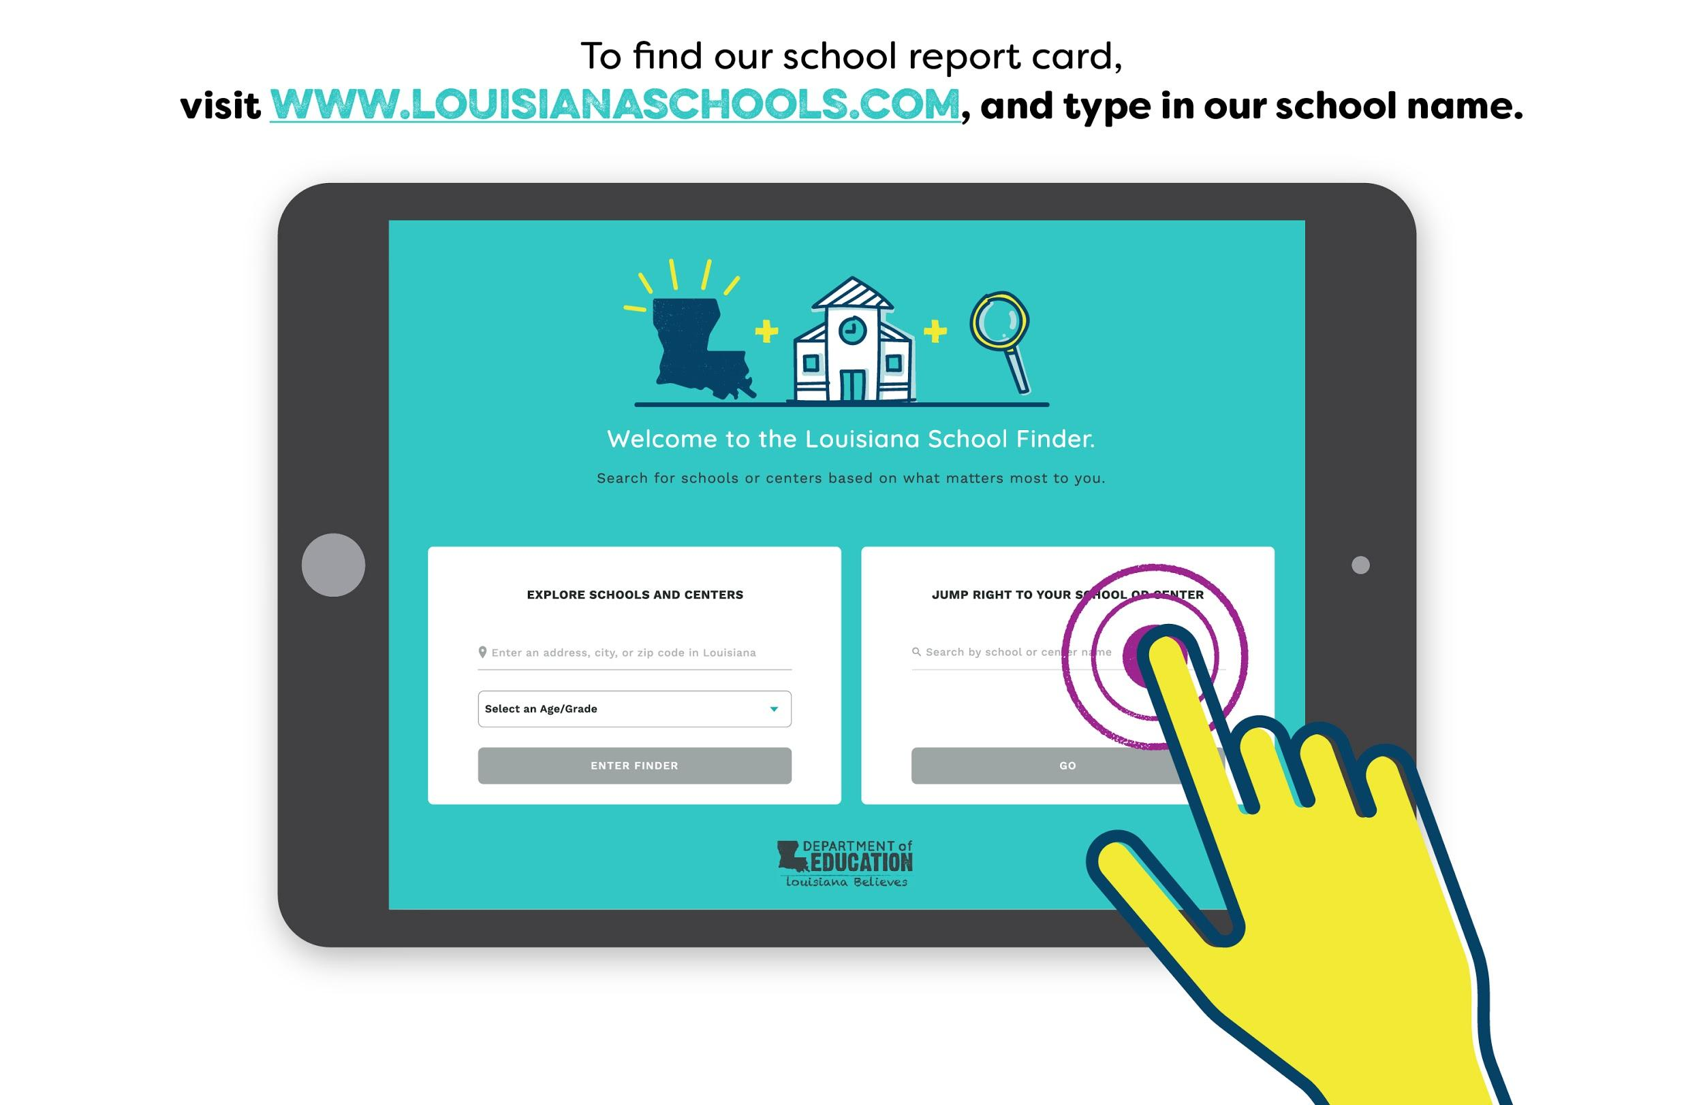
How to View Our School Report Card
Notes:
School report cards are available in the Louisiana School Finder at www.louisianaschools.com. The school finder allows families to find information about their own school, or help them find a school when they are moving to a new city or area within the state. The School Finder includes information on all early childhood centers and programs, traditional public, charter, magnet and alternative schools, and school participating in the Louisiana Scholarship program.
So let’s take a look and see how our school performed last year. If you would like to follow along, go to ww.louisianaschools.com on your phone and type in Pelican Elementary.

Slide 11
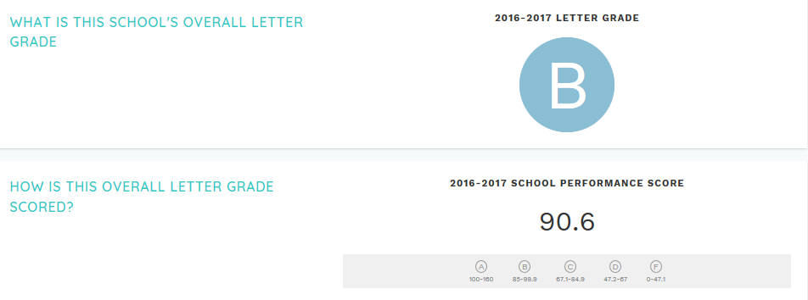
2018-2019 School Performance Score and Letter Grade
Notes:
USE THESE SLIDES TO WALK FAMILIES THROUGH YOUR SCHOOL REPORT CARD. SCREENSHOTS CAN BE EXTRACTED DIRECTLY FROM SCHOOL FINDER, OR INFORMATION CAN BE PRESENTED IN A BULLETED LIST.
Example Talking Pt: This past year, our school received a school performance score of 90.6 and a letter grade of a B.

Slide 12
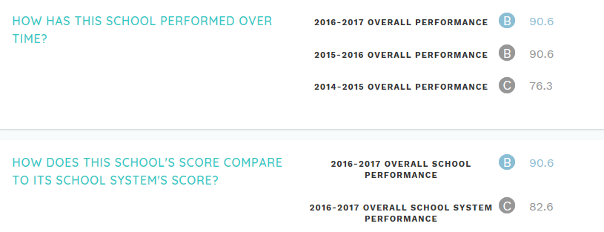
School Performance Score Trend and Comparison
Notes:
IF YOUR SCHOOL HAS DECLINED OVER THE PAST COUPLE OF YEARS, SHARE INFORMATION WITH FAMILIES ON WHAT YOU ARE DOING TO CHANGE THAT TRAJECTORY THIS YEAR.
Example Talking Pt: Our school has increased its school performance score 14.3 points in the past three years, and is one of the higher performing schools in our district!

Slide 13
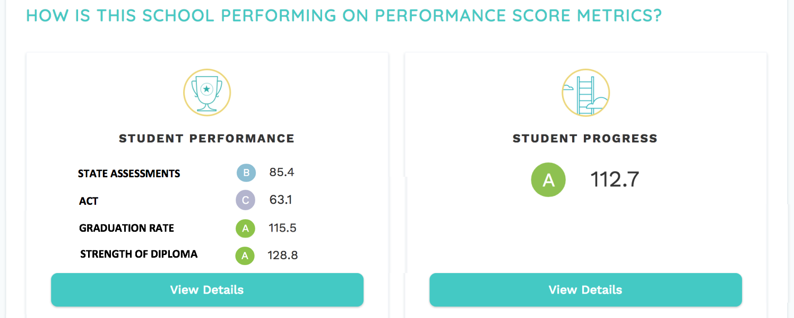
Student Performance vs Student Progress
The Department will report letter grade equivalents for student performance and progress. Based on feedback from school system leaders, high school report cards will include a letter grade equivalent for each of the four key indices.
These letter grade equivalent ratings will also be available in the public data files posted to the Department’s website.
Notes:
USE THIS SLIDE TO SHOW HOW YOUR SCHOOL PERFORMED IN OUTRIGHT STUDENT PERFORMANCE AND STUDENT PROGRESS.
Example talking point: Here you will see that while overall, we have some work to do to ensure that our students are mastering the keys skills they need to move on to the next grade as shown in our student performance score, they are improving at significant rates throughout the year as represented in our student growth score.

Slide 14
Additional Data in School Finder
In addition to the overall performance of the school, our report card in School Finder also includes additional information that you might find interesting such as:
Details on the percentage of students scoring “Mastery” and above on state tests, indicating their readiness for the next grade-level (Student Performance page), graduation and college enrollment rates, ACT performance, credential attainment and FAFSA completion rates
Details on how well students are progressing in English and math throughout the year, regardless of where they start at the beginning of the year (Student Progress page)
Details on how well our school is preparing specific groups of students compared to other school sin the state (Breakdown by Student Groups page)
Information about our teachers such as their attendance, certification and retention, and the diversity of our staff (Teacher Workforce page)
Details on how well sour school is ensuring that students are in classrooms and learning daily (Discipline and Attendance page)
Notes:
In addition to the overall performance of the school, our report card in School Finder also includes additional information that you might find interesting such as:
Details on the percentage of students scoring “Mastery” and above on state tests, indicating their readiness for the next grade-level (Student Performance page)
Details on how well students are progressing in English and math throughout the year, regardless of where they start at the beginning of the year (Student Progress page)
Details on how well our school is preparing specific groups of students compared to other school sin the state (Breakdown by Student Groups page)
Information about our teachers such as their attendance, certification and retention, and the diversity of our staff (Teacher Workforce page)
Details on how well sour school is ensuring that students are in classrooms and learning daily (Discipline and Attendance page)
Feel free to explore these pieces of data on your own, and let us know if you have questions.

Slide 15
Agenda
Looking Back at 2018-2019
2019-2020 Priorities
Supporting Student Learning at Home
Appendix

Slide 16
2019-2020 Pelican Goals and Priorities
Based on our students’ performance in 2018-2019, Pelican Academy is focused on the following priorities this year and next:
ensuring that 75 percent of students who begin the year behind grade level end the school year on or above grade level;
providing better support to 9th grade students in making the difficult transition into high school;
increasing access to Jump Start pathways, Advanced Placement classes, and dual enrollment courses to all high school students, especially those at risk of dropping out;
providing families with the tools they need to support student learning at home through our new Parent Center.
Notes:
INSERT SPECIFIC SCHOOL OR SCHOOL SYSTEM GOALS AND PRIORITIES FOR THIS SCHOOL YEAR AND NEXT BASED OFF OF NEEDS ANALYSIS ON SLIDE 3. SHOULD REFLECT THE KEYS PROBLEMS YOUR SCHOOL WILL SOLVE FOR WITHIN THE NEXT YEAR.
Read slide

Slide 17
Agenda
Looking Back at 2018-2019
2019-2020 Priorities
Supporting Student Learning at Home
Appendix

Slide 18
School and Family Engagement
Pelican Academy is committed to providing families with meaningful, two-way communication opportunities with teachers, school counselors, and Principal Struthers throughout the year.
Use the Remind app to contact teachers or counselors with questions about your child’s progress and learning needs or to inquire about school events.
Email Principal Struthers at sarah.struthers@pelicanacademy.la.org with additional questions or concerns that cannot be addressed by your child’s teacher or counselor.
Visit our Parent Center between the hours of 7:00 a.m. and 5:30 p.m. or attend one of our upcoming parent workshops to learn more about how you can support student learning at home.
Notes:
USE THIS SLIDE TO INSERT INFORMATION ABOUT HOW PARENTS SHOULD COMMUNICATE WITH TEACHERS AND THE SCHOOL LEADER THROUGHOUT THE SCHOOL YEAR.

Slide 19
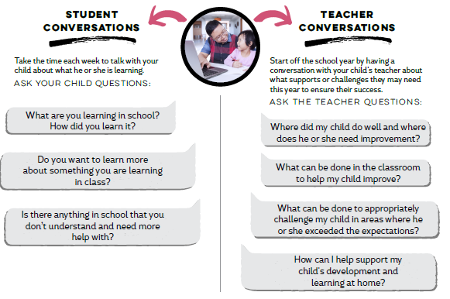
How Can You Support Learning at Home for
PK-K Students?
At home, you can play an important role in setting high expectations for learning and supporting your child.
Building this understanding of what your child knows and should be able to do begins with meaningful conversations with your child and your child’s teacher.
By taking these small steps, you will be helping your child become successful both in and outside of the classroom.
Notes:
USE THIS SLIDE IF YOU HAVE PK-K STUDENTS.
At home, you can play an important role in setting high expectations for learning and supporting your child.
Building this understanding of what your child knows and should be able to do begins with meaningful conversations with your child and your child’s teacher.
By taking these small steps, you will be helping your child become successful both in and outside of the classroom.
Here you will see questions you can ask your child and their teacher to make sure they are on track throughout the year.

Slide 20
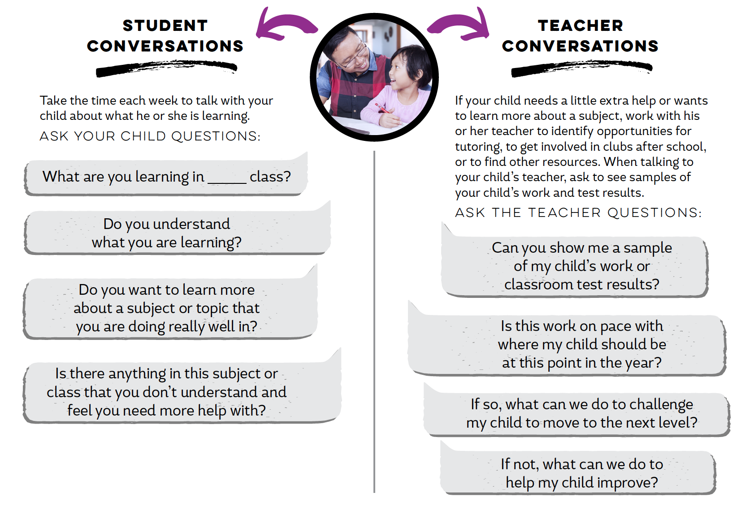
How Can You Support Learning at Home for
Students in Grades 1-8?
Families play an important role in setting high expectations for learning by having meaningful conversations with their children and their teachers.
By supporting what their children do at school, families are helping their children become successful both in and outside the classroom.
Notes:
USE THIS SLIDE IF YOU HAVE STUDENTS in Grades 1-8.
As students get older, the questions you ask them and their teachers to ensure they are on track become more involved.
Talk to your child weekly about what they are learning, and where they need additional help.
Stay in regular communication with your child’s teacher about their progress.

Slide 21
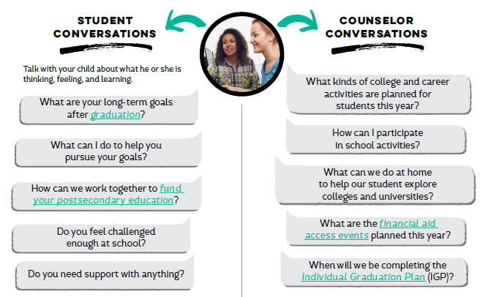
How Can You Support Learning at Home for
High School Students?
Student success is more than what can be measured in course grades and test scores.
One of the many ways families support high school students is by showing interest in their social/emotional needs as well as their academic success.
Notes:
USE THIS SLIDE IF YOU HAVE HIGH SCHOOL STUDENTS.
Student success is more than what can be measured in course grades and test scores.
One of the many ways families support high school students is by showing interest in their social/emotional needs as well as their academic success.
Talk with your child and their teachers and school counselor about what their goals are after graduation, and what courses, experiences and funding are needed to get them there.

Slide 22
Tools and Resources to Support Parents: General
Below are additional resources that you can access to further support your child’s learning at home.
Family Support Toolbox: information on standards, graduation requirements, test results, and links to PTA and Eureka Math parent guides https://www.louisianabelieves.com/resources/family-support-toolbox
Great Kids Milestones: free, online collection of videos showing what success looks like in reading, writing, and math in grades K–12. For high school students, it also includes helpful life and communication skills to prepare them for college or a career www.greatschools.org/gk/milestones/
Parent Assessment Portal: https://bealearninghero.org/spring-forward/louisiana/
PTA Family Guides: tips for helping your child succeed in key learning areas https://www.pta.org/home/family-resources/family-guides
Notes:
Example Talking Pt: Here are a few online tools that can help you support your child’s learning at home. Parents are welcome to visit our parent resource room anytime to get online and take a look at these tools. If you would like for us to print you a copy of any of these guides, please ask one of the volunteers in the Parent Center to help you.

